Slide 1



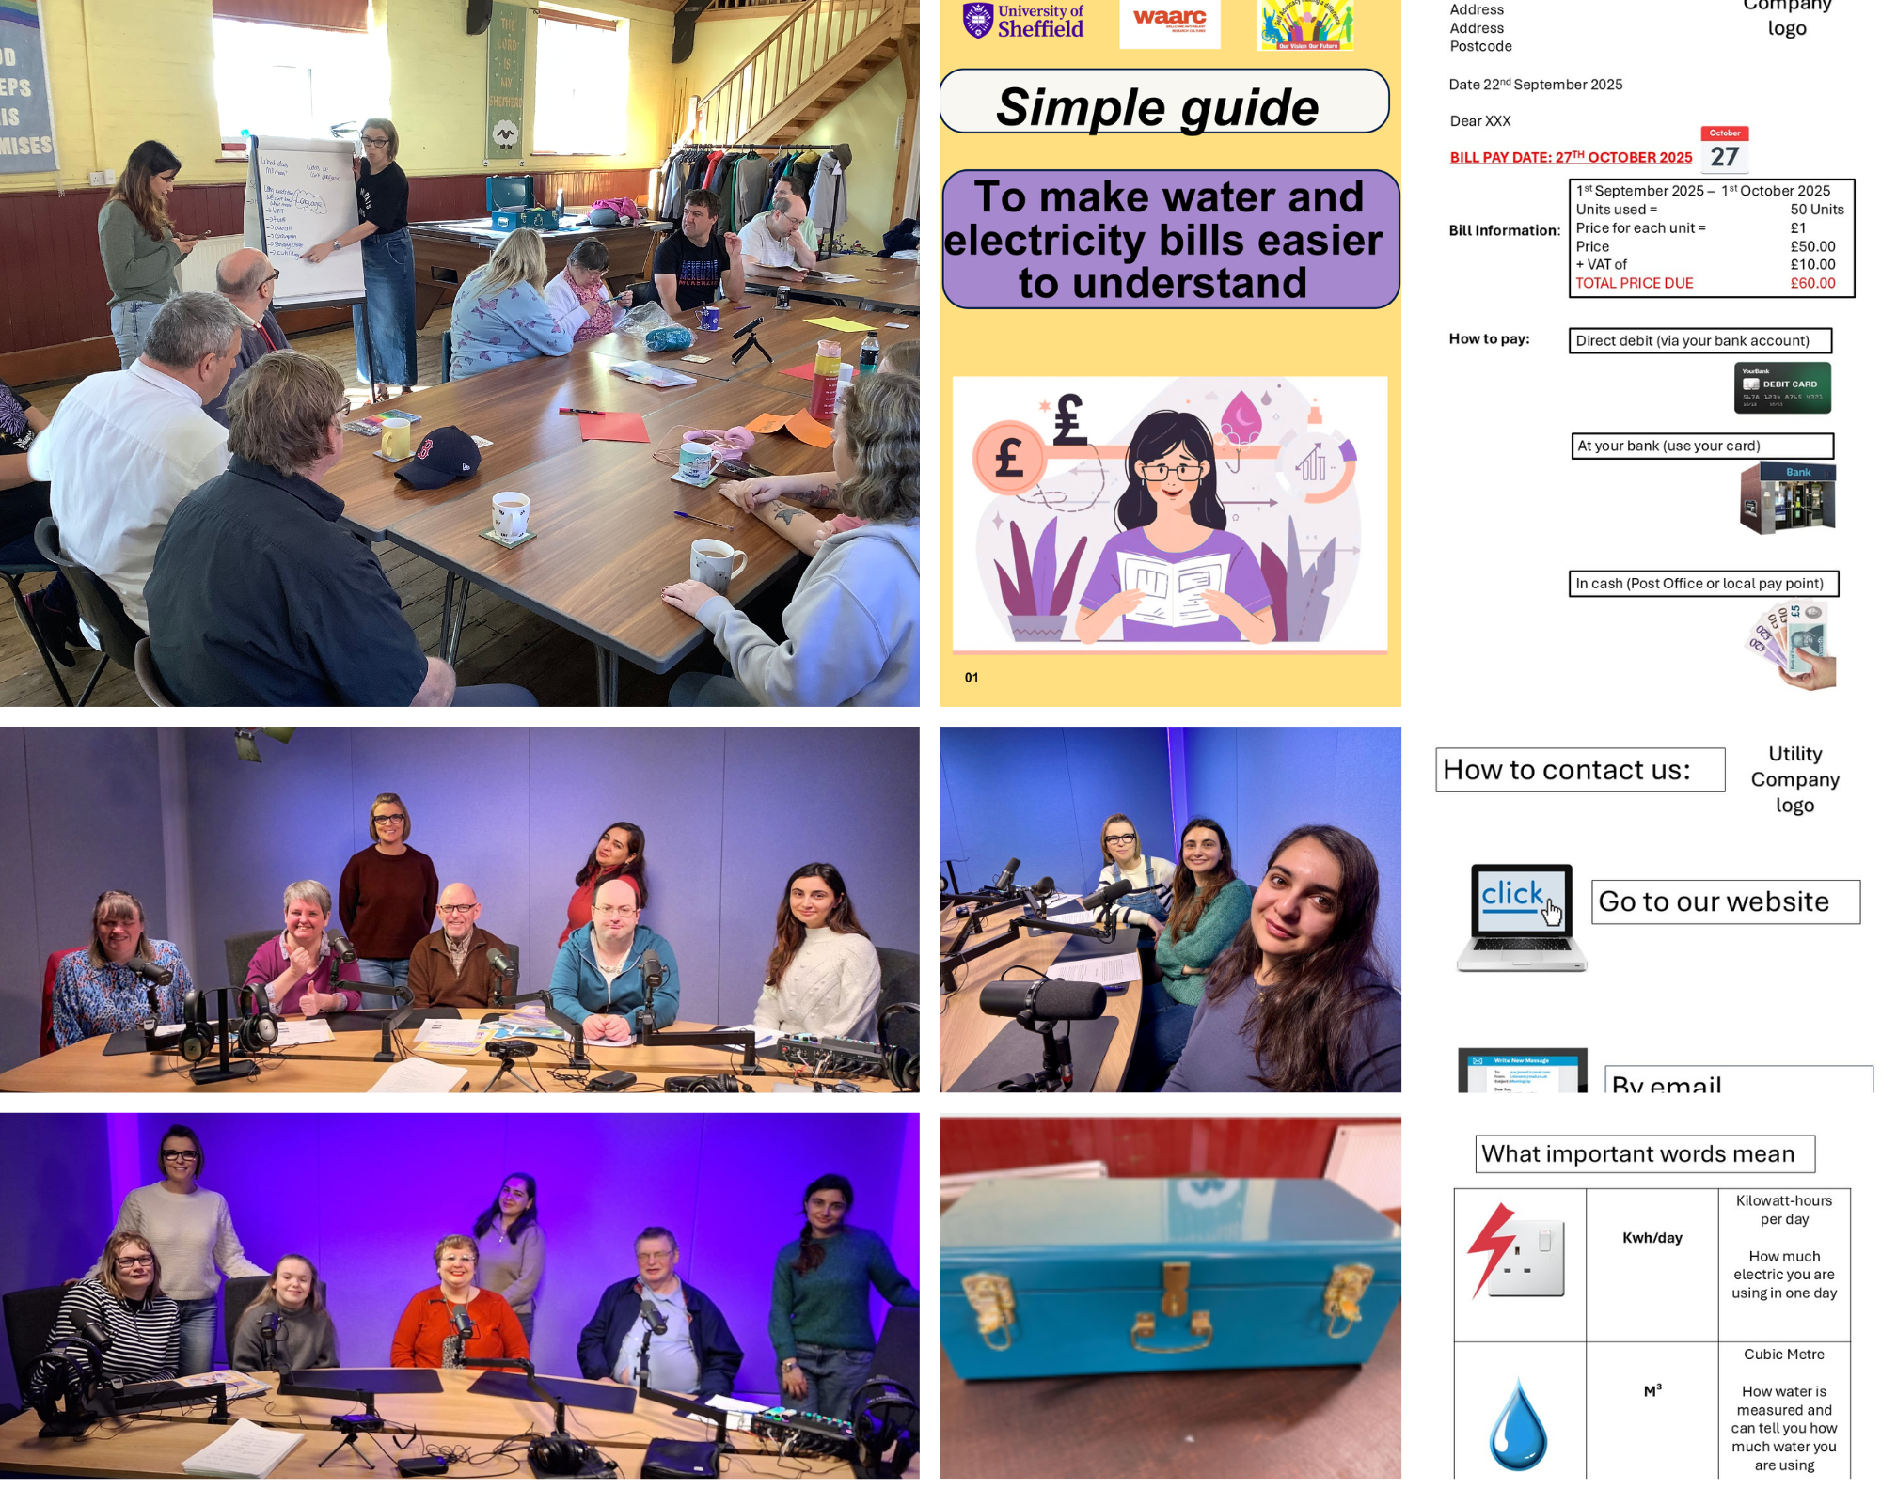
Making Bills Easier to Understand: Promoting Accessibility and Inclusivity

Slide 2
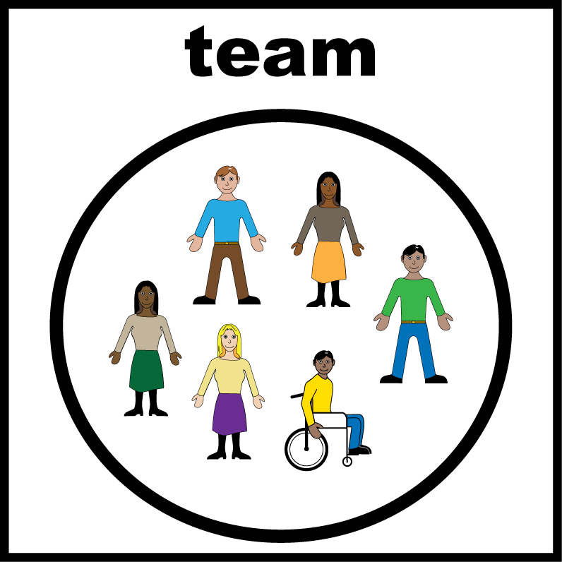
Making Bills Easier to Understand: Promoting Accessibility and Inclusivity
Bev Enion
Leyla Jabbarzade &
Turana Abdullayeva from the Univeristy of Sheffield
Members from Our Vision Our Future (OVOF)

Slide 3
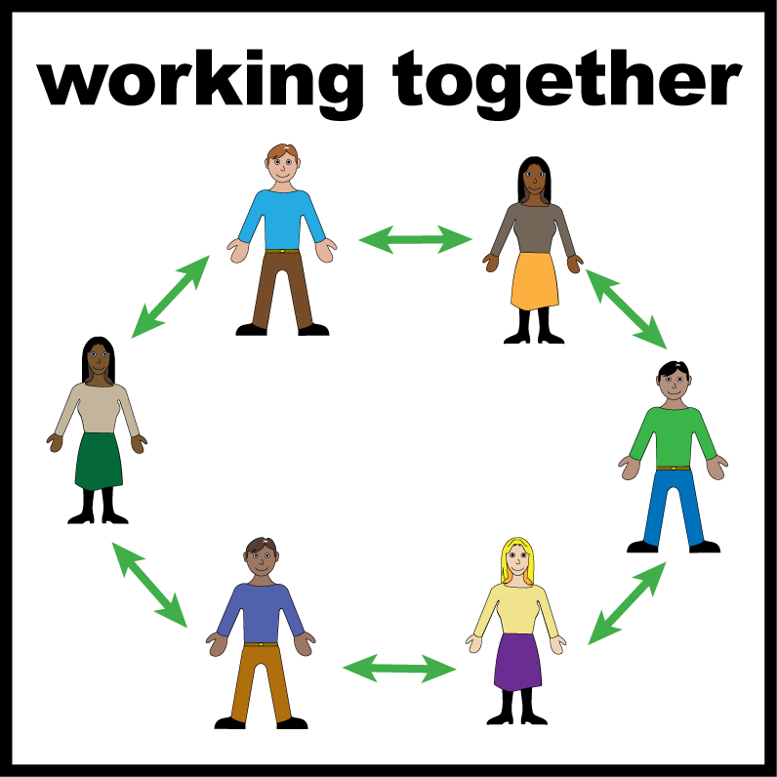
Who We Worked With
Our Vision Our Future:
Is a Disabled People’s Organisation for adults with learning disabilities;
Run by adults with learning disabilities;
Supports independent living.

Slide 4

Our goals
We wanted to:
Make bills easier to understand
Make information clear and simple
Help people feel more independent

Slide 5

Why this project matters
Bills can be hard to understand
People may need help with:
Reading bills
Understanding bills
Paying bills

Slide 6
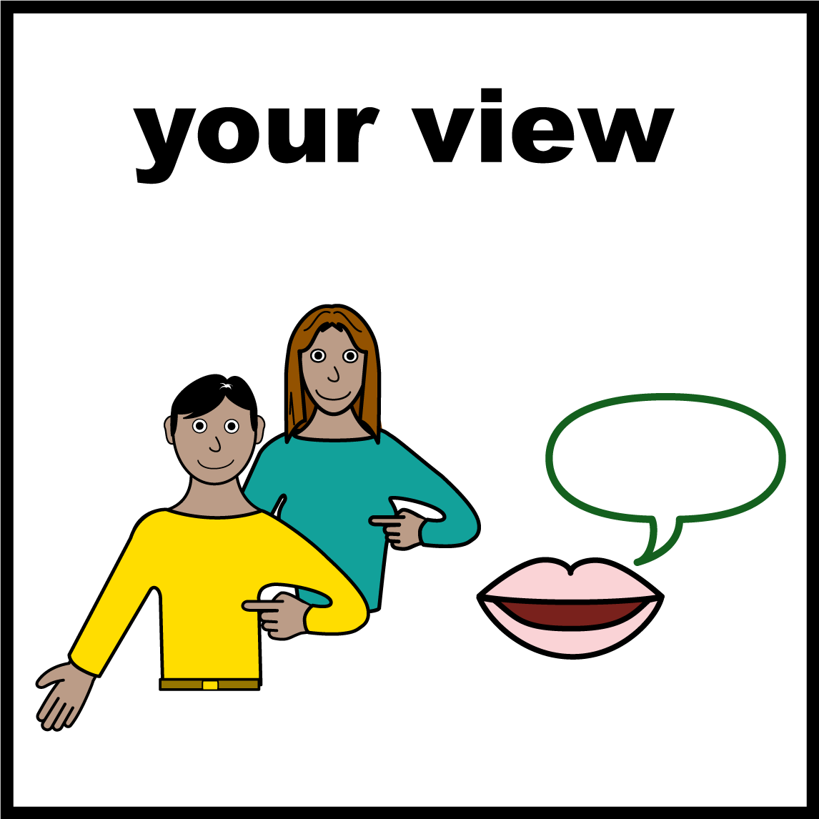
Now we will hear from:
Maria
Keith
They will share their experiences from working on this project

Slide 7
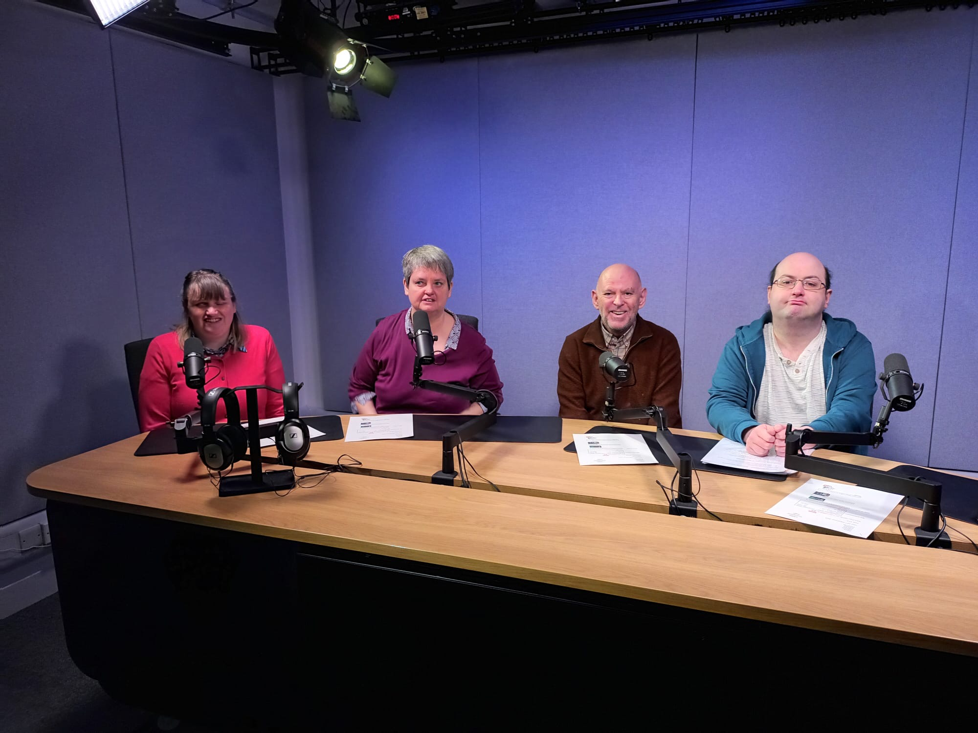

Teamwork
“We explored the problems… designed our own bill”
“It makes it more visual”

Slide 8
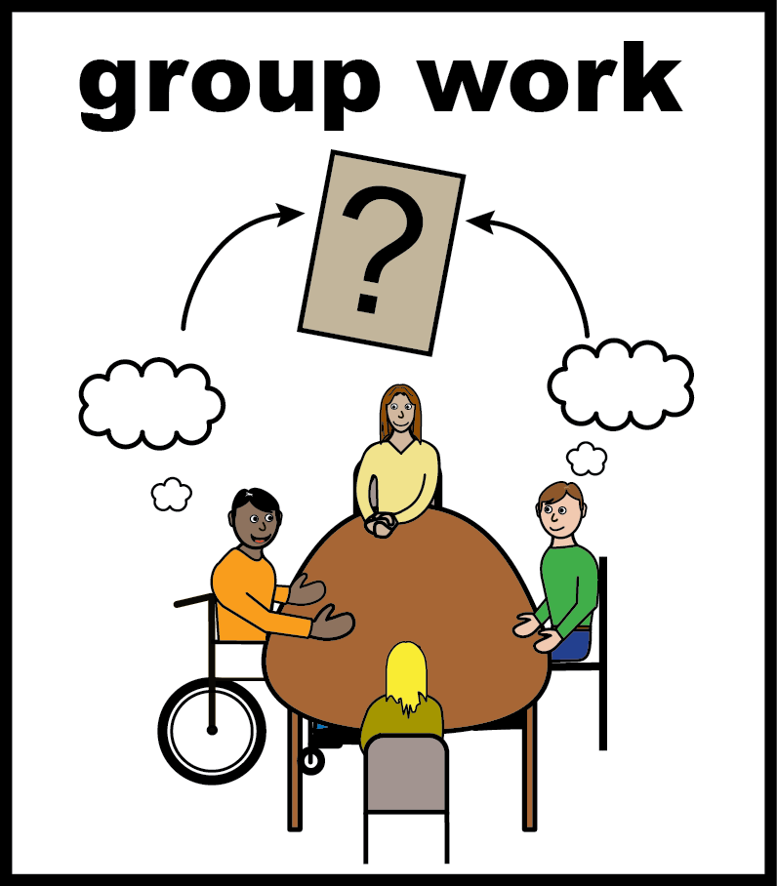
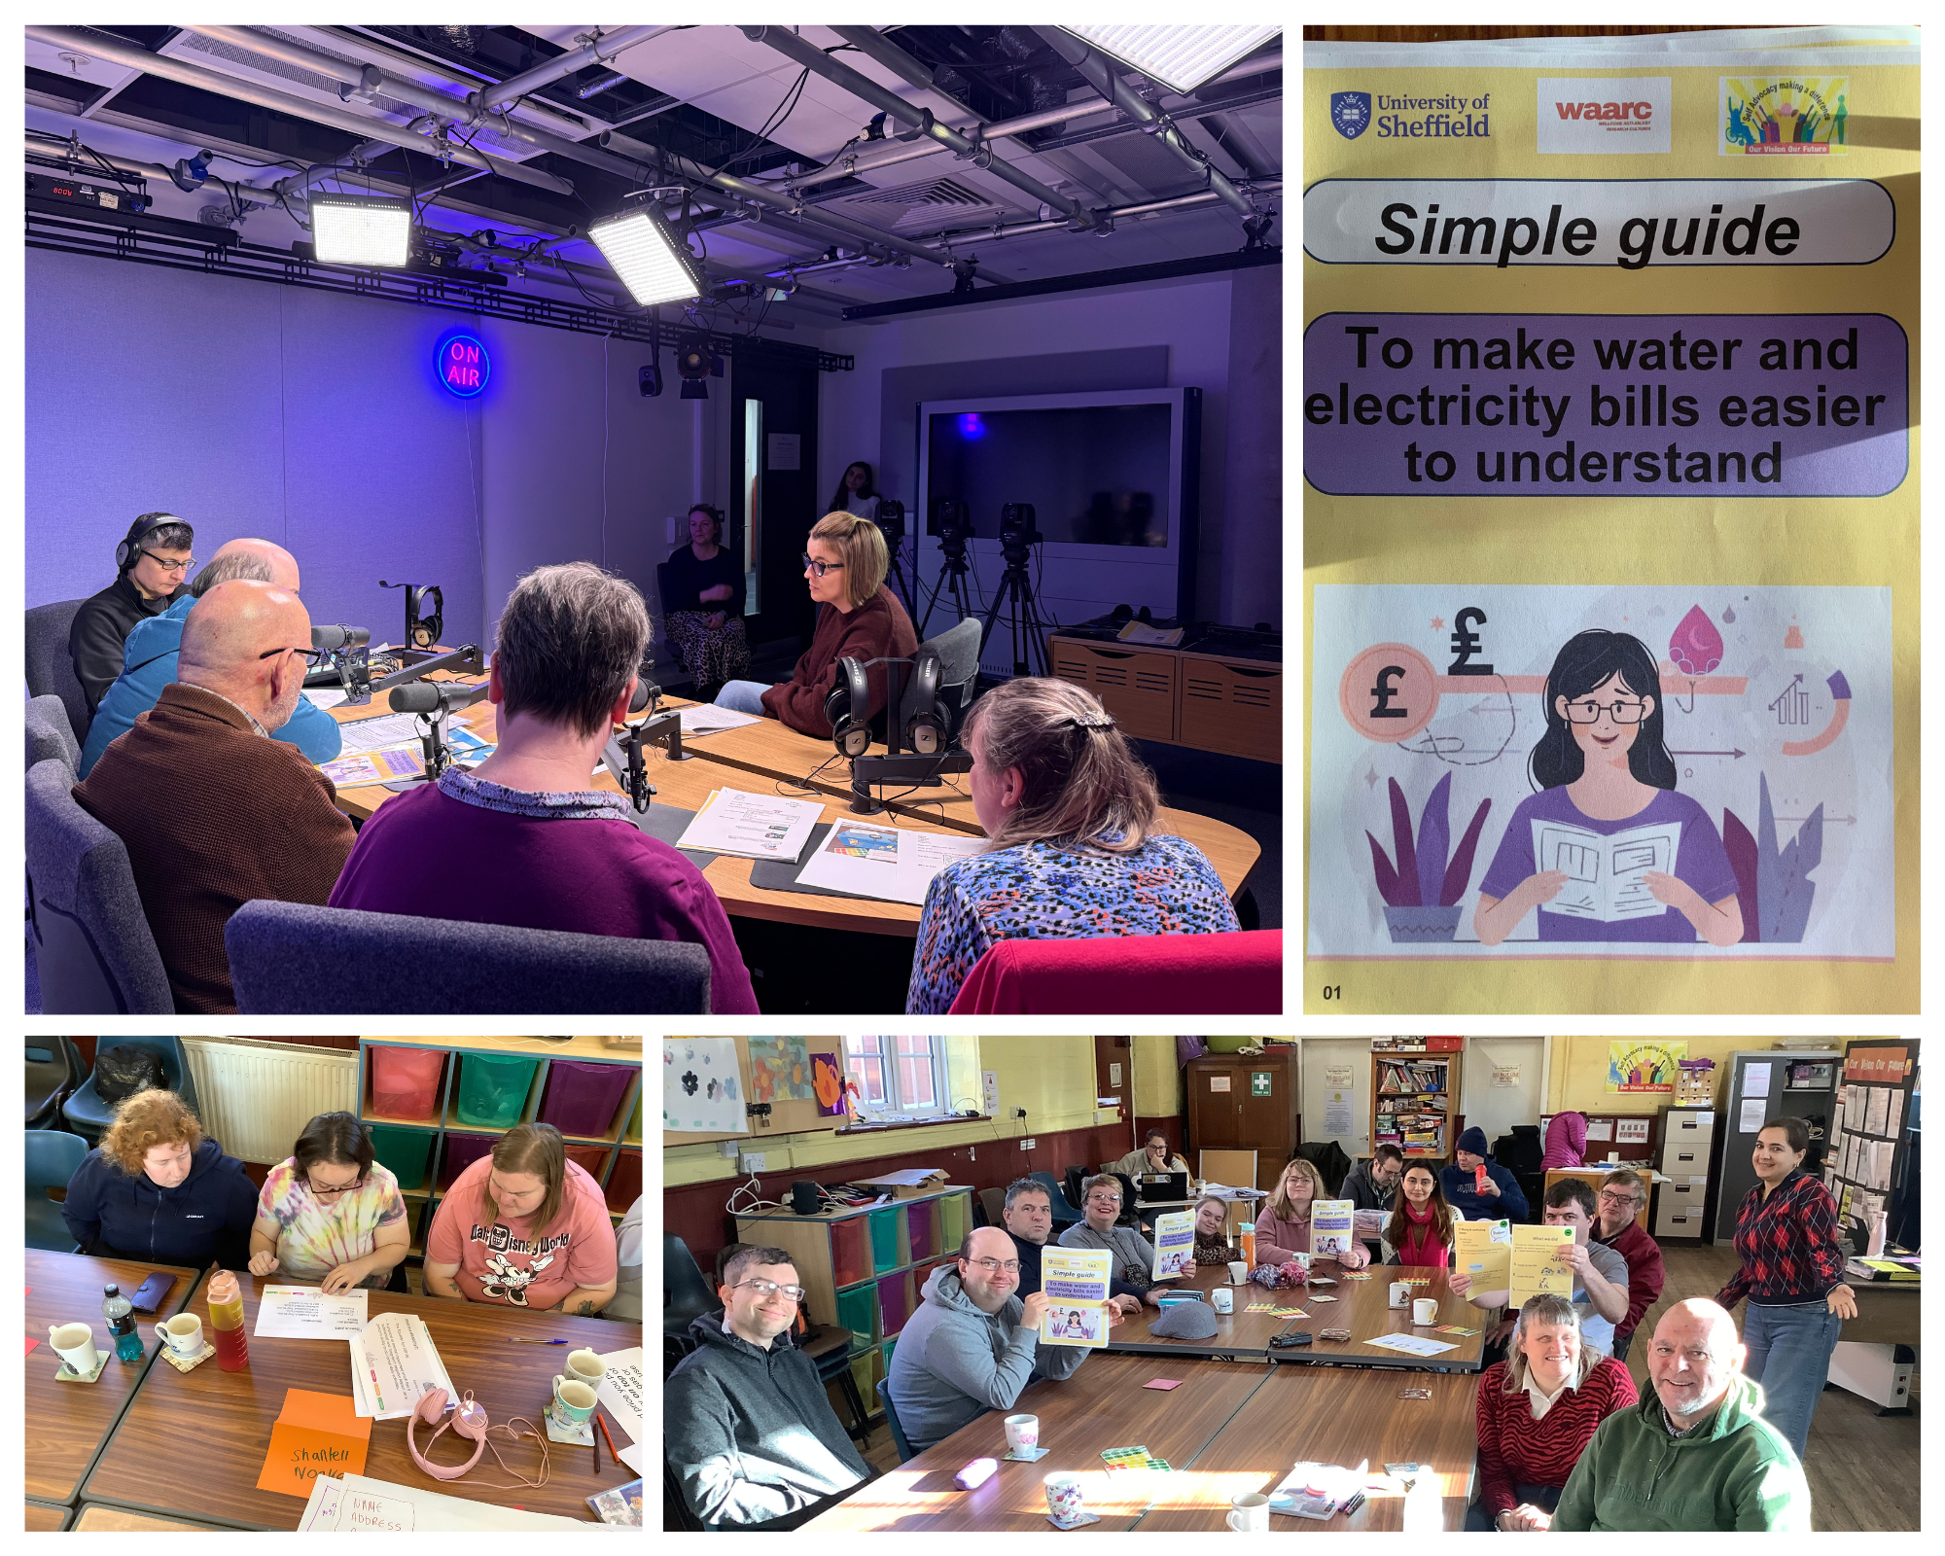
What we did
5 workshops
2 podcast sessions

Slide 9
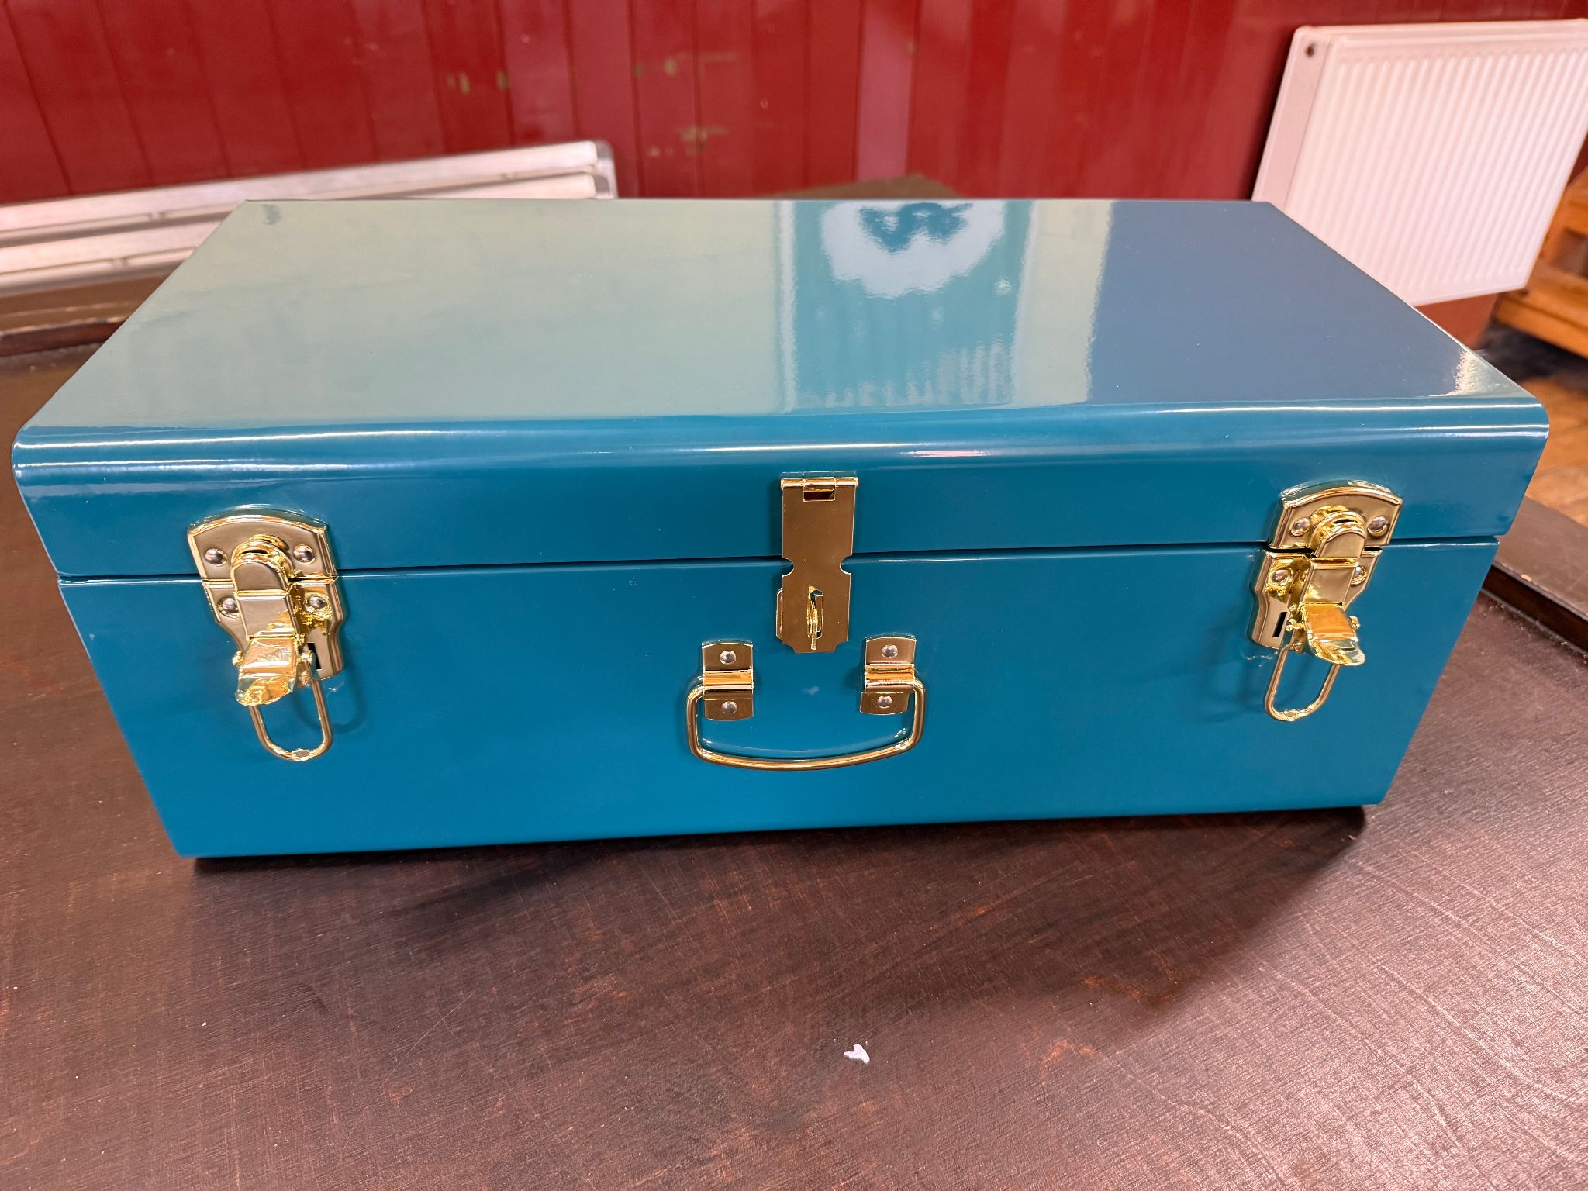
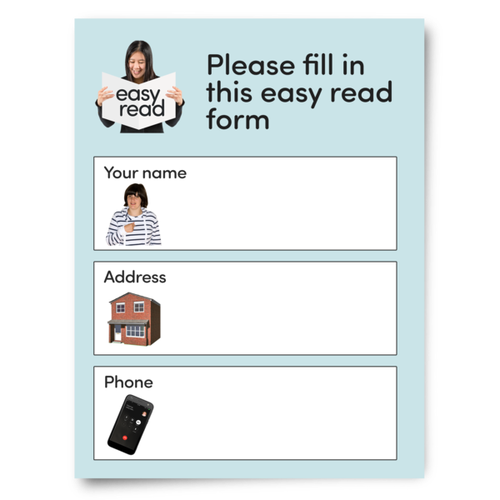
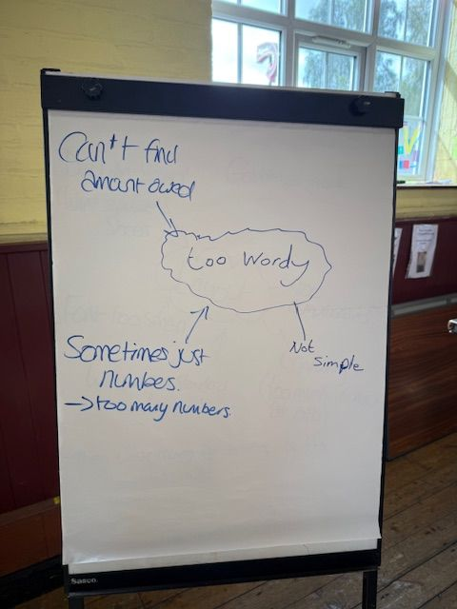
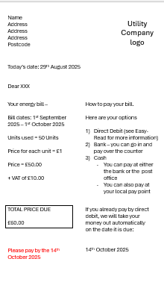
Workshop journey
Session 1
Ethics (consent, privacy)
Looked at real bills
Found problems
Session 2
Created an ideal bill

Slide 10
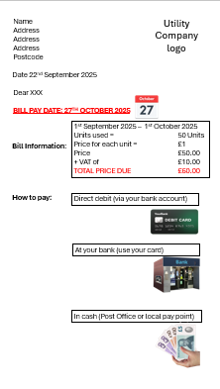


Session 3
Made changes to our bill
Started work on our guide
Session 4
Agreed our bill.
Worked on our guide some more

Slide 11
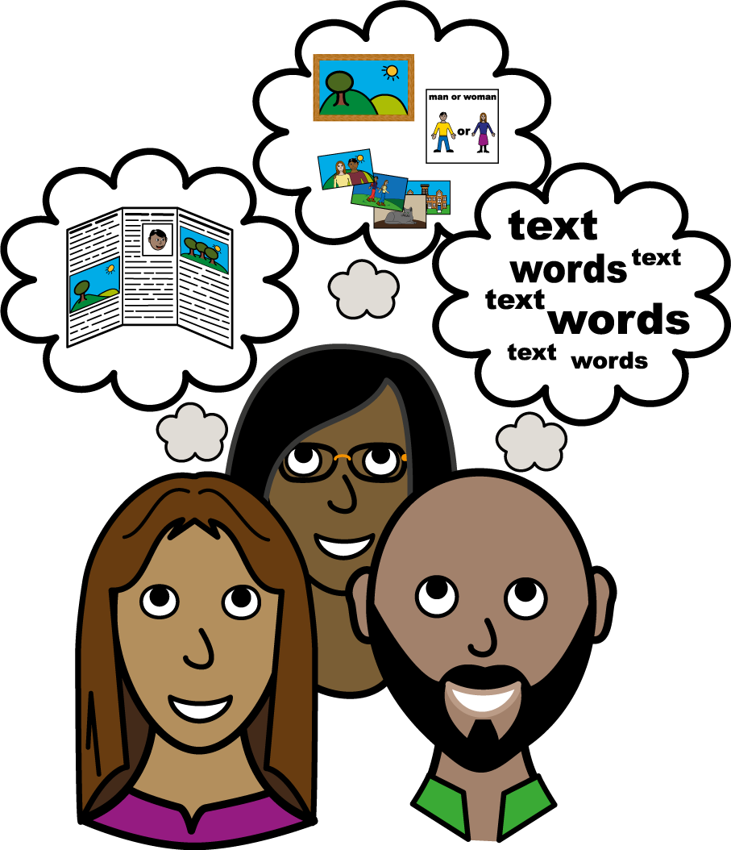
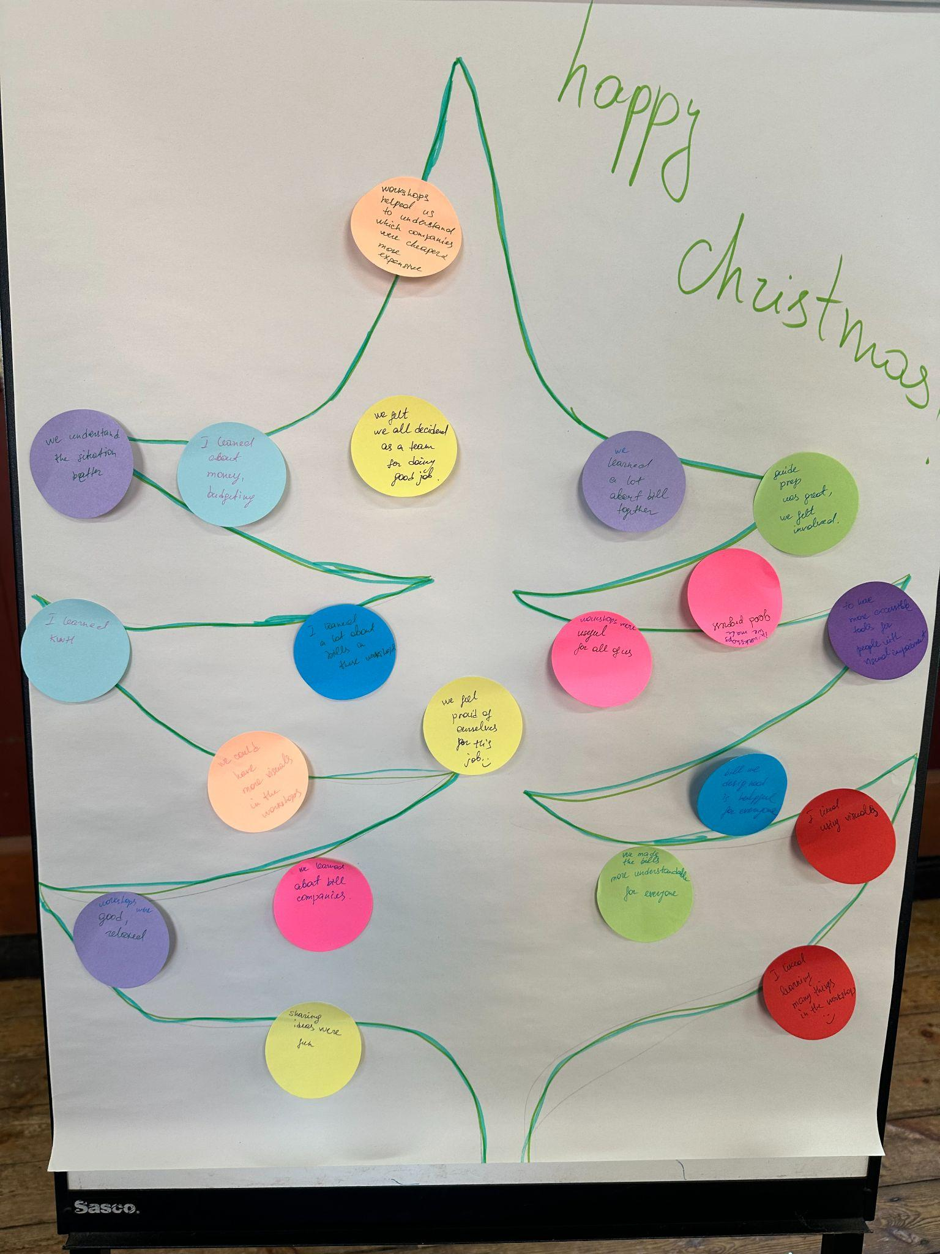
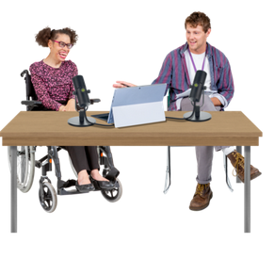
Session 5
Finalised our guide design and content.
Recorded feedback on our previous sessions
Had mock podcast to prepare for podcast sessions

Slide 12
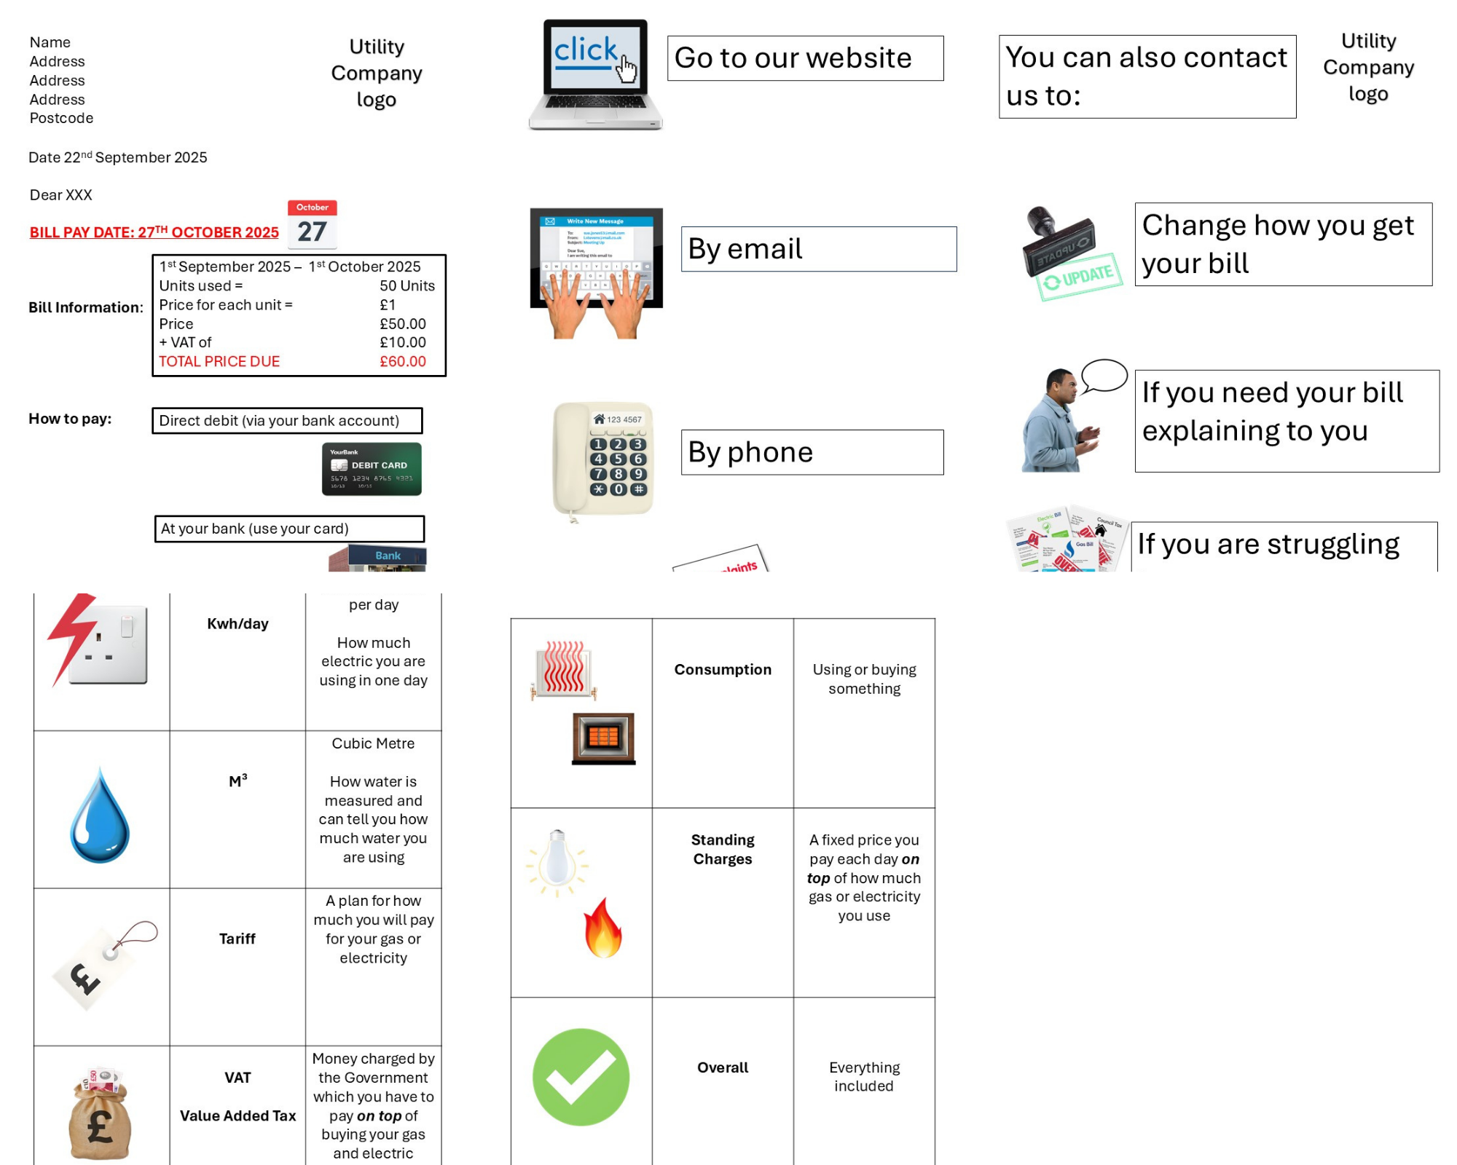
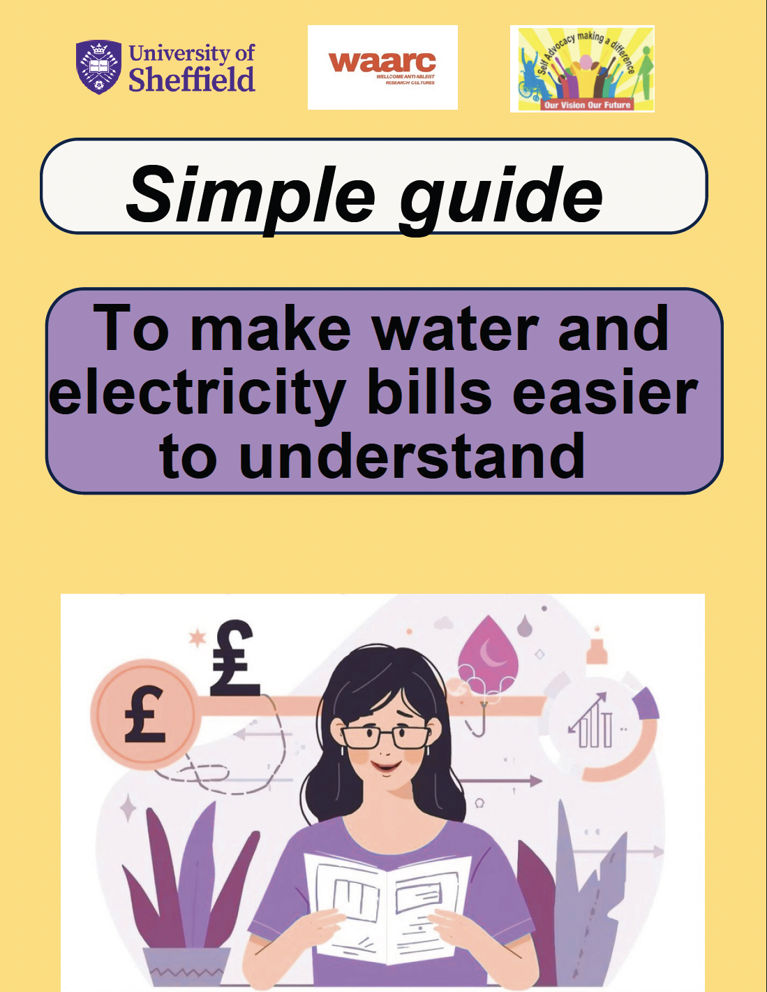
What we created
4-page ideal bill
21-page Simple guide
Click here to read the simple guide.

Slide 13
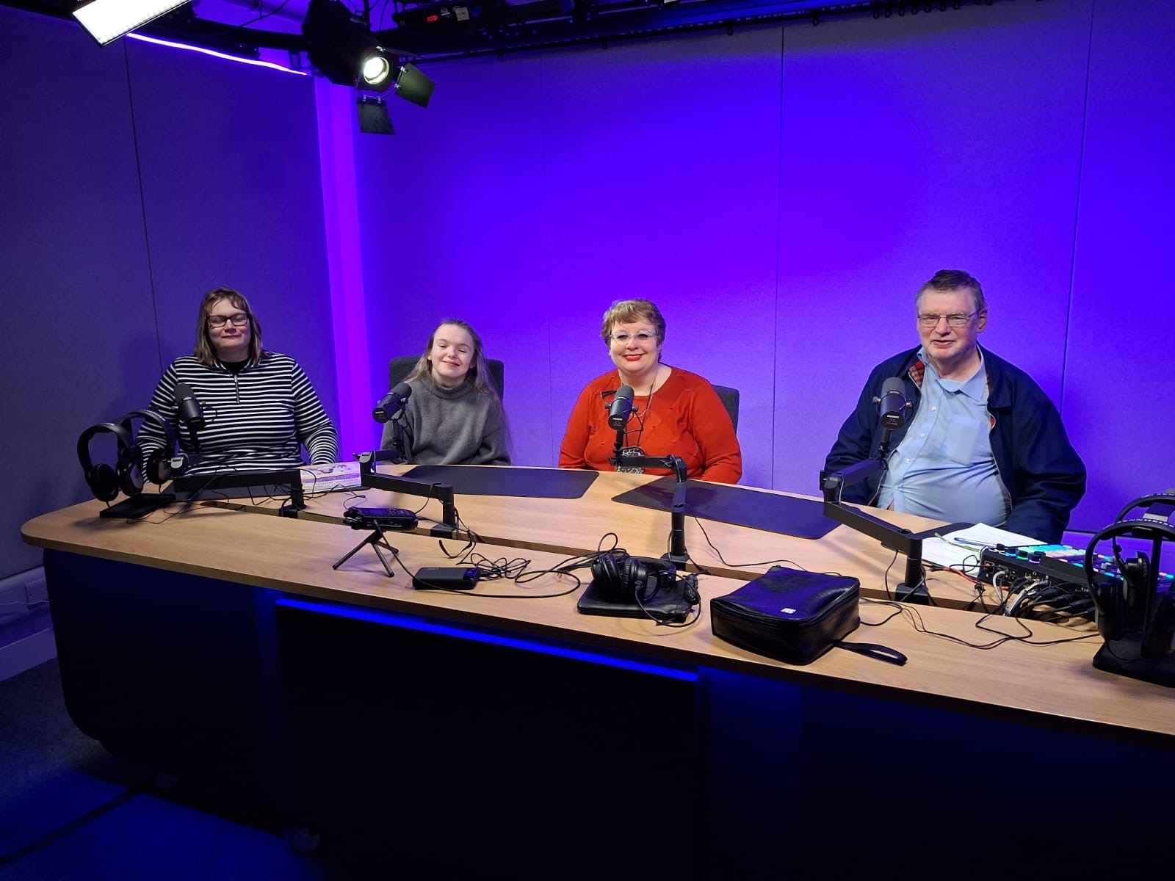
Workshops
“Bills are hard to read… small writing”
“More pictures and bold words help”

Slide 14
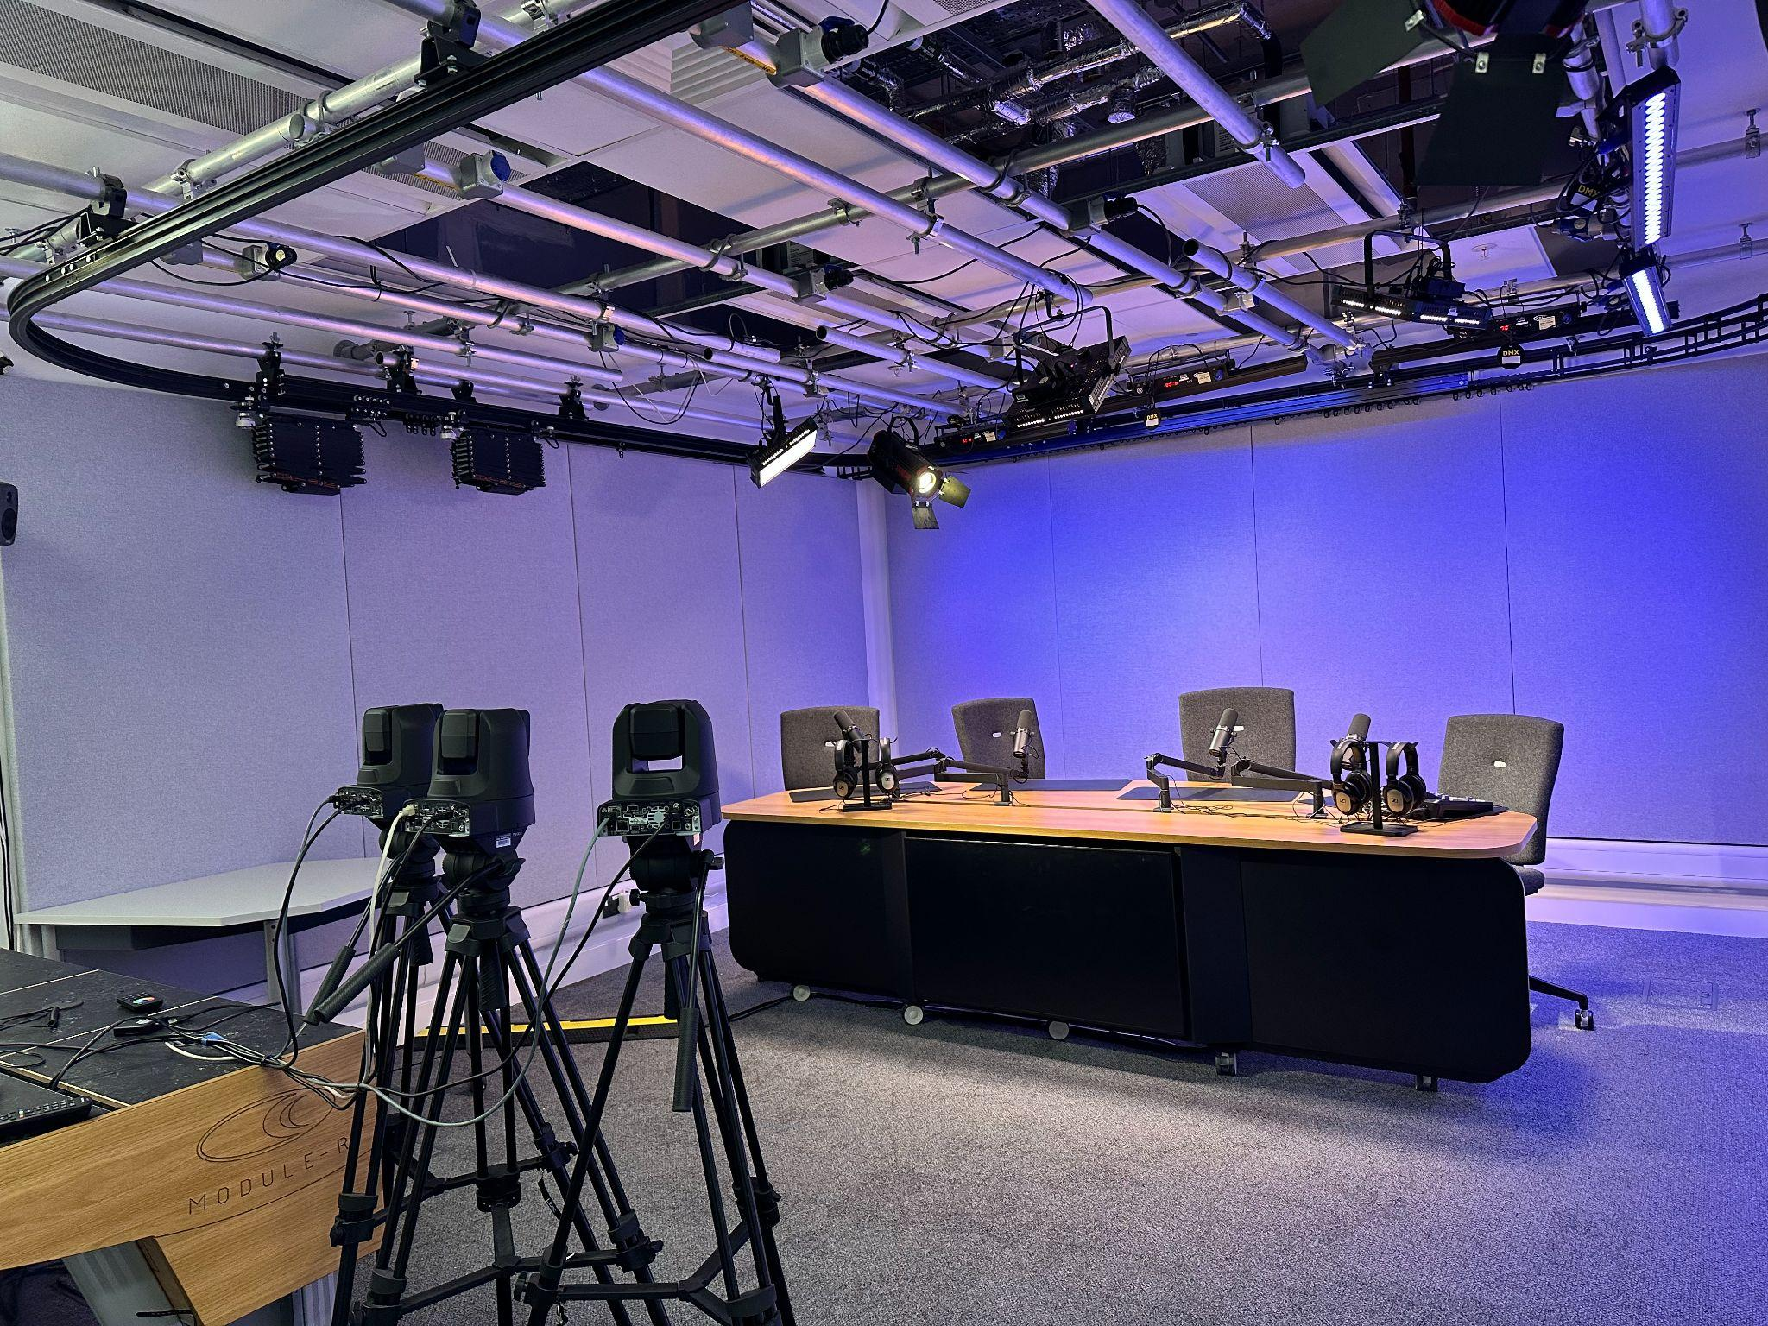
Podcast for research impact and output
Podcast sessions were organised as part of our research impact and outputs.
They were developed in collaboration with the research team and OVOF members.
Click here to listen to the full version of the podcast.

Slide 15
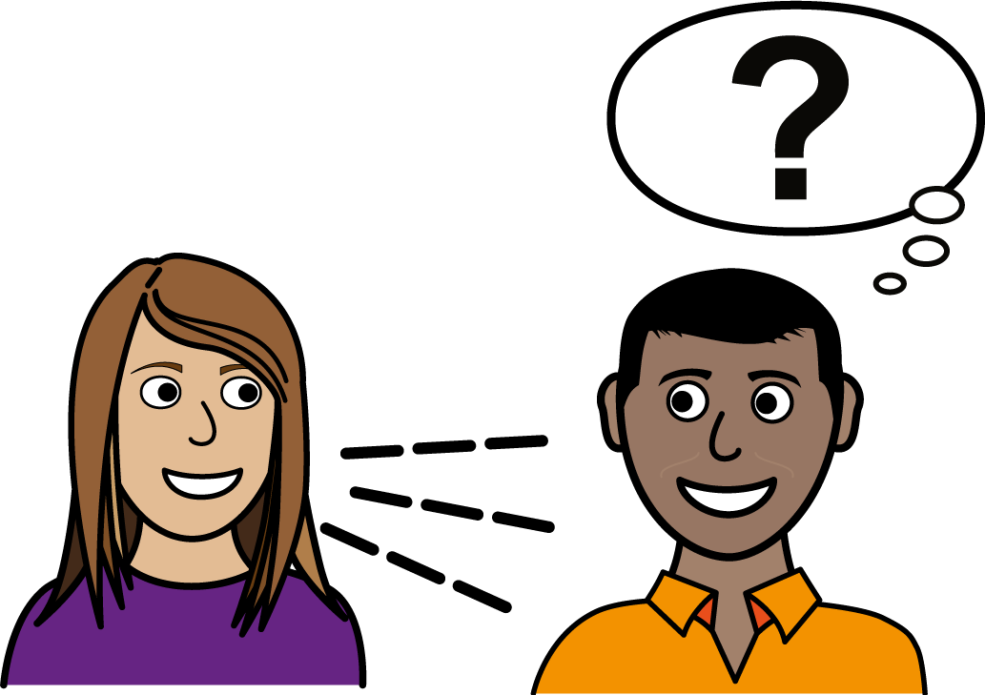
Impact of the project
Our team members said they:
understand bills better
feel more confident managing money
learned new skills

Slide 16
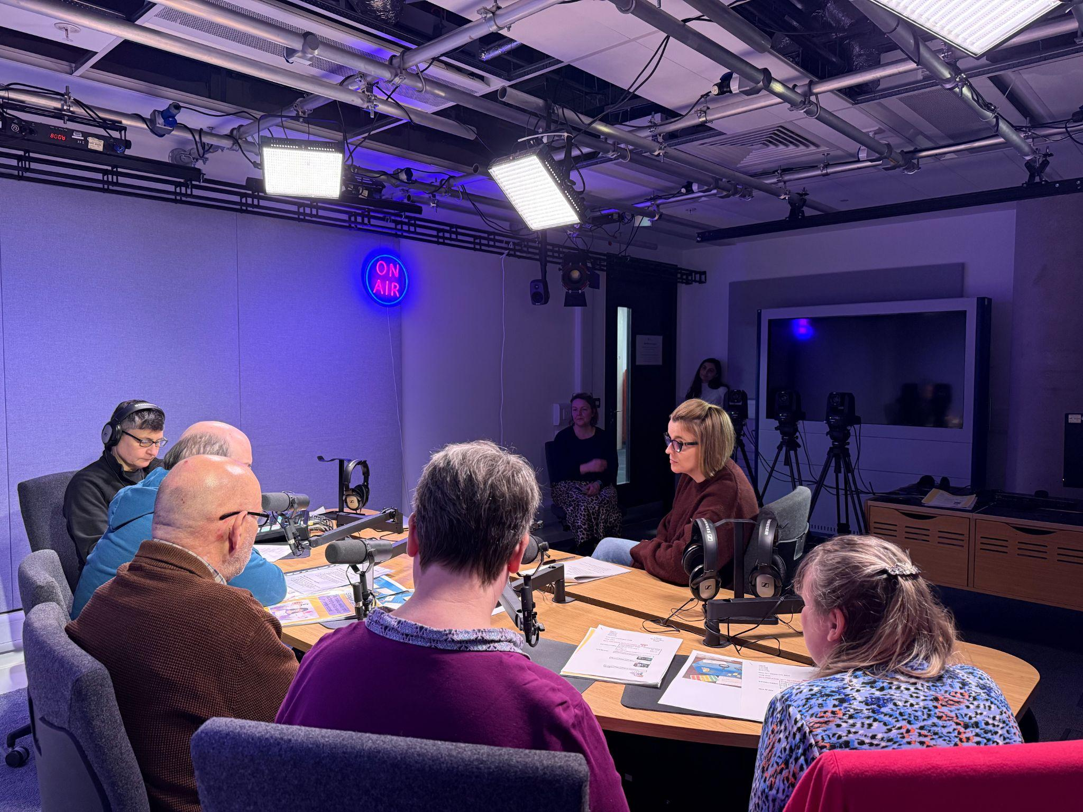
Impact & Confidence
“I felt comfortable sharing ideas”
“We learned from each other”
“We want change”

Slide 17
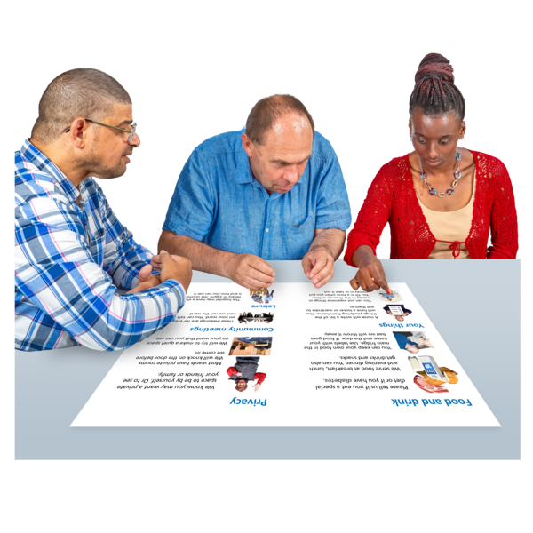
Future plans
We expect:
Companies to use our guide
More inclusion of adults with learning disabilities in research
More accessible bills
Awareness

Slide 18
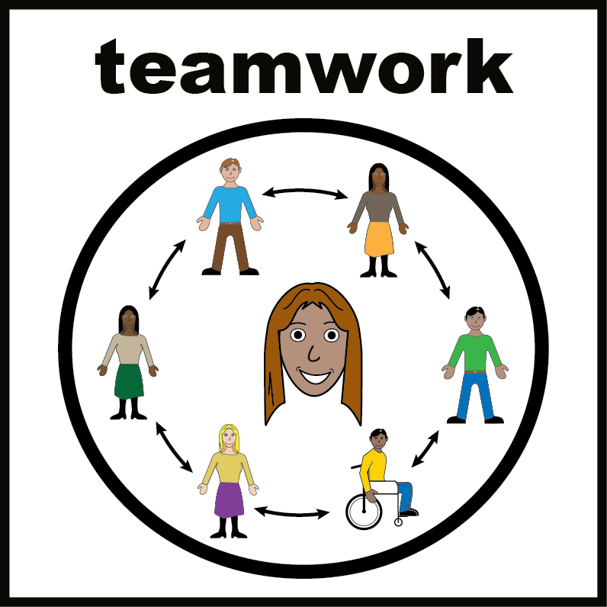
Thank you to everyone who helped make this project possible.
This project would not have been possible without the creativity, time, and ideas of Our Vision Our Future members.
And special thanks to:
The Wellcome Trust Anti-Ableist Research Cultures Project (WAARC) at the University of Sheffield for funding this project.

Slide 19


