Slide 1
Accessing Archives
Esme Cleall (Sheffield) and Rachel Bright (Keele)

Slide 2
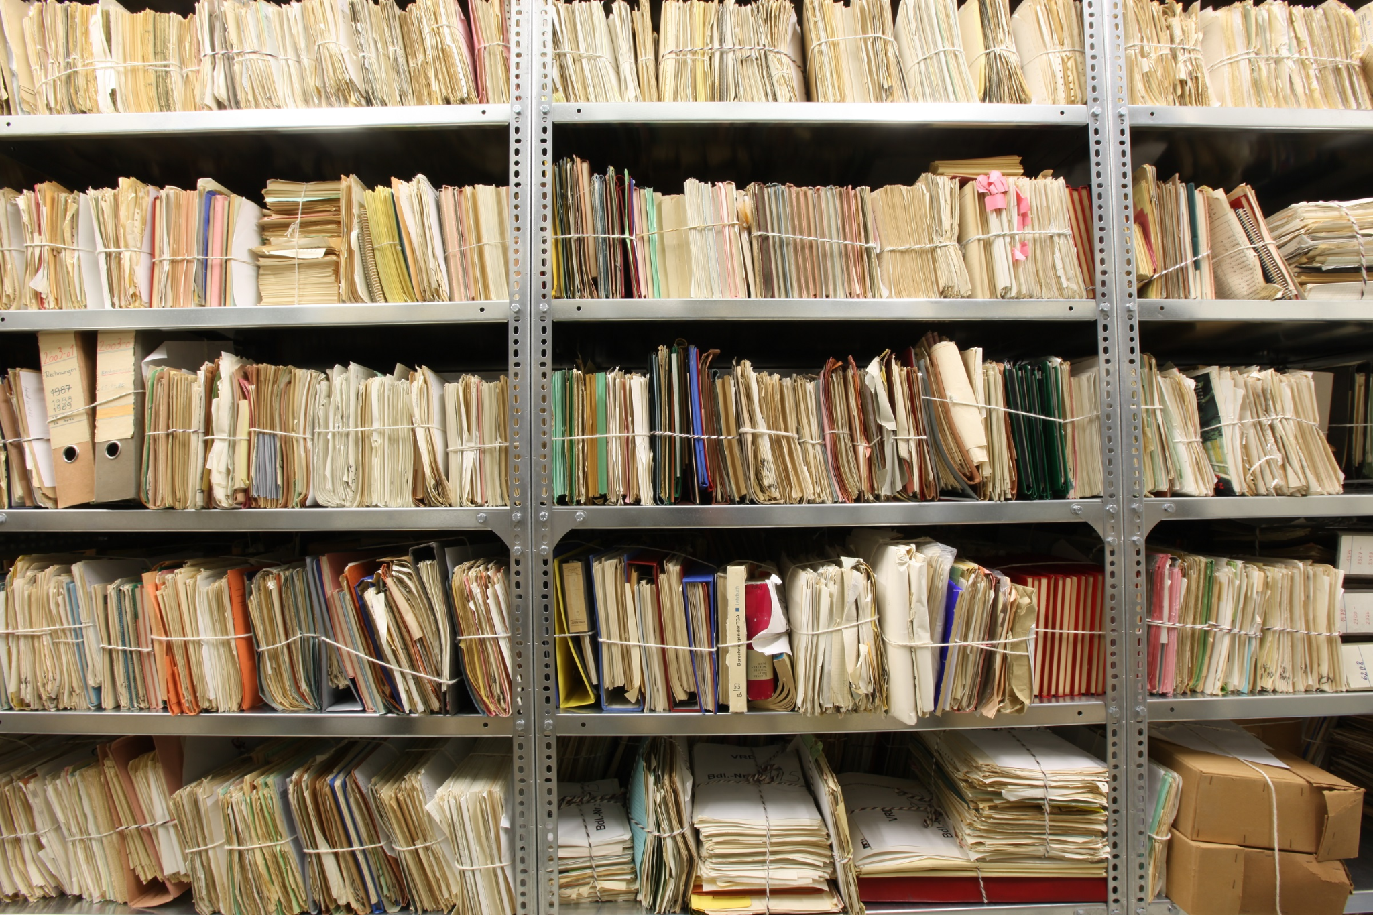
What is an archive?

Slide 3
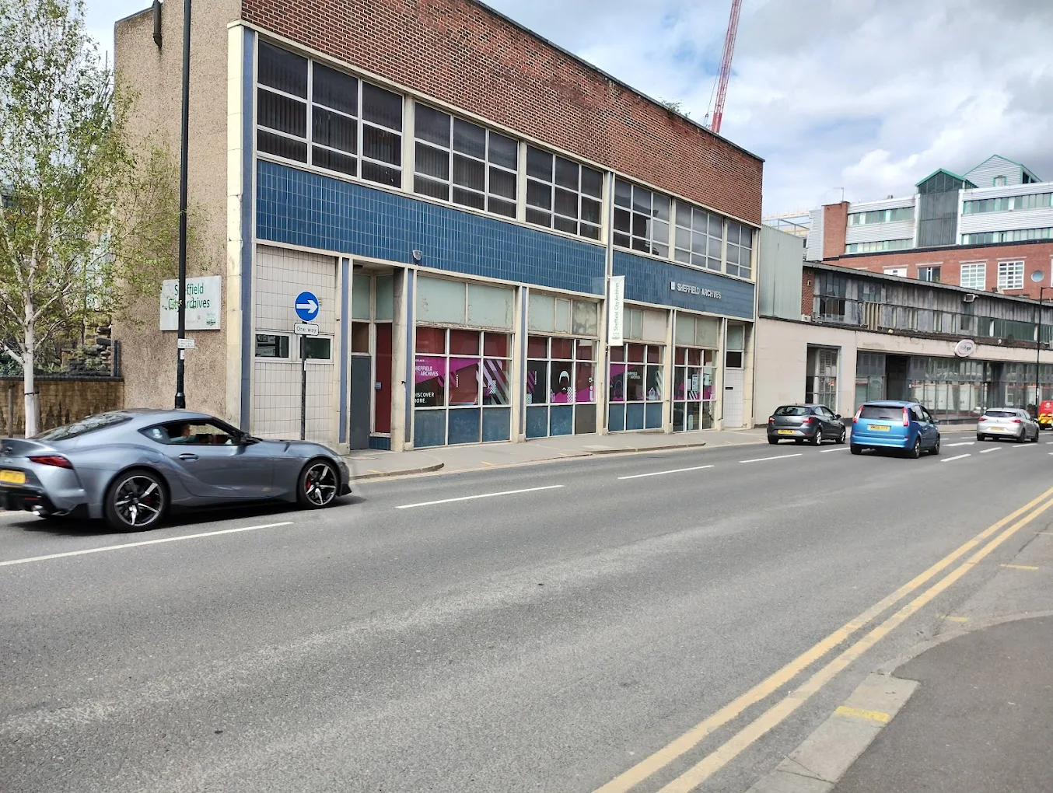
What is it like accessing the archives as a disabled person?
\

Slide 4
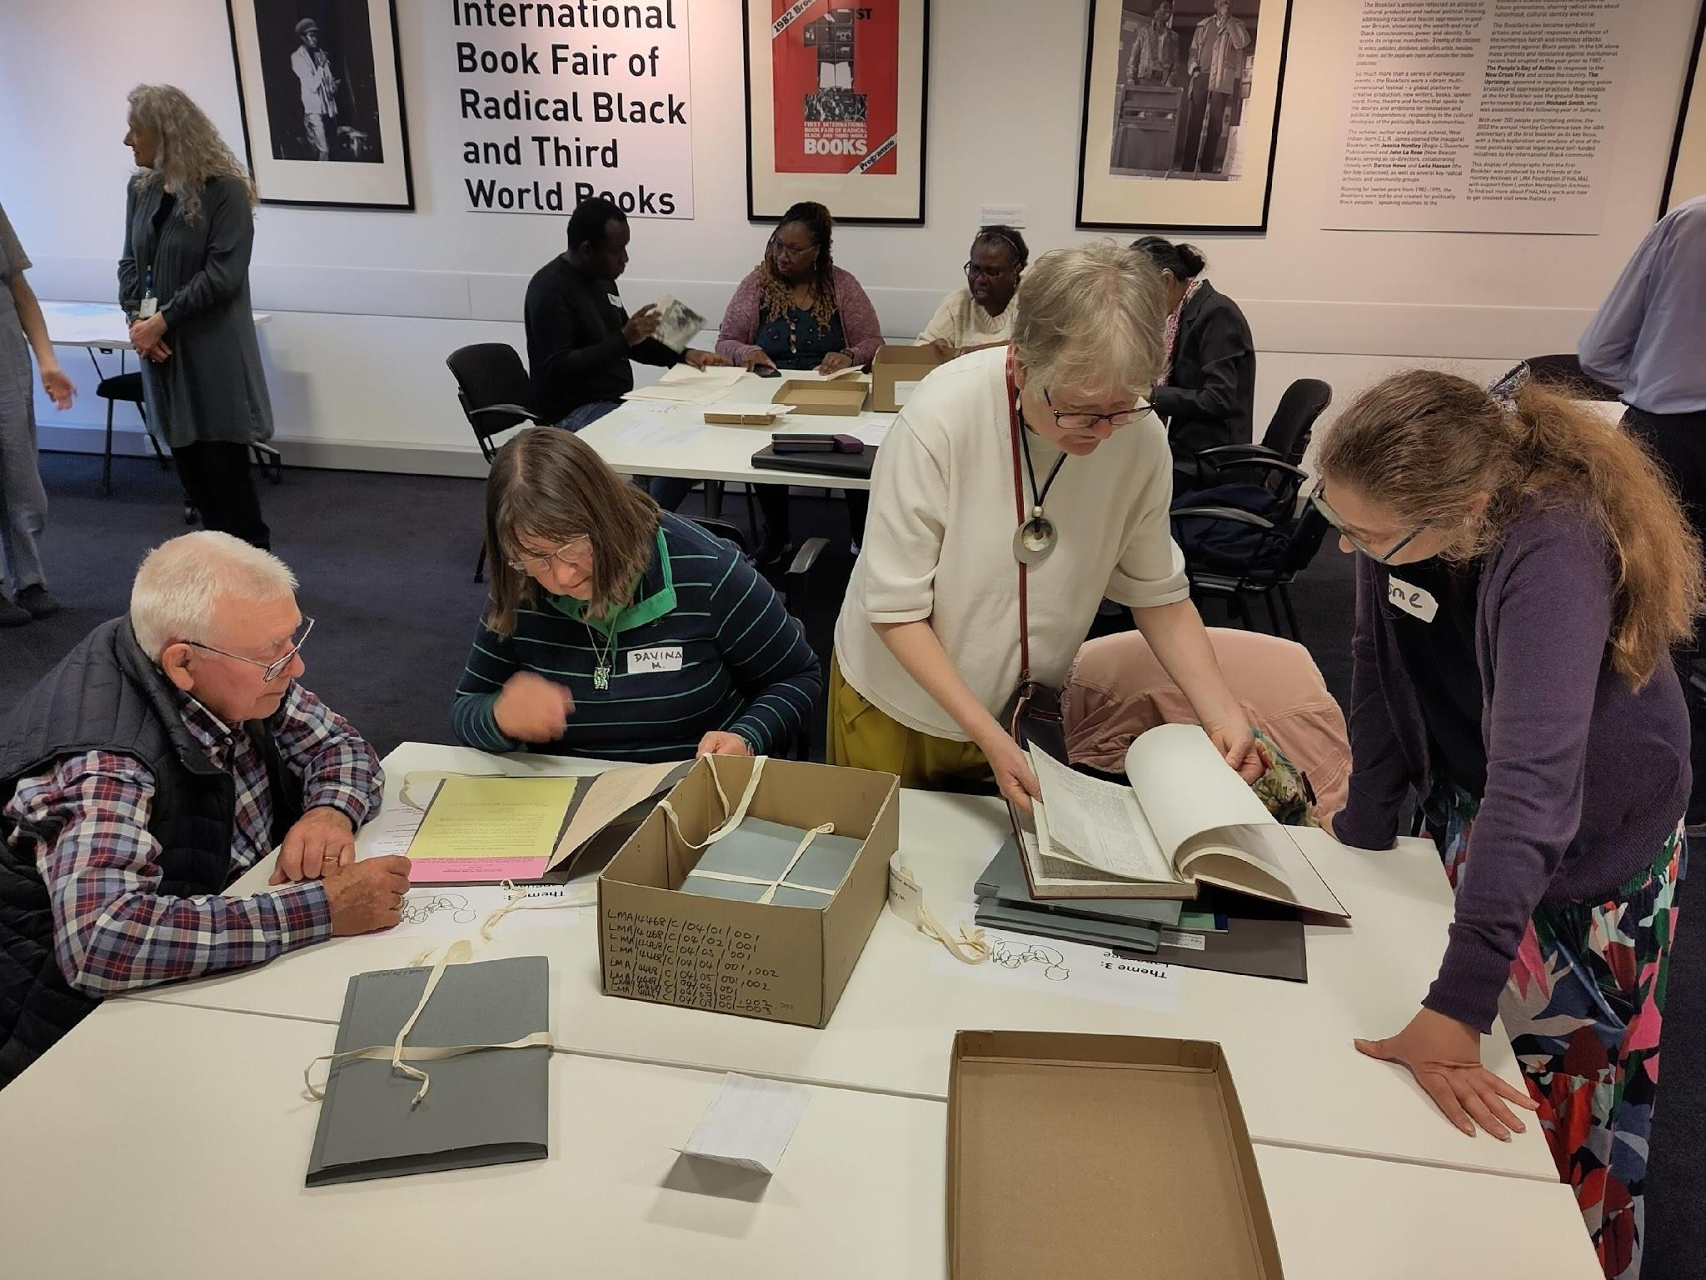

What did our project do?

Slide 5
Conclusions?
Learning from each other?
Building Resources
Addressing Archives?
Next steps?

