Slide 1
Pollutant Transport in Urban Floodwater using a Physical Scale Model
James Shucksmith
Matteo Rubinato, Ricardo Martins, Georges Kesserwani, Jorge Leandro, Slobodan Djordjevic.
Logo
Logo
Logo

Slide 2
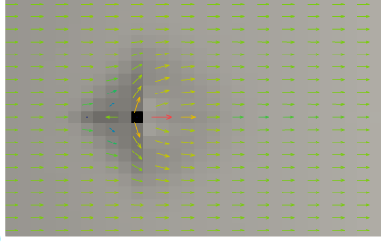
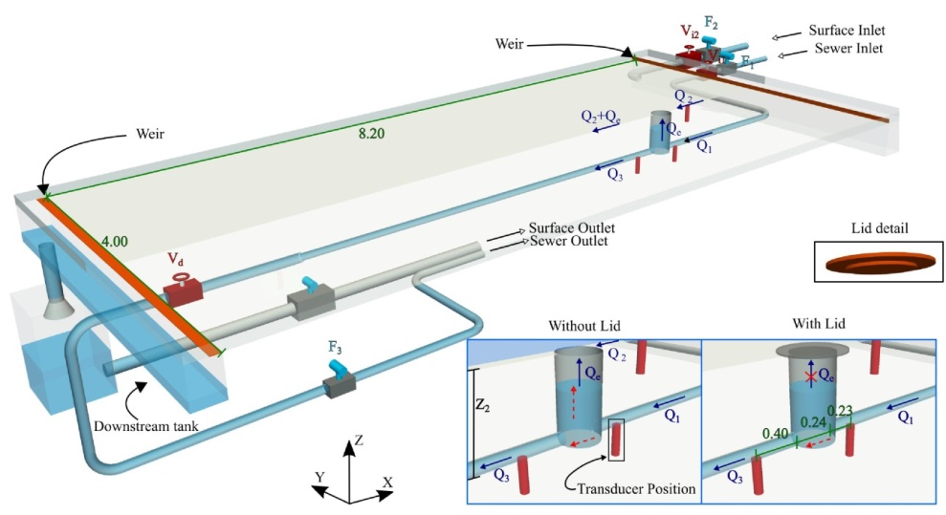
Project Background
Provide high quality datasets to verify and improve urban flood modelling
Physical + Numerical Modelling
Open Access Data
Above / below ground physical model
(from Rubinato et al 2018)
Numerical model testing (Fernández-Pato and García-Navarro 2018, using data from Rubinato et al 2017)

Slide 3
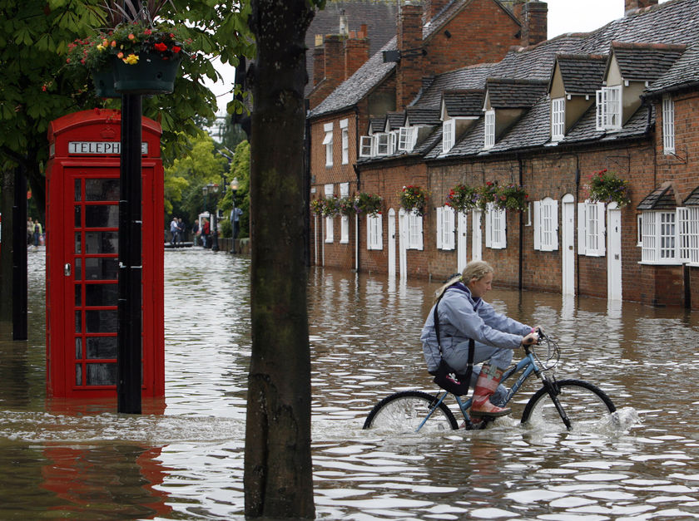
Health Impacts of Floods
Urban floods (especially from combined sewers) contain high levels of pathogens and other harmful bacteria
Direct and indirect contamination risk
Modelling tools starting to be developed to predict infection risk
Is this a good idea?
Calibration data?
“England is the home of rain. It is traditional. That’s why you should always carry an umbrella”.
Madsen et al, ICUD (2017)
Notes:
Many complexities…..concentrations and life in wastewater, in sewer processes, attachments to sediments, temperature, transfer to surface, life in surface waters, deposition etc.
One aspect o be studied – initial advection and dispersion in surface waters. I.e. soluble material will be moves and dispersed.

Slide 4
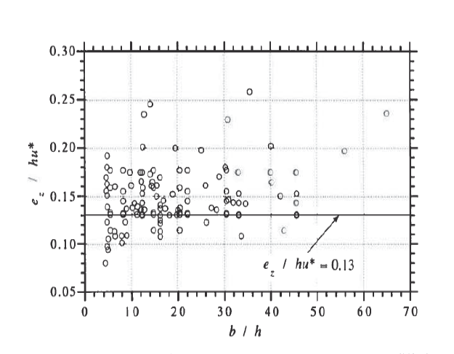
Mixing / Transport in Floodwater
2D (depth averaged) ADE used to describe evolution of concentration distribution
Rivers / Surface Waters
Little data on performance or for calibration at low flow depths/ flood conditions
Diffusivity terms?
Dx = 5.93hu*? Dy = ?
Field experiments are challenging
2D ADE for overland flow (Yan + Kahawita, 07)
Experimental data on transverse diffusivity vs aspect ratio in straight lab channels (Rutherford 94)
Notes:
Longstanding theoretical background to mixing….plot…..variance increases with time.
Applied to pipes, rivers, other surface waters. Long history of use. Lack of use and calibration data in shallow overland flood flows.
Dx from elder due to velocity shear over depth (mostly at higher depths). Transverse more challenging, experimental data from straight lab channels (note aspect ratio).
Can we measure this on our facility?

Slide 5
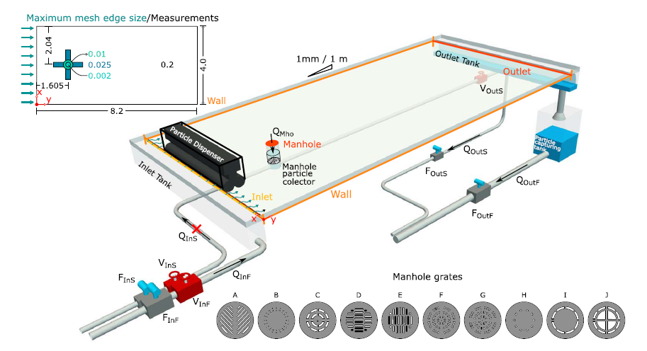
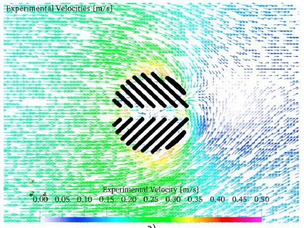
Facility and Instrumentation
4 X 8 m ‘surface’
Surface input
Sewer surcharge via manhole
Real time control/measurement
Flow
Depth
2D velocity via sPIV
Installation of obstructions
Velocities around inlet grate, Martins et al. (2018)

Slide 6
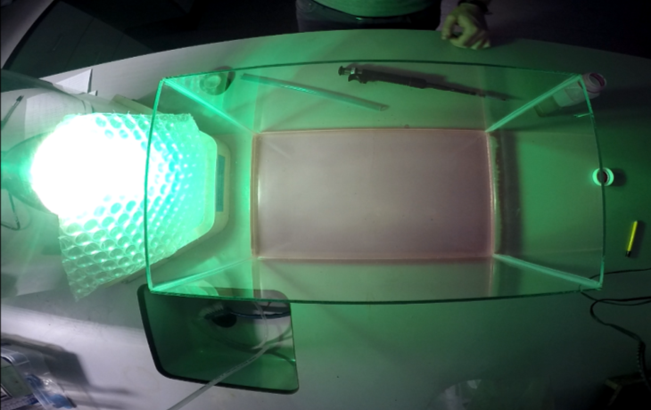
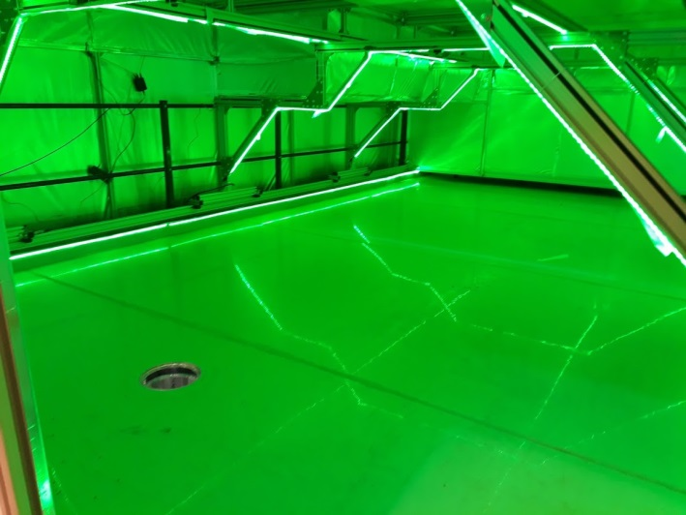
Facility and Instrumentation
Planar Conc. Analysis system
Soluble traceable dye
Injected into sewer flow
Calibration of observed light intensity vs concentration over whole surface
For each depth
Validated vs point measurement

Slide 7
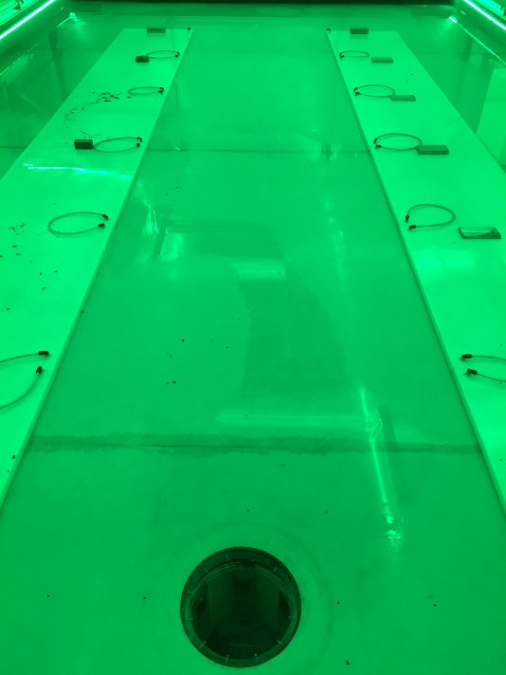
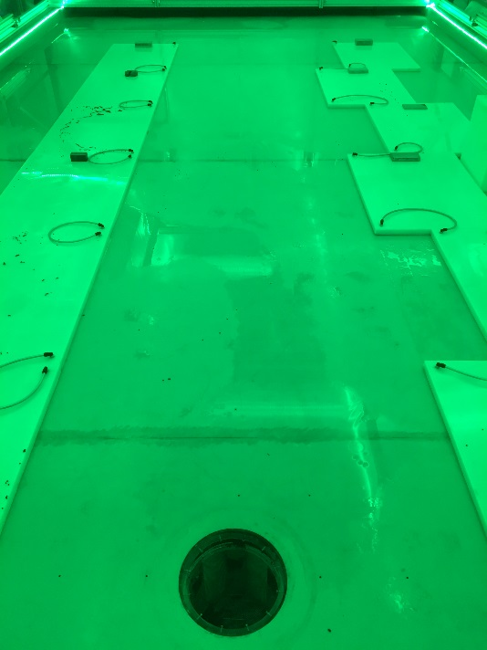
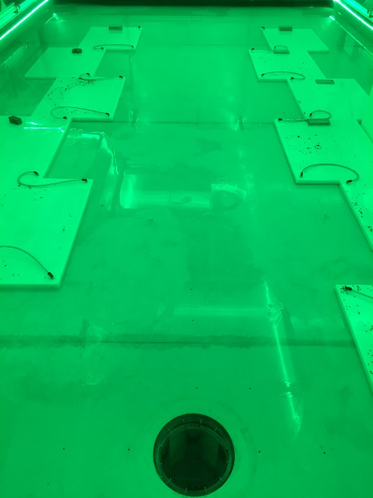
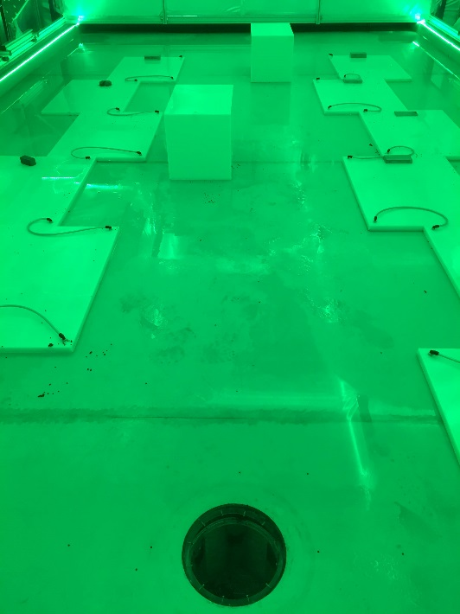
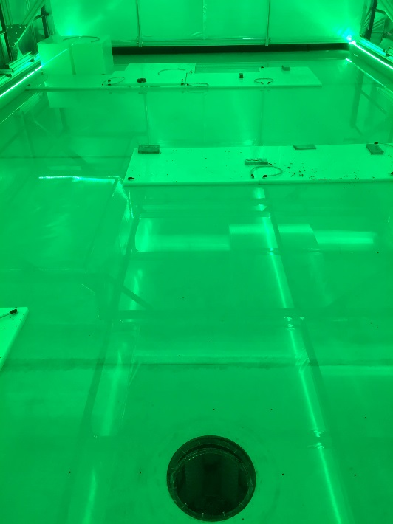
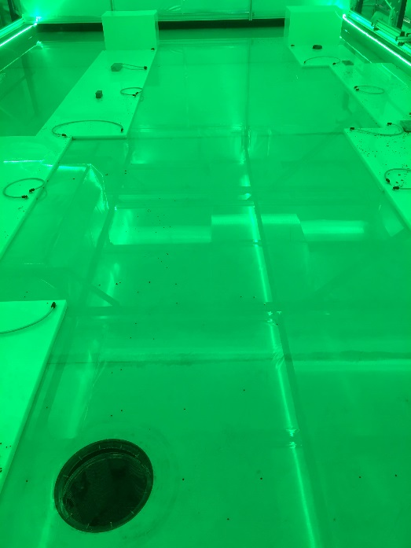
Some configurations (from upstream)

Slide 8
Some Results
(cm)
Upstream depth = 20mm
Upstream mean velocity = 0.11m/s
Manhole diameter 0.24m
Max surcharge = 3.1 l/s
(cm)

Slide 9
Preliminary modelling
2D SWE with Advection/Diffusion terms
SWE validated vs hydraulic data
ADE validated against analytical solution
Dx = 5.93hu*
Dy = 0.15hu*

Slide 10
Preliminary Conclusions
Accurate modelling of concentrations is challenging
Surcharge, local depths and velocities must be accurately predicted
Dispersion heavily affected by local velocities
High resolution required
Lack of velocity validation data a barrier to confidence in pollutant transport models

Slide 11
Future Work
Calibrate 2D ADE and validate performance over range of tests
Consider In-manhole dynamics
Behaviour of sediments
Microbiology?
Fieldwork?

Slide 12
Acknowledgements
Project funded by EPSRC (EP/K040405/1)
Open data can be found at:
https://www.sheffield.ac.uk/floodinteract/outputs
Fernández-Pato, J.; García-Navarro, P. (2018) Development of a New Simulation Tool Coupling a 2D Finite Volume Overland Flow Model and a Drainage Network Model. Geosciences, 8, 288.
Min Yan, Rene Kahawita, (2007) Simulating the evolution of non-point source pollutants in a shallow water environment, Chemosphere, Volume 67, Issue 5, 2007, Pages 879-885,
Martins R, Rubinato M, Kesserwani G, Leandro J, Djordjević S & Shucksmith J (2018) On the Characteristics of Velocities Fields on the Vicinity of Manhole Inlet Grates during Flood Events. Water Resources Research (In Press)
Rubinato M, Martins R, Kesserwani G, Leandro J, Djordjević S & Shucksmith J (2017) Experimental calibration and validation of sewer/surface flow exchange equations in steady and unsteady flow conditions. Journal of Hydrology, 552, 421-432
Rubinato M, Martins R & Shucksmith JD (2018) Quantification of energy losses at a surcharging manhole. Urban Water Journal, 15(3), 234-241.
Rutherford (1994) River Mixing; John Wiley and Sons

