Slide 1
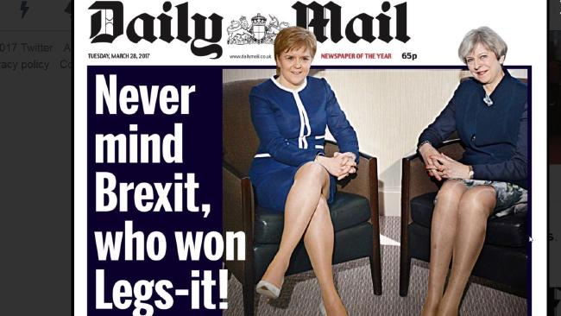
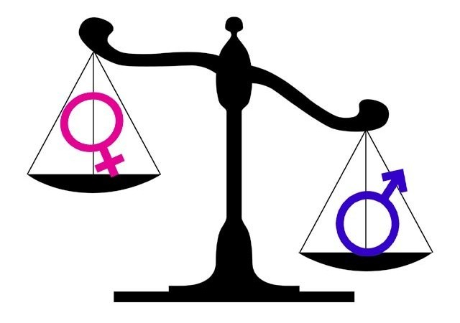
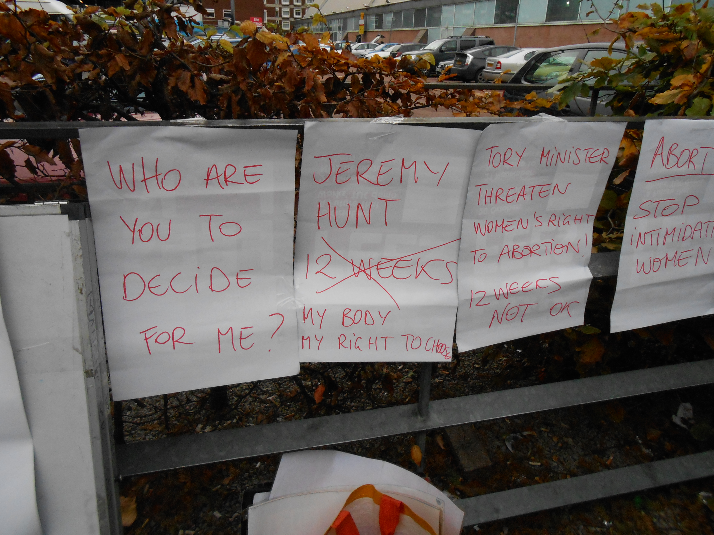
Gender trouble/ troubling gender: gender assumptions and the role of patriarchy in contemporary and everyday politics.
Dr Lucy Jackson lucy.Jackson@Liverpool.ac.uk
Notes:
Gender trouble/ troubling gender: gender assumptions and the role of patriarchy in contemporary and everyday politics.
The role of feminism and feminist discourses in our everyday lives has been both something to celebrate but has also been problematic. Whilst there has been a backlash against modern day feminism and what it represents, gendered ideals and practices are present in everyday life. Drawing on recent discussions in feminist geography, this discussion looks at the role of gender in politics- including recent political campaigns and more mundane elements of gender, sexism and the role of patriarchy which includes online discussion forums and campaigns regarding women’s reproductive rights. In looking at the connection between these debates, this event explores the question of ‘gender trouble’ and the continued role that assumptions about how different genders behave continue to be a prominent feature in our everyday lives.
general advances in women’s position in the labour market in Europe, North America and Australasia over the last few decades have led to popular claims that feminism is less pertinent to younger generations of women, and by implication to suggest that sexism as a form of prejudice may be disappearing
sexism and gender hate as forms of discrimination and prejudice appear to have largely dropped off the geographical map. Yet, cursory attention to public life exposes the apparent persistence of sexism and gender hate crime, from the British Prime Minister David Cameron’s banal put-down ‘calm down dear’ to a female opposition minister, to the repetitive misogynistic abuse of the Australian Prime Minister
Julia Gillard (Mclean and Maalsen 2013) and violent rapes in India and Kenya which have bought thousands of people onto the streets in protest.

Slide 2
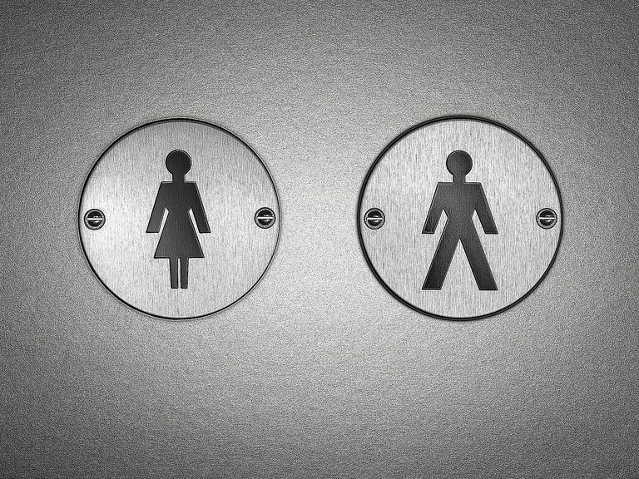
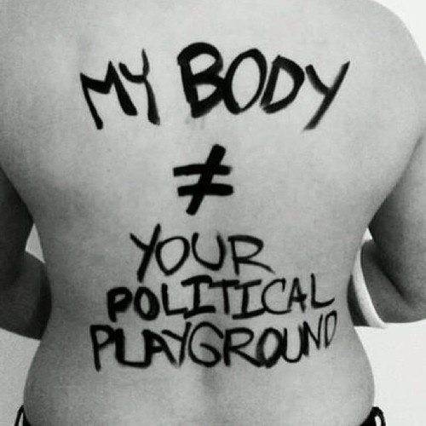
Body politics
“Begin…not with a continent or a country or a house, but with the geography closest in – the body” (p.212)…recognise “the places it [the body] has taken me, the places it has not let me go” (p.216)
Adrienne Rich A politics of location (1989)
Bodies at centre of national and international political struggles:
human rights, abortion, contraception, access to health care, domestic violence, rape, genetic engineering, euthanasia, corporal punishment, disease, etc.
“we use our bodies for grounding personal identity in ourselves and recognising it in others. We use other bodies as points of reference in relating to other material things. We use our bodies for the assignment of all sorts of roles, tasks, duties and strategies. We use our bodies for practical action. We use our bodies for the expression of moral judgements. We use the condition of our bodies for legitimating a withdrawal from the demands of everyday life. We use our bodies for reproducing the human species. We use our bodies for artwork, as surfaces for new material for sculpture” (Harre Â (1991: 257, Cited in Longhurst 1997a, p.487)
Notes:
Socially constructed meanings vary with changing context
E.g. Islamophobia in current political context means embodiment of Islamic identity (e.g. headscarf) marks Muslim bodies as ‘out of place’
Bodies signify certain qualities e.g.
Fat bodies: lazy, irresponsible
Unequal power relations caused by social interpretations of biological differences
Therefore prejudice, discrimination etc. can be challenged
Feminist and Critical Geographers are interested in questioning:
How do particular bodies get associated with particular meanings
How is knowledge produced about particular bodies
What forms of power are evident in the production of knowledge about bodies
How do meanings circulate through language, images, music, film etc.
How does power circulate in similar ways?
e.g. patriarchy not just about unequal ‘laws’ but perpetuated through discourse (language, text, media, etc) e.g. ‘That takes balls’
Not just about media but also questioning circulation of medical and policy knowledge/power

Slide 3
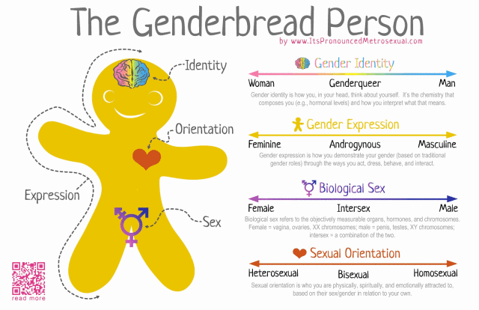
The body as self, the body as other
the body `as a site of cultural consumption' (Pile and Thrift, 1995: 7), a surface to be etched, inscribed and written on
Bodies as socially constructed
Leads to particular assumptions about what bodies can/ should do etc
Bodies are also an essentialist being
They affect how we experience the world.
The mind/ body dualism
For example, Woman is described only in terms of Man, the body is described only in terms of the mind and so on. `Dichotomies are inherently non-reversible, non-reciprocal hierarchies, and thus describe systems of domination' (Grosz, 1989: xvi, in Longhurst 1997a, p. 490).
Source: Autostraddle.com
Notes:
Social constructionist feminists tend to be concerned with the processes by which bodies are written upon, marked, scarred, transformed or constructed by various patriarchal and heterosexist institutional regimes
Constructionist feminists argue that bodies are discursively produced and that essentialist discourses ± that is, discourses which make reference to the physical, biological body ± serve to naturalize what is in fact social difference. For constructionist feminists, references to the biological body are seen to reinforce patriarchal claims that women are naturally incapable of certain kinds of action
Rich (1976; 1986), Braidotti (1989; 1991) and Kirby
(1992) are often read and cited as belonging in this category. They tend to take the
biological/anatomical body that is popularly considered to be the `real' body as a starting
point for their feminist analyses. In this way, essentialist feminists attempt to work with
the body. They do not wish to erase it in the way that they claim constructionist feminists do they want to treat the body as something more than representation. Essentialist feminists argue that by erasing the `real' body constructionist feminists tend to reinforce masculinist discourses which also ignore the body (see Gallop, 1988; Kirby, 1992).
In adopting either an essentialist or a con-structionist approach, a binary distinction between sex and gender develops: between the brutely biological (sex) often considered by constructionists as being irrelevant to, and outside, an understanding of women's position in society, and the construction of feminine and masculine identity (gender). Theorists such as Gatens (1991a) have persuasively argued that the distinction between sex and gender (and therefore presumably between essentialist and constructionist positions) does not hold.

Slide 4
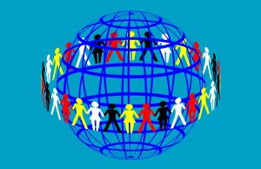
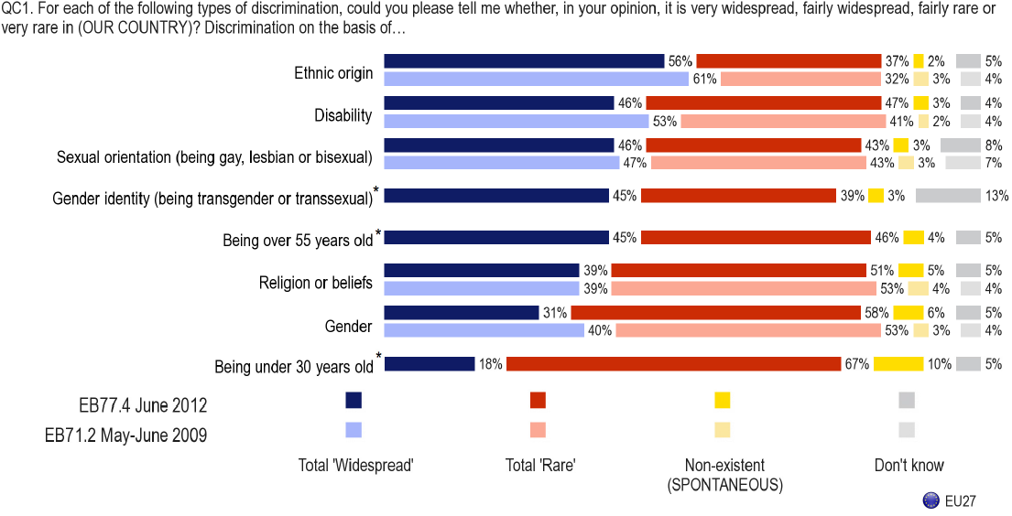
The politics of identity
Discrimination is still widespread
Source: EUROBAROMETER 2012, 2009
http://livedifference.group.shef.ac.uk/

Slide 5
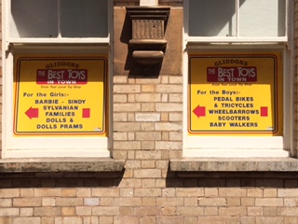
Gender and sex: Behaviour and biology
Butler questions the notion that "the body" itself is a natural entity that "admits no genealogy," a usual given without explanation: "How are the contours of the body clearly marked as the taken-for-granted ground or surface upon which gender signification are inscribed, a mere facticity devoid of value, prior to significance?" (1990, P.129).
Butler's claim is that "the body is itself a consequence of taboos that render that body discrete by virtue of its stable boundaries" (1990, P.133).
Notes:
BUTLER 1990
In her most influential book Gender Trouble (1990), Butler argued that feminism had made a mistake by trying to assert that 'women' were a group with common characteristics and interests.
Butler notes that feminists rejected the idea that biology is destiny, but then developed an account of patriarchal culture which assumed that masculine and feminine genders would inevitably be built, by culture, upon 'male' and 'female' bodies, making the same destiny just as inescapable. That argument allows no room for choice, difference or resistance.
Butler prefers 'those historical and anthropological positions that understand gender as a relation among socially constituted subjects in specifiable contexts'. In other words, rather than being a fixed attribute in a person, gender should be seen as a fluid variable which shifts and changes in different contexts and at different times.
Butler argues that sex (male, female) is seen to cause gender (masculine, feminine) which is seen to cause desire (towards the other gender). This is seen as a kind of continuum. Butler's approach -- inspired in part by Foucault -- is basically to smash the supposed links between these, so that gender and desire are flexible, free-floating and not 'caused' by other stable factors.
Butler says: 'There is no gender identity behind the expressions of gender; ... identity is performatively constituted by the very "expressions" that are said to be its results.' (Gender Trouble, p. 25). In other words, gender is a performance; it's what you do at particular times, rather than a universal who you are.
performative theory of gender (and the analysis of drag queens in this respect) which tries to account the manner in which a subject identity is formed while establishing Butler's claim that gender identity is not a manifestation of intrinsic essence but rather the product of actions and behaviors, that is, performance. In other words, Judith Butler argues that everyday actions, speech utterances, gestures and representations, dress codes and behaviors as well as certain prohibitions and taboos all work to produce what is perceived as an essential masculine of feminine identity. Butler aims at deconstructing this notion of integrated, stable identity as the extension of an inner essence, and the illusion of the sexual body, which are in Butler's view repressive and dangerous, but also undermineable.

Slide 6
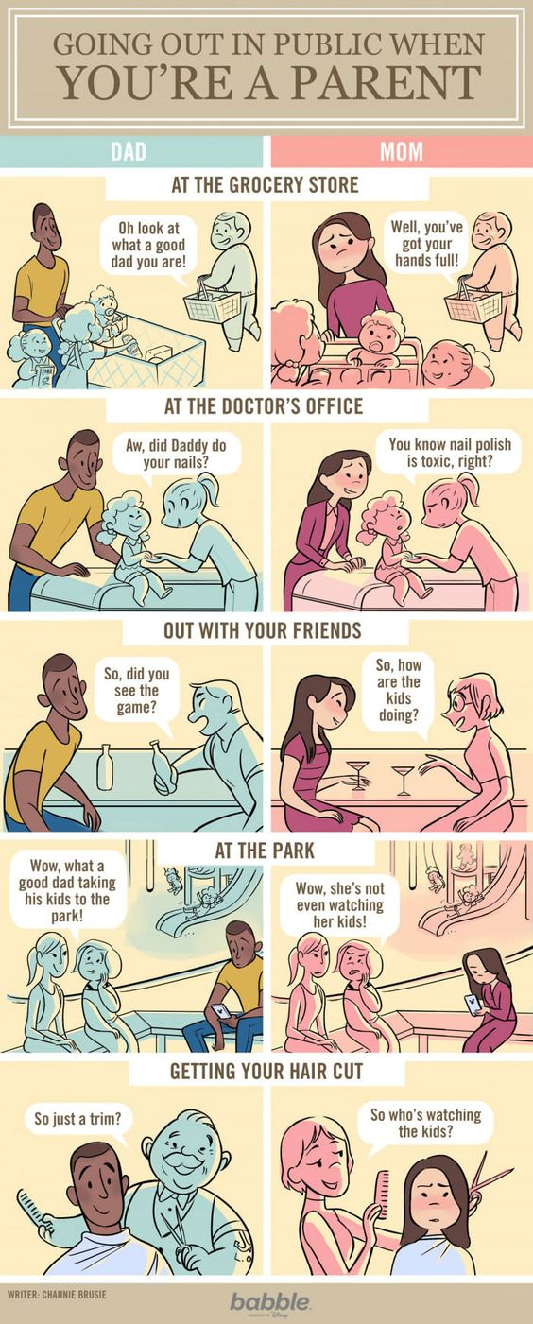
Gender and sex: Behaviour and biology
Idea of ‘biological determinism’
“Gatens (1988: 61) argues that `not only have mind and body been conceptualised as distinct in western knowledges but also the divisions have been conceptually and historically sexualised'. Gatens (1991b: 1) extends the point claiming that `culture, the mind and reason, social production, the state and society . . . are understood to have a dynamic and developmental character' and are associated with Man. `The body and its passions, reproduction, the family and the individual are often conceived as timeless and unvarying aspects of nature' and are associated with Woman (Gatens, 1991b: 1). Grosz (1989: xiv) argues that the mind has traditionally been correlated with positive terms such as `reason, subject, consciousness, interiority, activity and masculinity'. The body, on the other hand, has been implicitly associated with negative terms such as `passion, object, non-consciousness, exteriority, passivity and femininity' (Grosz, 1989: xiv). The body has been seen as reason's `underside', its `negative, inverted double‘ (Grosz, 1988: 30)”. (Longhurst 1997a, p.490)
Notes:
Mythbuster 8: What’s a Woman’s Job?
Expectations are imposed on all of us even from childhood. Girls are given Barbie’s, tiny buggies and play kitchen sets whilst boys are given fire engines, action figures and 200 piece Lego sets. If girls grow a liking for sports they’re labelled little tomboys, some parents may even think ‘I can’t let my son play with dolls he’ll grow up to be Gok Wan’. Sure enough these boys may grow thinking raising children is woman’s work and girls may think becoming fire-fighters and engineers are male careers. These gender stereotypes follow on into adulthood, making it hard to imagine women on building sites cementing bricks and whistling at men, a female taxi driver in a flat cap ranting about immigration or a woman fixing a leaky pipe in baggy trousers, fixing one crack and exposing another one. Unfortunately, this creates barriers to women’s career choices and advancement to decision-making positions.
Gender stereotypes are cultural and social attitudes towards what is traditionally considered ‘male’ or ‘female’ roles or traits. Evidence suggests that women in organisations are held back by stereotypical images and expectations, such as that of the ‘businessman’.
Science, Engineering, Technology (SET)
president of Harvard University, Lawrence H. Summers, sparked debate and outrage when he suggested that a reason for the limited number of women in top positions in the SET industries could be that females innately have less aptitude and ability in maths and science.
Gender stereotypes affect not only how others evaluate women’s math and science skill but also how women see themselves. Over 70% of Britain’s female graduates of SET subjects do not work in these fields. Meg Munn MP says: ‘It was clear that from an early age girls and boys learn what are considered appropriate careers for their gender.’
The decision by the Pentagon to lift the ban on women serving in close combat roles has raised questions about when the UK will also follow suit. In 2010, the Ministry of Defence (MoD) found key concerns surrounding ‘men’s desire to protect women’ and ‘women’s relatively lower physical strength and stamina’, based on a small study which also found that during incidents where women have had to shoot at the enemy during fire fights: ‘The majority of interviewees felt there was no impact due to the presence of a woman on getting the task done.’ MoD research from 2002 also found that women ‘required more provocation and were more likely to fear consequences of aggressive behaviour.’ Yet, this is contrary to what soldiers in the field are reporting; one was quoting saying:
‘We were on top cover, she on the right, me on the left. We both turned and started firing at the same moment. It didn’t matter she was a medical sergeant just that she was getting rounds off. The kit was not an issue, she carried her own and was happy to carry her own weight.’

Slide 7
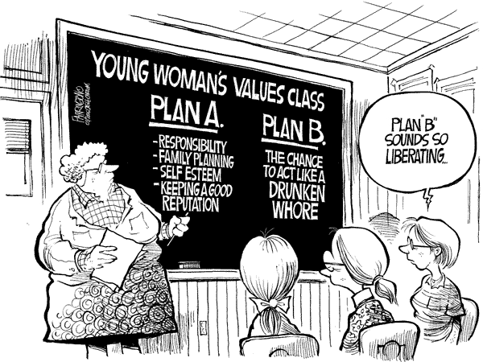
Gender and sex: Behaviour and biology
“Kirby (1992: 12 -13) extends this correlation between Woman and the body to make the point that Woman is the body: Although it is granted that Man has a body, it is merely as an object that he grasps, penetrates, comprehends and ultimately transcends. As his companion and complement, Woman is the body. She remains stuck in the primeval ooze of Nature's sticky immanence, a victim of the vagaries of her emotions, a creature who can't think straight as a consequence”. (Longhurst 1997a, p.490)
Notes:
There will always be socially and culturally constructed characteristics attached to gender. Power, autonomy and rationality are associated with masculinity and weakness, dependence and emotionality with femininity. Qualities of good warriors are also attached to manhood such as bravery and the notion that males fight wars to protect women and children have also been important for recruitment and institutional morale. Politicians have been known to use rhetoric such as ‘our men’; entrenching the belief that war is male territory. Joshua Goldstein in ‘War and Gender’ finds no biological reason why men are mostly fighters and attributes it to cultural socialisation, meaning men’s dominance is socially rather than biologically defined.
sexism as a forgotten form of prejudice?? Has sexism become SO EVERYDAY that we forget its influence on power and politics????
**************there are a number of Important issues which are gender related and tied to political decision making that we need to address questions about the everydayness of sexism as a form of discrimination
the ordinariness of everyday
sexism, demonstrating that while the development of equality legislation has contained the
public expression of the most blatant forms of gender prejudice, sexism persists and is
manifest in subtle ways.

Slide 8
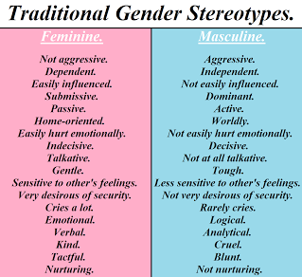
What is femininity?
“It embodies a constellation of meanings, it generally refers to the attributes, behaviours, interests, mannerisms, appearances, roles, and expectations that we have come to associate with being female during the socialization processes. Gender role socialization relies on modelling and reinforcement – girls and women learn and internalize socially expected and acceptable feminine traits and behaviours and are rewarded for gender-appropriate behaviour.” (Shea 2014)
Notes:
Shea, Munyi, et al. "Toward A Constructionist Perspective Of Examining Femininity Experience: The Development And Psychometric Properties Of The Subjective Femininity Stress Scale." Psychology Of Women Quarterly 38.2 (2014): 275-291. Academic Search Complete. Web. 23 Nov. 2014.
Associate professor of psychology California state university, LA.
Maintains specific gender roles
Gender stereotypes influence traditional feminine occupations, resulting in microaggression toward women who break traditional gender roles.^{[84]} These stereotypes include that women have a caring nature, have skill at household-related work, have greater manual dexterity than men, are more honest than men, and have a more attractive physical appearance. Occupational roles associated with these stereotypes include: midwife, teacher, accountant, data entry clerk, cashier, salesperson, receptionist, housekeeper, cook, maid, social worker, and nurse.^{[85]} Occupational segregation maintains gender inequality^{[86]} and gender pay gap.^{[87]}
Leadership is associated with masculinity in Western culture and women are perceived less favorably as potential leaders.^{[91]} However, some people have argued that the "feminine"-style leadership, which is associated with leadership that focuses on help and cooperation, is advantageous over "masculine" leadership, which is associated with focusing on tasks and control.^{[92]} Female leaders are more often described by Western media using characteristics associated with femininity, such as emotion.^{[92]}

Slide 9
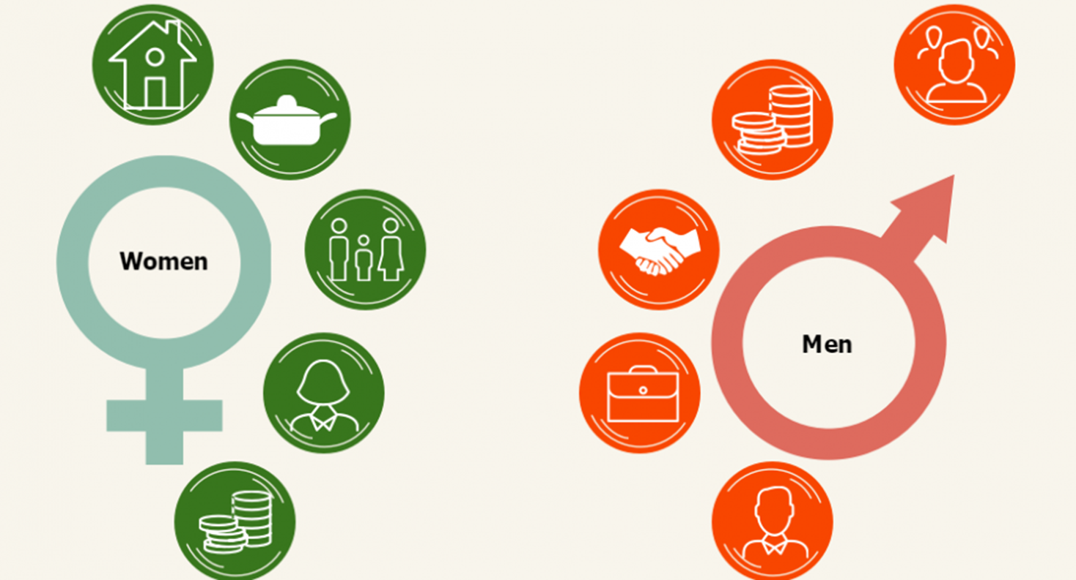
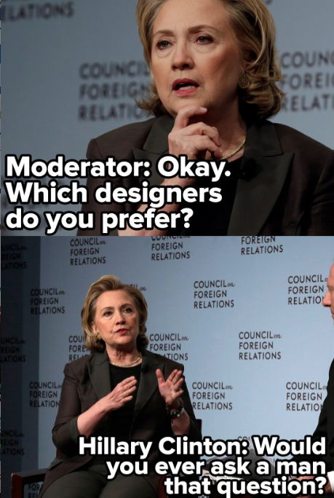
Gender ‘roles’
Source: http://www.osce.org/odihr/224171
Femininity | Masculinity
Weakness/ gentleness submission compliance/vulnerability dependence disempowerment passive emotion consumption nurturer object indoors nature | strength dominance aggression independence empowerment active rational thought production breadwinner subject outdoors technology
Source: Pinterest
Notes:
From an early age, children are socialized and encouraged to perform specific gender roles and conform to gender roles. The repetition of gendered narratives and images in media has helped to shape these cultural norms around what it means to be a man or a woman, masculine or feminine.
Media creates meanings about about gender, and plays an important role in the way we understand it as part of our identity, our history, our social institutions, and our everyday lives. Gender is a word we hear in everyday conversation. It is commonly used to describe an individual’s identity as male or female. However, the term “gender” is actually more complicated, and needs to be distinguished from one’s sex (male, female).
Sex is a system of classification based on a combination of biological and physiological factors (genitalia, chromosomes, hormones, internal reproductive organs). Biology is not always distinctly male or female, as there are some who are born as "intersex," with some variations in chromosomes or sexual organs.
Gender refers to the cultural meaning that is ascribed to a person's sex. We can think of gender as a social construct, an idea, or ideology, a way of seeing. It is not set in nature like biology. Because gender is a lens or social construct, it means different things in different parts of the world and at different times in history.
The important thing to remember is that masculinity and femininity are not only oppositional; They are also hierarchical. The values tied to masculinity, by and large, have been seen as superior to those associated with femininity. This does not mean that men are superior to women; rather it suggests that the characteristics associated with masculinity are culturally valued above those associated with femininity. In our culture, we tend to value strength over weakness. We value being rational over emotional. We value independence over dependence.
Given that masculinity and femininity are embedded with cultural values and meanings, it’s important for us to think about how those meanings circulate in our everyday lives and the media. We need to consider the way our thoughts, values, and media representations are gendered—the way in which femininity and masculinity shape
who we are
how we are perceived
how we see the world and interact with it
**Assumptions about what is right or appropriate for girls and boys has an influence well beyond whether their room is painted pink or blue. Gendered assumptions often lead to very different codes of conduct.
Girls play quietly and gently, and it's ok for them to cry. By contrast, boys “rough house” and should always be tough, never showing emotion.
When boys and girls don’t adhere to these “rules” or assumptions, they may be criticized or ostracized. Children are therefore often socialized or encouraged to perform specific gender roles and conform to gendered norms.
These norms are circulating all around us. We see them acted out by our peers, family members, and role models. We see them in school, at work, in politics, and in the media.
**important questions to consider
How are masculinity and femininity represented in the media?
What specific images and words contribute to our understanding of what masculinity and femininity mean?
Does the media make assumptions about what men/boys like and how they (should) behave? Are there similar assumptions made about women/girls?
What impact do such media representations have on real-life opportunities and possibilities offered men and women in their personal and professional lives?
Top 5 barriers for women and men when entering politics:
Men: lack of electoral support, lack of finance, lack of support of political parties, lack of experience in politics, lack of confidence
Women: Domestic duties,, cultural attitudes, lack of family support, lack of confidence, lack of finances.
On top of this, women can face multiple forms of discrimination due to personal characteristics or status: Age, national origin, religion or belief, language, social status, disability, gender identity and sexual orientation, health condition.
Barriers to equal participation of women in elections:
Inability to vote in secrecy (family voting, proxy voting, pressure), violence, intimidation, threats and harassment, lower salaries for women, limited access to social networks, expensive campaigning costs.

Slide 10
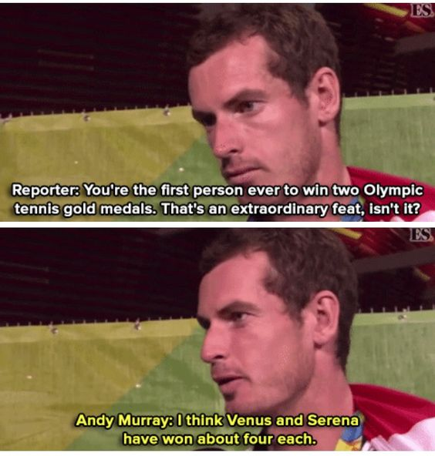
‘Throwing like a girl’
Young (1980)
“We often experience our bodies as a fragile encumbrance, rather than the media for the enactment of our aims. We feel as though we must have our attention directed upon our bodies to make sure they are doing what we wish them to do, rather than paying attention to what we want to do through our bodies” (p.146-7).
“I can’t lift that, I’m not strong enough”
“I won’t be able to get the ball in the net”
“I might get hurt”
“What if I look stupid doing that?”
“Typically, the feminine body underuses its real capacity, both as the potentiality of its physical size and strength and as the real skills and coordination that are available to it” (p.148).
“To the extent that a woman lives her body as a thing, she remains rooted in immanence, is inhibited, and retains a distance from her body as transcending movement and from engagement in the world’s possibilities” (p. 150).
Notes:
looks at differences in feminine and masculine movement norms in the context of a gendered and embodied phenomenological perspective. It examines how perceptions of the body relate to task performance and confidence.
Her point is not that there are no physical or muscular differences between the sexes, but rather that women have a different mindset when it comes to performing tasks. They do not see themselves as capable, do not “summon the full possibilities of our muscular coordination, position, poise, and bearing”, do not put their whole bodies into it with the ease that men do.^{[3]} So, when someone says that they throw like a girl, climb like a girl, hit like a girl, etc. it is not a compliment. It means that the person is not putting their whole body into it, that it is falling short. Young says that women tend to wait for and react to things, rather than meeting them. They lack confidence; they hesitate; they think of their bodies as fragile. This keeps them distracted from paying attention to what they want to accomplish. This extends beyond sports to other realms of life as well.
She says the cause is often from lack of practice. Women become used to thinking “I can’t” rather than “I can” and approach tasks this way. Thus, “Feminine bodily existence is an inhibited intentionality.^{[4]} By contrast, an uninhibited intentionality “projects the aim to be accomplished and connects the body’s motion toward that end in an unbroken directedness which organizes and unifies the body’s activity”.^{[5]}
Young’s point is that having an uninhibited intentionality makes a difference in how people think of themselves. For example, if someone sees a goal and put their whole body into reaching it, rather than shying away from full exertion, it will make a difference in whether or not the outcome is successful.
This means, though, that the body cannot exist as an object. But women often think of themselves as the objects of motion instead of subjects making the motion happen. They are uncertain of their body’s capabilities and feel like their bodies are not completely under their control (perhaps due to factors such as puberty or pregnancy). Her closing point is that “Women in sexist society are physically handicapped” which means that they are “physically inhibited, confined, positioned, and objectified.^{[6]}
Girls are not encouraged to use their bodies as freely as boys are, and this socialization follows them throughout life. They learn how to actively hamper their movements and act like little ladies and then see themselves as fragile. Even those who want to be bold and move their bodies openly face multiple threats—including being objectified, touched, or raped—and these threats serve to police women’s bodies and keep them confined, physically and mentally. She ends with the speculation that “the general lack of confidence that we frequently have about our cognitive or leadership abilities, is traceable in part to an original doubt in our body’s capacity”.^{[7]}
But it’s not just lack of physical training that leads to women under-utilising their bodies, according to Young. She argues that it is also manifested in the way women sit and take up space. This is easy to observe in daily life. Check out the different ways men and women use their bodies. Public transport is a good place to do this. Men take up more space when sitting, they generally take longer strides when walking. Women tend to sit cross-legged and hold their hands and arms close to their bodies.
Young attributes these differing modes of movement and use of space to a number of factors. She argues that women are conditioned by sexist society to limit their bodily capacity. For example, she says that girls play games that are largely sedentary and enclosing, and that they aren’t encouraged to develop bodily skills in the same way boys are.

Slide 11
Radio 4 debate (2014)
Former Thatcher chancellor Nigel Lawson went head-to-head with Met’ Office Chief Scientist Professor Julia Slingo – destroying her scientific assessments that the recent extreme weather conditions were almost certainly the result of climate change with the devastating scientific argument that she is just : “this Julia Slingo woman“ (Pride 2014)
https://tompride.wordpress.com/2014/02/15/climate-change-denier-lord-lawson-is-an-expert-he-once-wrote-a-book-about-dieting/
Notes:
Sex is a label — male or female — that you’re assigned by a doctor at birth based on the genitals you’re born with and the chromosomes you have. It goes on your birth certificate.
Gender is much more complex: It’s a social and legal status, and set of expectations from society, about behaviors, characteristics, and thoughts. Each culture has standards about the way that people should behave based on their gender. This is also generally male or female. But instead of being about body parts, it’s more about how you’re expected to act, because of your sex.
Gender identity is how you feel inside and how you express your gender through clothing, behavior, and personal appearance. It’s a feeling that begins very early in life.
historically and cross-culturally women have been regarded as subordinate to men –
perceived as less intelligent, strong, competent, competitive and so on (cf. Longhurst
1995; Rose 1993). The representation of women as weak, in need of protection and caring is a benevolent form of prejudice, often lacking the blatant aggression of common forms of racism and homophobia (Valentine 2010). Although, the emergence of the women’s rights movements in western countries over the last century led to the gradual (albeit uneven) development of gender equality legislation in these societies, nonetheless sexism as a form of prejudice persists
prejudice persists.
In the 1980s and 1990s, feminist geography identified occupational segregation by
gender (albeit that this process is not stable or consistent), observing the way both
essentialist (e.g. about gendered bodily competencies) and moral explanations (about how
men and women ‘ought’ to behave) were used to justify these patterns (e.g. McDowell
1997; Halford and Savage 1998). In this sense, as Morgan (2002, 71) argues, ‘gender is a
social practice that constantly refers to bodies and what bodies do’.

Slide 12
Gender and the everyday
Change.org
Petitioning Asda, Sainsbury, Tesco, Mothercare, Debenhams, Marks & Spencer, Matalan, M&Co, Morrisons, Next, UK Childrenswear Retailers
Time to let clothes be clothes: Stop selling children's clothes as "for girls" or "for boys."
#letclothesbeclothes
Childrenswear should be:
Comfortable
Sold in a choice of size and fit
Age appropriate
Safe and promote healthy body image
Designed in a variety of fun, imaginative themes and colours
Sold without active gender policing
Free from slogans and messages that reinforce gender stereotypes
Notes:
https://www.change.org/p/uk-childrenswear-retailers-time-to-let-clothes-be-clothes-stop-selling-children-s-clothes-as-for-girls-or-for-boys

Slide 13
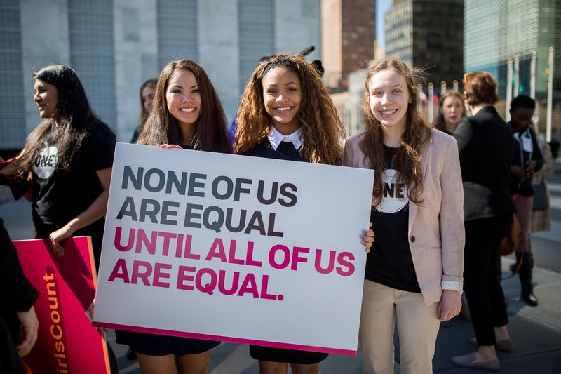
‘Anti-Women’ Laws around the world
Involving:
Kidnap
Restrictions on driving
Family inheritance
Punishments
Testimony in court
Marital rights
The right to work
Violence
Restrictions on physical labour
Restrictions on citizenship
https://www.one.org/us/2017/03/30/these-10-anti-women-laws-will-shock-you/?gclid=Cj0KCQjwqvvLBRDIARIsAMYuvBHCCM2ij3yhXLW1BvdxQi1CFdbRAf_WyeG2xwfTdFJZz7MmYmzgi3oaAiq9EALw_wcB
Source: Tillman 2017
Notes:
https://www.one.org/us/2017/03/30/these-10-anti-women-laws-will-shock-you/?gclid=Cj0KCQjwqvvLBRDIARIsAMYuvBHCCM2ij3yhXLW1BvdxQi1CFdbRAf_WyeG2xwfTdFJZz7MmYmzgi3oaAiq9EALw_wcB
Rachel Tillman 330th march 2017 “These 10 anti-women laws will shock you”
1. Women can be kidnapped
In Malta, if a man who abducts a woman intends to marry her, his sentence is automatically reduced. If the man marries his victim after the abduction, he is subsequently exempt from any and all prosecution and punishment. A similar law is in place in Lebanon, where a man who commits a rape or kidnapping cannot be prosecuted if he marries the victim after the crime.
2. Women are forbidden to drive
In countries such as Saudi Arabia, it is illegal for women to receive driver’s licenses. In 1990, a fatwa on Women’s Driving Automobiles was declared, for fear that men and women would use cars for secret rendezvous and would tempt both parties into committing lewd behavior.
3. Women inherit less than their brothers
Different versions of this law exist in various countries. In Tunisia, for example, women only inherit half of what their brothers do.
4. Men receive less punishment for “honor killings”
This law has come under intense fire in many different countries. In Egypt, a man who kills his wife upon discovering her in an act of adultery is automatically given a lesser sentence than for other forms of murder. In Syria, a man who murders his mother, sister, or wife due to catching them in an “illegitimate sexual act” can receive no more than seven years in prison. Until 2009, there were no legal ramifications for this crime in Syria.
5. A woman’s testimony counts for half of that of a man’s
In Iran, a woman’s testimony in court is less valuable than that of a man in cases such as adultery. In most of these cases, there must be testimony from at least double the number of women as there are men. In cases where the punishment may be severe, a minimum of two men and four women must testify.
6. Husbands have more rights than their wives
In Israel, divorce depends solely on the will of the husband. Half a world away in Mali, a 2011 law upheld the man’s status as head of the household and mandates a wife’s obedience to him. It also declared that women must wait three months to get remarried after a divorce or death; men have no such restriction.
7. Men can choose where women work
In countries such as Cameroon and Guinea, men have more of a say in where their wives will work than the women themselves. For example, in Cameroon, a husband may prohibit his wife from taking a job in a different trade or profession than him if it is in the best interest of his marriage and children. Cameroon is one of 18 countries where women cannot get a job if their husbands feel it is not in their family’s interest.
8. Women can be beaten
Laws such as this are not uncommon—in fact, 46 countries have no laws protecting women from domestic violence.
9. Women cannot perform physical labor
In China, women are forbidden from working in mines, and more broadly are prohibited from performing physical labor or work that female workers “should avoid.” In Russia, a similar law stops women from partaking in hard, dangerous, or unhealthy trades. This sweeping law includes many different types of jobs, from frontline firefighting to sailing—456 types of work in total!
10. Women cannot pass on citizenship in the same way as men
Even in the United States, men and women are viewed differently under the law. A child born out of wedlock to a foreign mother and American father has a grueling process to becoming an American citizen, and there are more requirements to meet if the mother is not a US citizen and the father is. At least 22 countries do not allow married women to pass citizenship to their children as fathers can and 44 countries do not allow married women to pass citizenship to their spouses as married men can.

Slide 14
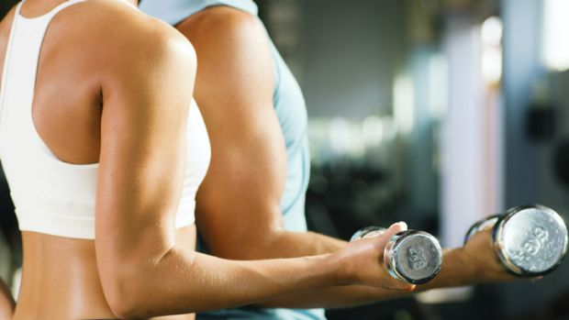
The prevalence of everyday sexism: Leisure spaces
Based on assumptions about sex/ gender and what bodies can/ should do:
(Valentine et al 2014)
. . . on this side [describing the layout of the gym] it’s got a lot of weight machines and dumbbells . . . sometimes when I’ve been in there I’ve felt quite like I shouldn’t be in there because I’m a woman and all the men are there, really pumping iron. So you sometimes get a few looks if you’re a woman going in there.
Interviewer: What kind of looks?
Just like . . . why are you in here? Or what are you doing? Or things like that. Sometimes I do get that feeling in there . . . I have gone in there sometimes because I want to use this machine. But you’ll go in and there’ll just be no women there, it’s just men. So I get the feeling that most women don’t like going in there . . . . (White British female, 20–24)
It’s classes . . . that is a woman’s thing to do I don’t know why the classes are a girls’ thing. I don’t really mind, I went on numerous occasions [to aerobics class] . . . I think, even in my generation, I know loads of my male friends wouldn’t go to a class. (White British male, 18–24)
Notes:
However, men who were interviewed in our research did not consider the gendered nature of the gym a problem, usually describing it in essentialised terms as ‘natural’: a product of choice because of the perceived different interests, and preferences of the sexes. In contrast, women interviewees described how their freedom to use the space of the gym was constrained by the behaviour of male gym members. In particular, women of all ages recounted being subject to the normalising judgement of the male gaze within the context of heteronormativity which has the disciplinary effect (after Foucault 1977) of causing them to self-regulate their bodies and use of space (cf. Bartky 1990; Johnston 1996).
As Young (1990) has argued in her seminal essay, Throwing Like a Girl, the patriarchal
gaze systematically positions feminine bodies as objects and in response women come to live their bodies in such terms.

Slide 15
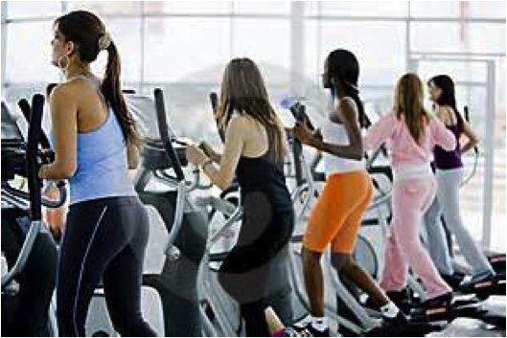
The prevalence of everyday sexism: Leisure spaces
. . . the thing I really find threatening and actually frankly annoying is in the swimming pool, there are two Jacuzzis at the side which I never go in . . . It is really obvious that men go in there just to sit and ogle the women. (White British female, 60–64)
. . . when you’re in the classes there’s a water fountain outside which is next to the weights bit so there’s quite a lot of guys come out and just stand there watching the girls queue up for the classes. (White British female, 18–24)
They [referring to other men] usually they watch from the mirror.
Interviewer: From the mirrors?
Okay. So, you can stand in front of the mirrors and then you can see the women behind you? Because the place [the weights area with mirrors] is near some machines, like bicycle machine or running machine. Usually girls are going [on the exercise bikes and running machines] there and they’re just watching girls. (White British male, 25–29)
Notes:
When challenged about women’s rationale for why there is gender segregation within the gym, male interviewees failed to recognise a problem arguing it is ‘normal’ – thereby implicitly invoking the taken for granted hegemony of heterosexuality (Valentine 1993) – for men to look at women in this way. Yet, as Cooper (2004, 96) has observed, historically inequality is secured through particular forms of differentiation and segregation being read as ‘natural’ or ‘normal’. In particular, we develop habitual or socially sedimented ways of seeing which mean some dimensions of difference become salient and others less visible or invisible (Al-Saji 2009). In this way, sexism is lived as habit and enacted as embodied everyday practices and through this repetition this particular ordering of difference becomes the norm with the consequence that patriarchy as a power structure which operates in and through particular spaces to systematically (re)produce gender inequalities is obscured. In the following section, we reflect in more detail on the visibility of contemporary sexism.

Slide 16
The prevalence of everyday sexism: The workplace
Valentine et al (2014)
Fire and rescue service
She’s rubbish [referring to a female colleague]. I’m not being funny. Great person, lovely. Do anything for you. You’re not knocking them as people. But they’re really not suited to this job, this line of work . . . If you say at the end of the day if you were in a house fire with that person and something goes wrong and they’ve got to drag you out, would they be able to do it, right? There’s a lot of people that you would say no, they wouldn’t have the ability. They wouldn’t have the strength. Maybe they would because the adrenaline is coursing through their veins and stuff like that. But . . . you wouldn’t want them watching your back if you get me. It’s no detriment to them because it’s just the way things are, isn’t it? It’s just nature. Sometimes a female can’t physically do a certain physically demanding task. (White British male, 35–39)
They’ve lowered standard anyway to get females into the job. So they’ve made the standard easier anyway . . . that’s okay if there’s one person on a watch I suppose because you can make compensations, you’re like okay she’s never carrying the ladder or whatever, but if there were two or three . . . . (White British male, 30–34)
Notes:
Our case study research with the Fire and Rescue Service found that traditional
stereotypes about men and women’s bodily capacities persist. Firefighting is a traditional class-based occupation associated with a hard, physical and heroic masculinity that has allowed firefighters to distance themselves from women and other men employed in ‘feminized’ office employment (Hall, Hockey, and Robinson 2007). In this context, teamwork is highly valued, producing a culture predicated on male sociability. The gradual entry of women into this occupation has led to a focus on embodiment and specifically the gendered nature of ‘natural’ capabilities. Some of the male firefighters interviewed reproduced traditional discourses about women’s unsuitability for this physically demanding work drawing on what they considered ‘common-sense’ arguments about embodied differences between men and women which fail to acknowledge the complexity of bodily realities. In particular, a common claim was made that the physical entry standard to the Fire and Rescue Service has been reduced to accommodate women.
This, it was claimed, is leading to consequent erosion of the skills and professionalism of the occupation, and placing a greater burden of responsibility on male firefighters to cover for the physical inadequacies of female colleagues.
As you can see from the quotes- there is an insistence on bodily differences which is used to justify attitudinal judgements- think also of the military and women’s ability ot serve in frontline combat positions- the fear of women getting hurt because they are weaker than the other soldiers.
introduction of the Equality Act (2010) to level up and extend this protection. This legislation requires people to be treated equally in most aspects of public life, regardless of the protected characteristics of age, disability, gender, gender reassignment, marriage and civil
partnership, race, religion or belief, sex and sexual orientation. Such equality legislation –
popularly described as political correctness – is perceived to be redefining spatial
normativities about how people should talk and behave in public environments, such as the
workplace, de-legitimising certain language, practices and uses of space = male firefights know how they OUGHT to behave even if they don’t believe in such normativities and therefore contemporary sexism is manifest in more subtle ways
What these examples show is that sexism is INGRAINED IN CULTURAL NORMATIVITIES- the idea of mens jobs and womens jobs which we can see in a number of specific examples………………………..
By normalising these assumptions and using them in everyday society it encourages underlying, sexist discourses to prevail – i.e there will be a continuation of ‘girls clothes’ and ‘boys clothes’ toys etc- it becomes ‘common knowledge’ and assumed behaviour
What is dangerous is when such assumptions regarding gender ideology, ‘normal’ behaviour etc are written into political legacies………

Slide 17
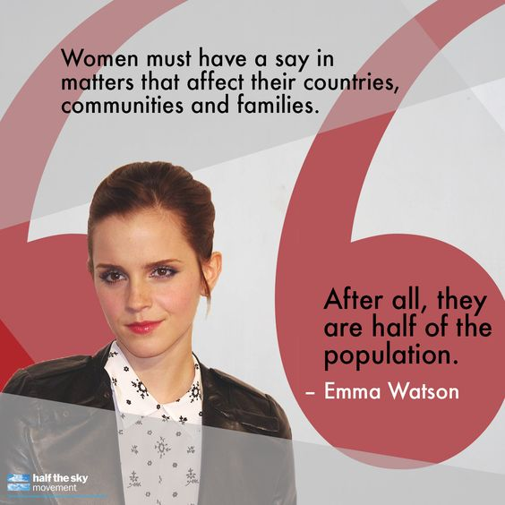
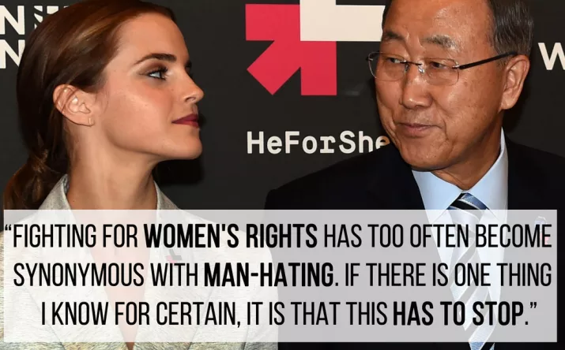
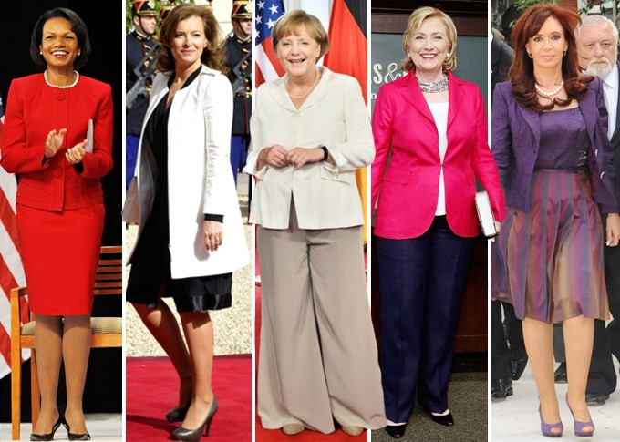
Gender roles: A modern day story
Hilary Clinton: On the role of sexism “It is real. It is very much a part of the landscape politically, socially and economically."
Emma Watson
Theresa May : girl jobs and boy jobs?
Nicola Sturgeon: Nicola Sturgeon criticises Daily Mail over 'Legs-it' front page. First minister says newspaper is ‘leading the way’ in taking Britain back to the 1970s after its coverage of her meeting with prime minister Theresa May (headline ‘headline “Never mind Brexit, who won Legs-it!” March 2017)
What do they have in common?
Top 73 most powerful people in the world- how many are women?
Article: ‘how to dress women in politics’ Maizini.com
Notes:
Judgements about female politicians looks over their political policies (Nichola sturgeon and Theresa may headline)
On Clinton’s campaign
The reaction to her candidacy, however, has been unconventional. The percentage of Americans who hold a “strongly unfavorable” view of her substantially exceeds the percentage for any other Democratic nominee since 1980,
According to the Public Religion Research Institute, 52 percent of white men hold a “very unfavorable” view of Clinton.
At the Republican National Convention, this fervent hostility was hard to miss. Inside the hall, delegates repeatedly broke into chants of “Lock her up.” Outside the hall, vendors sold campaign paraphernalia. As I walked around, I recorded the merchandise on display. Here’s a sampling:
Black pin reading don’t be a pussy. vote for trump in 2016.
Black-and-red pin reading trump 2016: finally someone with balls.
White T-shirt reading trump that bitch.
White T‑shirt reading hillary sucks but not like monica.
Red pin reading life’s a bitch: don’t vote for one.
White pin depicting a boy urinating on the word Hillary.
Black T-shirt depicting Trump as a biker and Clinton falling off the motorcycle’s back alongside the words if you can read this, the bitch fell off.
Black T-shirt depicting Trump as a boxer having just knocked Clinton to the floor of the ring, where she lies faceup in a clingy tank top.
White pin advertising kfc hillary special. 2 fat thighs. 2 small breasts … left wing.
Never in my lifetime has there been more misogyny on display than during the 2016 election. It was disgusting. The biggest offender: Donald Trump. The flat-out derisive language and more subtle "messaging" were so prevalent that we began to accept it.
From attacking Carly Fiorina's appearance ("Look at that face. Would anyone vote for that?") to questioning the integrity of Fox host Megyn Kelly when she asked him in a debate about his long list of sexist comments ("She had blood coming out of her wherever," he later said), it was an endless barrage against women.
Of course, using sexism is also the laziest way to demean a woman. If you can't debate her ideas, just slam her appearance, her personality, her relationships and her likeability. Trump crossed the line all the time. Flustered during the debate because he couldn't out debate Clinton on policy, he just leaned into the mic and dismissed her entirely: "nasty woman.“
at a 2016 PRRI/Atlantic poll found that 40% of respondents believe that America would be better off if women would "stick to the jobs and tasks they are naturally suited for" and that number is even higher among Trump supporters. This poll is not an outlier.
social psychologists call “precarious manhood” theory. The theory posits that while womanhood is typically viewed as natural and permanent, manhood must be “earned and maintained.”
**Among the emasculations men most fear is subordination to women. (Some women who prize traditional gender roles find male subordination threatening too.) This fear isn’t wholly irrational. A 2011 study in the Journal of Experimental Social Psychology found that men who have female supervisors earn less, and enjoy less prestige, than men whose bosses are male.
Given the anxieties that powerful women provoke, it’s not surprising that both men and women judge them more harshly than they judge powerful men.
****In a study of several hundred people, Jennifer Berdahl of the University of British Columbia found that women who “deviated from traditional gender roles—by occupying a ‘man’s’ job or having a ‘masculine’ personality” were disproportionately targeted for sexual harassment.
To be sure, some women leaders—Margaret Thatcher, Angela Merkel, Indira Gandhi—have thrived despite sexist opposition. Still, research suggests that women leaders are less likely than their male counterparts to be accepted as legitimate, a problem that plagued both Australian Prime Minister Julia Gillard, who was ousted in 2013 after only three years, and Brazilian President Dilma Rousseff, who was impeached earlier this year for corruption even though her male predecessors and some of her key male tormentors had likely done worse.
Because women in positions of power are seen as less legitimate than men in comparable positions, a study led by Yale’s Andrea Vial warns, their mind-set can come to resemble that of “illegitimate authorities.” A “self-reinforcing cycle” develops: In the face of disrespect, a woman’s leadership style can become overly tentative or aggressive. People in turn attack her, and she responds with more self-defeating defensiveness. In their 2007 biography of Clinton, the former New York Times reporters Jeff Gerth and Don Van Natta Jr. write:
Buzzfeed: if men in politics were described like women in politics
"Can you savor being a grandfather and be president?"
"His nagging voice is the reason he lost male vote. When she speaks, men hear, 'Take off for the future.' And when he speaks, men hear, 'Take out the garbage.'"
"How do you relate to him and his struggles as a father?"
"He gave a really aggressive, feisty interview."
"There was a bulge on display Wednesday afternoon on C-SPAN2. It belonged to President Barack Obama."
"He was asked whether he could serve as governor and still raise his kids the way he wants to. Pressed further on whether he could simultaneously hold both jobs — governor and dad — he said, 'I can be the attorney general and do that. There are plenty of men who juggle.'"
"What's his likeability aspect? He comes off as not a very likable person."
"I think he's hot. He's tiny, he's short. He's got a banging little body on him. Facial-wise, I give him about a seven. Body-wise, I give him about an eight-and-a-half. Tight little butt. I endorse him for State Treasurer."
"When he reacts the way he reacts with just the look, the look toward her, looking like everyone's first husband standing outside a probate court. When he looks at her that way, it's all I could think of."
"He is really attractive, and he sounds nice. But I don't care if he's as good looking as Ryan Gosling or as nice as Mr. Rogers."
"That was my first close encounter with Sen. Chuck Schumer, and with The Cackle. At that moment, the laugh seemed like the equivalent of an eye-roll — he felt he was being nit-picked, so he shamed his inquisitors by chuckling at them (or their queries)."
"He's hot, he's blue collar, he's electable."
"When he comes on television, I involuntarily cross my legs."
"He isn't afraid to let his fury fly."
"The defining issue that will decide this race between two men is mud wrestling. So far, these guys have displayed such lack of class we're beginning to think, Strip down and get 'er on, dudes."
"Living room. Gentleman on a settee. Where's the needlepoint?"
"In person, he cuts an indefatigable and glamourous figure. He eschews a Church Man mien for something more The Bachelor: fit, attractive, and encased in suits that stop just below the wrist and just above the ankle."
"Take him out of the House and put him back in the kitchen.“
Article on ‘how to dress women in politics’

Slide 18
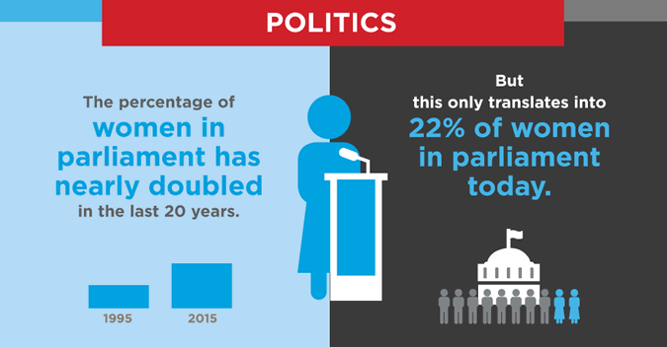
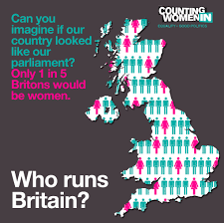
WOMEN’S REPRESENTATION IN PARLIAMENT STALLS AT 32% AFTER GENERAL ELECTION 2017 (the Fawcett society 2017)
Source: The Fawcett Society (2017)
Notes:
WOMEN’S REPRESENTATION IN PARLIAMENT STALLS AT 32% AFTER GENERAL ELECTION 2017
https://www.fawcettsociety.org.uk/news/womens-representation-parliament-stalls-general-election-2017
- 207 women MPs returned to Parliament, 11 more than before the election
- Labour have 31 more women MPs and Conservatives lose three
The June 2017 general election has seen women’s representation in Parliament break the 200 barrier for the first time, with 207 women winning seats. However, this represents only a 2 percentage point increase. If the UK only improves by this much at each election, we will not see equal representation in Parliament until 2062.
Women are under-represented in positions of power and politics.
Only 1 in 4 non-executive directors and just 1 in 10 executive directors of FTSE 100 companies are women. In politics, the lack of women in Westminster is increasingly reported yet the dearth of women in local government is very often forgotten.
WHY DOES IT MATTER?
Ongoing cuts to local government spending are having a hugely disproportionate impact on women, undermining access to key services such as childcare, social care and special services such as protection from domestic violence. A lack of female voices around local decision-making tables will only exacerbate this situation.
challenges facing women who run for office. “Political parties are male dominated. When there isn’t a specific measure in place, women fall off the ground. Men tend to choose those who are made in their own image.”
She noted that some women also experience pushback from men, including physical violence, taunting and bullying; while the media sometimes focuses too much on women’s physical attributes rather than their experiences and political platforms.
“In 2016, we saw confirmation of a trend we had been seeing, when it comes to representation of women in parliament, there is progress but the progress is excruciatingly slow. At this rate, it will take 50 years to reach 50-50 parity,” Mr. Chungong told the press. “This is a warning signal; we have to do something about this.”
http://magdalene.co/news-507--low-representation-of-women-in-politics-hampers-development.html
Aqila Putri (2015) ‘Low Representation of Women in Politics Hampers Development
A paper published by Social Science Research Council (SRRC) says that there is a “strong resistance to women’s participation in public life.” The report says cultural, customary, and religious practices are used to show that women’s place is not in the politics. Violence against women who are politically active by speaking up in public, running for office, or defending human rights, is also a big obstacle, especially in conflict-prone countries.
Barriers to women in politics in the UK
- In Britain, however, research overwhelmingly demonstrates that the central issue is one of demand rather than supply – in other words, women aren't the problem, parties are. Several studies have found evidence of well-entrenched gender bias in British party politics, including widespread incidences of direct and indirect discrimination by party selectors towards women candidates, ranging from gendered assumptions regarding women's traditional roles to explicit sexual harassment (see for example Lovenduski 2005). This is not to suggest that supply-side factors aren't still important in explaining women's political under-representation, but rather to highlight, first, that party demand shapes supply. While there are no standard or universally recognised qualifications to be selected as a candidate, formal and informal requirements such as party service, resources, and experience influence who decides to run for office and shape the supply of candidates along gendered lines (which may also result in women ‘self-selecting’ themselves out of the process due to anticipated failure or perceived discrimination). And, second, even if there are gender imbalances in the eligibility pool for public office, there are generally sufficient numbers of women candidates to be selected for winnable seats if parties chose to do so. Indeed, when parties are required to select women – through measures such as gender quotas – they usually manage to find that they had women who'd been willing to stand all along. Both Wales and Scotland, for example, managed to find women to stand for election to the new devolved institutions, achieving record levels of women's representation in 1999 and 2003. Problems of supply are, therefore, easier to overcome when party demand increases.

Slide 19
Gender roles and the correlation with politics
“With the overall gender pay gap still at 18%, violence against women and girls still rife in our society, and Brexit posing a risk to hard-fought protections, it is as important as ever that women have a say. We urge women across the country to take these demands to their candidates.” (Fawcett Society 2017)
The Commission on the Status of Women (CSW) is the principal global intergovernmental body exclusively dedicated to the promotion of gender equality and the empowerment of women. A functional commission of the Economic and Social Council (ECOSOC), it was established by Council resolution 11(II) of 21 June 1946.
The CSW is instrumental in promoting women’s rights, documenting the reality of women’s lives throughout the world, and shaping global standards on gender equality and the empowerment of women.
Notes:
‘MISSING EIGHT MILLION’ WOMEN SAY THEY ARE UNCERTAIN TO VOTE AS FAWCETT RELEASES WOMEN’S MANIFESTO
https://www.fawcettsociety.org.uk/news/missing-eight-million-women-uncertain-vote-womens-manifesto
New Fawcett Society analysis of recent polling data finds that a ‘missing eight million’ women say that they aren’t necessarily going to vote in the 2017 general election. An average of recent polling shows that 2.5% points fewer women than men say they are certain to vote. When applied to 2015 turnout levels this could see 8 million women not exercising their rights, half a million more than the 7.5 million men who are not certain they’ll vote.
During the Commission’s annual two-week session, representatives of UN Member States, civil society organizations and UN entities gather at UN headquarters in New York. They discuss progress and gaps in the implementation of the 1995 Beijing Declaration and Platform for Action, the key global policy document on gender equality, and the 23rd special session of the General Assembly held in 2000 (Beijing+5), as well as emerging issues that affect gender equality and the empowerment of women. Member States agree on further actions to accelerate progress and promote women’s enjoyment of their rights in political, economic and social fields. The outcomes and recommendations of each session are forwarded to ECOSOC for follow-up.
UN Women supports all aspects of the Commission’s work. The Entity also facilitates the participation of civil society representatives.
2017: Priority theme: Women’s economic empowerment in the changing world of work. Review theme: Challenges and achievements in the implementation of the Millennium Development Goals for women and girls, from the 58th session of the CSW.
2018: Priority theme: Challenges and opportunities in achieving gender equality and the empowerment of rural women and girls. Review theme: Participation in and access of women to the media, and information and communications technologies and their impact on and use as an instrument for the advancement and empowerment of women, from the 47th session of the CSW.
2019: Priority theme: Social protection systems, access to public services and sustainable infrastructure for gender equality and the empowerment of women and girls. Review theme: Women’s empowerment and the link to sustainable development, from the 60th session of the CSW.

Slide 20
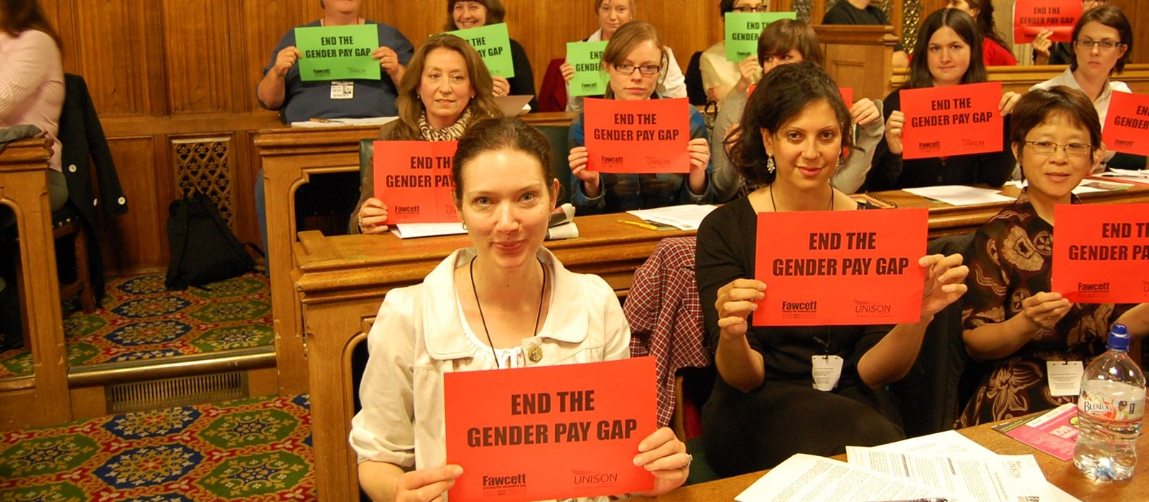
The gender pay gap
Research by Cross (2017)
Women on average are paid 77 cents for every one dollar earned by a man (UN 2017).
In 2016 Equal Pay Day is 10th November. This marks the day after which women are effectively working for free as a result of earning less on average than men. The current overall gap for full time workers is 13.9% (Fawcett Society 2016)
Notes:
At the current rate of progress it will take over 60 years to close the gender pay gap [1]. With low pay impacting on the lives of millions of women now and with mounting evidence of the impact gender inequality has on our economy, it’s clear we simply can’t afford to wait that long.
The jobs women do are more likely to be low paid, they are less likely to receive bonuses or to progress to the most senior and highest paid roles. Women still face discrimination in the workplace with 54,000 women having to leave their jobs early every year after having a baby or becoming pregnant. Furthermore, the under-valuing of caring roles means those not in paid employment but working looking after loved ones often do not have sufficient support and recognition and are often excluded from opportunities to move into paid work.
There are four big causes of the gender pay gap:
Discrimination: It’s illegal, but some women are still paid less than men for the same work. Discrimination, particularly around pregnancy and maternity leave, remains common, with 54,000 women forced to leave their job every year after becoming a mother.
Unequal caring responsibilities: Women play a greater role in caring for children, as well as for sick or elderly relatives. As a result more women work part time, and these jobs are typically lower paid with fewer progression opportunities.
A divided labour market: Women are still more likely to be in low paid and low skilled jobs, affecting labour market segregation. 80% of those working in the low paid care and leisure sector are women, while only 10% of those in the better paid skilled trades are women.
Men in the most senior roles: Men make up the majority of those in the highest paid and most senior roles – for example, there are just seven female Chief Executives in the FTSE 100.
BBC Case study
The BBC has published the salaries of its staff earning above £150,000 a year, exposing a major gender imbalance.
Chris Evans tops the list at over £2 million. The highest paid woman at the BBC, Claudia Winkleman, earns just 20% of his salary.
Of the top twenty earners, only five are women - and there are no Black, Asian or Minority Ethnic (BAME) stars featured in the list of 24 staff earning over £300,000.
Higher Education case study
The Times Higher Education Pay Survey 2017 published today, revealing that the gender pay gap for full-time university staff in the UK is closing at a slow pace for all academics, and has stagnated for professors.
Sam Smethers, Fawcett Society Chief Executive, says:
“The gender pay gap among academics is slowly diminishing. But at this rate it will take 29 years to close the gap, and progress has flatlined for professors.
According to new Gender Pay Gap reporting rules, which came into force last month, universities will be required to publish their gender pay gap data by April 2018.

Slide 21
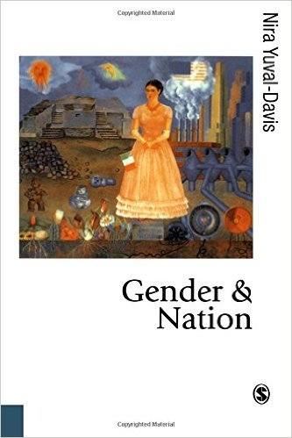
The body and the nation
Connecting intimate, everyday lives to broader discourses of ‘the nation’
Nira Yuval Davis (1995)
Women as ‘reproducers of the nation’
Particular expectations regarding what we ‘should’ do with our bodies……….
McDowell (1993: 306) refers to work by Rich (1986) which suggests that being a woman challenges conventional ideas of boundaries, especially the assumed boundary between the body and the object world, between self and other. McDowell (1993: 306) explains that: Women's experiences of, for example, menstruation, childbirth and lactation, all represent challenges to bodily boundaries. The feminine construction of self is an existence centred within a complex relational nexus, compared to the masculine construction of self as separate, distinct and unconnected (In, Longhurst 1997a, p. 494).
Notes:
Bodies are social entities inscribed with notions of normality, control and discipline (Parr 2001; 160). One way to control and discipline bodies is to inscribe categorical identities to them (Calhoun 2003; 548). Such identities could entail eg nation, gender, class, race, clan, but also asylum seeker and its ‘sub-categories’ are ways of disciplining bodies. These notions invoke ideas of sharp lines and clear boundaries and clear compositions, and they work in order to control the chaotic flows of migrants.
Bodies, located at the line that is seen to separate inside from outside, are sites of political struggles.

Slide 22
Reflections in contemporary media
The Handmaid’s Tale: is the handmaid’s tale closer than we think?’ (Clarke 2017)
Speaking with The Guardian, Atwood explained that
when The Handmaid’s Tale was published, many began to wonder how long they had until the events described by her main character, Offred, would come to pass. “Apparently, not as long as I thought,” she said, adding: “The Handmaid’s Tale [is] unfolding in front of your very eyes. “With any cultural change there is a push and a pushback. Trump has brought out a huge pushback that was originally against immigrants. “Now it has shifted to being very misogynistic, partly because of Hillary Clinton. You have not seen anything like this since the 17th-century witch hunts, quite frankly.”
(Dray 2017)
Notes:
http://www.huffingtonpost.co.uk/charlotte-clarke/reproductive-rights_b_17450404.html
Based on Margaret Atwood’s 1985 novel of the same name, the show (in which Elisabeth Moss plays titular ‘handmaid’, Offred) takes place in Gilead, a near-future version of North America in which the Constitution has been overthrown. As a result of this, women’s rights and identities have been stripped away, with fertile women being rounded up, red tagged, and forced into a life of sexual servitude and surrogacy.
It paints a picture of a dark and thought-provoking dystopia – made even more so by President Donald Trump’s recent stance on abortion, women’s health, and feminism.
Atwood has pointed out time and time again, every aspect of Gilead’s culture has really happened at some point in history, somewhere in the world.
Speaking to The Guardian, the 77-year-old author explained: “When it first came out it was viewed as being far-fetched. However, when I wrote it I was making sure I wasn’t putting anything into it that humans had not already done somewhere at some time.”
Enforced surrogacy and adoption
In The Handmaid’s Tale, Offred and her fellow handmaids are forced to bear children for the families they are ‘owned’ by. Any healthy babies that are born are then raised by the wives of the men that the handmaids are systematically raped by.
It’s an abhorrent concept – but it’s worth remembering that similar practices occurred in multiple Western nations just a few decades ago, with the effects continuing to the present day.
- In Australia as recently as the seventies, indigenous children were lawfully stolen from their homes and placed in religious institutions or fostered out to white families.
And, of course, let’s not forget the Magdalene laundries in Ireland, which saw young girls punished for their “immorality” by being forced into slave-like conditions. The babies they bore were taken away from them and placed with adoptive families all over the world – with 2,000 alone being shipped across to the USA.
- FGM (female genital mutilation)
In The Handmaid’s Tale, we see women punished for their ‘immoral behaviour’ by having their bodies mutilated – and it is hinted, on numerous occasions, that the Aunts will also use FGM as a “corrective” punishment on anyone deemed an “un-woman”.
Tragically, the concept of female genital mutilation is not confined to the pages of Atwood’s book: 140 million women and young girls all over the world are believed to have undergone the procedure, which sees their outer labia, inner labia, and clitoris removed, often without anaesthesia or pain relief.
And it is estimated that some 23,000 girls living in the UK are at risk of FGM, too, despite the fact that the act was criminalised in the UK in 1985.
- 17th century American-Puritan theocracy
In Gilead, the government rules in the name of God (or a god), which is why they continuously reference the fact that they are “under His eye”.
Nowadays, of course, the United States of America is founded on the idea of democracy – with the public electing officials to make laws and government decisions on their behalf, and according to the rules of the Constitution. But this was not always the case.
Serena Joy (Yvonne Strahovski) is a major character in The Handmaid’s Tale – and, as those who have read the book will know, she played a major role in the shaping of Gilead’s regime.
That’s right: before the Republic was formed, Serena made headlines with her powerful lectures and essays on the subject of “a women's place”. She repeatedly argued that traditional gender roles should be upheld at all costs, that women should remain in the home, and that ‘wicked’ and ‘immoral’ females be punished for their ‘sins’. And, as we all know, her dreams of a misogynist future have come true – although she, like so many others of her gender, has been forced to pay for it with her freedom.
- While Serena is undeniably fictional, it is fair to speculate that she was inspired by the real-life Phyllis Schlafly, who was a similarly paradoxically public advocate for domestic women. She began her political career as an anti-feminist in 1964 when she published her first pro-family book, and led the charge against the Equal Rights Amendment, insisting that women should stop focusing on politics and instead tend to their families and work inside the home.
Kristalnacht
The women of The Handmaid’s Tale are not allowed to own property, run businesses, or hold jobs. It is a law which is implemented without warning: soldiers march into offices all over the country, the women are ordered to leave, and their bank accounts are frozen. It quickly becomes apparent that this isn’t just an act of discrimination: it’s a form of control, and it renders the women vulnerable to the new regime.
Again, this is very similar to how the Jews were treated in Nazi Germany.
The Romanian ban on birth control
In The Handmaid’s Tale, we quickly learn that fertility rates have plummeted – and, in an act of desperation, the government has rendered abortion and birth control illegal. Every fertile woman has a duty to bear children, and those who don’t… well, they’re either sent to work (and die) in the Colonies, or they’re hanged as an example to all other handmaids.
The idea of a birth control ban may be frightening, but it is not a new one: in 1966, President Ceausescu, in a desperate attempt to increase the population of Romania, banned birth control and abortion, and ordered Romanian women of child-bearing age to have five children each.
To enforce Decree 770, secret police were instated at hospitals, women were subjected to monthly tests by gynaecologists, sex education in schools was refocused on the benefits of motherhood, and people were taxed for being childless. Women, of course, found themselves heavily criminalised if they did not comply with Ceausescu’s reproductive policies.
Decree 770 was reversed in 1990, after the Romanian Revolution, and, since that time, abortion has been legal on request in Romania

Slide 23
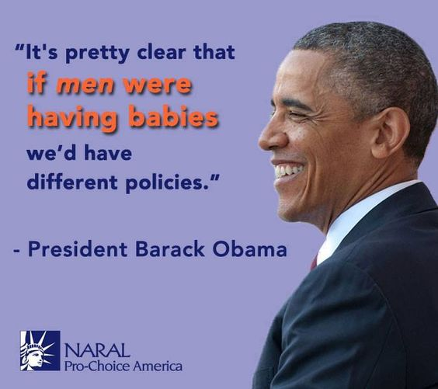
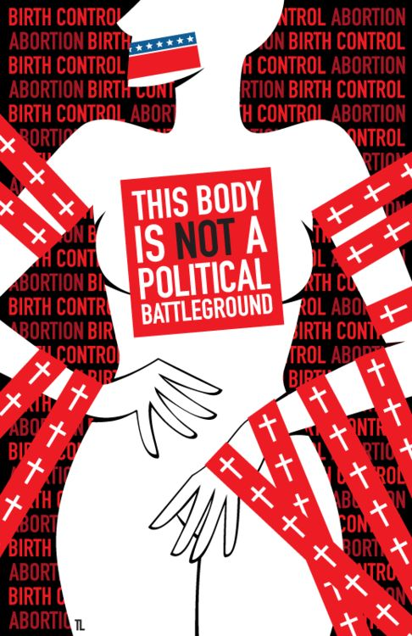
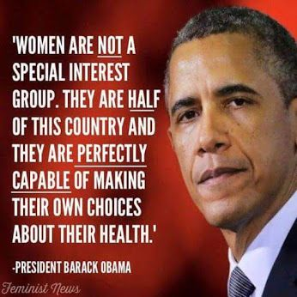
Gender and patriarchy: The body as a battlefield
Simonsen (2000)
“Women are controlled, and free themselves from control in many ways….. As Smart and Smart (1978, p.2) point out ‘the social control of women assumes many forms, it may be internal or external, implicit or explicit, private or public, ideological or repressive’. It may also not be perceived or experienced as control” Hutter and Williams 1981, p.9)
Control of bodies is about normality- questions of deviance and the idea of the ‘abject’
Notes:
Simonsen, K (2000). Editorial: The body as a battlefield. TIBG 25, 7-9
The ‘limits of the body’- what does Simonsen mean here?
What are the underlying politics involved in the body as a marker of class?
How does this link to the notion of ‘controlling’ bodies in different ways?
How are bodies a representation of morality?
The body as a moral project- what ideas does this incorporate?
What does Simonsen mean when she talks about the body as a ‘cultural battlefield’?
Who has the power to ‘other’ particular bodies?
How might we see power, domination and subordination ‘written onto’ bodies?

Slide 24
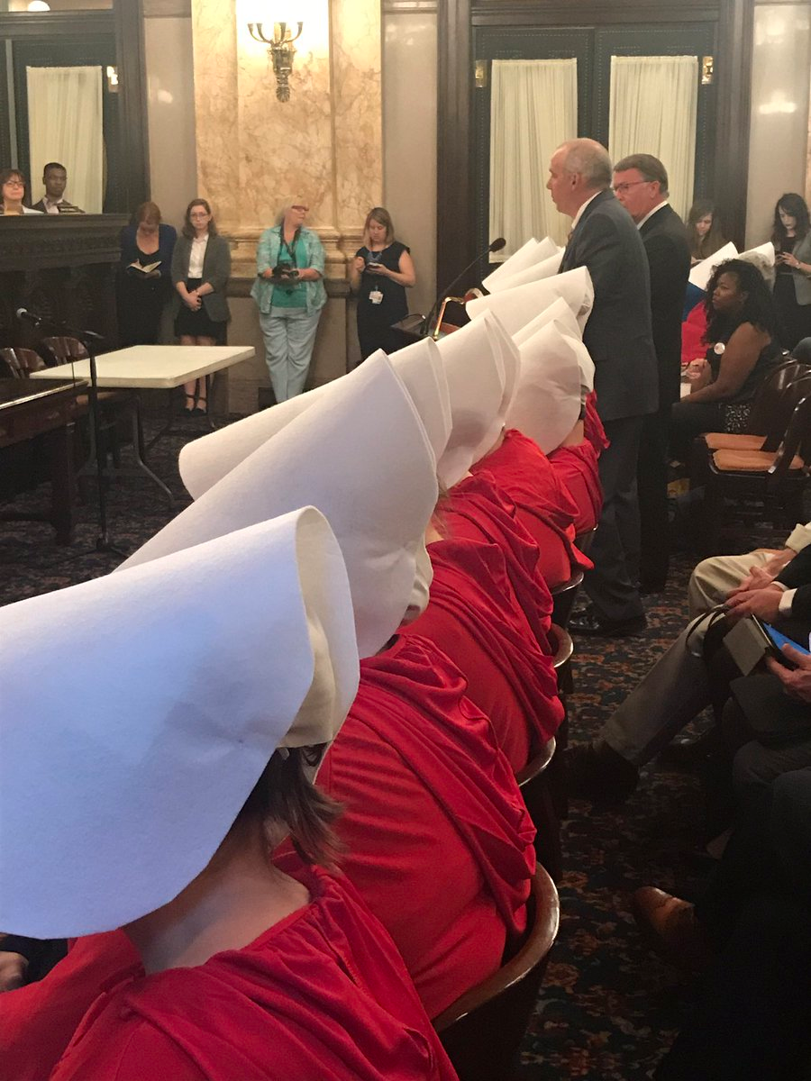
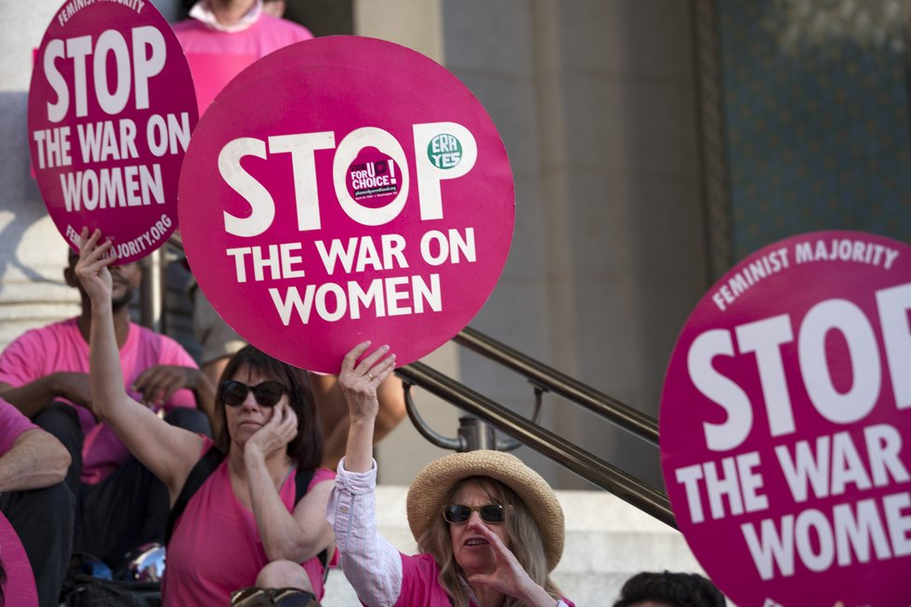
Gender and patriarchy: The body as a battlefield
Source: NARAL ProChoice Ohio @prochoiceOH
13 June 2017
Women now require a man’s permission to get an abortion in Arkansas (Crockett 2017)
Bill sponsor is talking about how women cannot be trusted to make their own healthcare decisions surrounded by #OHHandmaids
Notes:
A new law in the US demands that women seeking abortions must first gain permission from the man who impregnated them. The bill means that women in the southern state of Arkansas will not be able to have a termination without a man’s approval. Exceptions will not even apply in the cases of rape – meaning that sexual abusers would have the power to refuse and potentially block their victims from ending a traumatic and unwanted pregnancy.
The law, which is set to come into effect at the end of July, includes foetuses in a rule stating that family members have to agree on what to do with a deceased relative’s body. As a result, a woman would have to tell whoever impregnated her that she was planning on having an abortion, as they would need to agree on what to do with the remains before the procedure took place.Theoretically, if the woman and man could not come to an agreement, the woman could not then legally go ahead with the abortion.In addition, parents of girls under the age of 18 will be able to decide whether or not she can have an abortion.
A spokesman for NARAL Pro-Choice told HuffPost that the bill, known as H.B. 1566, is ultimately a way to “make it harder” for women to access abortion.
Civil and reproductive rights organisations in the US have been campaigning hard against the bill, which was signed into law in March. A lawsuit against it, mounted by the American Civil Liberties Union (ACLU) and the Center for Reproductive Rights, will be heard on Thursday 13 July. The Independent reports that there are only four facilities providing terminations in the entire state, which spans an area of more than 85,000 square miles and has a population of nearly three million people. Before having a termination, Arkansan women must also have state-directed counselling and wait 48 hours before the procedure is provided. Reproductive rights think tank the Guttmacher Institute states that this counselling often includes information designed to discourage women from continuing with the abortion.
With The Handmaid’s Tale dominating our screens right now, it seems this cautionary fable of female enslavement is spilling over to real life too.A group of women protesting legislation that would dramatically restrict abortion in the US state of Ohio have drawn inspiration from Margaret Atwood’s chilling dystopian novel.Campaigners dressed in the same red robes and white bonnets worn by handmaids forced to bear children in Atwood’s story staged a silent protest at the first hearing of the bill motion this week.
Senate Bill 145 is a state-wide measure that, if passed, would ban the “dilation and evacuation” method of termination commonly carried out in the second trimester of pregnancy.Opponents say it is an attempt to block a widely-used and safe method of abortion, and will particularly impact women who already struggle to access reproductive health services.
Senators continued to hail the proposed legislation at the committee hearing, even when faced with the mute but conspicuous group of handmaids.
As one Tweeter pointed out, “It's really a chilling visual. For a horrifying bill.”

Slide 25
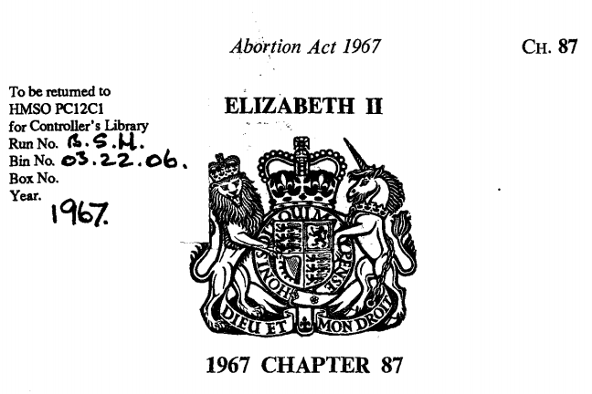
Abortion and the law: UK
In England and Wales and Scotland, section 1(1) of the Abortion Act 1967 now reads:
Subject to the provisions of this section, a person shall not be guilty of an offence under the law relating to abortion when a pregnancy is terminated by a registered medical practitioner if two registered medical practitioners are of the opinion, formed in good faith -
(a) that the pregnancy has not exceeded its twenty-fourth week and that the continuance of the pregnancy would involve risk, greater than if the pregnancy were terminated, of injury to the physical or mental health of the pregnant woman or any existing children of her family; or
(b) that the termination of the pregnancy is necessary to prevent grave permanent injury to the physical or mental health of the pregnant woman; or
(c) that the continuance of the pregnancy would involve risk to the life of the pregnant woman, greater than if the pregnancy were terminated
(d) that there is a substantial risk that if the child were born it would suffer from such physical or mental abnormalities as to be seriously handicapped.
Subsections (a) to (d) were substituted for the former subsections (a) and (b) by section 37(1) of the Human Fertilisation and Embryology Act 1990.
Notes:
Sections 58 and 59 of the Offences against the Person Act 1861
Section 58 of the Offences against the Person Act 1861 provides:
58. Every woman, being with child, who, with intent to procure her own miscarriage, shall unlawfully administer to herself any poison or other noxious thing, or shall unlawfully use any instrument or other means whatsoever with the like intent, and whosoever, with intent to procure the miscarriage of any woman whether she be or be not with child, shall unlawfully administer to her or cause to be taken by her any poison or other noxious thing, or unlawfully use any instrument or other means whatsoever with the like intent, shall be guilty of felony, and being convicted thereof shall be liable . . . to be kept in penal servitude for life . . .^{[4]} Section 59 of that Act provides:
59. Whosoever shall unlawfully supply or procure any poison or other noxious thing, or any instrument or thing whatsoever, knowing that the same is intended to be unlawfully used or employed with intent to procure the miscarriage of any woman, whether she be or be not with child, shall be guilty of a misdemeanor, and being convicted thereof shall be liable . . . to be kept in penal servitude . . .^{[5]}

Slide 26
Abortion and the law: The UK
In R v British Broadcasting Corporation (2002), ex parte ProLife Alliance, Lord Justice Laws said:
“There is some evidence that many doctors maintain that the continuance of a pregnancy is always more dangerous to the physical welfare of a woman than having an abortion, a state of affairs which is said to allow a situation of de facto abortion on demand to prevail”
The Abortion Act 1967 sought to clarify the law. Introduced by David Steel and subject to heated debate, it allowed for legal abortion on a number of grounds, with the added protection of free provision through the National Health Service. The Act was passed on 27 October 1967 and came into effect on 27 April 1968.[64]
The Act provided a defence for doctors performing an abortion on any of the following grounds:
To save the woman's life
To prevent grave permanent injury to the woman's physical or mental health
Under 28 weeks to avoid injury to the physical or mental health of the woman
Under 28 weeks to avoid injury to the physical or mental health of the existing child(ren)
If the child was likely to be severely physically or mentally handicapped
Notes:
Before the Human Fertilisation and Embryology Act 1990 (see below) amended the Act, the Infant Life Preservation Act 1929 acted as a buffer to the Abortion Act 1967. This meant that abortions could not be carried out if the child was "capable of being born alive". There was therefore no statutory limit put into the Abortion Act 1967, the limit being that which the courts decided as the time at which a child could be born alive. The C v S case in 1987 reconfirmed that at 19–22 weeks a foetus was not capable of being born alive.^{[59]} The 1967 Act required that the procedure must be certified by two doctors before being performed.

Slide 27
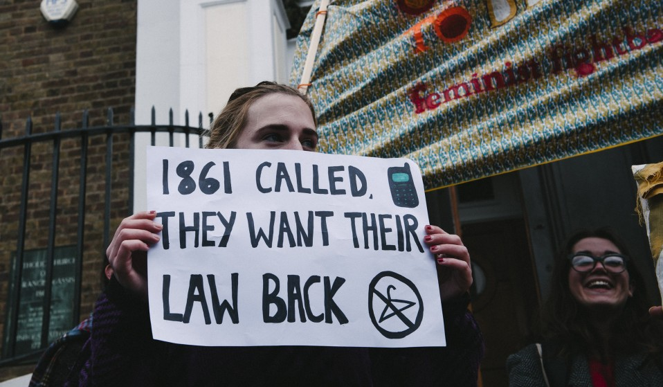
Abortion and the law: Northern Ireland
In Western Health and Social Services Board v CMB and the Official Solicitor (1995) unreported, Pringle J stated "the adverse effect must be permanent or long-term and cannot be short term … in most cases the adverse effect would need to be a probable risk of non-termination but a possible risk might be sufficient if the imminent death of the mother was a risk in question"
Family Planning Association Of Northern Ireland v Minister for Health, Social Services and Public Safety (8 October 2004) - Nicholson LJ stated at paragraph 73 - "it is unlawful to procure a miscarriage where the foetus is abnormal but viable, unless there is a risk that the mother may die or is likely to suffer long-term harm, which is serious, to her physical or mental health.“ Sheil LJ stated at paragraph 9 - "termination of a pregnancy based solely on abnormality of the foetus is unlawful and cannot lawfully be carried out in this jurisdiction."
Northern Ireland
Abortion is defined as “unlawful” in Northern Ireland. The 1861 Offences Against the Person Act provides the foundation for Northern Ireland’s abortion laws. It became law on 1 November 1861 and remains in force today.
Abortion is permitted under the following conditions:
To preserve the life of the mother
Survey on attitudes towards abortion in Northern Ireland: http://www.amnesty.org.uk/sites/default/files/milward_brown_poll_results_october_2014_final_0.pdf
Notes:
Northern Ireland:Health policy is part of the devolved powers transferred to the Northern Ireland Assembly (NIA) by the Northern Ireland Act of 1998 in the frame of the devolution in the United Kingdom.^{[11][12]} Abortion Law in Northern Ireland falls within the scope of the Criminal Law in Northern Ireland. Criminal Justice and Policing powers were devolved to Northern Ireland in 2010.
Abortion is legal in Northern Ireland under strict criteria. The majority of women living in Northern Ireland seeking abortion treatment will have to travel to England or another country to access the service. Women in Northern Ireland will not be entitled to an NHS abortion in England and will therefore need to pay for their treatment privately. Marie Stopes UK provides a discount price for women travelling from Northern Ireland.
The 1861 act was modified in Great Britain by the 1929 Infant Life (Preservation) Act, subsequently enacted in Northern Ireland in 1945 as the Criminal Justice (Northern Ireland) Act. This act allows the abortion of a “child capable of being born alive” only where the mother’s life would otherwise be put at risk. Because of the reference to a “child capable of being born alive”, it was generally assumed that this act focused on abortion after the 28th week of pregnancy. Confusion therefore arose as to whether it was legal or illegal to perform a similar abortion in the first 27 weeks of pregnancy.
Abortion is only allowed to preserve the life of the mother
If the continuance of the pregnancy threatens the life of the mother, or would adversely affect her mental or physical health. In most cases, the risk of the adverse effect occurring would need to be a probability, but a possibility might be regarded as sufficient if the imminent death of the mother was the potential adverse effect.
If continuing with the pregnancy would have other serious permanent physical or mental health effects. The adverse effect on her mental or physical health must be a “real and serious” one, and must also be “permanent or long-term”. It will always be a question of fact and degree whether the perceived effect of a non-termination is sufficiently grave to warrant terminating the pregnancy in a particular case. To receive medical abortion treatment, the pregnancy must be under 9 weeks 4 days gestation. If you have been pregnant for over 9 weeks, you will need to travel to England for surgical treatment.
**** On 30 November 2015, Horner J in the High Court in Belfast made a declaration of incompatibility under the Human Rights Act 1998 to the effect that Northern Ireland's law on abortion, specifically its lack of provision in cases of fatal foetal abnormality or where the pregnancy is the result of rape or incest, could not be interpreted in a manner consistent with Article 8 of the European Convention on Human Rights

Slide 28
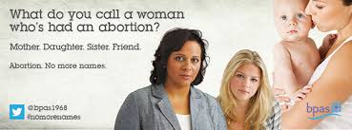
Abortion and society: Stigma, taboo and visibility
“As a society, we construct the social world according to our interests and beliefs; and as individuals we construct our beliefs to make sense of our own particular experiences of the world. So shared beliefs and experiences support each other- at least for a good deal of the time. Sex-role norms do not exist only in people’s heads. They influence people’s behaviour. We are constantly giving each other evidence to support our beliefs” (Fransella and Frost 1977, p.24 in, Hutter and Williams, 1981, p.11)

Slide 29
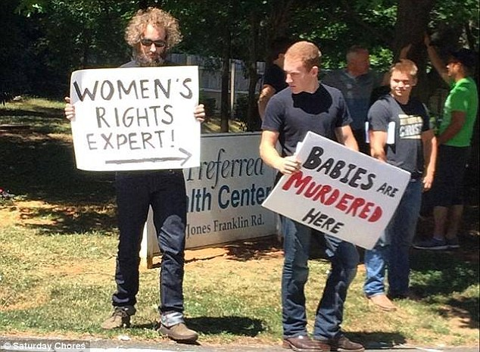
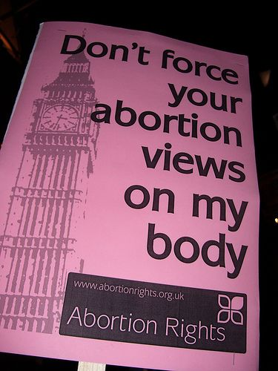
Gender and patriarchy: The body as a battlefield
Why does this matter?
Coalition government- Conservative/ DUP alliance- the future of bodily/ reproductive rights in the UK
USA- Republican president Donald Trump- backtrack statements regarding reproductive rights
Need to think about WHO is in power and WHO has power to make decisions regarding intimate, personal and everyday lives.

Slide 30
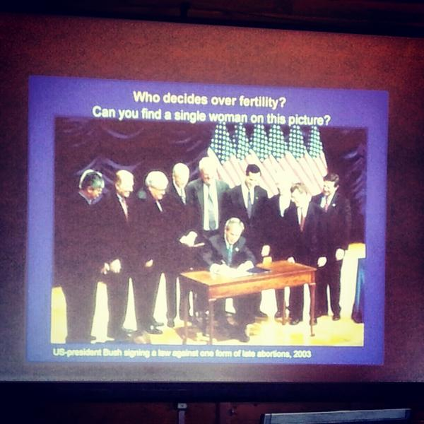
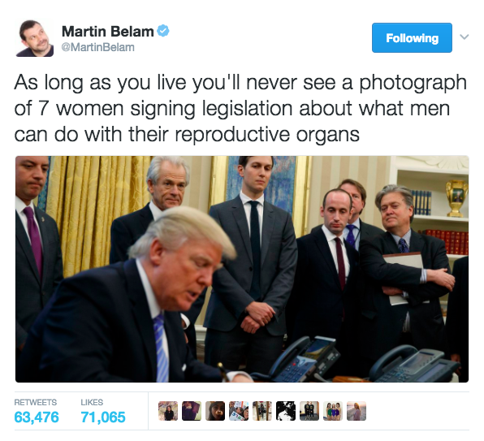
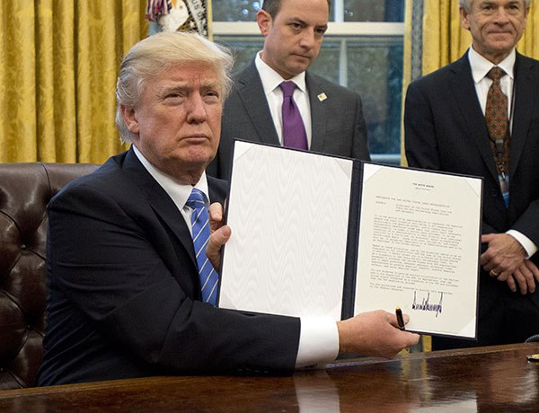
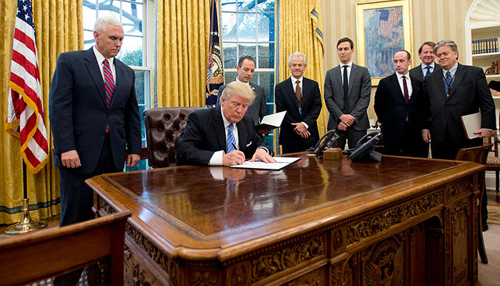
Gender and patriarchy: The body as a battlefield
Medhi Hasan article and backlash: Gendered decisions regarding bodies
Notes:
Donald Trump signs anti-abortion executive order- surrounded by men of course ( Sullivan n.d)
http://www.scarymommy.com/surrounded-by-men-donald-trump-signs-anti-abortion-executive-order/
Donald Trump signs anti-abortion executive order defunding international planned parenthood (Radvan 2017)
http://hollywoodlife.com/2017/01/23/donald-trump-signs-anti-abortion-executive-order-defunding-planned-parenthood/
Quick question about this photo of POTUS signing away women’s reproductive rights: Anyone notice anything funny about this pic? Lmk (Lanigan 2017)
https://babe.net/2017/01/24/quick-question-photo-potus-signing-away-womens-reproductive-rights-680
1984
At a conference on population in Mexico, Ronald Reagan, the US president, introduces a new policy that prohibits any overseas organisation currently receiving US funding from obtaining money from other partners for work that involves abortion. The Mexico City policy, otherwise known as the “global gag rule”, follows restrictions on aid imposed under the Helms amendment, passed in 1973. Helms banned the use of US aid for abortion as a form of family planning, but did allow organisations to source money from elsewhere for this purpose.
1993
Bill Clinton becomes US president and rescinds the global gag rule. He also resumes funding to the UNFPA.
2001
George W Bush is sworn in as US president and reintroduces the global gag rule,
2009
The US president, Barack Obama, rescinds the global gag rule. The World Health Organisation estimates that each year 47,000 women die from complications arising from unsafe abortion, which accounts for about 13% of all maternal deaths. Obama resumes funding for the UNFPA.
2012
Donors pledge $2.6bn to increase access to family planning in 69 countries with the lowest prevalence rates. The FP2020 partnership is established to accelerate and monitor progress. It aims to reach an additional 120 million women and girls by 2020.
Campaigners express anger at the failure of the UN Commission on the Status of Women to adopt agreed conclusions, because of arguments over women’s reproductive rights. Each year, religious and conservative groups attempt to undermine negotiations at the annual forum.
The UN general assembly passes a resolution to ban female genital mutilation. An estimated 3 million girls are at risk of being cut each year.
2017
The US president, Donald Trump, reinstates the global gag rule on his first full day in the White House, expanding the ban to include all health programmes, not just family planning. Women’s rights campaigners say the move will be devastating for women. And the US defunds the UNFPA. In his budget, Trump announces there will be no funding for international family planning. The US was previously the world’s largest bilateral donor for family planning.
Driven by the Dutch, other states and organisations like the Bill and Melinda Gates Foundation raise €181m to help plug the gap, as part of the She Decides campaign. While the money raised is impressive, it is a small fraction of the $600m a year the US spends on family planning.
The natural, logical conclusion to criminalization is that pregnant individuals become second-class citizens.
"For the entire 40 weeks of pregnancy a woman's every action, inaction, or decision could be the basis for a criminal charge of assault," Yocca's lawyers said. "The additional absurd, illogical, and unjust results that could spring from this interpretation are boundless."
This is a fear that Diaz-Tello of the SIA Legal Team shares. "What are we going to do if a pregnant woman is involved in a car crash or slips on an icy sidewalk or even picks up a heavy toddler?" she demanded. "Where do you draw that line? If the state can step in and punish people for the outcome of their pregnancy, and there is no logical place to draw it. The line becomes arbitrary. If somebody doesn't like the way a pregnant person is conducting themselves during a pregnancy, that could become a crime.“
hundreds of anti-abortion laws have been passed since 2010, drastically reducing abortion access in large swaths of the South and Midwest by imposing burdensome restrictions and shutting down clinics. In these states, getting an abortion is not easy and may prove impossible for women of low economic means.
There are currently 27 states in the US that require women to wait a specific amount of time between mandatory counseling and the abortion procedure, according to the Guttmacher Institute. The two-trip requirement, combined with the fact that 90 percent of counties do not have abortion providers, means that millions of women are forced to drive long distances twice just to access care, creating steep barriers for people without flexible work schedules, the capacity to get childcare, transportation options, and disposable income. And then there is the cost of the procedure. Early abortions start around $500 and get more expensive as pregnancy progresses. That's a lot of money, particularly if gas, hotel, and other travel costs are loaded on top.
sttate laws differ, and only a handful of states have laws that explicitly prohibit self-induced abortion (some which predate Roe). As a result, prosecutors have brought a panoply of charges that were not meant to be applied in this way, including murder, manslaughter, neglect, feticide, aggravated assault, criminal abortion, procurement of a miscarriage, criminal recklessness, abuse of a corpse, and more. It's like prosecutors are throwing charges at the wall to see what sticks; there is great variability and little consistency in their legal strategies.
"We've seen very creative, egregious prosecutors taking laws and manipulating them far beyond their reading," Adams said.
***** When women are criminalized for the outcomes of their pregnancies, wombs become crime scenes. When states monitor reproduction, women are dehumanized and relegated to baby carriers. When people are punished for the choices they make about their own bodies, including when to have children, they are not free. Incarceration is an agent of intimidation and fear, and women will die to avoid it.********************************
President-elect Donald Trump is on record saying there would "have to be some form of punishment" for women who have abortions if the procedure were outlawed in the US. He later backtracked, but the sentiment is clear. His meaning lingers. A Glover Park Group survey found that 39 percent of Trump voters think a woman seeking an abortion should be punished if the procedure is made illegal in America. In January, an Idaho lawmaker said he planned to put forward a bill that would classify abortion as first-degree murder, for the mother as well as the provider.
Whether or not the Trump administration manages to engineer the overthrow of Roe v. Wade, there is no doubt that under its reign, abortion will become harder to access. By defunding Planned Parenthood, by allowing Congress to pass laws that restrict abortion, and by filling lower courts with judges who will allow state lawmakers to get away with anti-choice legislation, abortion could quickly become an option available to only a privileged few.

Slide 31
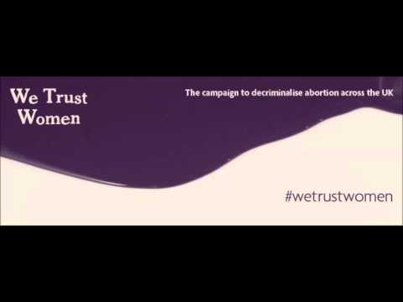
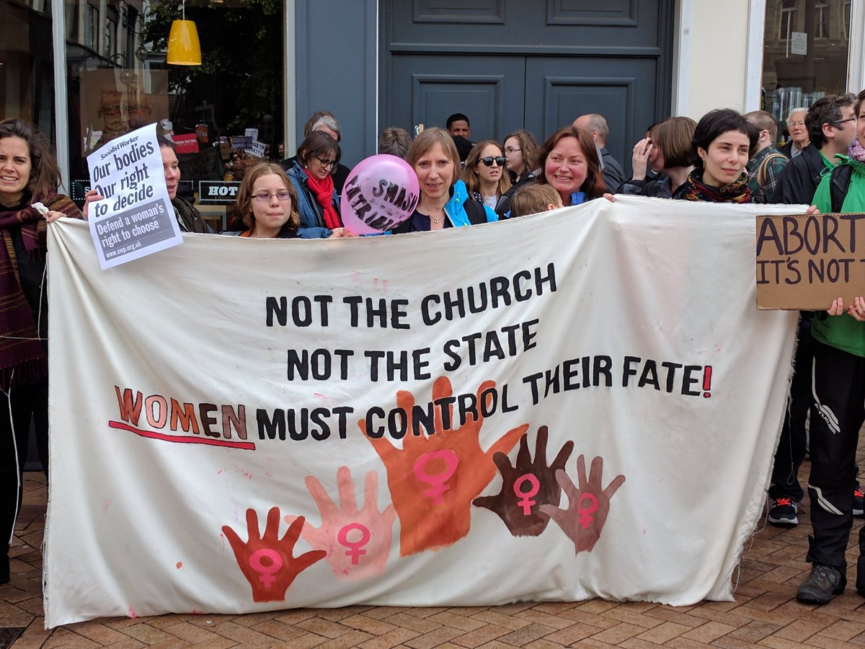
Intersections: ‘popular feminism’ or political statements?
Boots morning after pill
‘we trust women’ BPAS https://www.youtube.com/watch?v=YE2H_WU_mKQ
‘Not the church, not the state, women must control their fate’ (Jackson and Narkowicz working paper)
Mullins (2016) argues that “Behind the opposition to decriminalise both abortion and sex work lies the belief that some people – and both abortion and sex work are associated primarily with women, so specifically, some women – are incapable of physical autonomy, that their choices are so socially harmful, so deluded, they must be legislated against”.
Notes:
Boots has apologised for the way it responded to a campaign calling for it to reduce the price of emergency contraception, which it sells for almost £30 per pill.
The high street chemist was criticised after refusing to cut the cost of the morning-after pill. It told the British Pregnancy Advisory Service (BPAS) this week that making emergency contraception cheaper may mean it is "misused or overused".
The apology, made late on Friday night, came after the women's parliamentary Labour party (PLP) had written to Boots' chief pharmacist to express "deep concern" about the company's refusal to lower the price of emergency contraception.
It also came after people took to social media and called for a Boots boycott, with campaigners saying the company's comments were insulting and sexist. Dr Sue Black, a UK government advisor, wrote on Twitter: "Disgraceful behaviour by @BootsUK please consider boycotting, I will be."
We trust women- the case for decriminalising abortion: The 1861 Offences Against the Person Act (OAPA) criminalised abortion and threatened women with life imprisonment for ending a pregnancy. This cruel law is still in force today. The 1967 Abortion Act did not replace the OAPA or decriminalise abortion, but stipulated specific circumstances where women and their doctors would not be prosecuted. While often seen as a triumph of the women’s movement, the Act was in fact introduced in response to the huge public health problem of backstreet abortions. It placed decision-making on abortion firmly in the hands of the medical profession – not women. Now is the time to trust women. Here are 5 reasons why we should take abortion out of the criminal law and regulate it like other women’s healthcare procedures.
It is unacceptable that women across the UK are risking prosecution for ending a pregnancy
The threat of prosecution puts doctors off training in this field and providing care
The 1967 abortion act is preventing the best medical care
There is no evidence that de-criminalisation would lead to an increase in the rate of abortion nor numbers of later abortions
Public opinion does not support the current law

Slide 32
The role of gender in reproductive rights
“Just because you've got a womb doesn't influence your way to think about something, just the way you feel about it but it doesn't - whether a guy - that is totally different from whether a guy has an ability to intercede in somebody's choice about something that relates to their own bodily integrity. Which I think our law fortunately completely doesn't allow that and I think it would be wrong” (spokesperson, BPAS )
“So that whole sort of paternalistic view on women's bodies. Women still can't make choices about their bodies is so ingrained in our society isn't it? I don't think that this is something new but I think the stone's been lifted off it and I think it's probably rearing its head a bit larger really” (Simon, Sexual Health worker)
Wilkinson, A (2016). ‘Abortion opponents don't really think it's murder. They just want to judge women’. The Telegraph (online) 26/2/2016. Available at http://www.telegraph.co.uk/news/uknews/northernireland/12159388/Abortion-opponents-dont-really-think-its-murder.-They-just-want-to-judge-women.html

Slide 33
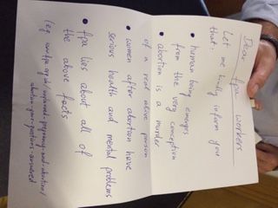
Research on reproductive rights in the UK
“I think the coverage as well, particularly in the tabloid press, I think is a way of making women look divided. They'll put Nadine Dorries on one side and they'll put a woman from Abortion Rights or something on the other side and it'll be like it's a bitchy argument rather than a political ideological debate about women and their bodies. … If they’re (pro-life activist men) just going to argue that they do care about women - I'd have no problem with someone being personally pro-life but why argue for a change in the law. Why try and influence women's decisions when they already have objective information in front of them and can make up their own minds. I don't know.(Amy PC activist)
“I actually think they’re misogynists - I think that’s what it’s about. It’s about the fact that women’s rights - they think they can couch it in whatever they want to couch it in” (PC activist)
Notes:
i.e women should not be reduced to their ‘biological destiny’- they are more than just their reproductive parts.
The press often pitt women against each other to show how ‘emotive’ the topic is. – there is also the idea that women are ‘subject to their emotions when pregnant and therefore unable to be capable of rational decision- making.

Slide 34
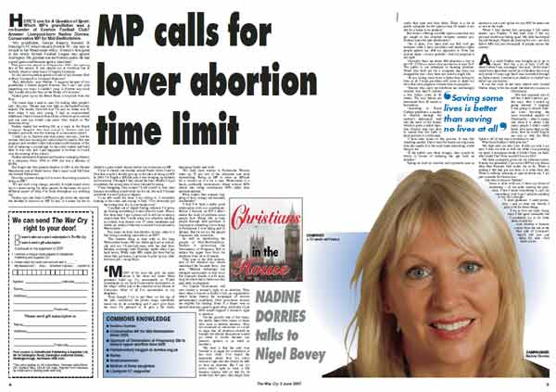
Research on reproductive rights in the UK
“about women having choice while we have the Nadine Dorries' of this world, lots of the people, the politicians that are antiabortion are actually men, who will never be in a position to actually have an abortion. You know unless science moves on dramatically, they will never be personally in that position to actually know what it feels like to have pregnancy that's unwanted, or that a woman may have planned and then for whatever reason her life's fallen apart and she just cannot cope with having a child in the circumstances that she's living in. They will never live through that… they will never know what that emotional aspect of that is. Again, I think it is very easy for them as politicians to stand in judgment of what's happened” (Sexual health worker, PC).
“I hate to bring in the gender issue, but if it was a male issue. If men got pregnant and didn't want to be, I don't think we would be having this conversation to be fair. I think women would be much more understanding about a man not wanting to be pregnant than some men are.” (Sexual health worker, PC)
Notes:
3. Connect to Donald Trump’s signing of the bill to further restrict planned parenthood funding – i.e a women’s issue that is being decided by men.
4. Notion of punishment for being reckless with their bodies- i.e having ‘unprotected sex should have consequences’.

Slide 35
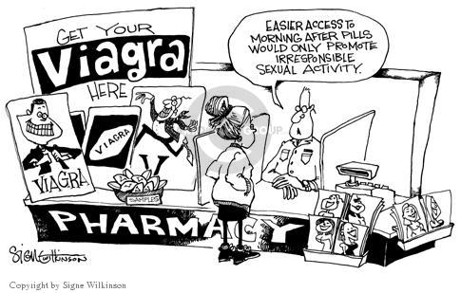
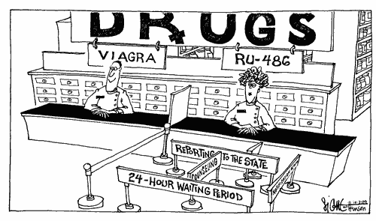
Research on reproductive rights in the UK
“I personally believe that it's one of the hardest decisions that a woman will have to make in their life. Because once you've done it you can't undo it. It's irrevocable and for that woman at that particular time in her life, she needs the right support. She doesn't need to have to walk over hot coals to get it basically. It comes back to this gender issue I think. If men had to do it, we wouldn't be having a conversation… it's a means of controlling women. Certain religions and certain politicians will use it as a means to control what happens in society…. there's a really good cartoon that's got, which comes down to the gender issue, that's got a pharmacist, it's got two pharmacists. It's got a man with Viagra above his head and it has got a woman pharmacist with are you 486 which is the code name for Mifepristone, abortion pill. The man's just got, the men can just walk straight up to him. The women's got one of these queues that's as if it's restricting to get you - so it will take and it's basically saying get your Viagra, not a problem. If you want to get your Mifepristone, your abortion pill, you have to jump through hoops to get it…it's such a fundamental argument, isn't it? It's kind of women have the right to decide what happens to their bodies ” (Sexual health worker, PC).
Notes:
5- this quote shows how activists thought that current legislation was about social and political control- i.e that decisions should be taken out of a woman’s hands as she is unable to make the ‘right’ choice. Further, this participant kept referring to the ‘gender issue’ with the focus on ideas that sexism was inherent throughout all of these discussions.

Slide 36
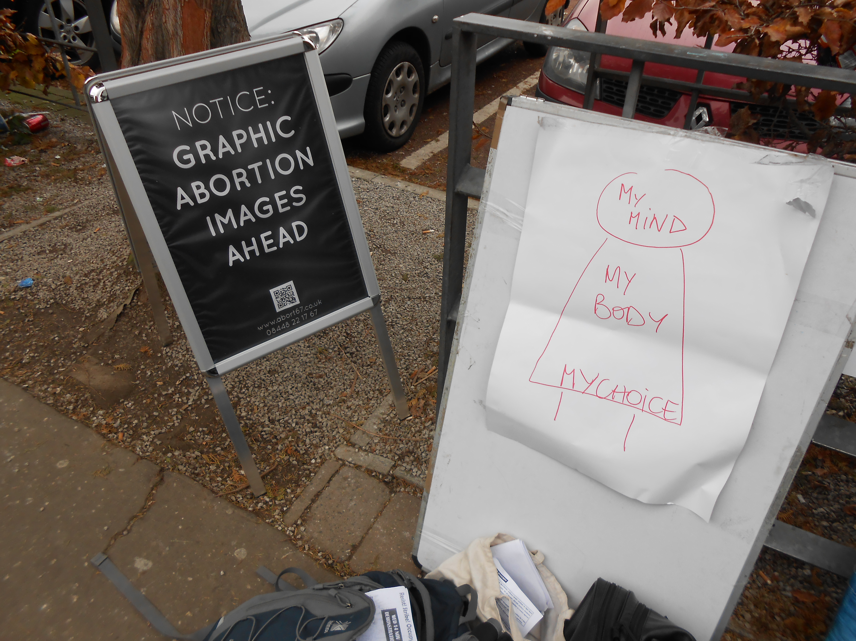
Research on reproductive rights in the UK
“The moment I was pregnant - the first week, I suddenly thought - now I understand why it is that men should not be legislating on this. Because my whole - like the axis of my world had shifted. I thought right, yeah - there’s a whole thing here that made me kind of focus men don’t get. … it’s like the government - they’re a bunch of upper class white man who don’t want to stand for it… There’s a narrative about family values which is always essentially about control of women. The model of the family they’re talking about is about control of women’s fertility and making sure men are in control of that.” (Feminist activist)
“There are guys making laws for things which affect women which makes me really nervous. A room full of men discussing what happens to women's bodies…… ageing men in politics that have these views and because they're in power it becomes - it causes - I don't know how to word this but there's a lot of outrage when male old politicians say I think this, this and that. I don't feel like it's their right to be able to say these things. …. They should say it but because they have the power to influence policy like that I think it's very disturbing that their opinions can affect something so fundamental to women's rights” (Student focus group, mix of PL and PC)
Notes:
7- quote shows that there is a lack of understanding about the decision-making process and how much women need to be able to make a choice that is best for them.
This is also tied to the idea that all women WANT to be mothers associated with the idea of the ‘motherland’ and seeing women as ‘reproducers of the nation’.
7.1 the scary prospect that ‘men out there’ decide what women in their everyday lives can do

Slide 37
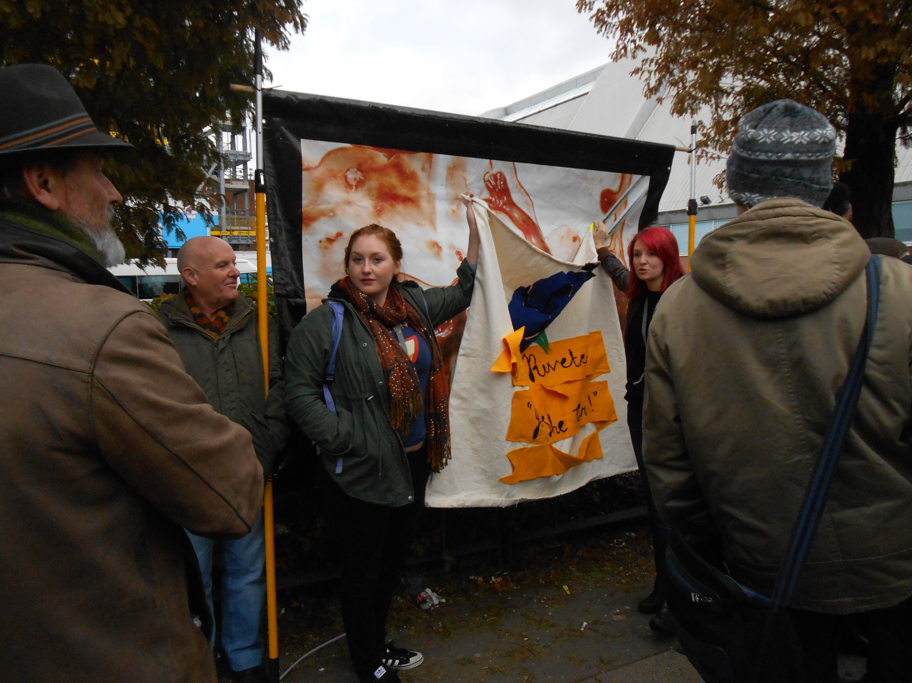
Research on reproductive rights in the UK
“It’s that whole sort of paternalistic view on women's bodies. Women still can't make choices about their bodies is so ingrained in our society isn't it? I don't think that this is something new but I think the stone's been lifted off it and I think it's probably rearing its head a bit larger really… often what seems to happen there's an old man trying to tell young women what they should do with their bodies. So an obvious reaction or it seems to be an obvious reaction is well you're an old man what have you got to say about what women do with their bodies. ” (Mark, sexual health worker)
“I think we're kind of going backwards in terms of our attitudes towards women in general and I don't really know - I think it's that - I don't know if it's like the glass ceiling type stuff but it's the way that it's no longer okay to say you're a feminist, it's no longer okay to say that you think that women aren't treated equally to men, even though the evidence still shows that they're not. It's become socially unacceptable to say things like that and have that kind of point of view” (Student focus group, mixed PL and PC).
Notes:
9- the ‘calm down dear’ reference from David Cameron-
10- the idea of the feminist has become dirty and tainted somehow so that its no longer ok to say that you ascribe to this way of thinking.

Slide 38
Research on reproductive rights in the UK
“Abortions are traumatic, abortion is the most unfeminine thing that there is because it involves the destruction of what is most feminine and that is the power to give birth, to be mothers, to be true feminists, to be feminine. Abortion is none of those things at all, so I would say abortion strikes at the heart of feminism” (Steve, PL charity)
“In most of the world we live in a very patriarchal society where men are in power in a lot of places. Don't get me wrong, if they're the right person for the jobs or whatever they're doing then so be it but it perpetuates the whole situation….. But really in poorer countries or in this country, especially people who come from these very traditional backgrounds, they say oh we protect the role of the family in society and family is a woman, a man and a baby and it's kind of feeding into the role of a woman as a reproductive machine and cleaning robot. It's really past times but still people are still clinging onto it. They're just afraid of changes or women wanting more than just that being ambitious” (Student focus group, PL and PC)
Notes:
8- here you can see the equation of femininity with motherhood- to be a woman IS to be a mother. This calls into question the notion of femininity itself and what it means- what are the associated traits/ characteristics and how did this get written into everyday language as well as our political system? STEREOTYPES and stereotyping are a form of social control and categorisation that essentially ‘keeps order’- in terms of race, religion, ethnicity, sexuality and gender- isn’t it time to break down these assumptions and stereotypical ideas
8.1 – this is really interesting- the fear that women are being free and sexually liberated- what are the consequences of this for women in the future?

Slide 39
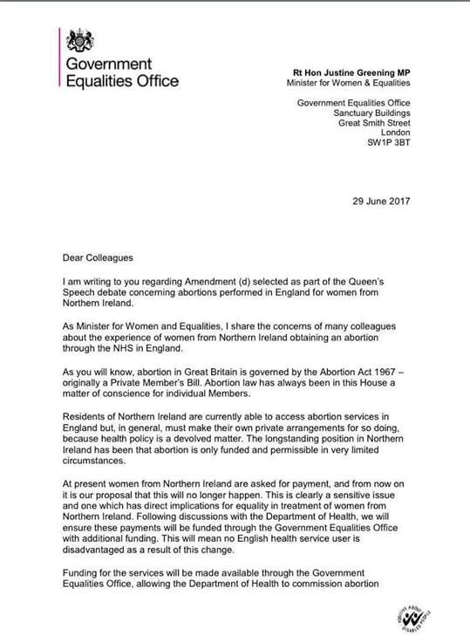
The body as a battlefield
Northern Ireland’s Abortion Laws come under the spotlight (July 2017)
Irish referendum on abortion scheduled for 2018
the eighth amendment enshrines the equal right to life of the mother and the unborn; written into the Constitution in 1983
June 2017: the UK government announced women from Northern Ireland would be given access to terminations by the NHS in England, following a proposal by Labour MP Stella Creasy.
Source: Alliance for Choice 2017

Slide 40
Gender and patriarchy: The body as a battlefield
Theresa May and the DUP
Dear Prime Minister,
We are writing to seek a categorical assurance from you that you will not allow women’s rights and, in particular, women’s access to abortion to be used in any kind of trade-off with the Democratic Unionist Party. We would strongly oppose any proposal to re-open the issue of time-limits or to in any way restrict women’s access to abortion. As you will know, unlike elsewhere in the UK, abortion is only permitted in Northern Ireland if a woman’s life is at risk or there is a permanent or serious risk to her mental or physical health. As a result, women in Northern Ireland are forced to travel to another part of the UK in order to access the same abortion services as women in the rest of the UK. This affects hundreds of women each year. Only those who can afford to travel and pay for treatment – as, despite being UK taxpayers, women resident in Northern Ireland are currently not entitled to NHS funded abortion care in England – can do so.
In 2015 a High Court Judge ruled that the current law on abortion in Northern Ireland was incompatible with human rights law. In his ruling, Mr Justice Horner said there was “one law for the rich and one law for the poor,” because the law makes it “much more difficult for those with limited means to travel to England.” Women in Northern Ireland, left with few other options, have turned to the internet to buy abortion pills – but they are then criminalised for doing so. Instead of contemplating any compromise the UK government should be focussing on extending access to abortion for women in Northern Ireland to give them the same rights as others in the UK. This is not a devolved matter but rather a question of their fundamental human rights. We are a pro-choice country which supports a woman’s right to choose. In our last parliament, MPs across all the main political parties voted for a bill to decriminalise abortion up to 24 weeks of pregnancy in England and Wales. 50 years since the Abortion Act was passed, there is clearly an appetite to extend, not restrict, reproductive rights. We urge you – do not allow the clock to be turned back on women’s rights, and do not turn your back on the women of Northern Ireland.
Notes:
https://www.fawcettsociety.org.uk/news/fawcett-issues-joint-letter-theresa-may-dup-abortion-rights
On the Tory/ DUP deal
http://www.reuters.com/article/us-britain-election-dates-factbox-idUSKBN1920SU?mod=related&channelName=worldNews

Slide 41
Not the church, not the state, women must control their fate?
...a great deal turns for women on whether abortion is or is not available.
If abortion rights are denied, then a constraint is imposed on women's freedom to act in a way that is of great importance to them, both for its own sake and for the sake of their achievement of equality;
and if the constraint is imposed on the ground that the foetus has a right to life from the moment of conception, then it is imposed on a ground that neither reason nor the rest of morality requires women to accept, or even to give any weight at all.
Judith Jarvis Thomson
Notion of rights:
Women's rights arguments in favour of abortion
women have a moral right to decide what to do with their bodies
the right to abortion is vital for gender equality
the right to abortion is vital for individual women to achieve their full potential
banning abortion puts women at risk by forcing them to use illegal abortionists
the right to abortion should be part of a portfolio of pregnancy rights that enables women to make a truly free choice whether to end a pregnancy
Notes:
Bodily rights
Many people regard the right to control one's own body as a key moral right. If women are not allowed to abort an unwanted foetus they are deprived of this right.
The simplest form of the women's rights argument in favour of abortion goes like this:
a woman has the right to decide what she can and can't do with her body
the foetus exists inside a woman's body
a woman has the right to decide whether the foetus remains in her body
therefore a pregnant woman has the right to abort the foetus
The issue brings many ideas about human rights into brutally sharp focus.
every human being has the right to own their own body
a foetus is part of a woman's body
therefore that woman has the right to abort a foetus they are carrying

Slide 42
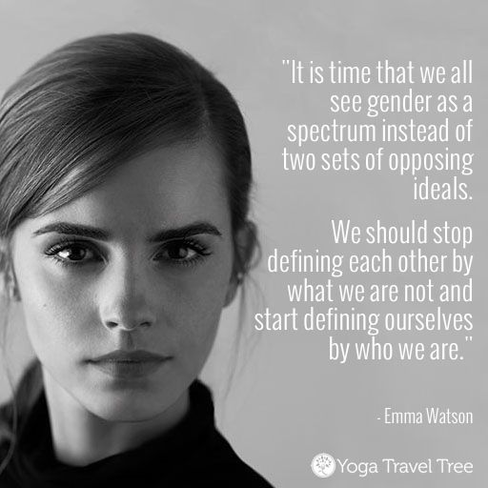
How are contemporary struggles indicative of more traditional gender discourses?
“the fact that the woman lives her body as object as well as subject. The source of this is that patriarchal society defines woman as object, as a mere body, and that in sexist society women are in fact frequently regarded by others as objects and mere bodies. An essential part of the situation of being a woman is that of living the ever-present possibility that one will be gazed upon as a mere body, as shape and flesh that presents itself as the potential object of another subject’s intentions and manipulations, rather than as a living manifestation of action and intention. The source of this objectified bodily existence is in the attitude of others regarding her, but the woman herself often actively takes up her body as a mere thing. She gazes at it in the mirror, worries about how it looks to others, prunes it, shapes it, moulds and decorates it… This objectified bodily existence accounts for the self-consciousness of the feminine relation to her body and resulting distance she takes from her body” (Young 1980, p.155).
Notes:
While women have unimaginable liberty compared to previous generations, habitual
or socially sedimented ways of seeing have developed over time (Al-Saji 2009) which
mean that in everyday life patterns of gender differentiation and segregation have come to be read as ‘natural’ or normalised: the product of modes of embodiment, and in this sense Charlotte Bunch’s observation that the fundamental basis of feminism is the body, with which we introduced this paper, remains as true today as 20 years ago
Consequently, gender as a dimension of difference has become less socially visible (although not necessarily to those who experience its effects personally). While, the development of equality legislation has contained the public expression of the most blatant forms of gender prejudice, sexism persists and is manifest in subtle ways. Indeed, women are often complicit in its reproduction. As a consequence, it can be difficult to name and challenge, thus making it hard to identify contemporary patterns of sexism in form and intent with the effect that patriarchy as a power structure which systematically (re)produces gender
inequalities, is obscured by its ordinariness

