Slide 1
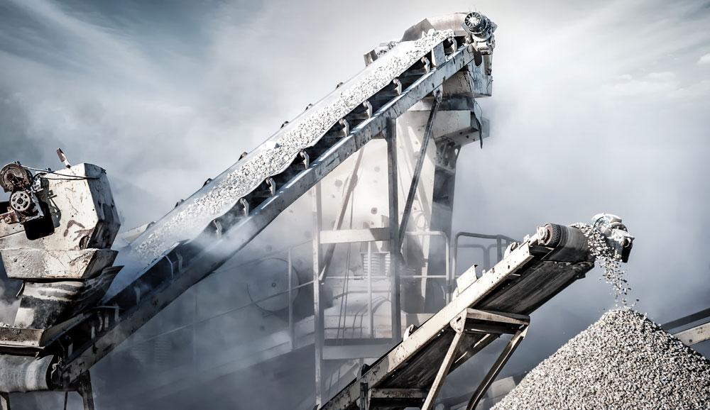
Banana Republic images/shutterstock.com
MATERIALS SCIENCE AND PROCESS ENGINEERING
Dr Theodore Hanein
GET STARTED
www.futurumcareers.com

Slide 2
In this presentation:
Meet Theo
Cement – the most manufactured commodity in the world!
The chemistry of cement
Talking points
About materials science and process engineering
Pathway from school to materials science and process engineering
Explore careers in materials science and process engineering
Theo’s career
Talking points
More resources
© P.KASIPAT/shutterstock.com
02 futurumcareers.com

Slide 3
Meet Theo
Theo is based in the Department of Materials Science and Engineering at the University of Sheffield, UK.
He is investigating the chemical processes and qualities involved in alternative cement manufacture, and how this could bring benefits to the UK’s environmental targets and economic goals.
Dr Theodore Hanein
03 futurumcareers.com

Slide 4
The most manufactured commodity in the world!
Cement is vital for society as it is a core material of concrete and mortar, which are essential components in the buildings and infrastructure that surround us.
“Current demand is at 4 billion tonnes every year, which is more than one kilogram of cement every day for every person on the planet!
“Cement production requires vast amounts of natural resources and is responsible for 8% of our carbon dioxide (CO2) emissions, which are changing the climate.
“The UK cement industry is set to cut 4.2 megatons (Mt) of CO2 emissions per year by 2050 — and about half of these savings could be through resource efficiency.”
– Theo
Banana Republic images/shutterstock.com
04 futurumcareers.com

Slide 5
The chemistry of cement
“Unlike other manufacturing processes that emit CO2 through their use of energy, emissions from cement production are mainly from the conversion of the raw material into clinker, a key process in cement manufacture.”
– Theo
Dr Cecilia Pesce controlling the cooling rate of a calcium (alumino)ferrite sample doped with zinc
05 futurumcareers.com

Slide 6
The most common type of cement produced today – and for the past 200 years – is Portland cement, which relies on the following reaction to begin production:
“Not only does this emit CO2, but almost half of the limestone’s solid mass is lost in the process. The UK cement industry uses about 12.5 Mt of limestone every year, so we’re interested to see if this natural raw material can be substituted with by-products from other sectors.”
– Theo
06 futurumcareers.com

Slide 7
The contamination challenge
This replacement could be by-products from steel manufacturing or mineral mining, or even the reprocessing of old cement from construction or demolition sites.
However, any alternative materials will contain other elements that could change the underlying chemistry of the cement manufacturing process and the end product.
“The effects of these contaminants across the service life of the new cement need to be studied and understood completely to ensure that the cement can be used safely.”
– Theo
Banana Republic images/shutterstock.com
07 futurumcareers.com

Slide 8
The FeRICH project
The FeRICH project is investigating the use of by-products from steel manufacture.
“While these by-products contain the key elements that are essential to cement production, they also have an unusually high amount of iron. FeRICH aims to replace natural raw materials used in traditional Portland cement by upcycling these iron-rich by-products, but our understanding of the reactions that take place when we do this is still incomplete.
“The FeRICH project will establish the best cement-making conditions to achieve maximum efficiency in both production and performance.”
– Theo
By establishing the traits of ferrite-rich cement, the project can help reduce the environmental impact of both the cement and steel industries in the UK.
Three alumina crucibles (containing clinker) that were fired and removed from a temperature of 1300 °C to cool
08 futurumcareers.com

Slide 9
The circular economy
Theo’s research feeds into a broader emerging concept known as the circular economy.
Much of our economy is based on linear processes: we extract a raw material, process it and use it, and then discard the waste.
Finding ways to break this trend, through repurposing one industry’s waste as the raw materials of another, simultaneously solves the issues of extracting raw materials and the disposal of waste. It is a key concept for a truly sustainable future.
09 futurumcareers.com
© jamesteohart/stock.adobe.com

Slide 10
Banana Republic images/shutterstock.com
Talking points
What is the current demand for cement, globally?
What target is the UK cement industry working towards for 2050?
What is problematic about the chemical reaction required to make Portland cement?
What is Theo’s FeRICH project aiming to do?
How could Theo’s work contribute to the UK’s ‘circular economy’?
10 futurumcareers.com

Slide 11
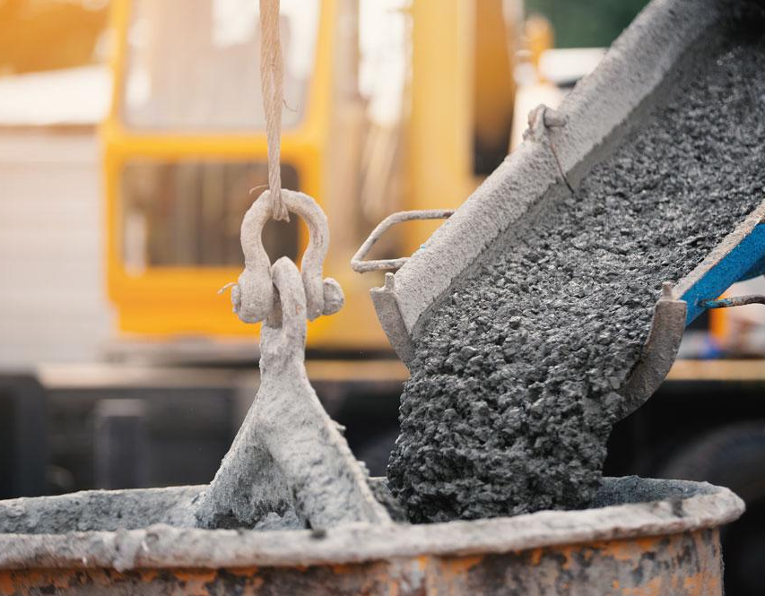
About materials science and process engineering
The way we use the Earth’s resources needs a major overhaul to ensure a sustainable future. Investigating the chemical and thermodynamic processes behind manufacturing – and how to make these more efficient and circular – forms the core of Theo’s research.
“To make any device, structure or product, you need the right materials. Materials science involves learning about what things are made of, and what properties make them behave as they do. It also involves applying this knowledge to improve these processes and properties.
“Materials science and process engineering requires the integration of various fields. We incorporate knowledge from chemistry, physics, mathematics and biology with chemical engineering to help address society’s most pressing challenges.”
– Theo
11 futurumcareers.com
© P.KASIPAT/shutterstock.com

Slide 12
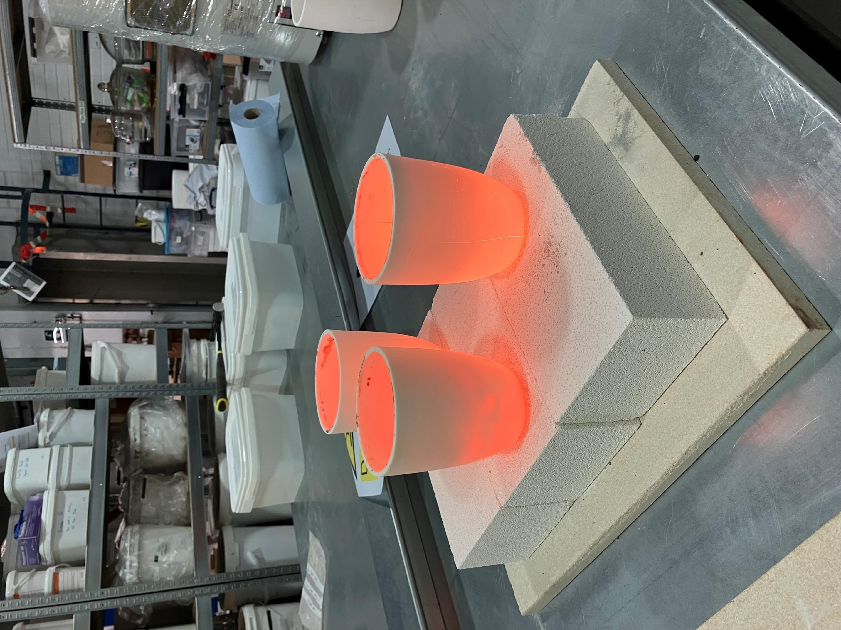
About materials science and process engineering
“I find my research highly rewarding because it feels important. I am contributing to developing sustainable materials and processes and helping to solve the most pressing challenge of our time: climate change.
“Most of our processes were not designed with sustainability or the circular economy in mind. We need to redesign and develop new techniques for an environmentally friendly world. Sticking-plaster methods such as carbon capture and storage (CCS) are useful for the short term, but, in the long term, we need to re-engineer our processes and society as a whole for true circularity.”
– Theo
Three alumina crucibles (containing clinker) that were fired and removed from a temperature of 1300 °C to cool
12 futurumcareers.com

Slide 13
Pathway from school to materials science and process engineering
At school and post-16, subjects such as physics, chemistry and mathematics are favourable to go on to a relevant degree.
Theo recommends university courses or modules in materials science and engineering, chemical engineering, product design engineering, computer science, environmental engineering, chemistry and physics.
13 futurumcareers.com

Slide 14
Explore careers in materials
science and process engineering
The University of Sheffield’s Department of Materials Science and Engineering hosts a variety of open days, summer schools and other STEM activities aimed at secondary school students.
The Institute of Materials, Minerals and Mining (IOM3) has a variety of outreach materials for students of all ages and their teachers, including inter-university-run learning opportunities and a virtual science laboratory.
According to Check-a-Salary, the average salary for a materials scientist in the UK is around £35,000 per year. Prospects.ac.uk highlights that as a senior engineer with chartered status, you can earn up to £60,000 per year.
14 futurumcareers.com

Slide 15
Theo’s career
My undergraduate degrees were in chemistry and chemical engineering. I then spent a summer interning in a cement manufacturing plant, before taking on a master’s degree in advanced process integration and design. It was my master’s project that really inspired me to follow the career path that I have.
Failure and mistakes are essential for development, especially for scientists. They’re an inevitability, but every setback presents an invaluable learning opportunity. Obstacles will come, but never give up.
15 futurumcareers.com

Slide 16
Theo’s career
The worst advice I have been given is not to be myself. Since then, colleagues, friends and family convinced me to follow my own ambitions, and this has been essential to my career.
My proudest career achievement was when I was awarded the UKRI Future Leaders Fellowship, which provides long-term funding and support for my research. On the theme of ‘Green, Circular, and Smart Cement Manufacture’, I’ll help lead research in low-carbon cement production. I also aim to use this research to influence UK policy and write standards for new innovative cements. Furthermore, I can use this platform to help mould other future leaders in my field.
Theo's research team, from left to right:
Dr Chancel Mawalala Moundounga, Dr Aniruddha Baral, Dr Vaishnav Kumar Shenbagam, Dr Zhanar Zhakiyeva, Dr Cecilia Pesce, Zhili Ren (front), Dr Theodore Hanein, Rand Farhan, Dr Marco Simoni, Siti Rohaidah Yahaya, Lucy Ellwood, James Pearson, Jack Ambrose, and Anna Simmons
16 futurumcareers.com

Slide 17
Theo’s top tips
Surround yourself with people who motivate you.
2. Be true to yourself.
A cartoon of Theo held by Theo!
17 futurumcareers.com

Slide 18
Banana Republic images/shutterstock.com
Talking points
What is the long-term aim of investigating the chemical and thermodynamic processes behind manufacturing?
Which fields are integrated into materials science and process engineering?
Which of the university courses recommended by Theo interests you the most, and why?
To what extent do you agree with Theo that failure is essential for development? When has a setback enabled you to learn?
Why do you think it is important to be ‘true to yourself’? What can make this difficult to do, at times? How can these difficulties be overcome?
18 futurumcareers.com

Slide 19
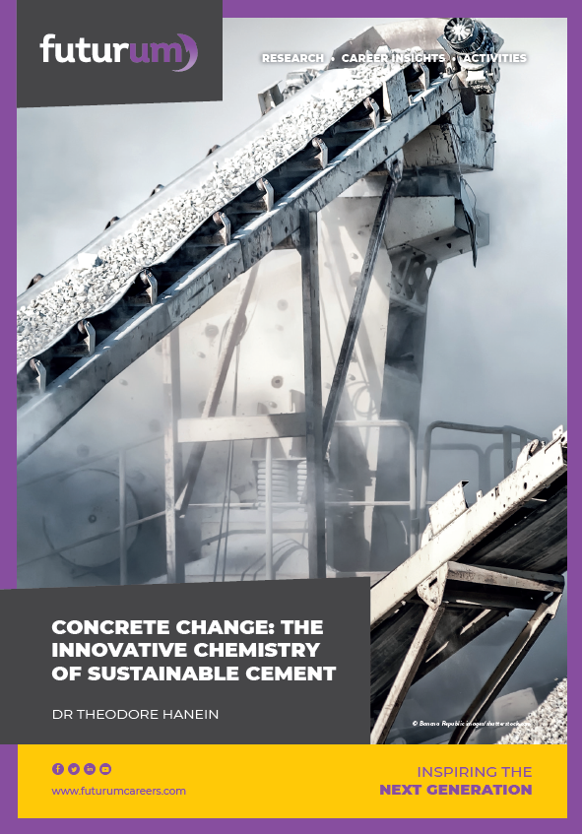
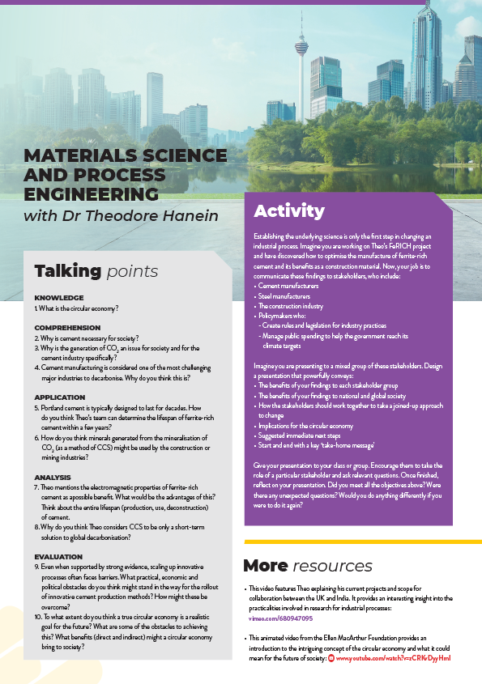
Banana Republic images/shutterstock.com
Resources
01
Download Theo’s article
02
Download the activity sheet
03
Watch the animation
19 futurumcareers.com

Slide 20
For more on Theo’s mission-led sustainable cement research, follow:
Linkedin: Cements@Sheffield
Twitter: @CementsSheff
20 futurumcareers.com

