Slide 1
BDS DENTISTRY
AMANDA OKRASA
AND DUNCAN WOOD

Slide 2
COMPETITION
Approximately 1,245 applicants
71 places available
Each applicant makes four applications
Academic attainment is not a guarantee of a place
We’re looking for good all-round applicants
Each applicant is assessed individually
Panel of assessors screen applications for interview
Interview panels select applicants to be recommended an offer
2

Slide 3
ENTRY REQUIREMENTS
GCSEs:
6 A/7 grades including English, Maths and Science
A-Levels: AAA
Including Chemistry and Biology + pass in the practical element of any science A Levels taken
Other requirements:
UCAT
See BDS Dental Surgery online prospectus for full entry requirements
3

Slide 4
SCREENING FOR INTERVIEWS
Academic qualifications
Career exploration: reflection on work experience and research
Personal qualities and values demonstrated
Academic reference
UCAT SJT: Band 1 and 2
UCAT: Reduce number of applications to target of approx. 300 for interview using the total score* (and VR depending on competition)
*Data for each year is available on our website.
4

Slide 5
SCREENING: ACADEMIC QUALIFICATIONS
GCSE Grades:
If you have one or two B/6 grades consider applying once you have achieved your A-levels.
A-level Grades: AAA
No additional merit for A*
No additional merit for 4 subjects
Academic staff and hospital staff screen:
Academic Reference, Personal Statement
5

Slide 6
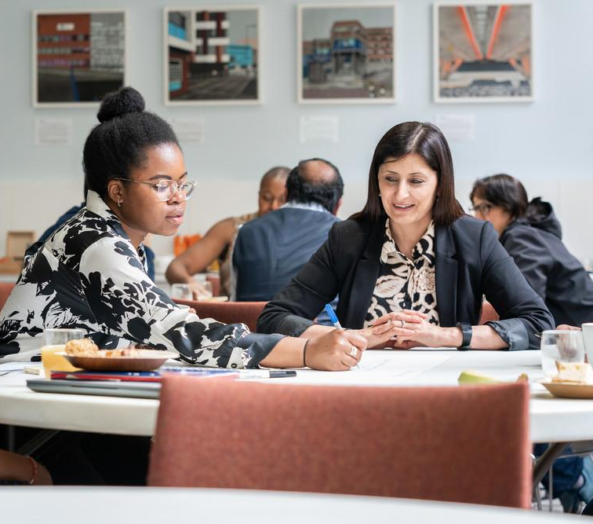
SCREENING: ACADEMIC REFERENCE
Referee should:
Give recommendation for higher education and dentistry
Validate the personal statement
Offer interview preparation
Guide research and work experience
6

Slide 7

SCREENING: PERSONAL STATEMENT
Personal qualities and values
Values Based Recruitment for NHS funded programmes
Qualities of a healthcare professional
NHS constitution and NHS values
Highly motivated individuals
Team working skills
Charity work
7

Slide 8
SCREENING: PERSONAL STATEMENT
Demonstrate exploration of the profession
Extensive reading
Online courses (Discover Dentistry)
Work experience
Discussion with the dental team, current students, graduates and young dentists
8

Slide 9
SCREENING: PERSONAL STATEMENT
Career exploration and work experience
Busy NHS practice is ideal
Specialist dentistry is useful as comparison - Secondary care – hospitals, referral practices
Knowledge of specialisms – training pathways, specialist register – GDC, etc.
9

Slide 10
SCREENING: WHY WORK EXPERIENCE?
To make sure you are making an informed choice
Experience the reality of dealing with patients
Explore dental team and team working
Investigate professionalism and professional responsibilities - working in the patient's best interest
Current issues in dentistry
Compare and contrast to other careers such as medicine and pharmacy
10

Slide 11
SELECTION: INTERVIEW
Interviews to be held Friday 20th February – Friday 27th February (TBC)
You are assessed throughout your visit
Semi-Structured Panel Interview
Academic staff Hospital Staff and Consultants take part in selection at interview
The interview panel will comprise:
Clinical Academic
Academic
Senior Student
Approximately 15 minutes in duration
11

Slide 12
SELECTION: INTERVIEW
Interviews: three areas of assessment
CAREER EXPLORATION
MOTIVATION TO STUDY AT HIGHER EDUCATION
AND AT SHEFFIELD
COMMUNICATION, VALUES AND PERSONAL QUALITIES
12

Slide 13
SELECTION: INTERVIEW
1. Career exploration
Are you making an informed choice?
Why have you chosen dentistry?
How have you informed yourself and made the decision?
13

Slide 14
SELECTION: INTERVIEW
2. Motivation to study at higher education, and at Sheffield
Are you ready/mature enough to undertake a 5-year clinical programme?
Is Sheffield the right school for you?
What are you going to bring to our community/school?
14

Slide 15
SELECTION: INTERVIEW
3. Communication, values and personal qualities
Do you demonstrate the values of the NHS Constitution?
  Compassion
  Respect and Dignity
  Everyone Counts
  Quality of Care
  Improving Lives
  Working together for patients
15

Slide 16
SELECTION: INTERPERSONAL SKILLS TEST
Held separately to the interview
You will be asked to tackle a problem or dilemma either by yourself or as part of a group - No clinical knowledge is necessary
The test aims to assess those qualities outlined in the NHS constitution:
  Teamwork
  Communication skills
  Empathy
  Respect
  Compassion
16

Slide 17
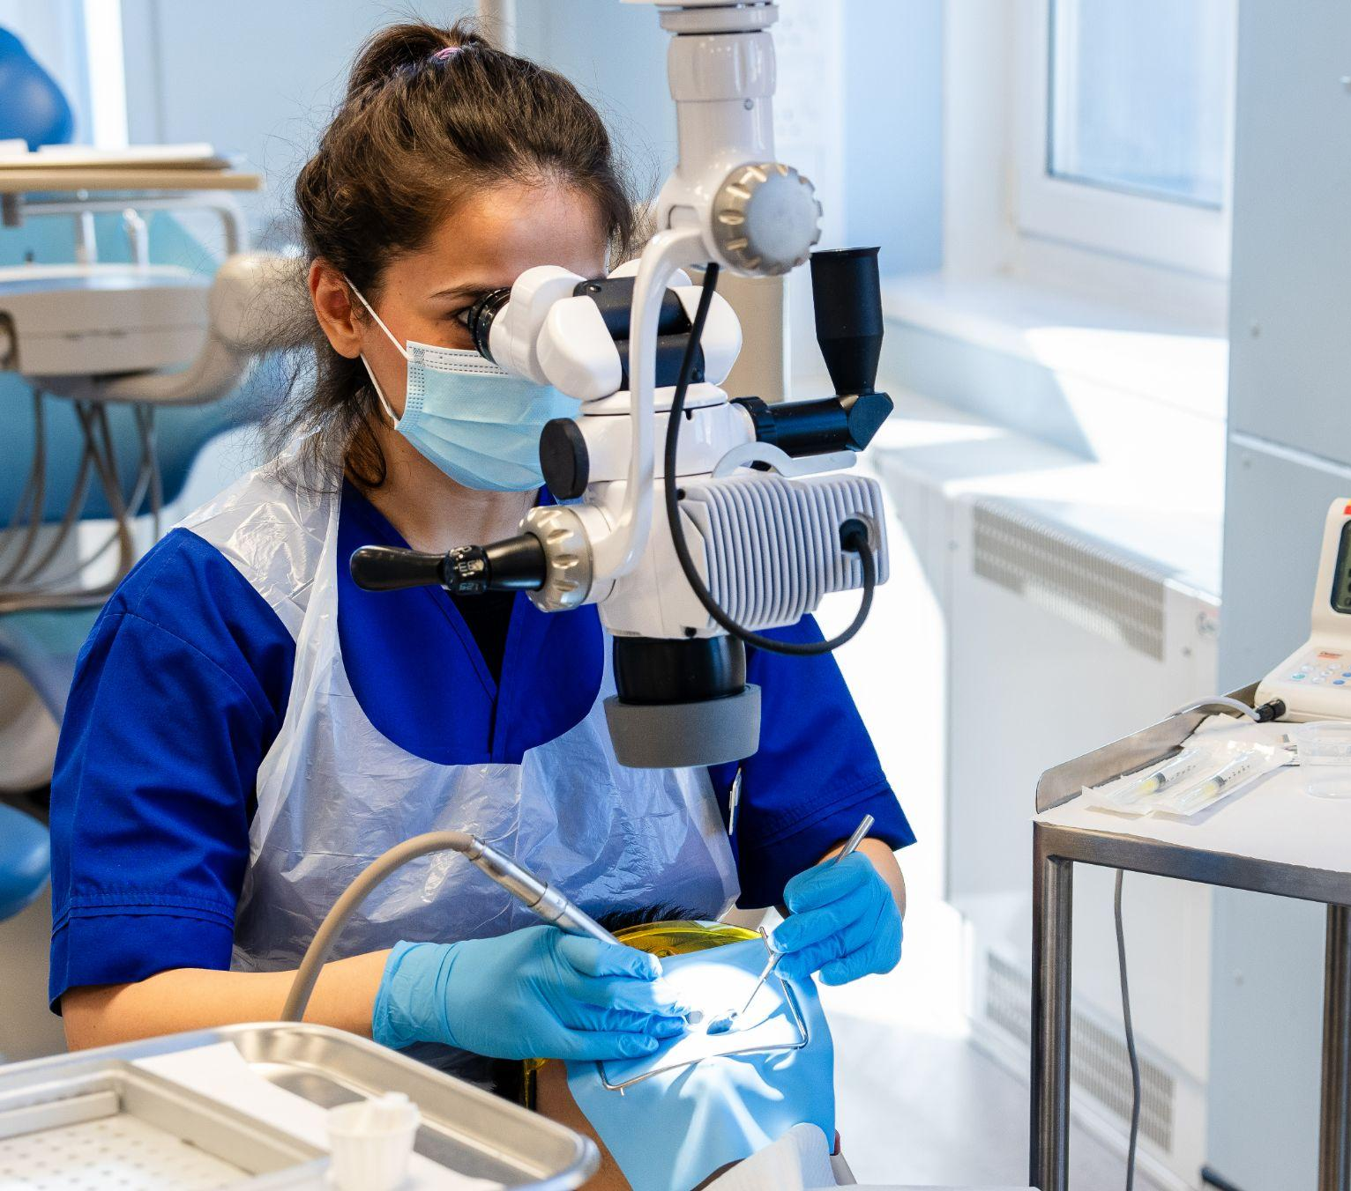
INTERVIEW PREPARATION
Interviews are challenging!
Prepare well by making sure you:
can support your decision to study dentistry
know what the course, school, university and city have to offer
know what makes the course/school different to others
get some practice/experience before attending
17

Slide 18
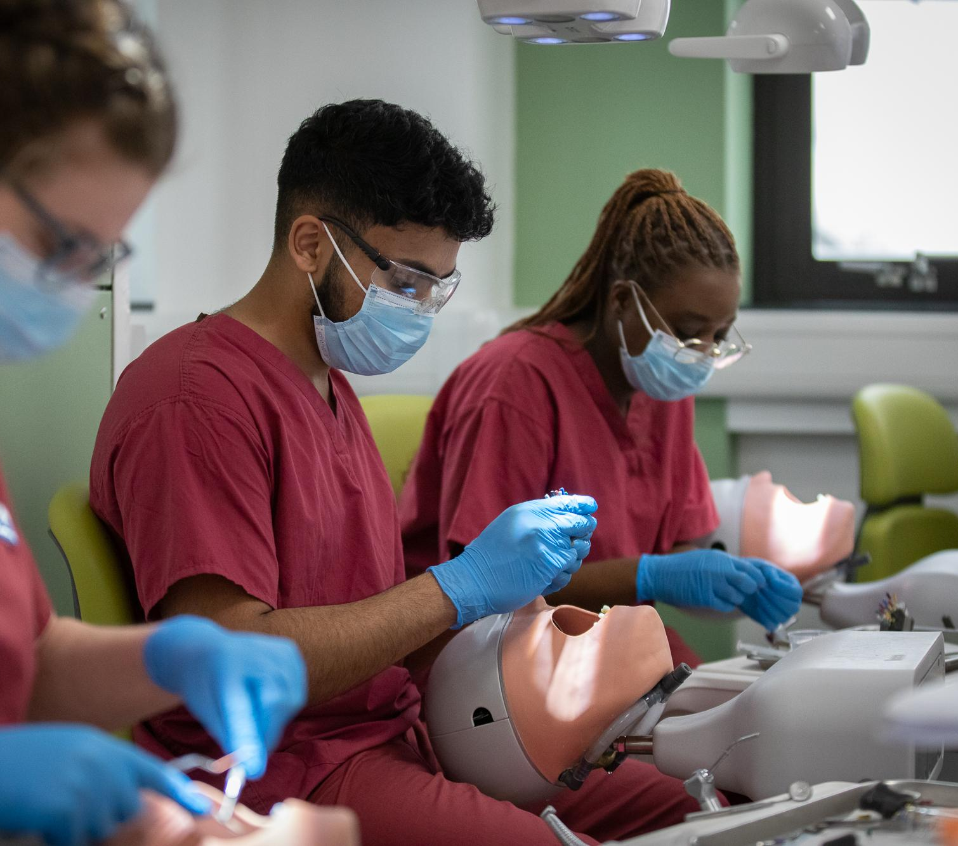
AFTER YOUR INTERVIEW
Offers are made following a selection process after all interviews are completed
We aim to process the decisions by the end of March but this may run into April
18

Slide 19
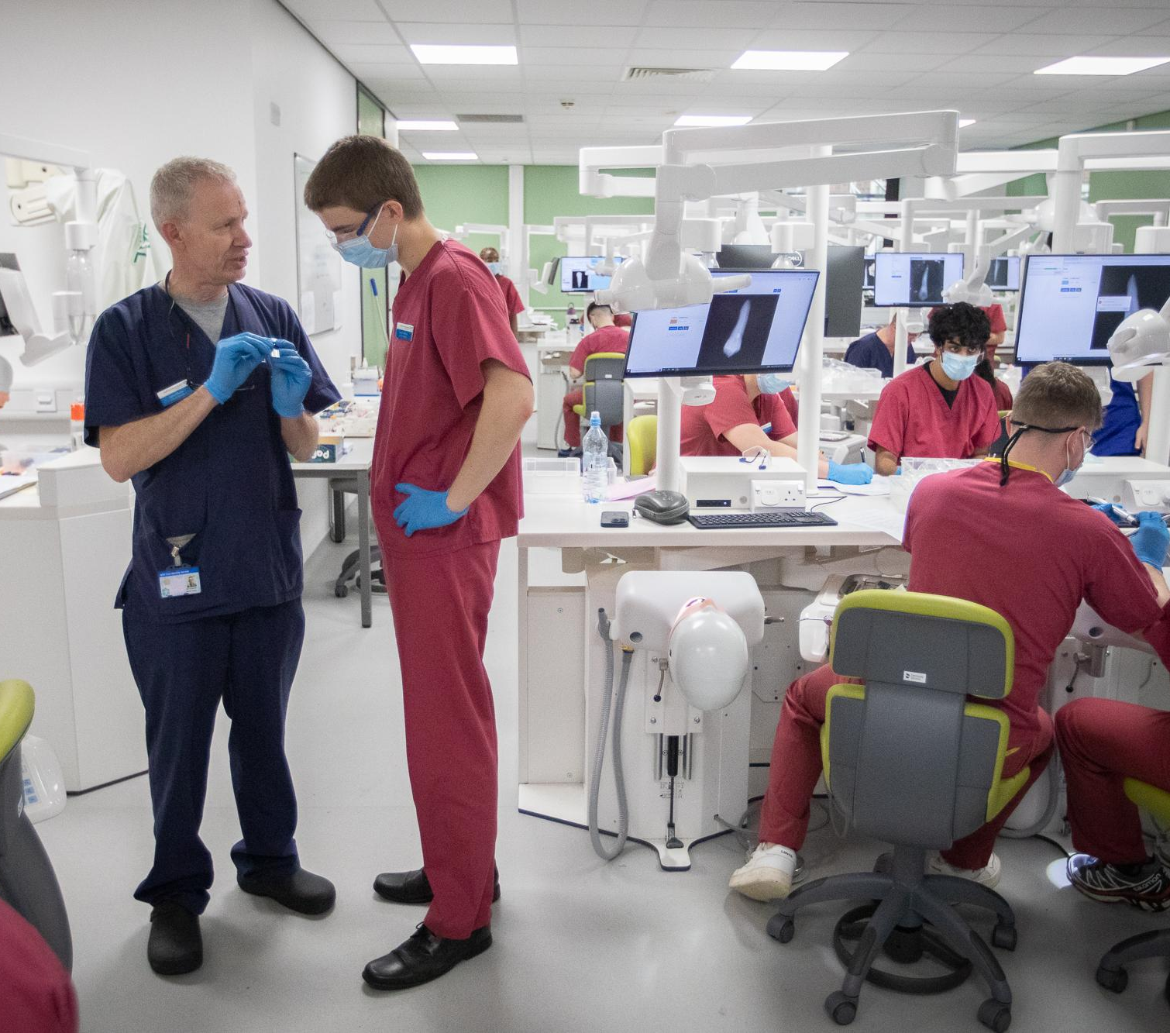
TYPICAL NUMBERS
1245 applicants
350 interviews
130 offers
90 accepts
71 candidates meet the requirement of the offer
Details for the last five years are available on our website
19

Slide 20
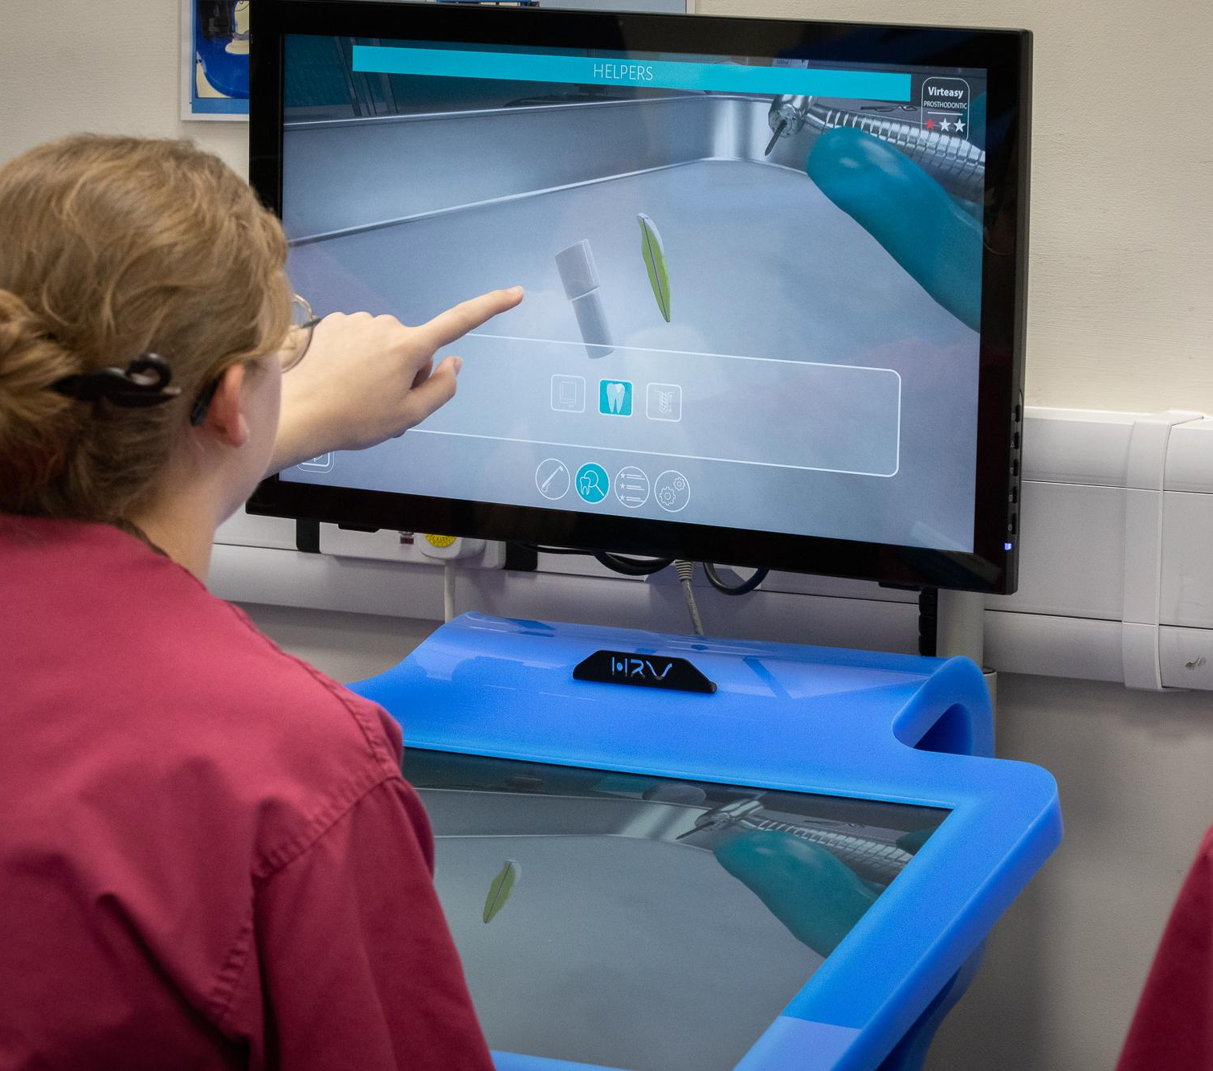
FREQUENTLY ASKED QUESTIONS
How do you use the UCAT?
Do you have a cut-off score?
Can I defer?
Do you accept resit applicants?
Do you consider the EPQ?
Do I need to demonstrate manual dexterity?
How much work experience do I need to do?
20

Slide 21
RESOURCES
Dental Schools Council: www.dentalschoolscouncil.ac.uk
Studying healthcare: www.studyinghealthcare.ac.uk
UCAT: www.ucat.ac.uk
Contact us: dental.admissions@sheffield.ac.uk
Please don’t pay any money!
21

Slide 22
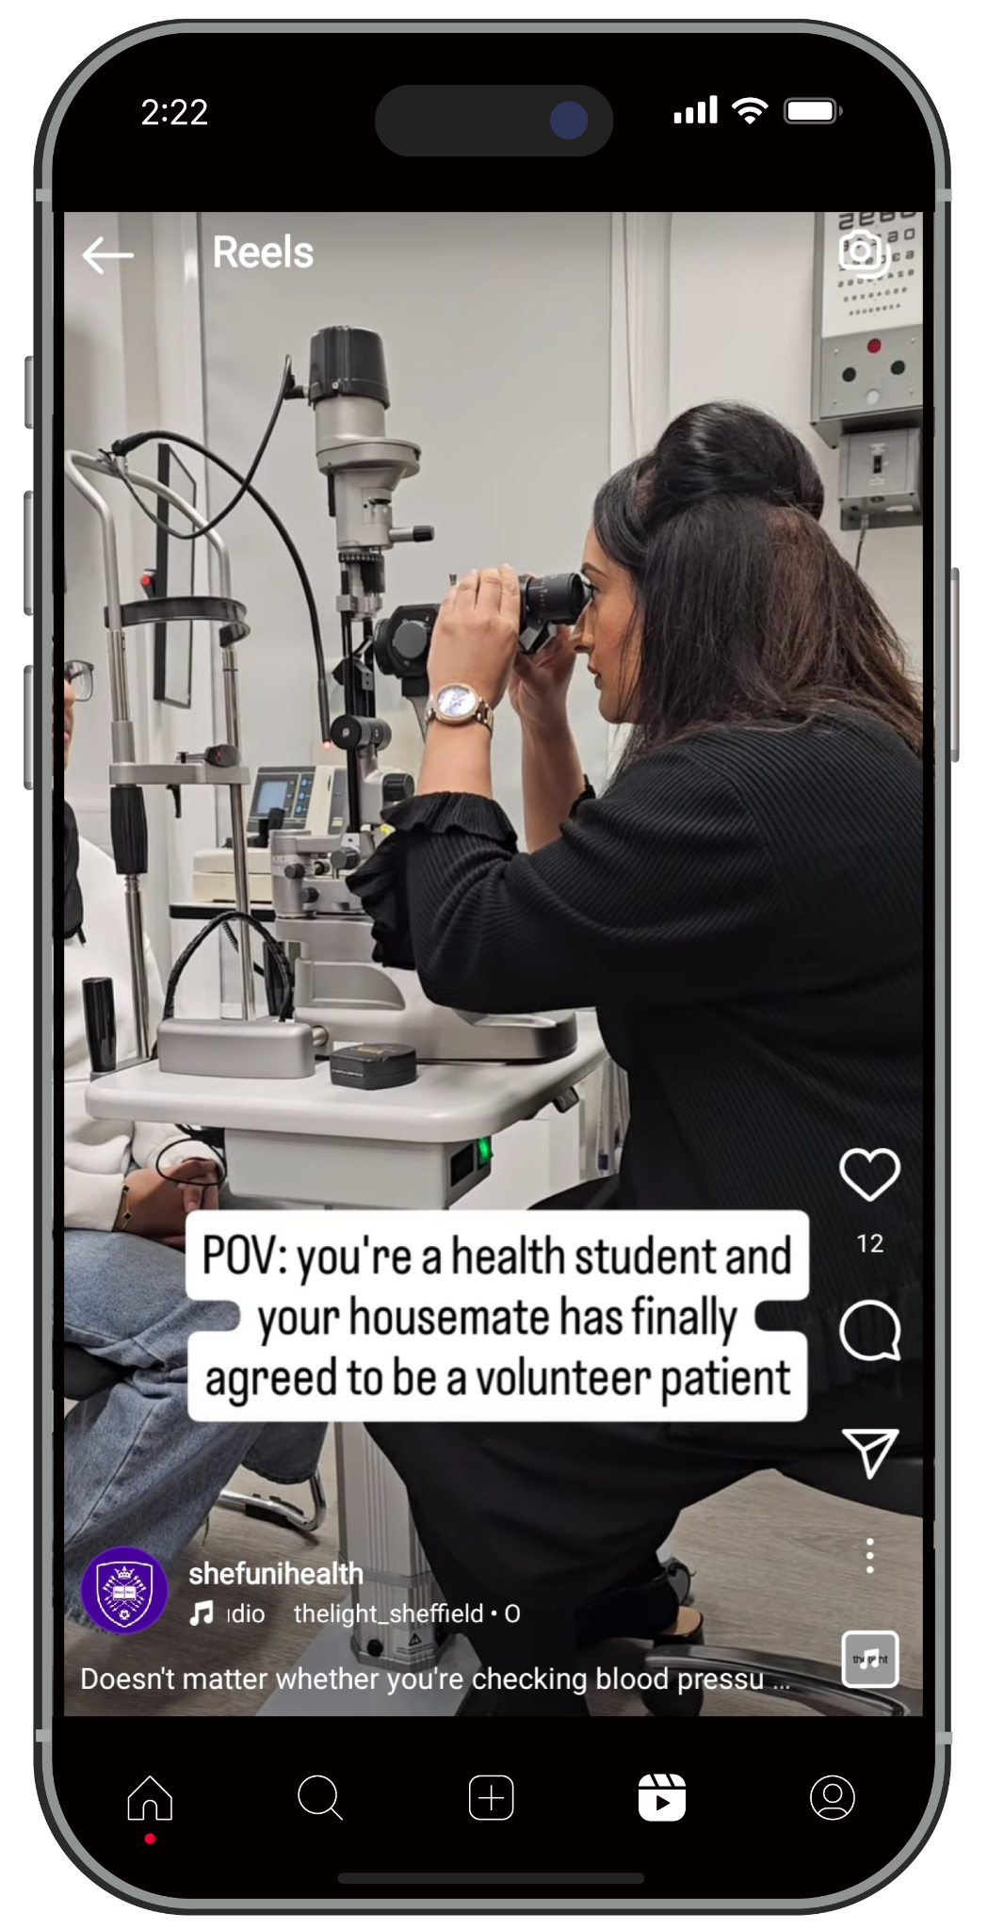
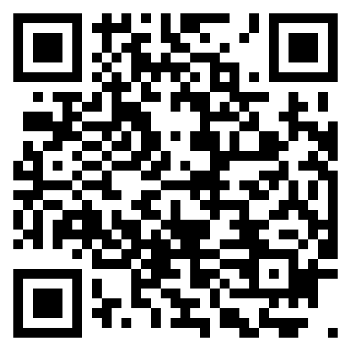
FOLLOW US ON INSTAGRAM
Get an inside look at what it’s really like to train as a health professional at Sheffield – from lectures and clinical skills sessions to placements and everything in between.
@shefunihealth

Slide 23
VISIT OUR EXHIBITIONS
Visit our exhibitions in The Quad, at Goodwin Sports Centre and outside the Information Commons. Experts can answer your questions on:
Access Sheffield
Accommodation
Admissions
Careers and employability
Disability and Dyslexia support
Sport
Student fees and funding
Year abroad
Advice for parents and supporters
Safety on campus
23

Slide 24
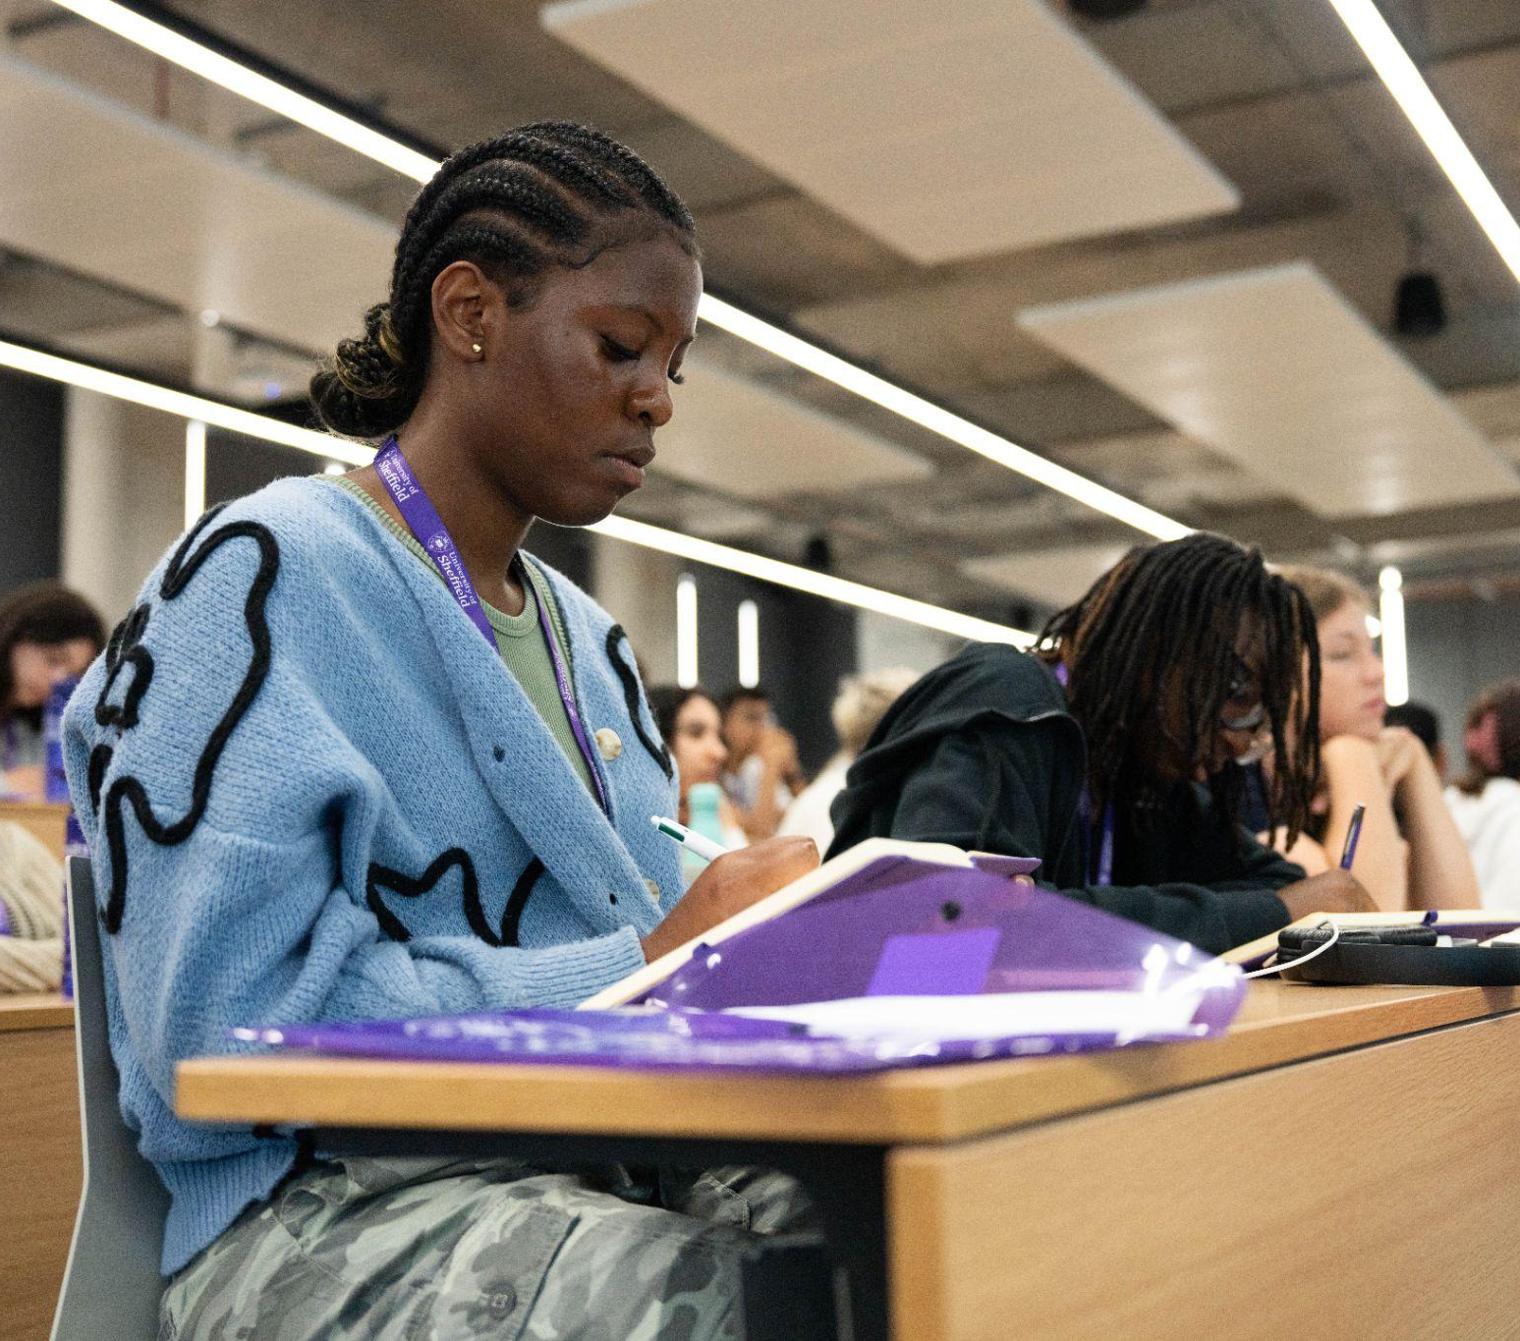
ACCESS SHEFFIELD
Do you face extra hurdles getting to uni?
Students from underrepresented groups
get extra support via Access+. You could
be eligible even if you haven’t considered
it before. Support includes:
Travel bursaries for open days
and offer holder days
Access+ contextual offer - a lower
offer on grade requirements
A dedicated support team
Visit the information fair in the Octagon
to chat to us and find out more.
24

