Slide 1
Reimagining ‘becomings’: Disrupting notions of ‘ought’ selves among doctoral and early career researchers who teach
Researcher Education & Development Scholarship Conference, 25 October 2018
Sarah Moore, The University of Sheffield
sarah.moore@sheffield.ac.uk @saharafudge

Slide 2
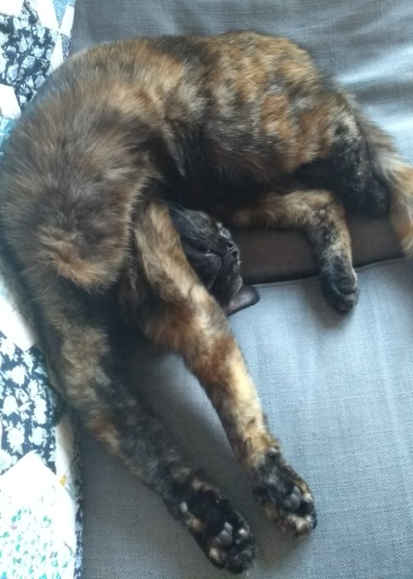
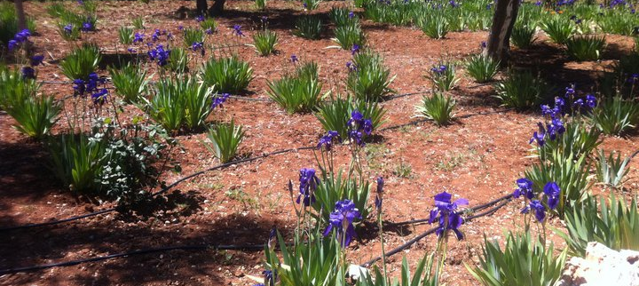
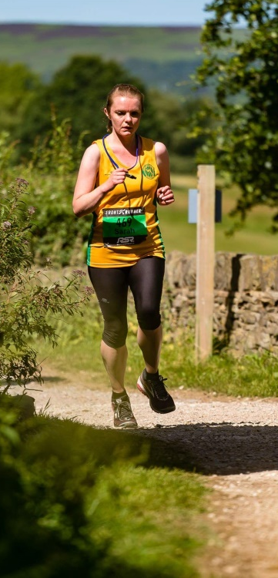
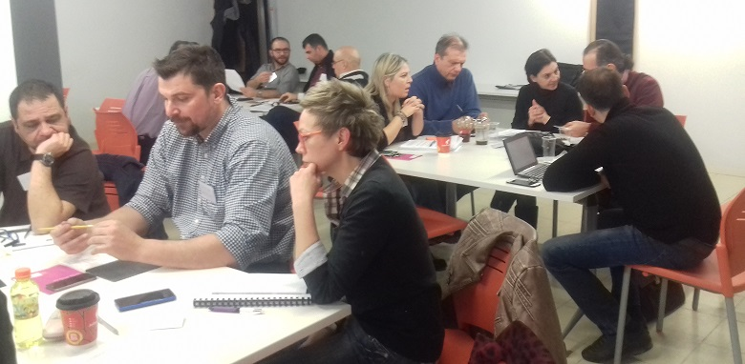
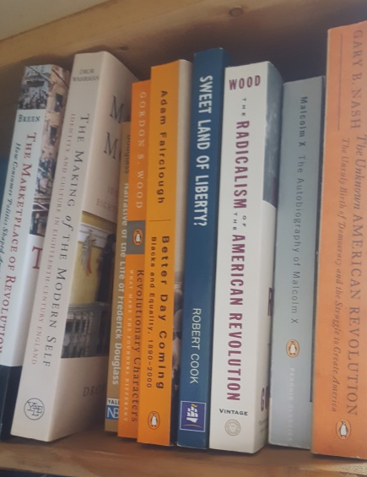
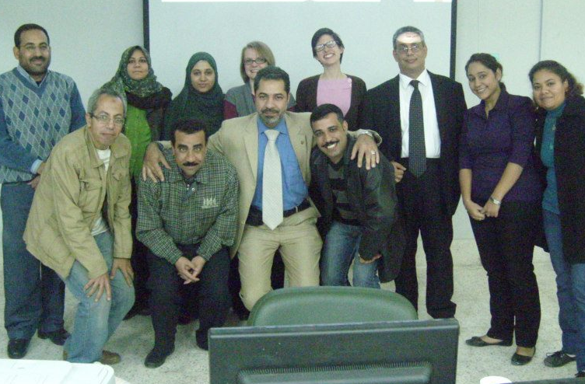
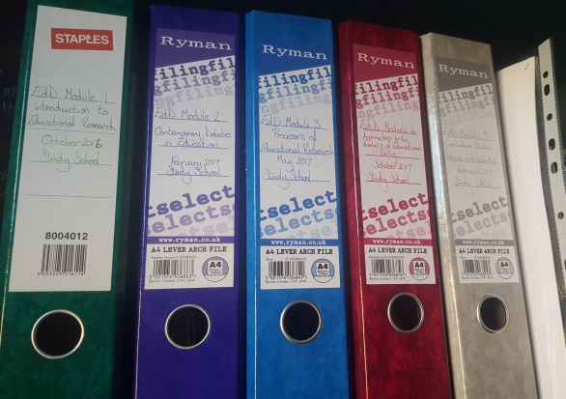
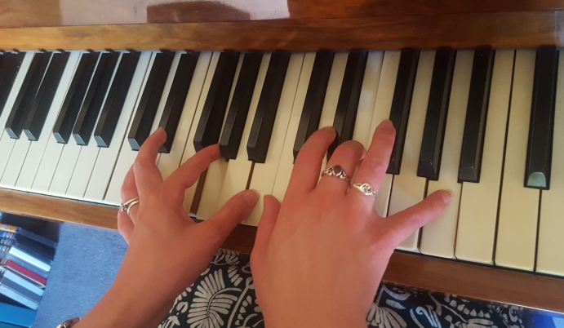
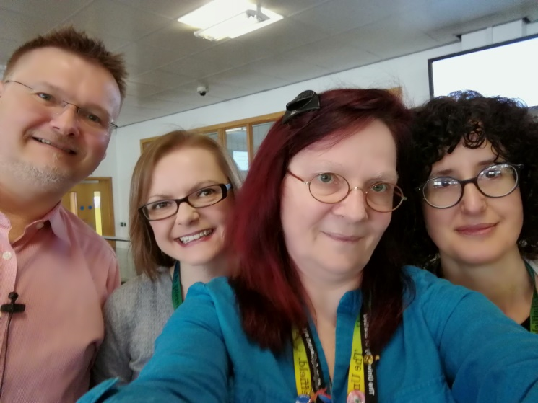
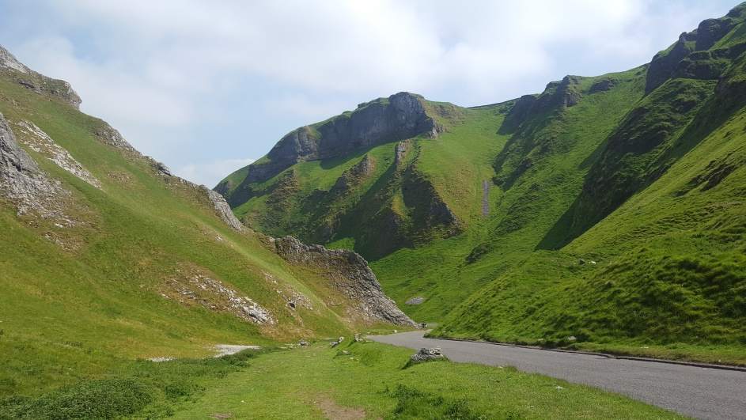

Slide 3
Position of doctoral and early career researchers in HE
Casualised, precarious, pressured
Responsibilities often held in tension with each other (Fitzmaurice, 2013; Jawitz, 2009, Clegg, 2008)
Research and teaching
Discipline and institution
Home and university
Liminal position (Winstone and Moore, 2016)
Notes:
Liminal position – GTAs ‘trying on’ professional selves, GTA work as a ‘halfway house’

Slide 4
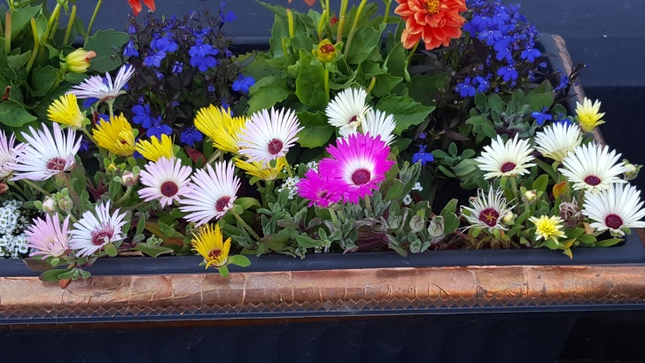
Identity construction
Conceptualised ‘not as a fixed property, but as part of the lived complexity of a person’s project’ (Clegg, 2008, p.329)
Fluid, dynamic, non-linear, ongoing, incomplete, active (Beauchamp and Thomas, 2009)
Not only individual introspection, but also through dialogue with others and broader institutional discourses and expectations (Watson, 2006; Beauchamp and Thomas, 2009)
Emotional, and often uncomfortable (Akinbode, 2013; Jones, 2011)
Messiness offers opportunity, if allowed to flourish
Notes:
Identity isn’t constructed in a vacuum
So what I said earlier about increased scrutiny on teaching practice, and of course research outputs, ideas from others including supervisors about what they’re expected to do after their PhD, will all play a part, whether consciously or subconsciously

Slide 5
“Becoming” (Todd, 2001)
“On the one hand, [pedagogy] touches on the hope that people can think differently, can change the way they relate to each other, and can form new understandings of themselves and the world that makes possible the very act of teaching and learning.”
“On the other hand…if pedagogy is about the becoming of the subject, then it can become a tool for the most oppressive ends.”
(Todd, 2001, p.435)
Notes:
So what can we learn from learning and teaching in terms of the way we work with early career researchers who teach?
Not just about survival techniques – survival professional development is a form of becoming, doesn’t take into account the messy, non-linear, emotional nature of identity construction
Assumes a deficit model (Uprichard) – focuses on what they lack rather than the agency they bring with them

Slide 6
Actual
Ideal
Ought
Adapted from Lauriala and Kukkonen (2005)
Academics create ‘spaces for the exercise of principled personal autonomy and agency’ (Clegg, 2008, p.340) – Winstone and Moore (2016) suggest early career researchers who teach do this too
Notes:
I find Lauriala and Kukkonen’s framework a helpful heuristic device when thinking about how construction of identities because it reflects how we hold together the multiple selves we inhabit.
Actual self – who we are at any one time (recognising of course that identities are plural, dynamic and constantly in development).
Ought self – who we think we should be (recognising that some elements of an ‘ought’ self are necessary in professional contexts).
Ideal self – who we aspire to be (recognising that this is often constrained, consciously or subconsciously, by the reality of the world around us).
Of course, all three of these are potentially contributing parts of an individual’s construction of self at any one time. When exploring professional selves however, there is a risk that teachers put forward a version of themselves, either consciously or subconsciously, that they believe the listener wants to hear.
Winstone and Moore talk about malleability

Slide 7
Reimagining “becomings”
Fictionalised accounts (Ball, 1984)
Graphic novels (Bjartveit and Panayotidis, 2014)
Concept maps (McMillan and Gordon, 2017)
Cartoons (Fashanu, 2017)
Video/photography (Taylor et al, 2011)
Stimulated recall (Baker and Lee, 2011; Rowe, 2009)
Notes:
How do we help them make sense (or not) of the messiness?

Slide 8
Disrupting “ought” narratives: a work in progress
Title: A critical exploration of if, and if so, how, GTAs’ perceptions of their role as teachers in Higher Education influence their classroom practice.
Draft research questions:
How do GTAs perceive their role as teachers in UK higher education?
What influences these perceptions?
What is the relationship between these perceptions and the decisions that GTAs make in the classroom?
How far do GTAs feel they have agency over what they do in their day-to-day practice?

Slide 9
Disrupting “ought” narratives: a work in progress
Data creation:
Initial concept mapping of the role of the teacher (by participants)
Recording of 3x teaching sessions and reflective discussion on recording and mapping (researcher and individual participants)
Data analysis and (re)presentation:
Narrative analysis of concept maps and reflective discussions, and co-production of individual fictional narratives
Notes:
Initial concept mapping – to see how new teachers perceive their role and the influences on their practice
Reflection based on recordings – can be stopped and started. Role of the researcher is to ask questions- what’s going on here? Why did you take this approach? How are you feeling at this point? Exposing and disrupting dominant discourses
Production of narrative can be based on any format
Peer discussion – creation of a network, also to discuss how the research should be disseminated

Slide 10
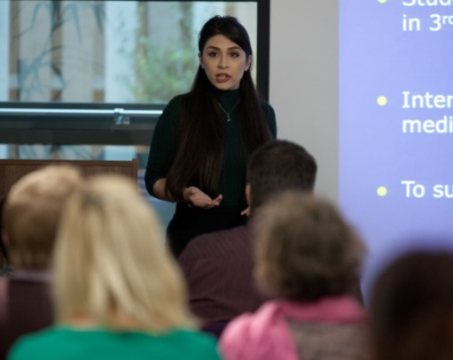
What does this mean for researcher professional development?
How far do we focus on the affective, not just cognitive and skills-based development
How far do we as professionals embrace and model messiness?
What values, experiences, assumptions are we bringing to our interactions with doctoral and early career researchers?
How do we honour the diverse voices of doctoral and early career researchers in professional development activity?
What spaces can we provide for early career researchers to enact Clegg’s (2008, p.340) ‘principled personal autonomy and agency’?
What methods of “imagining” could we use?
Notes:
How do we help them make sense (or not) of the messiness?

Slide 11
References
Akinbode, A. (2013) Teaching as lived experience: the value of exploring the hidden and emotional side of teaching through reflective narratives. Studying Teacher Education, 9(1), 62-73.
Baker, A. and Lee, J. (2011) Mind the gap: Unexpected pitfalls in doing classroom research. The Qualitative Report, 16(5), 1435-1447.
Ball, S. (1984) Beachside reconsidered: Reflections on a methodological apprenticeship. In: R. Burgess (ed) The Research Process in Educational Settings: Ten case studies. London, The Falmer Press. pp.69-96.
Beauchamp, C. and Thomas, L. (2009) Understanding teacher identity: an overview of issues in the literature and implications for teacher education. Cambridge Journal of Education, 39(2), 175-189.
Bjartveit, C. and Panayotidis, E. (2014) Pointing to Shaun Tan’s The Arrival and re-imagining visual poetics. Contemporary Issues in Early Childhood, 15(3), 245-261.
Clegg, S. (2008) Academic identities under threat? British Educational Research Journal, 34(3), 329-345.
Fashanu, C. (2017) Collaboration through cartoons: Drawing cartoons to assist collaborative ethnography with young children. Review of Social Studies, 4(2), 1-18.
Fitzmaurice, M. (2013) Constructing professional identity as a new academic: A moral endeavour. Studies in Higher Education, 38(4), 613-622.
Jawitz, J. (2009) Academic identities and communities of practice in a professional discipline. Teaching in Higher Education, 14(3), 241-251.
Jones, A. (2011) Seeing the messiness of academic practice: exploring the work of academics through narrative. International Journal for Academic Development, 16(2), 109-118.

Slide 12
References
Lauriala, A. and Kukkonen, M. (2005) Teacher and student identities as situated cognitions. In: P. Denicolo and M. Kompf (eds) Connecting Policy and Practice: Challenges for teaching and learning in schools and universities. Oxford, Routledge. p.199-208.
Leigh, J. (2016) An embodied perspective on judgements of written reflective practice for professional development in Higher Education. Reflective Practice, 17(1), 72-85.
McMillan, W. and Gordon, N. (2017) Being and becoming a University teacher. Higher Education Research and Development, 36(4), 777-790.
Rowe, V. (2009) Using video-stimulated recall as a basis for interviews: Some experiences from the field. Music Education Research, 11(4), 425-437.
Taylor, C., Downs, Y., Baker, R. and Chikwa, G. (2011) “I did it my way”: Voice, visuality and identity in doctoral students’ reflexive videonarratives on their doctoral research journey. International Journal of Research & Method in Education, 34(2), 193-210.
Todd, S. (2001) “Bringing more than I contain”: Ethics, curriculum and the pedagogical demand for altered egos. Journal of Curriculum Studies, 33(4), 431-450.
Watson, C. (2006) Narratives of practice and the construction of identity in teaching. Teachers and Teaching, 12(5), 509-526.
Winstone, N. and Moore, D. (2016) Sometimes fish, sometimes fowl? Liminality, identify work and identity malleability in graduate teaching assistants. Innovations in Education and Teaching International, 14 June 2016, 1-9.

