Slide 1
Networking & career seeking as
Planned Behaviour
experiences of engaging with an
online mentoring platform for
careers beyond academia.
Steph Ward & Kay Guccione
University of Sheffield
@CareerPostPhD

Slide 2
Tacit ideas, insight, and cultural information about a role or workplace are more rich if delivered by an insider.
Social networks matter in career development and the effectiveness of a network depends on the occupations and experiences of the contacts (Podolny and Baron,1997; McDonald, 2011)

Slide 3
Researchers report that ‘doing networking’ is a ‘painful process’; a ‘necessary evil’:
Engaging in ‘networking’ (taking action to build career-related social networks) is a critical factor in career development (e.g. Wolff & Moser, 2009) and a core researcher competency (Vitae, 2010).
What do I want?
Will my supervisor find out?
Will I know what to say?

Slide 4
Why do we engage with activities?
(Theory of Planned Behaviour: Azjen, 1991)
We feel we’ll benefit
It fits within cultural norms and expectations
We believe we have the ability & control

Slide 5
Why do we engage with activities?
(Theory of Planned Behaviour: Azjen, 1991)
We feel we’ll benefit
What do I want?
It fits within cultural norms and expectations
Will my supervisor find out?
We believe we have the ability & control
Will I know what to say?

Slide 6
The power of ‘norms’
For many the post-PhD transition is characterised by exploitative, unsustainable working conditions, emotional upheaval, financial worry, and poor wellbeing. Despite this, most PhD graduates remain absolutely determined to forge an academic career, unwilling to even entertain the idea of working in another sector. This paradoxical condition can be seen as a type of ‘cruel optimism’, with early-career researchers remaining attached to the fantasy of the academic ‘good life’ despite a precarious lived reality. This may be attributable to the culture of doctoral training which centralises academic careers as the ‘norm’, devalues other career paths as ‘alternative’, and views leaving academia as ‘failure’ (Thouaille, 2018).
cruel optimism, the ‘condition of maintaining an attachment to a significantly problematic object’ (Berlant, 2011, p. 125).

Slide 7
The v i s t a mentoring portal
Automated
Responsive
Compliant
User controlled
Process
Authentication
Induction
Profile
Availability
Browse
Select
Connect
[mentoring]
Evaluation

Slide 8
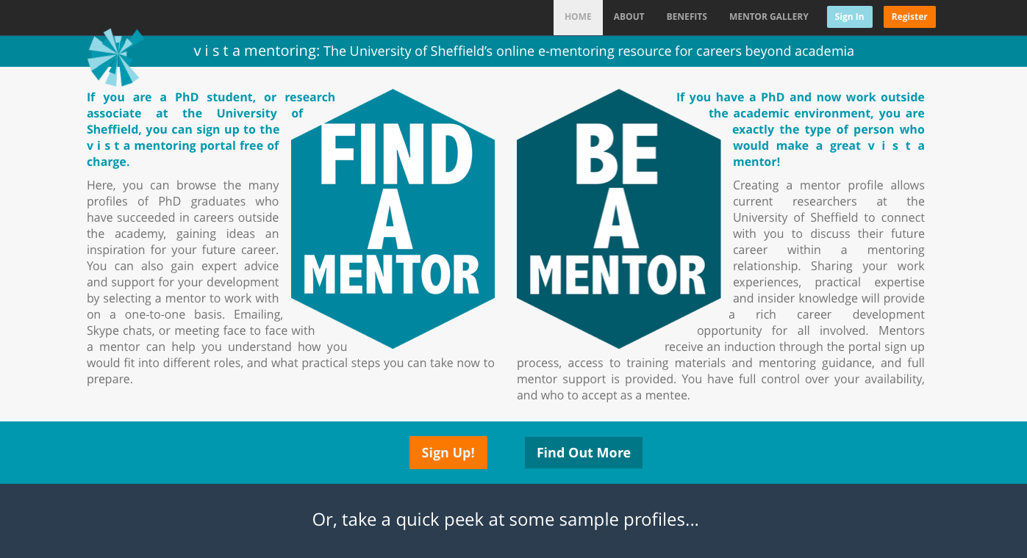
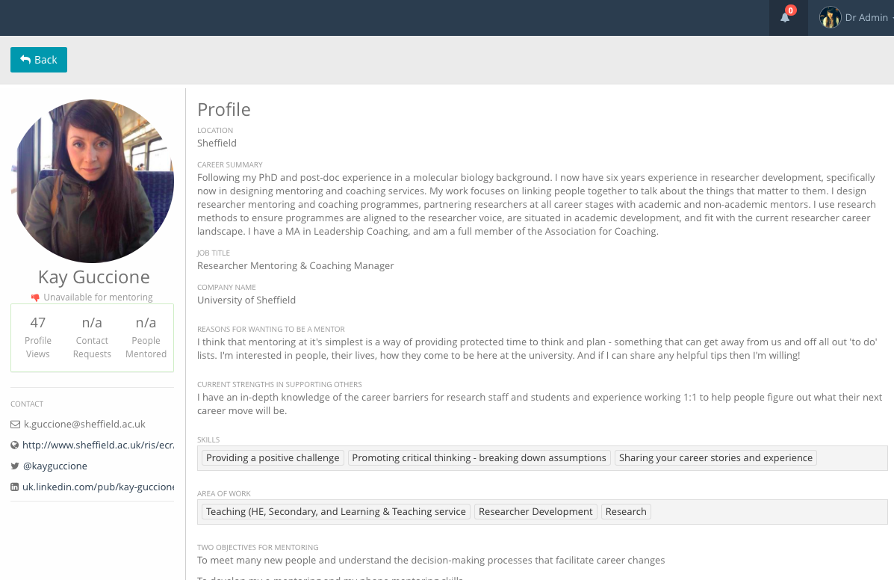
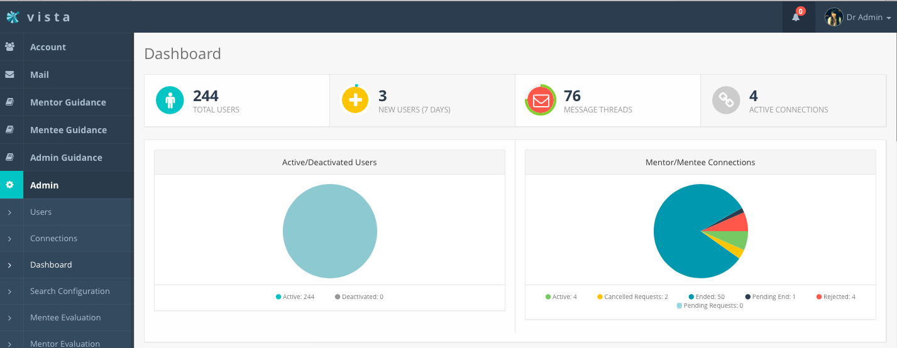

Slide 9
OUTCOMES, researchers gained:
Alternative perspective
Familiarity with new roles
Networking skills
Long term contact
Communication skills for applications
Interview technique
Career planning opportunity
Decision making
Confidence
Motivation
3 User interviews: themes
New cultural norms and expectations
Better ability & sense of control

Slide 10
OUTCOMES, researchers gained:
3 User interviews: themes
New cultural norms and expectations
He gave me the perspective of what he’d look for. It's nice to get that inside perspective of the job…they’re people that have got a PhD at Sheffield so you can kind of familiarise yourself
they gave me a fair judgment of what leaving it might be like to leave and it was certainly a big influence in making that decision because you don’t really get much chance to speak to people like that.
it seemed like a ‘proper job’ where as academia isn’t in a way and is quite different. So to actually speak to someone who does that job helped me realise that they're just a normal person that was really helpful.
Better ability & sense of control
It was through chatting to him about it that I got my confidence about it back and realised I could definitely do it.
how many different things they’ve go onto to do so a real insight into how diverse successful PhD careers can be was something I gained from it.
The more I learnt about it the more I thought ‘yeah I could definitely do something like this and it ticks all the boxes’.

Slide 11
…involves a propensity to return to the ‘scene of fantasy’ as a result of the ‘emotional habitus’ that has been built up around the object of desire. In this case then, cruel optimism ‘is not just a psychological state’, Indeed, it may not even ‘feel optimistic’ as it can ‘manifest as a range of emotions. One might be flooded and feel numb, overwhelmed, teary, angry, detached, capacious, sleepy, or whatever’. What makes this affective structure cruel is that the thing one desires and develops attachments to (such as the idea of a ‘secure’ job in the academy, or the university as a ‘retreat’ from stress) may in fact be ‘an obstacle to your flourishing’. This ‘double-bind’ means that ‘massive loss is inevitable if you stay or if you go’. Understanding the double-bind of loss may get us closer to why it can be so difficult for students to re-mould existing forms of attachment to the PhD.
(Burford, 2018)
It’s not just about ‘supervisor permission’ it’s very hard to let go
of a dream
of the
perfect
job
1:1 coaching can build self awareness and optimism, hope confidence and positivity
(Archer, 2017).

Slide 12
messages
Transition in new career paths is enhanced by a professional network.
We can build initiatives that support network building in a palatable way.
Being ‘ready to leave’ involves some letting go/grieving, as well as new info
1:1 partnerships support sensemaking, not passive receipt of information
Peer relatability has impact in ‘re-norming’ what happens at the end of the PhD
Change happens over time, with sustained contact
It’s not all about supervisor ‘permission’ to engage
Also about finding positive role models, who support emotional development
The (voluntary, boundaried, defined) process of engagement is important

Slide 13
Ajzen, Icek (1991). "The theory of planned behavior". Organizational Behavior and Human Decision Processes. 50(2): 179–211. doi:10.1016/0749-5978(91)90020-T
Archer, S., & Yates, J. (2017). Understanding potential career changers’ experience of career confidence following a positive psychology based coaching programme. Coaching: an International Journal of Theory, Research and Practice, 0(0), 1–19. http://doi.org/10.1080/17521882.2017.1292535
H G. Wolff, K. Moser. (2009) Effects of networking on career success: A longitudinal study. Journal of Applied Psychology, 94 pp. 196-206, 10.1037/a0013350
Podolny, J. M. and Baron, J. N. (1997). Resources and relationships: Social networks and mobility in the workplace. American Sociological Review. 62(5) 673-693
McDonald, S. (2011). What you know or who you know? Occupation-specific work experience and job matching through social networks. Social Science Research. 40(6): 1664—1675.
Vitae (2010), Researcher Development Framework, available at: www.vitae.ac.uk/CMS/files/upload/Vitae‐Researcher‐Development‐Framework.pdf (accessed 25 June 2018).

