Slide 1
Supportive and Sustainable: Creating an Interactive PGR Community at the University of Northampton
Anthony Stepniak, Maitreyee Buragohain, Sue Watling REDS conference, 25 October 2018 Coventry University

Slide 2
Our Vision To develop a collaborative, supportive, innovative research community to transform lives, create impact and inspire change

Slide 3
Aims and Objectives
To create a multi-functional PhD support group to increase engagement, wellbeing and participation through the use of ABL
To sustain the FEASST@8’s CAIeRO informed curriculum development to create and deliver ABL-led activities
To use ‘learning by doing’ and ‘work-placement’ to develop students’ digital literacy through engaging with and contributing to the multi-functional peer support group
To establish an online community to overcome PhD students’ isolation and thus support their wellbeing and mental health
To make the experience and resulting digital artifact available to others and embed them as part of the discipline-based development and annual review

Slide 4
What is the problem?
Isolation from events and peers
A diverse Doctoral cohort

Slide 5
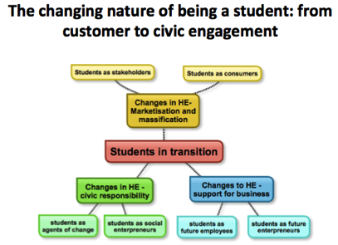
The starting points …
POINT 1
The role, identity, and expectations we have of our students have changed.
Yet, PGR/PhD students have remained an unknown and invisible cohort whose potential for innovation is untapped and wasted.
POINT 2
The FEH cohort is varied in terms of age, professional experience, motivations, and ability to benefit from what is currently available.
While diversity is a strength, it can also be a limitation.
SuCCEED@8 started a process of inclusion valuing diversity and enabling equity.

Slide 6
PhD students face:
Isolation
Low self-esteem
Anxiety
Depression
Stress
Loneliness

Slide 7
Work done so far
Formed a community of PhD students
Peer Support sessions
Blog writing
Abstract writing workshop
Website Facebook group Twitter page

Slide 8
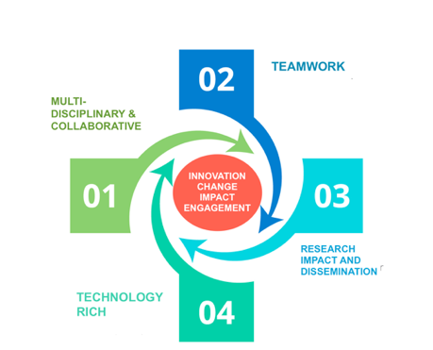
How have we done it?
Education, History, ECW, Business
Each is a leader, manager and administrator. We take team responsibility
Website, blogs, Twitter, Facebook
UKCGE workshop, support for PhD induction, Support for UoN conference, Chancellor Fund, Learning & Teaching conference

Slide 9
Impact & Reach
@Succeedat8
36 members and growing
PhD Northampton
Achievements so far
Faculty PhD Induction (October 2017 and March 2018)
Support through ABL 6 PhD students to write and successfully submit abstracts to ECER conference
Support the organisation of the UoN conference
Provide training for abstract and blog writing
Contribute to Graduate School Update Day on wellbeing & resilience (June 2018)
Increase the visibility of doctoral programme at UoN
Keynote at UKCGE workshop for deans of Graduate Schools
Submission to REDS conference on PhD careers and employment
UoN PGR workspace launch

Slide 10
Skills developed as co-researchers
Digital skills
Communication
Leadership
Networking
Collaboration

Slide 11
Postgraduate Research
Experience Survey 2018

Slide 12
PRES 2018 results
Only around 63% of PGR students are satisfied with their research culture, and their opportunities to collaborate with other students
Improving this aspect potentially holds the key to driving improvements in satisfaction overall but also with providing students a way to experiment with post-PhD opportunities

Slide 13
PRES 2018 Skills training and advice

Slide 14
PRES 2018 results
Yet less then 50% of PGR students are satisfied with the support they receive in applying the skills they learn and in developing a career plan
Improving this aspect potentially holds the key to enabling students to make informed choices during and after their studies

Slide 15
Ongoing and Future plans: A PGR Community
UoN is moving forward to build a stronger PGR community inclusive of students, supervisors and student support services
Increase the number of PGR students involved as researchers or co-researchers in projects
Expanding the opportunities of students to take part or lead in research and innovation projects
Dedicated support through Changemaker Hub and Graduate School ECRs training and staff development

