Slide 1
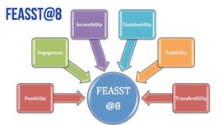
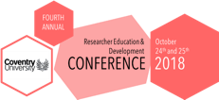
Life Beyond a PhD: Working with PhD students as co-researchers to re-imagine their employability skills
Embarking on a PhD should be a journey lasting a lifetime of discovery
A job would be nice too!
Cristina Devecchi
University of Northampton REDS conference, 25 October 2018 Coventry University

Slide 2
Preamble
UK universities are under increasing accountability pressures to ensure that their students are ready for employment. Cast within the mantra of ‘value for money’, this discourse is mainly framed within a utilitarian modernist view of human capital as the cumulative aggregation of discrete skills.

Slide 3
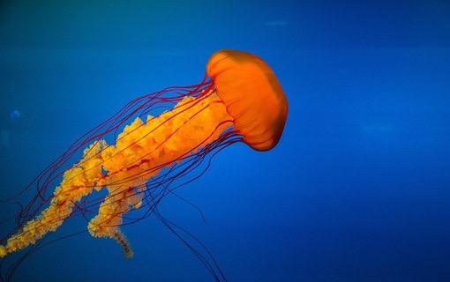
A proliferation of petrifying and slippery skills
Core skills,
Researcher skills,
Transferable skills
Soft skills
Hard skills
Skills for life …
The skill discourse presupposes a common agreement on what skills are needed now and in the future (Bridges, 1993). Such a managerialist and reductivist discourse (Craswell, 2007) erases the complexity of addressing the interplay between skills, attitudes, competencies but also motivation and personal development, and the economic and geopolitical forces which shape the available opportunities.

Slide 4
Scylla, Charybdis and the treacherous waters of employability
The nature and purpose of a PhD is caught between the Scylla of Humboldtian memory and the Charybdis of transferability while navigating the unchartered waters of employability outside the ‘safe’ harbour of academia.

Slide 6
Solution @UoN
Co-learning by doing

Slide 8
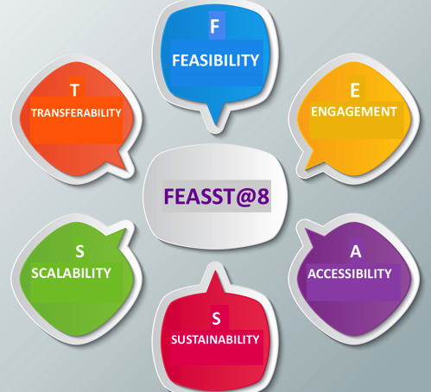
FEASST@8

Slide 9
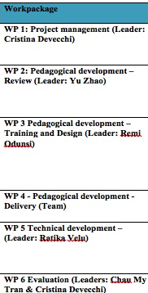
FEASST@8 at a Glance
Core values
Aims
Project management
Community
Student Choice & Autonomy
Student Voice
Active discovery
Applied concepts
Innovative guided learning path
Accessibility
Strands

Slide 10
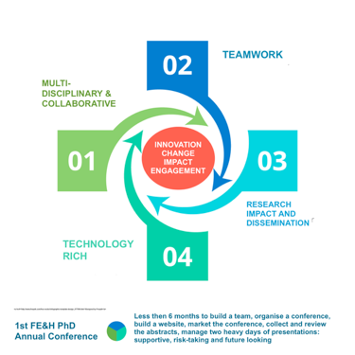
1st FE&H PhD Conference

Slide 11
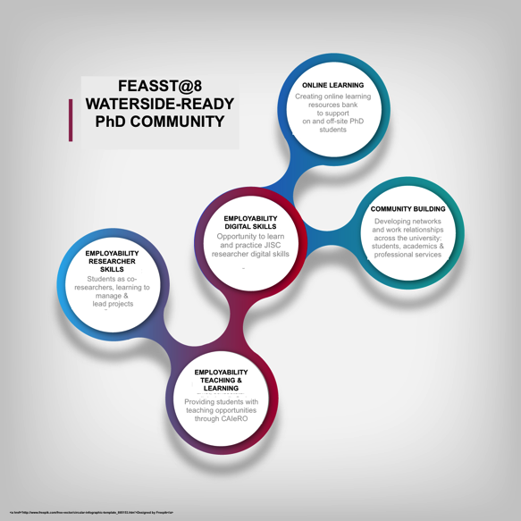
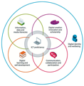
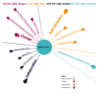
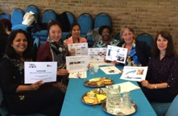
A combination of skills
JISC Digital capabilities
ChANGE Graduate Attributes

Slide 12
What did we learn and what is the impact?
What we have learnt
What is the impact?
To work together
To think outside the box
To solve problems
To network
To deliver
To embrace change
To aspire
To imagine a different future
Intrapreneurial mind-set
Reaching out – networking
Increased confidence
Closer ties with student reps
Digital skills confidence
Organising future PhD students’ led events
Notes:
Cristina
I will put this together once I have your side of the story

Slide 13
Recommendations

Slide 14
Final considerations There is no single recipe to equip students with they they might need It is our responsibility to create opportunities for learning skills, competences and develop attributes and attitudes We should do this:
Through ‘learning by doing’ using a collaborative and inclusive approach
Work with students as colleagues
Harness their innovation and commitment, motivations and inspiration
Embed this approach within the organisation structure and culture

Slide 15
Thank you!
Any Questions?

Slide 16
References
Bridges, D. (1993) Transferable skills: A philosophical perspective, Studies in Higher Education, 18:1, 43-51
Craswell, G. (2007) Deconstructing the skills training debate in doctoral education, Higher Education Research & Development, 26:4, 377-391
Disney, T. et al (2013) Doctoral researcher skill development: Learning through doing. Planet, 27, 2, 14-20
VITAE (2011) Researcher Development Framework. London: VITAE

