Slide 1
Notes:
This is a presentation of the theory behind a workshop called ‘I’ve got a PhD, what now?’
Intros
Dani – Education consultant
Anna – RD manager
We both have a background in academia, a passion for supporting PGR and ECR in their career transition and a belief in the power of reflection to support this.
This collaboration has worked well.
I have been developing this workshop for about a year, doing the leg work around understanding need, dev content
In the past few months I have been working with Anna to understanding University need and to develop the model that sits behind it, this model is grounded in theory and it has evolved naturally from research with PhD grads, empirical research and conversations with colleagues in different universities. You could say a grounded theory methodology.
We have collaborated to see how theories can work together to provide a lens through which support grads to think through the complexity of trans.
The focus of this presentation is to provide an example of how we might support our PhD graduates with some of the challenges they face navigating their career following submission and how social theories of learning can be a powerful lens through which to understand and support PhD transition.

Slide 2
Careers In Limbo: Using Social Theories of Learning to Support Doctoral Graduates in Transition
Dr Danielle White & Dr Anna Seabourne

Slide 3
Structure
Introduce Workshop
Theory behind it
Policy it responds to
What next
In Summary
Notes:
Introduce Workshop (outcomes, structure)

Slide 4
Summary of Applications
Feeling directionless
Paralysis
Feeling isolated
Desire for guidance
Desire for role models
Notes:
Main intentions of workshop participants, themes in applications received
We asked people to submit short applications explaining why they felt this course would be useful for them.
Looking through the applications the following themes came through:
People discussed feeling lost, conflicted, confused, directionless about options
Some paralysis re writing for publication or applying for work
A feeling of being alone/isolated in this process. Wanting to know how others have managed
Extra one: Some were anxious of the path they had followed so far and how it would serve them considering options they were contemplating
There is a desire to be guided whether within academic posts, in research posts or into employment.
These very much reflected some of the research I have conducted last year with PhD graduates where this sense of paralysis was very powerful in the research, this connected through into identity, especially the academic identity when considering other options.

Slide 5
Summary of Workshop Outcomes:
Develop greater clarity of career options and influencing factors
Understand PhD transition trends, common experiences and challenges
Critique myths, assumptions and perceptions detrimental to progress
Understand career-planning strategies into academic and non-academic posts
Engage in peer coaching to select career priorities and create a strategic plan to present back to the group
Build relationships of support with others across departments
Notes:
These themes map on very well to the workshop outcomes
Supporting participants in exploring their options considering values and priorities
To understand the challenges others have experienced, common themes
To dev career strategies
To dev proactive career planning
To feel motivated to take control of their career strategy

Slide 6
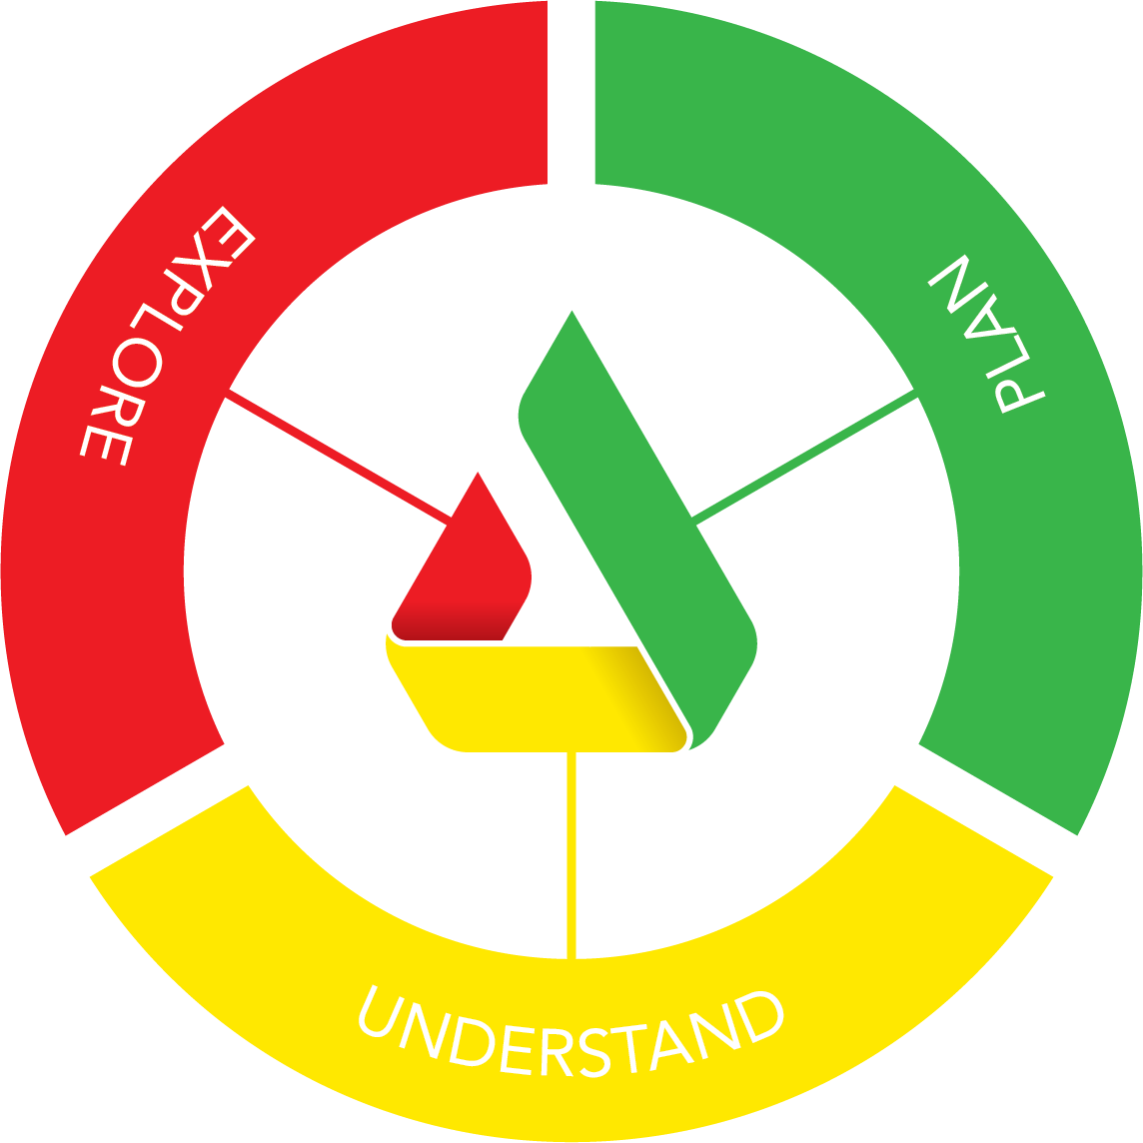
Notes:
How this theory is structured

Slide 7
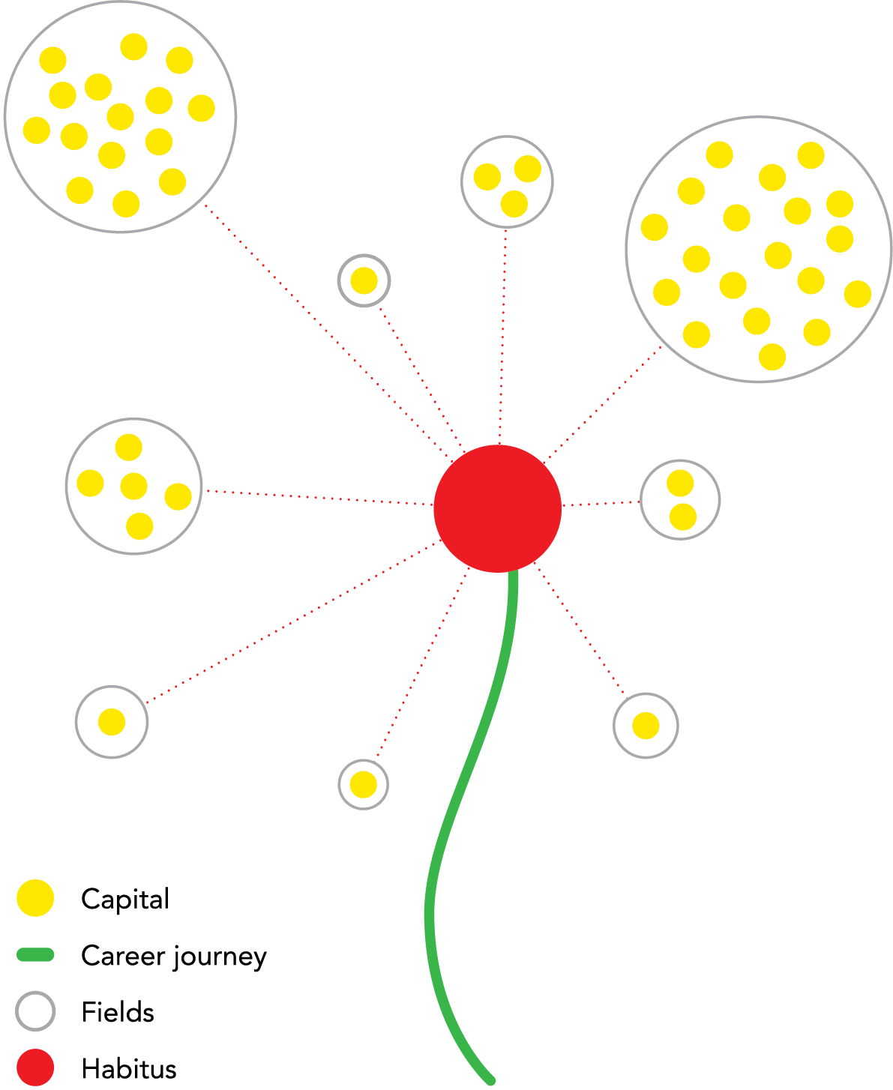
Explore
Notes:
The explore element of this diagram utilizes some of Bs thinking tools namely Capital, habitus and field.
These tools enable an opportunity for exploration of where the participant are at a moment in time, to see the development of the self and being something fluid (relates the Skeggs work) . That what is valued is dependent upon the spaces one inhabits. This kind of criticality enables the development of agency within career decision making.
When conducting research with Post grads and themes from within the empirical research reveal that following the doctorate graduates can for years work in insecure contracts, the qualitative accounts enabled me to get behind the psychology of how this feels for people. This is what has really moved me to write this workshop. For many there is a feeling if they do not achieve a role in the academy they have failed.
The theory behind this visual
Challenges identified in research and lit
Why this theory is a useful way to understand PhD trans
The activities that support this part of the workshop

Slide 8
Career Journey

Slide 9
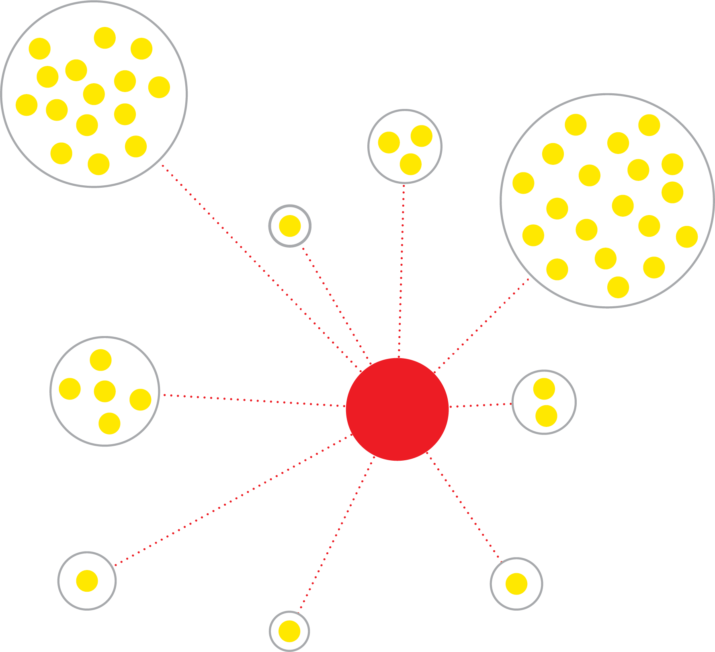
Social Networks

Slide 10
Explore
Notes:
The theory behind this visual
Challenges identified in research and lit
Why this theory is a useful way to understand PhD trans
The activities that support this part of the workshop
Understand
Enables honest conversations
Why honest conversation and factual information is important
What is covered through this part of the model
Some examples, discussion that come from this
Why useful for Phd trans convs
What I hope participants with get out of this

Slide 11
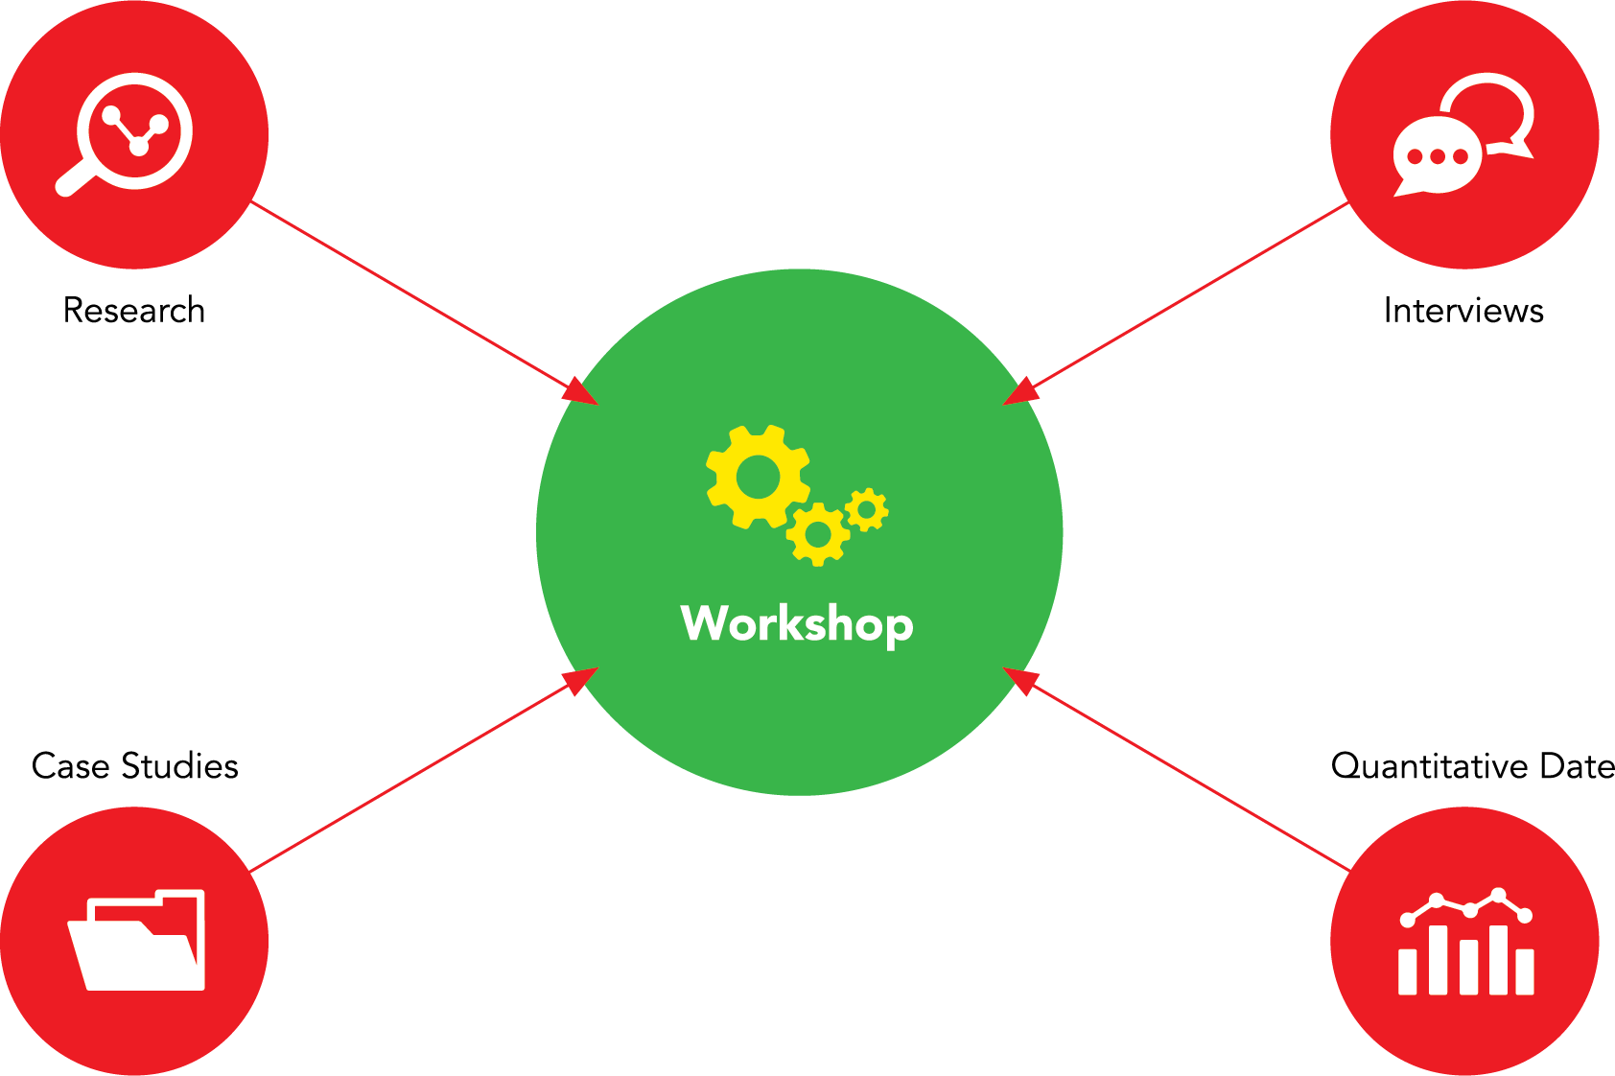
Understand
Notes:
Understand
So the workshop is peppered with data, examples from the research, empirical data, case studies..
Enables honest conversations to support an understanding of context, to feel understood, to resonate with participants, create connections to not feel alone, stimulate debate
Just to give you a sense of this part I have chosen some information that links to the need for honest conversations…

Slide 12
PhDs Who Become Academics
Notes:
Some statistics that set the context for PhD transition, this is to inform honest conversations.
From the same study that interviewed 5,000 graduates by Jobs.ac.uk in 2017 titled ‘PhD Employability, Career pathways and recruiter insight’
That working within academia is the exception rather than the rule
Pre PhD = When deciding to take on a doctorate, who aimed to become an academic
Post PhD = On completion of doctorate, who initially chose to become an academic
An average of 17% ended up in a permanent academic role
I ran a workshop recently where I asked a group of 20 PhD candidates who would like to work in academia following their doctorate, all but 2 raised their hands and those 2 looked uncomfortable and gave me a bit of a maybe signal.
The point of discussing this data is not to say it is not possible but to focus the mind is this is the goal, to argue that to work in this space requires proactive planning
That there are other options available
We could understand through Bourdieu - The longer one stays in an academic environment, the more a person matches one’s professional identity, and values to what is typical in this setting.
So we know there is a strong and evolving desire, but to what extent does this get fulfilled
There is a growing number of PhDs who simply can not be absorbed by the academic system
This trend is recognised nationally and globally, Vitae conf, PhD transitions literature, see bibliography…

Slide 13
Increase in PhDs Graduates
Notes:
The production of PhD grads is increasing year on year. This is deliberate. The ‘UK Industrial Strategy; Building a Britain fit for the future’ recognises the need for PhD grads in providing highly skilled professionals to strengthen the research and development agenda in order to achieve the 5 challenges (AI, data driven tech, clean growth, aging society & social mobility). A doctoral loan system of £25,000 per student has been introduced for all who have gained a place on a program of study in September this year, this will add to numbers here in the UK.
OECD is promoting knowledge based capital as a key driver of economic growth in advanced economies (according to the industrial strategy but also a ref in bib). Thus Britain is not the only country wanting to increase PhD production…
Here we can see PhD completions are increasing in the UK, Europe and internationally…
Ref - ‘Career pathways following doctoral research 2017’ by Jobs.ac.uk (N=5,000)
These stats are from the OECD and Chinese ministry of education, and show the average annual growth of doc degrees across all disciplines (1998-2006)
Countries are investing in their HE infrastructure, boosting PhD outputs. The number of people graduating with a PhD is increasing by 4% annually across the UK and 12% internationally.
Ref - ‘Career pathways following doctoral research 2017’ by Jobs.ac.uk (N=5,000)

Slide 14
Increase in PhDs Graduates
Notes:
And here this global trend is broken down…
These stats are from the OECD and Chinese ministry of education, and show the average annual growth of doc degrees across all disciplines (1998-2006)
Countries are investing in their HE infrastructure, boosting PhD outputs. The number of people graduating with a PhD is increasing by 4% annually across the UK and 12% internationally.
Ref - ‘Career pathways following doctoral research 2017’ by Jobs.ac.uk (N=5,000)

Slide 15
Distribution of PhD Graduates in HE
Phase 1
Doctoral Student
Assistant
Phase 2
Research Assistant
Post Doctorate
Research Associate
Lecturer
Notes:
Spend a bit of time exploring the roles common for graduates.
What do we mean when we say an academic job?
If we look at research paths in the United Kingdom. The association of Graduate Career advisory services explored different roles that exist and progression stats.
55% of those who get a job, do so in phase 1 roles
25% progress to phase 2
So 55% of grads exist in p1with a view to move into p2- where 25% progress
Only 12% progress to p3, and 8% to p4
P1
Doctoral Student (3-4)
Assistant (1-3)
P2
Research assistant (1-3)
Post Doctorate (1-3)
Research Associate (3-5)
Lecturer (1-5)
P3
Research Associate (4-5)
Research Fellow (4-5)
Senior Researcher (4-5)
Senior Lecturer (Perm)
Reader (4-5)
P4
Reader (Perm)
Professor (Perm)
Research Professor (5-8)

Slide 16
What do PhDs do…
Notes:
Spend a bit of time exploring what PhD do
Vitae (2013) What do researchers do? Early career progression of doctoral graduates. The Careers Research and Advisory Centre (CRAC) Limited
This research shows a number of areas of work people go into and it does this across disciplines. I have taken the cross discipline data and identified the 4 most popular areas.
Doctoral graduates had a wide range of occupations across different employment sectors. Common occupations were teaching and lecturing professions, one quarter of respondents (27%). Followed by scientific research, analysis and development professions (19%) and other professional, associate professional and technical occupations (17%). The next most common occupations were commercial, industrial and public sector managers (10%)
27% Teaching professionals (including lecturers)
19% Scientific, research, analysis and development occupations
17% Other professional, associate professional and technical occupations
10% Commercial, industrial and public sector managers
eg
Scientific, research, analysis and development occupations (19%)
0% Arts and humanities
35% Biological sciences
19% Biomedical sciences
25% Physical sciences and engineering
3% Social sciences
Teaching professionals (including lecturers) (27%)
59% Arts and humanities
15% Biological sciences
17% Biomedical sciences
18% Physical sciences and engineering
50% Social sciences
3.1% Marketing, sales, media and advertising occupations
6.1% Arts and humanities
4.9% Biological sciences
2.2% Biomedical sciences
2.6% Physical sciences and engineering
1.4% Social sciences
10.4% Commercial, industrial and public sector managers
9.4%
13.9%
8.3%
10.6%
11.9%
4.1% Engineering professionals
0.5%
1.0%
0.4%
11.6%
0.0%
9.3% Health professionals and associate professionals
0.0%
3.0%
30.8%
0.2%
0.0%
5.3% Business and finance professionals
1.3%
5.7%
4.0%
6.9%
8.1%
2.9% Information technology professionals
0.0%
1.2%
0.6%
7.7%
0.0%
17.0% Other professional, associate professional and technical occupations
16.4%
19.1%
17.3%
14.6%
20.9%
1.1% Numerical clerks and cashiers, clerical, retail and bar staff
3.6%
1.3%
0.0%
1.2%
1.6%
0.3% Armed forces and public protection service occupations
1.1%
0.0%
0.0%
0.5%
0.4%
0.6% Other occupations
2.4%
0.0%
0.4%
0.4%
0.8%
0.6% Unknown occupations
0.5%
0.5%
0.2%
0.8%
1.8%

Slide 17
International PhD Graduate in School Leadership
Return home?
Job search
Got married
Volunteer in career support
Career mapping
Volunteer as school governor
Volunteer in school
Math GCSE
Job in professional membership organisation
Notes:
Some case studies, photo and videos
So competition is high, this does not mean getting a job within a university is an impossibility. Many people go on to find work and some with time, determination and resilience progress.
I conducted some research with PhD graduates. This was over 4 months, I interview 11 people in a range of jobs from RA, secondary school teacher, freelancer, unemployed, SL etc.
I collected case studies and quotes that I will share with you. Here is a case study…
Career Narrative over 3 years.
Return home?
Spent ½ year considering whether to stay, pressure from family
Job search
Looked for jobs in research, school improvement. Not many jobs, no UK education background or practical experience, not many publications
Found it difficult to imagine options – felt frustrated, confused, stressed as not able to apply self.
Realised job searching was not going well (filing, walking around, blank page, couldn’t imagine journey,
Got married
Met Husband, got married. My husband supports me to do what I like, help me a lot to do all sorts of things. I want independence, useful person, skills contribute to world.
Volunteer in career support
Volunteered in with city council supporting peoples job searching
Career mapping
Did a skill map for possible jobs, considered what I needed experience qualifications to work in, areas connected to the PhD.
Volunteer as school governor
Volunteer in School
1 day per week in a school, help in classroom. How they teach, challenges, diff levels of maths,
Took me a while to workout what I can do! Felt fustrated, consused, stressed, no long term goals, things I want to do but cant. Before I could do things. I tried really hard, I wasn’t lazy, working everyday, asking people, rejection. Some people plan. I did not do this, purely focused on PhD. Felt important to do something, so I know I can, apply knowledge. Different spaces provided opportunities to ask questions, to consider what I enjoy, possible options.
Math GCSE
GCSE in Math at night school
Job in professional membership organisation
Part time fixed term contract
Be realistic about what you will be qualified for on completion, you will have gained many transferable skills but you need to know how to market these and how to complement them considering what you are going for!

Slide 18
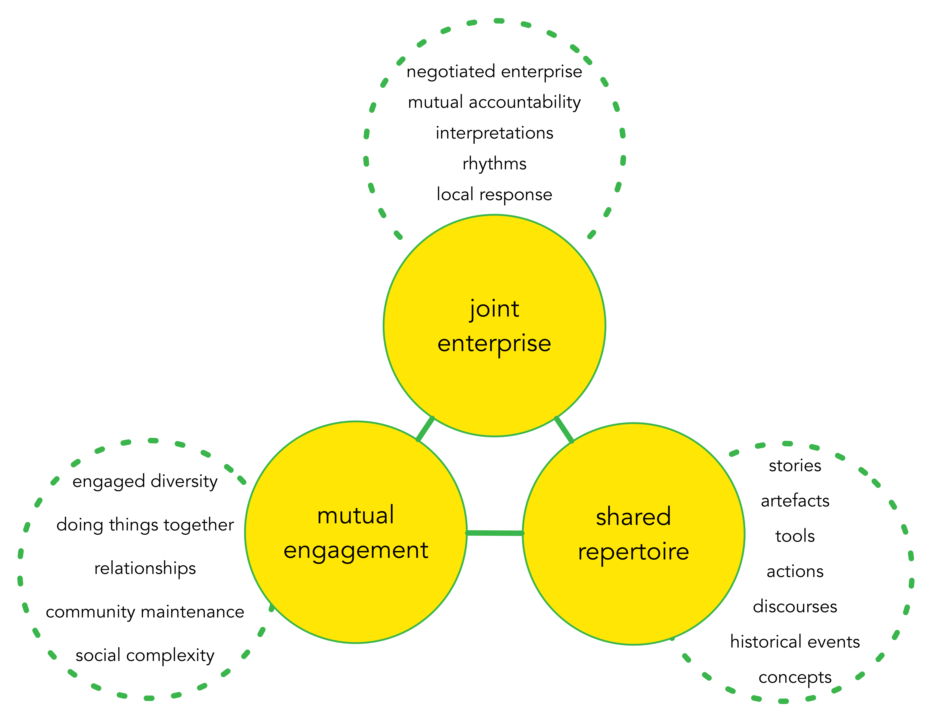
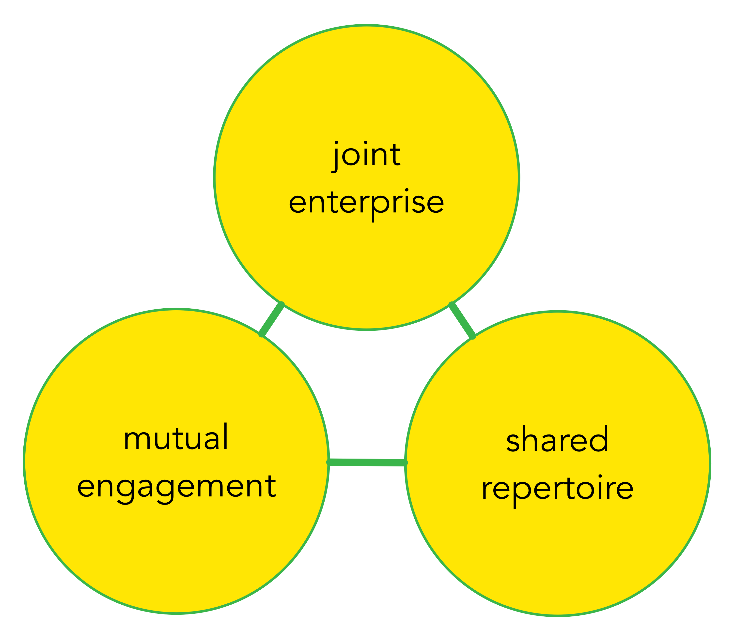
Plan
“Dimensions of practice as a property of a community of Practice” (Wenger, 1988, 73)
Notes:
This next part of the workshop is based upon Wengers community of practice model
Anna to present?
What is a Community of Practice? – Definition
Example of a community of practice
Examples of trajectories people follow to get to the core
What communities of practice do you currently exist in?
Where are you positioned in these?
What communities of practice would you like to enter? Progress in?

Slide 19
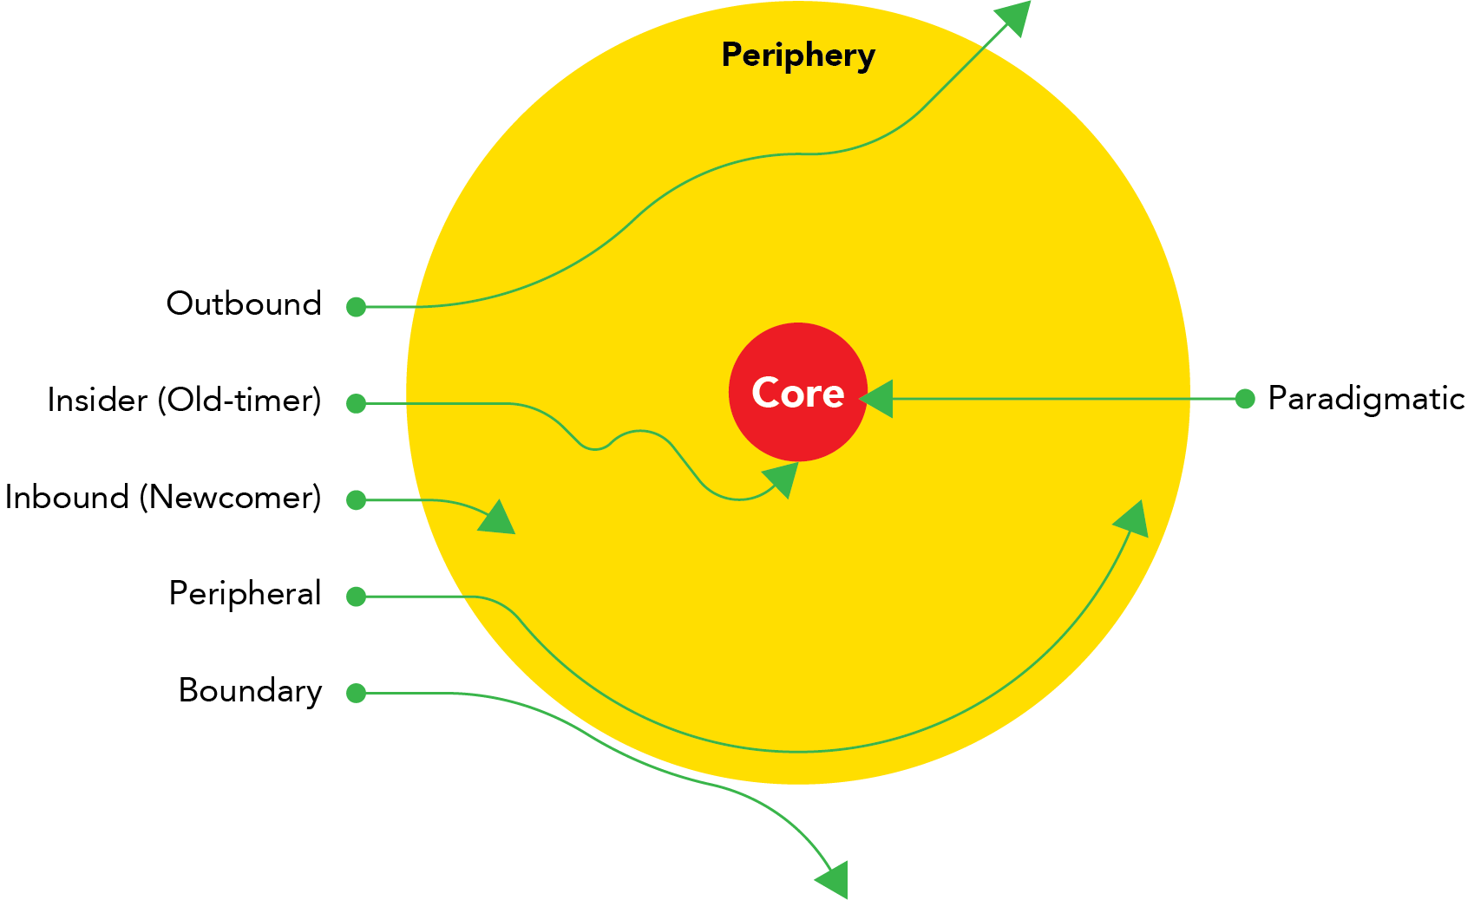
Plan
Trajectories into and through a community of practice using Wenger’s terms. Representation based on Seabourne (2017).
Notes:
This next part of the workshop is based upon Wengers community of practice model
Anna to present?
What is a Community of Practice? – Definition
Example of a community of practice
Examples of trajectories people follow to get to the core
What communities of practice do you currently exist in?
Where are you positioned in these?
What communities of practice would you like to enter? Progress in?

Slide 20
Policy Context
European Charter For Researchers:
“Employers and/or funders should ensure that career advice and job placement assistance, either in the institutions concerned, or through collaboration with other structures, is offered to researchers at all stages of their careers, regardless of their contractual situation” (European Charter For Researchers, 2005)
Notes:
Policy context
How this workshop addresses the needs of unis
The polic context, specific ref to conc etc
Supporting the career management of staff and researchers
address the following HE policies, awards and funds: Workshops are also able to demonstrate alignment to the European Charter for Researchers and Code of Conduct for their Recruitment
“Welbeing Quote” () HEFCE Catalyst Fund

Slide 21
The Concordat
“Researchers are equipped and supported to be adaptable and flexible in an increasingly diverse, mobile, global research environment” (The Concordat, principle 3)
“The importance of researchers’ personal and career development, and lifelong learning, is clearly recognised and promoted at all stages of their career” (The Concordat, principle 4)
“Individual researchers share the responsibility for and need to pro-actively engage in their own personal and career development, and lifelong learning” (The Concordat principle 5)
Notes:
Directly addressing these three Concordat principles means these workshops are able to fulfill gaps when applying for the HR Excellence Award.
Finally the HEFCE Catalyst Fund.
Together these three parts provide a comprehensive framework through which PhD transition challenges and strategies for progression can be negotiated in two thought provoking workshops. PGRs and ECRs will be better ‘equipped and supported to be adaptable and flexible in an increasingly diverse, mobile, global research environment’ (Concordat principle 3). ‘Personal and career development, and lifelong learning’ is supported (Concordat principle 4) and participants are encouraged to ‘pro-actively engage in their own personal and career development, and lifelong learning’ (Concordat principle 5)

Slide 22
What Now?
Pilot workshop next week
Focus group evaluations
Send out in UK Council For Graduate Education
This and other workshops available to run nationally
Notes:
Dani
The evaluation process that will inform future iterations
I have a workshop working group whom I will continue to work with for future iterations
Is academia for me?
Understand PhD transition trends
Understand common experiences
Requirement
Being equipped
Exploring your PhD career ideas
Explore the possible options available
Distinguish between your and other people values
Planning your post PhD trajectory
With a clear idea of what you would like to do work with others to create a clear plan moving forward

Slide 23
In Summary
Career transition is difficult, common to feel:
Directionless
Confused
Paralyzed
Isolated
How do we support our PGR and ECR even MCR to navigate these periods?
What makes it difficult to provide this support within our Universities?
Notes:
Research, empirical research and practice tells us that PhD transition can be an extremely challenging period.
It is usual to feel…
This workshop is one way to provide guidance
I hope that this have stimulated your ideas re how PGR can be supported within your own institutions
I’m interested in how it is in your own universities? What makes providing this support challenging ?

Slide 24
References 1
Bourdieu, Pierre. 1977. Outline of a Theory of Practice. Cambridge: Cambridge University Press
Brooks, Rachel, and Glyn Everett. 2008. “The Prevalence of ‘Life Planning’: Evidence from UK Graduates.” British Journal of Sociology of Education 29 (3): 325–27.
Careers Research & Advisory Centre. 2016. Provision of Professional Doctorates in English HE Institutions. Cambridge: Higher Education Funding Council for England.
Developed from ‘7 myths the academic world keeps telling you’ (Ref for blog: Published on October 17, 2016. Mariana Cerdeira https://www.linkedin.com/pulse/7-lies-academic-world-keeps-telling-you-mariana-cerdeira/)
European Commission Directorate-General for Research. 2005. “EUR 21620 The European Charter for Researchers, The Code of Conduct for the Recruitment of Researchers.” Luxembourg.
Grande, Hannelore De, Katrien De Boyser, Karen Vandevelde, and Ronan Van Rossem. 2014. “From Academia to Industry: Are Doctorate Holders Ready?” Journal of the Knowledge Economy, no. 5: 538–61.
Higher Education Funding Council for England. 2018. “Postgraduate Research Students: Supporting Mental Health and Wellbeing.” 2018. http://www.hefce.ac.uk/funding/ catalyst/pgr-wellbeing/
Mallett, Martina, and Alison Osborne. 2017. PhD Employability: Career Pathways and Recruiter Insights. Place of publication not identified: Jobs.ac.uk.
Organisation for Economic Co-operation and Development. 2013. “Careers of Doctorate Holders: Analysis of Labour Market and Mobility Indicators.”

Slide 25
References 2
Research Councils UK. 2008. “The Concordat to Support the Career Development of Researchers: An Agreement between the Funders and Employers of Researchers in the UK.” [Swindon]: [Vitae].
Robin Kessler and Linda Strasburg’s Competency-Based Resumes to become familiar with competencies versus skills
Seabourne, Anna E. 2017. “Teaching and Learning in a Japanese Koryū Dōjō: A Classical Japanese Martial Art as a Community of Practice.” University of Manchester, PhD Thesis.
Sinche, M, Layton, R (2017) An evidence-based evaluation of transferrable skills and job satisfaction for science PhDs
Skeggs, Beverley. 1997. Formations of Class and Genter: Becoming Respectable. London: Sage.
Vitae (2013) What do researchers do? Early career progression of doctoral graduates. The Careers Research and Advisory Centre (CRAC) Limited
Vitae. 2018. Exploring Wellbeing and Mental Health and Associated Support Services for Postgraduate Researchers. Cambridge: Vitae.
Grande H, Boyser K, Vandevelde K, Rossem R (2014) From Academia to Industry: Are Doctorate Holders Ready? Springer Science & Business Media New York
Wenger, Etienne. 1998. Communities of Practice: Learning, Meaning and Identity. Cambridge: Cambridge University Press.
Willson, Rebekah. 2016. “Information in Transition: Examining the Information Behaviour of Academics as They Transition into University Careers.” Charles Sturt University, PhD Thesis. https://rebekahwillson.com

Slide 26
Thank you

