Slide 2
PhD Graduate Perceptions of Employability Skills, Within and Beyond the Academy
Dr Emma Compton-Daw, Academic Development Lead (Research)
Dr Kathleen Savage, Academic Development Lead (Teaching and Learning)
Organisational and Staff Development Unit
Dr Campbell Reid, Course Coordinator PG Certificate in Researcher Professional Development
Researcher Development Programme
Victoria Walker, PhD Candidate and PGR Intern
Lee Coutts, PhD Candidate and PGR Intern

Slide 3
Presentation Outline
Project Background
Project Remit and Methods
Results
Conclusions and Recommendations

Slide 4
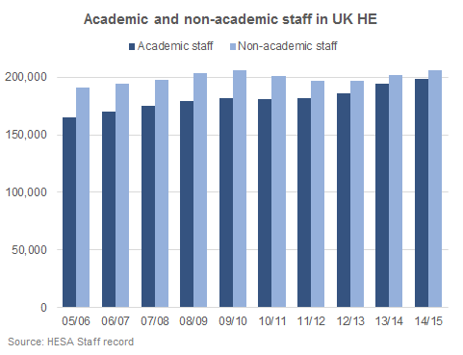
56% increase in number of PhDs awarded (since 02/03)
~26% increase in number of new academic positions
(since 05/06)
Data extracted from Higher Education Statistics Agency, www.hesa.ac.uk

Slide 5
Project Remit
What skills and attributes do previous PGRs perceive as valued in their current employment roles?
How well are PGRs prepared for the transition into employment, in careers both within and outside of academia?

Slide 6
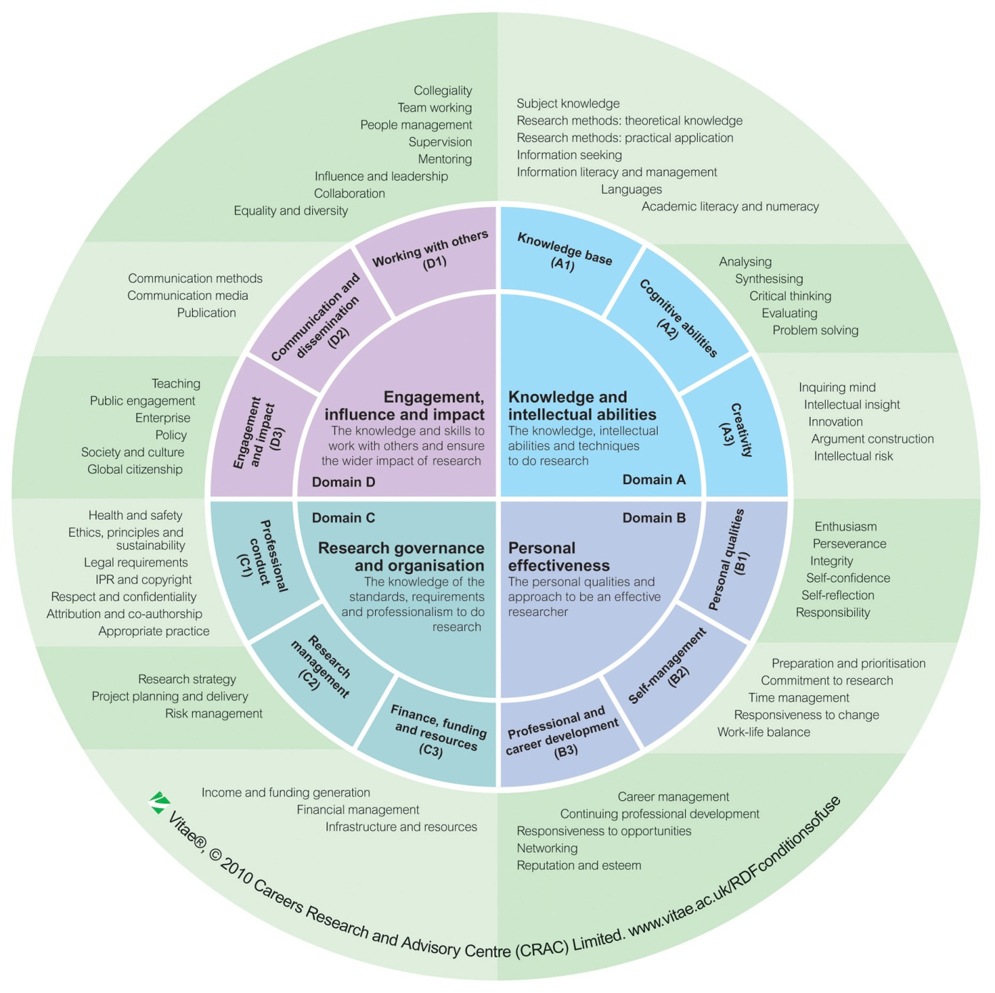


Researcher Development Framework
Survey
32 responses
Engineering, Science, Social Sciences, Humanities, Business
44% 56%
<25 – 60 yrs
55% Academia
45% outwith Academia
Follow up questions

Slide 7
Questions… Remit
Which skills and attributes are valued by their current employer?
Which skills were they most and least equipped with by their doctoral studies?

Slide 8
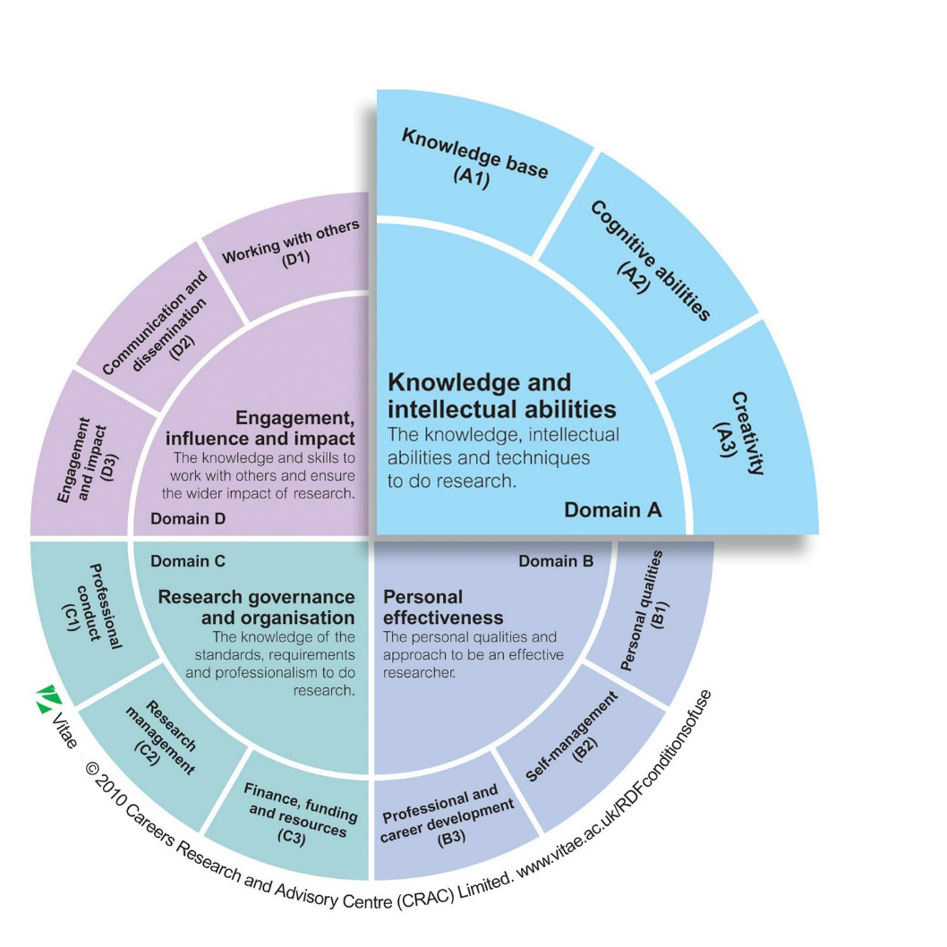
Knowledge and intellectual activities

Slide 9
38%
47%
59%
% of respondents that felt these skills were valued by their employer
31%
Academic
Non-academic
Most equipped (% respondents)
Least equipped (% respondents)
31%
59%

Slide 10
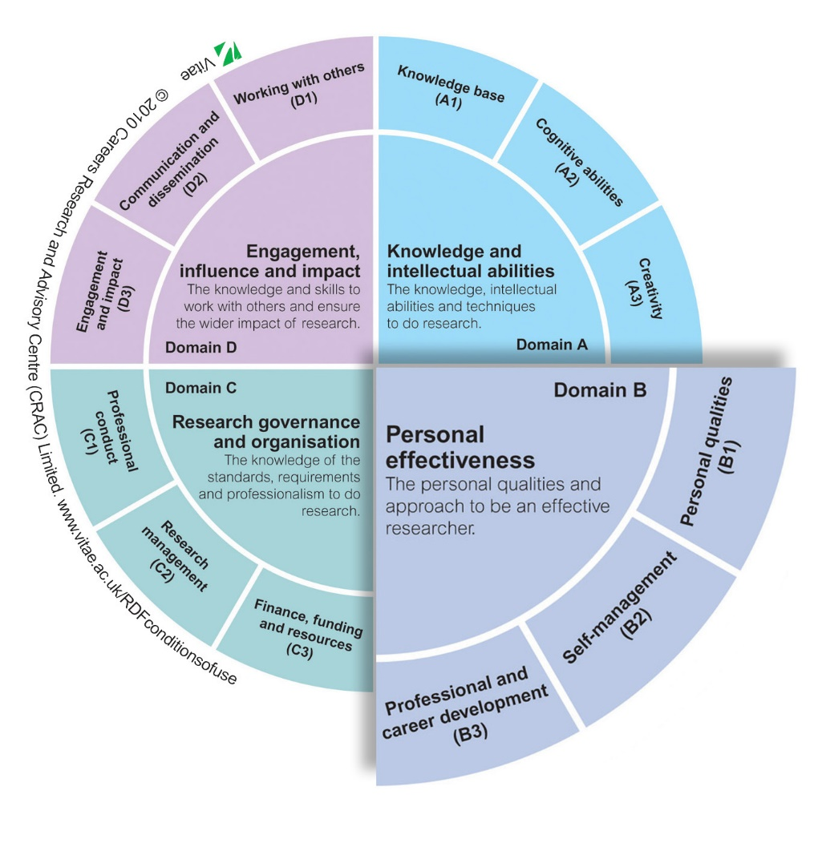
Personal effectiveness

Slide 11
28%
44%
31%
47%
Most equipped (% respondents)
34%
44%
Least equipped (% respondents)

Slide 12
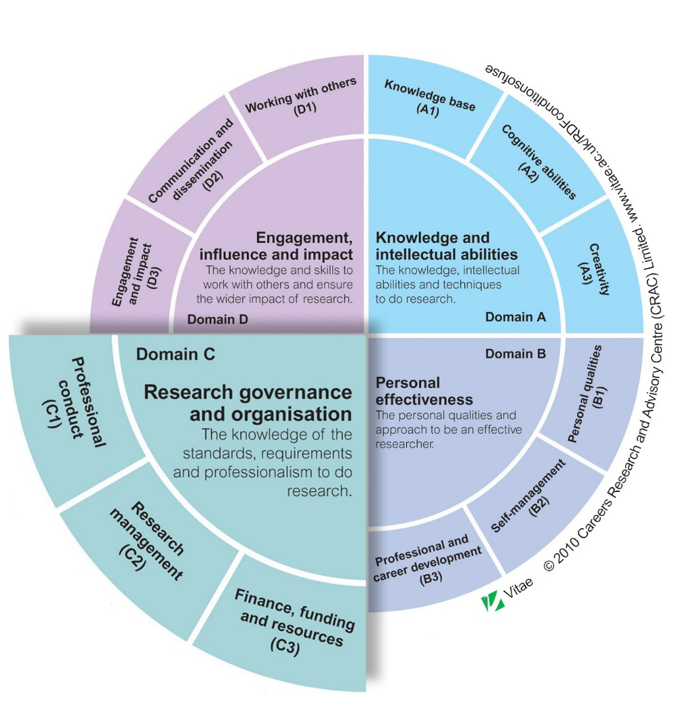
Research governance and organisation

Slide 13
41%
50%
50%
% of respondents that felt these skills were valued by their employer
38%
Academic
Non-academic
Most equipped (% respondents)
Least equipped (% respondents)
53%
63%

Slide 14
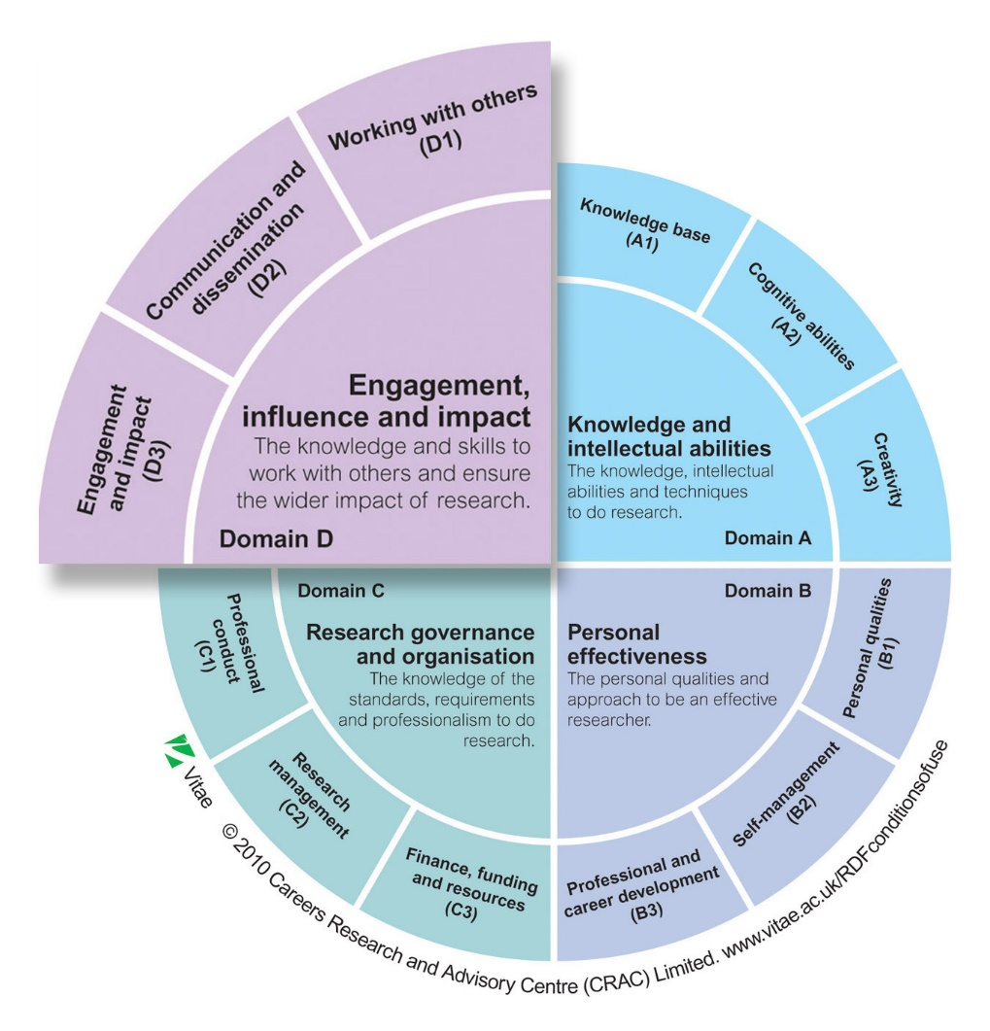
Engagement, influence and impact

Slide 15
66%*
38%
31%
47%
% of respondents that felt these skills were valued by their employer
34%
Academic
Non-academic
Most equipped (% respondents)
66%*
41%
Least equipped (% respondents)

Slide 16
Conclusions and Recommendations

Slide 17
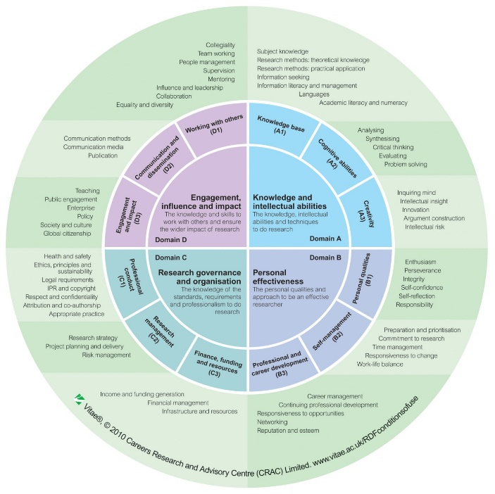
Which skills and attributes are valued by their current employer?
Which skills were they most and least equipped with by their doctoral studies?

Slide 19
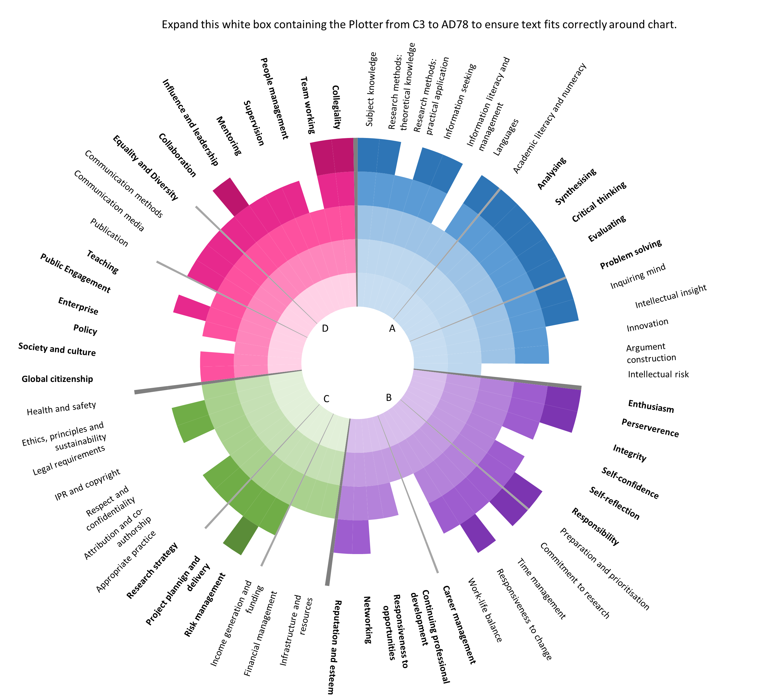
Valued by employers
Most equipped
Least equipped

Slide 20
Conclusions and Recommendations
There is a good match between the skills that previous PGRs have gained and the skills perceived as valued by employers.
The skills gaps identified could be addressed via researcher development programmes.
Generally a good match between skills valued by academic and non-academic employers
The RDF is a valuable tool which PGRs should engage with for planning their development and transition into both academic and non-academic careers.
Integrate personal development planning into the annual review process for PGR students and provide training to supervisors to support this.
Next steps
Programme changes
Collaborate..Publish…Expand…

Slide 21


Slide 22
Where did students feel most equipped?

Slide 23
  Collegiality, team working and collaboration - 66%
  Publication - 41%
  Supervision - 31%
      Research methods (practical application) - 59%
      Critical thinking - 59%
      Subject knowledge - 38%
Engagement, influence and impact
Knowledge and intellectual abilities
Research governance and organisation
Personal effectiveness
        Perseverance - 44%
        Commitment to research - 44%
        Self confidence - 31%
  Research strategy - 63%
  Project planning and delivery - 53%
  Ethics, principles and sustainability - 41%

Slide 24
Where did students feel least equipped?

Slide 25
  Policy – 47%
  People management – 38%
  Enterprise – 34%
      Intellectual Risk – 47%
      Information seeking, literacy and management – 31%
      Academic literacy and numeracy – 31%
Engagement, influence and impact
Knowledge and intellectual abilities
Research governance and organisation
Personal effectiveness
        Career management – 47%
        Work life balance – 34%
        Reputation and esteem – 28%
  Legal requirements – 50%
  Financial management – 50%
  Intellectual property rights and copyrights – 38%

Slide 26
Equipped vs Valued?
Least equipped Most Valued

