Slide 1
EURAXIND - Careers Beyond Academia: An Horizon 2020 project examining researcher intersectoral mobility May 2016 – May 2018 Emma Day – Project Manager, Vitae Researcher Education and Development Conference – 25th October 2018
Notes:
Thank you for having me today.
My name is Emma Day – PM at Vitae managing multiple projects including European projects, gender work and Catalyst Mental Health and wellbeing evalution
Project I am going to talk about today goes by name of EURAXIND
Project that ran from May 2016 – May 2018
Look at topics from an European at the topic of careers outside of academia from an European perspective.

Slide 2
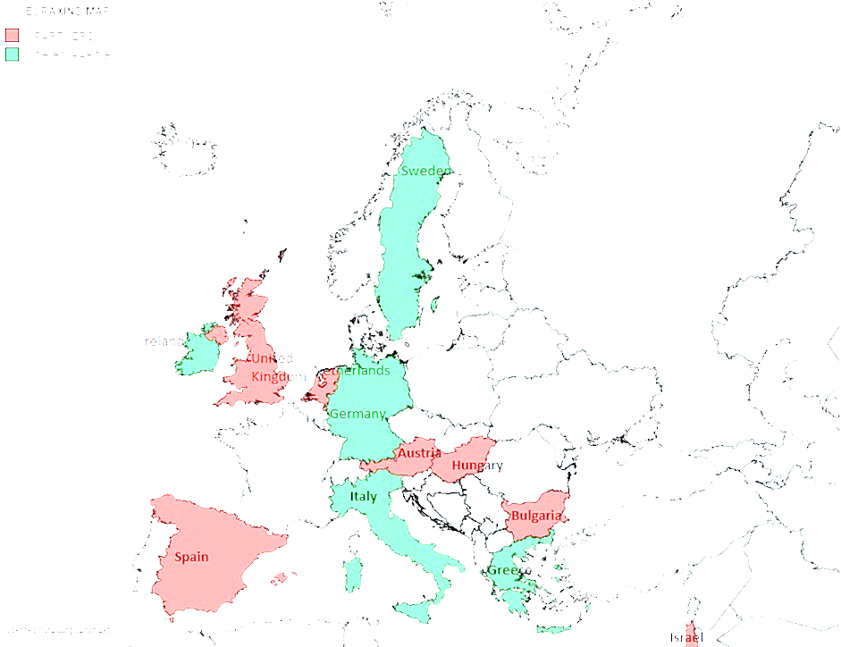
EURAXIND – EURAXESS for industry
Identify employers’ and researchers’ needs to support intersectoral mobility and collaboration
Provide online resources to support institutional engagement with employers
Encourage researchers to consider career and research opportunities within industry
Attract more employers beyond academia to use EURAXESS services
Notes:
Explain EURAXESS – Ask who is aware etc?

Slide 3
Partners
CRAC-Vitae, UK
FECYT, Spain *
FFG, Austria * #
BZN, Hungary *
SU, Bulgaria * #
IP&D, Israel *
NUFFIC, The Netherlands *
* BHO EURAXESS
# NCP H2020
Notes:
7 partners
Deliberate variety of countries and institutions

Slide 4
EURAXIND Core outcomes
Literature review
Understanding researchers, employers and institution needs.
Four surveys
EURAXESS Institutions (320 responses)
Researchers (994 responses)
Alumni (339 responses)
Employers (144 responses)
Employer engagement strategy
Workshops for EURAXESS network and employers
Development of a Toolkit for EURAXESS network
Development of a Career Development Module for researchers
Notes:
Explain key outcomes

Slide 5
Literature Review – researchers views and experiences
Perception of researchers is that intersectoral mobility is low.
More common in arts, social sciences and humanities (particularly moving into academia)
Perceived as much less common that international mobility
Few examples of multiple intersectoral moves
More common when schemes are funded to enable it
Little published research on researchers’ experiences of intersectoral mobility
From the little there is it seems that it is easier to move to and from the public sector than private sector
Notes:
Talk through literature reviews
Make the point that there was most information from the researchers perspective.

Slide 6
Literature Review – barriers to researchers
Different cultures in academia and private sector mitigate against mobility including lack of understanding of skills developed by the other sector
Different motivations provide barriers eg. private sector perceived as exploitative, whilst academia perceived as only interested in producing knowledge
Perceptions of excellence differ
Traditional academia views time in industry less favourably (eg. no papers published
In academia, security of employment increases with length of experience and progression mitigating mobility by senior researchers

Slide 7
Literature Review – Institution Needs
Institution engagement with industry is a priority
There is still a need for practical actions in fostering the enga
gement of academia with industry.
Possible national initiatives:
cross-sector collaborative programmes
targeted funding to develop individuals
overarching services and networks that help or advise researchers financial incentives for companies to employ doctoral graduates
innovative or exemplary projects and programmes

Slide 8
Literature Review – Employers Needs
“The voice of the business sector is rather difficult to detect in this literature”
Limited involvement of industry in discussions on how all actors can best profit from intersectoral mobility; important to directly address the non-academic/business sector to identify their needs
Importance of transferable skills for intersectoral mobility emphasized
Internships/intersectoral doctoral programmes e.g. MSCA support early exposure of researchers to non-academic sector
Notes:
Employers – very difficult to find any literature from the UK perspective.
Some has been done largely in the UK eg. Rugby Team 2007.
Limited involvement – we must ask ourselves why this is and how we can address eg. Lack of interest, awareness, culture of employers. Are we doing enough

Slide 9
Researchers’ career thinking and development
78% want an academic career in the long term
57% would consider working outside academia – of these:
70% would still want to do research
37% in research/grant management
35% in research/science policy
65% think it would be hard to get a non-research job in business
< 30% think businesses value what researchers offer working in non-research roles

Slide 10
Researchers’ commercial awareness
Interactions with business
28% have done joint research; 27% business-focused research
27% consultancy
12% temporary sector mobility; 7% long term mobility
48% would like internship/placement in business; 52% to do joint research; 59% knowledge exchange / innovation
Barriers to interactions
45% uncertain impact on career (& reduction in research outputs)
35% lack of experience/skills valued by business
26% lack of confidence
Researchers less confident about presenting evidence of people skills or commercial skills, compared with their research or self management
Researchers less confident about interviews / selection, and getting good references, whereas confident about their CV/application form

Slide 11
Alumni Responses - Leaving academia
Top reasons for leaving…. they wanted: - Better long-term employment prospects - More job security, not short-term contracts, better work/life balance - Wanted different professional challenges
Most helpful support in transition: - Their own active job searching - Professional and personal networks
Most useful support / experience / attribute when making transition: - Personal motivation / confidence / determination (73%) - Flexibility / adaptability (69%) - Training in transferable skills / competencies (26%) - Guidance from careers advisers etc. (11%)

Slide 12
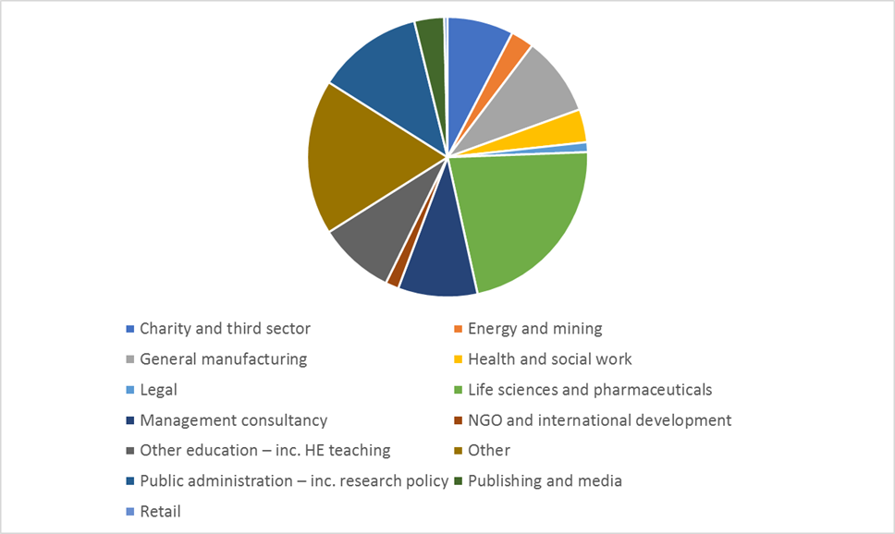
Sectors alumni now work in

Slide 13
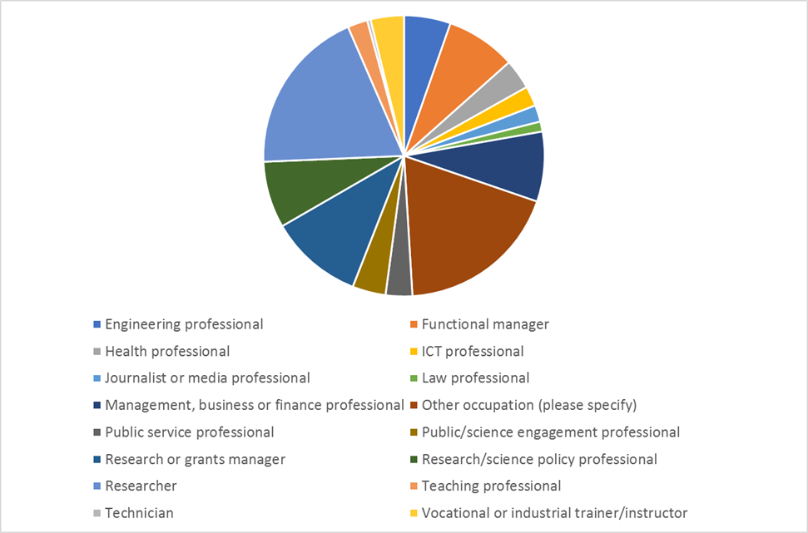
Occupations alumni now work in

Slide 14
In their current job…
84% are very or fairly satisfied with current work/job
(42% very satisfied)
Only 6% now want an academic career
What they actually do now:
43% conduct research
43% use detailed knowledge from their specialism
68% evaluate/understand others’ research
75% draw on experience/competencies developed during HE research

Slide 15
What would help researchers’ interact with business
more knowledge of opportunities (>60%)
greater recognition of value of intersectoral mobility to an academic career (45%)
more training in skills valued outside academia (43%)
better understanding of skills valued outside academia (41%)

Slide 16
Most valued in highly-skilled employees
Problem solving
Technical / subject expertise
Research skills
Communication
Creativity
Self-organisation
Collaboration
Innovation
Project management
Emotional intelligence
Motivation / self confidence
Flexibility / agility
EURAXIND Outreach to industry, 2017

Slide 17
Toolkits to Support
Discover: Careers Beyond Academia
https://euraxess.ec.europa.eu/career-development/researchers/discover-careers-beyond-academia
Interact: Academia reaching out to Business
https://euraxess.ec.europa.eu/career-development/organisations/resources-and-tools/engagement-tool

Slide 18
Messages for intersectoral mobility
Academia is seen as the first career choice with fears about the impact of temporary mobility – and message of failure.
There is evidence of varied careers, good satisfaction and value of researcher skills beyond academia
Current researchers in HE lack of knowledge about career opportunities beyond academia
They generally know the most important key competencies for employers, but less able to present and evidence these
Generally, there is still a major task to be done to persuade more employers the value of employing researchers – particularly in non-research occupations.

