Slide 1
Better value? Bigger value? How could the value of a PhD be enhanced for different groups of graduates?
Kay Guccione & Billy Bryan
University of Sheffield, Technopolis Consulting
@kayguccione @drbillybryan

Slide 2
Personalised development that aligns with individual career trajectories can help to mesh the needs of society and employers, with individual satisfaction
(Halse & Mowbray, 2011).
Raising early
awareness of
the value of a PhD
across diverse potential career paths
(Mangematin, 2000) and enabling researchers to make choices about how to access the complex systems of support and institutional resource (McAlpine & Turner, 2012) is paramount in encouraging engagement with value-added opportunities.

Slide 3
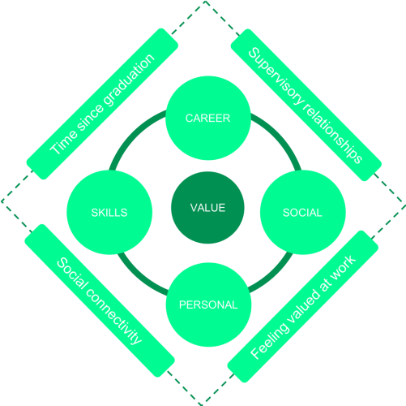
Doctoral
graduates perceive that despite their personal sacrifices (the time they commit to study, the emotional effort,
and their financial investment) they benefit overall from the time they spent earning their PhD, and that engagement with ‘value-added’ opportunities enhances this sense of value
(Bryan & Guccione, 2018)
Figure 1: Doctoral value model developed from 22 in depth interviews with graduates in a range of career pathways post-PhD

Slide 4
Enabling broad development?
Doctoral
graduates perceive that despite their personal sacrifices (the time they commit to study, the emotional effort,
and their financial investment) they benefit overall from the time they spent earning their PhD, and that engagement with ‘value-added’ opportunities enhances this sense of value
(Bryan & Guccione, 2018)
Prestige?
Financial?
Figure 1: Doctoral value model developed from 22 in depth interviews with graduates in a range of career pathways post-PhD

Slide 5
tension
Is there time to build value into the doctorate?
Participants told us that it was the ‘extracurricular’ opportunities they valued most.
Existing worries about supporting PGRs to finish within their time limit have become further strained in recent months – ‘submit within funded period’
Supervisors are trying to reconcile timely completion of the research project with permitting PGRs the freedom to explore and engage more widely.
Ideas for an integrated approach, building relationships, modelling good practice.
(Guccione, 2018)
http://blogs.lse.ac.uk/impactofsocialsciences/2018/10/10/how-to-build-value-into-the-doctorate-ideas-for-phd-supervisors/

Slide 6
context threat
Doctoral loans could reduce value derived from career
Running out of money in the PhD is a major reason why students drop out
A PhD may offer no financial benefit over a master’s degree. It can even reduce earnings. Exacerbated for women, more so for women of colour.
loan-funded PhD graduates may unfairly be seen as being of lower value to employers
Mounting loan repayments counteract could counteract any PhD salary premium
(Bryan, 2018) https://www.theguardian.com/education/2018/oct/19/who-are-the-new-phd-loans-really-for?

Slide 7
Phase 2
Methodology:
10min survey about PhD graduates personal perspective on the value
of their doctorate post-graduation. 3
open questions,
preceded by
demographic data questions.
Between graduation and now how valuable has the Doctoral experience been to you within your various job roles?
How valuable has your Doctorate been in terms of social, personal, and professional networks?
3. Do you view yourself as changed, or different in the world because of your doctorate? And in relation to and in comparison to your family, friends, and society?

Slide 8
262 responses
Very preliminary analyses
Who?
46% men : 54% women 42% Academic : 58% ‘Not Academic’ (Private, Public & Third Sector inc HE)
1-15 years post PhD mean = 5.4 years post-PhD 3% unemployed
32 % Biol/Med sciences
25% Eng/Phys Sciences
26% Social Sciences
17% Arts & Humanities
(HESA JACS 3.0 codes (2012/13)
Headlines (work in progress!)
Our perceptions of value from the framework we established hold true
Postdocs report that a PhD was not worth it or feels of low value to them
Financially, no group feels it was of much value

Slide 9
examples
"From the perspective of personal growth and development, yes - the PhD was worth doing. However, from the perspective of establishing a financially rewarding career, no - the PhD certainly has not been worth doing." - postdoc
"If I hadn't have done the PhD I would have started work 3 years earlier and might well be further along in my career right now."
- Clinical trials manager
“Despite earning more
than my peers, lost earnings over the duration of the PhD and lack of industry experience meant I was still worse off than others. The personal cost in terms of relationships, stress etc was also not insignificant.”
- Private sector
"the very act of getting through it feels like the sort of thing that changes you - a bit like climbing Everest! - you know you have the capacity to do something like that again if you had to." - Uni Librarian

Slide 10
messages
DATA ARE PRELIMINARY AND SUBJECT TO CHANGE
Engagement with 'value-added' or 'extra curricular' opportunities enhances how doctoral graduates perceive the value of their doctorate.
We need to enable researchers, and their supervisors, to make choices about how to access complex systems of support and development.
As practitioners we need to enable choice, planning and wise use of time
Because UG/PG loans, fees, delayed earnings/NI/pensions and unpaid writing up years are a serious challenge to whether a PhD is actually ‘worth it’
Postdocs tend to say it wasn’t worth it, postdocs who leave for new careers say it was worth it – moving beyond the postdoc holding pattern is an urgent priority.
ENABLER Good quality national data set on destinations
ENABLER The ‘demand’ end of the equation! ‘Higher Grad Scheme’

Slide 11
Bryan, B., & Guccione, K., (2018) Was it worth it? A qualitative exploration into graduate perceptions of doctoral value, Higher Education Research & Development, DOI: 10.1080/07294360.2018.1479378
Halse, C., & Mowbray, S. (2011). The impact of the doctorate. Studies in Higher Education, 36, 513–525. doi: 10.1080/03075079.2011.594590
Mangematin, V. (2000). Phd job market: Professional trajectories and incentives during the PhD. Research Policy, 29(6), 741–756. doi: 10.1016/S0048-7333(99)00047-5
McAlpine, L., & Turner, G. (2012). Imagined and emerging career patterns: Perceptions of doctoral students and research staff. Journal of Further and Higher Education, 36(4), 535–548. doi: 10.1080/0309877X.2011.643777

