Slide 1
Adopting open research practices: engaging doctoral students through debate-based learning.
Dr Christine Daoutis & Dr Christian Gilliam
University of Surrey

Slide 2
New outlooks on the development of researchers
in a changed landscape
Notes:
First of all, a bit about myself and how I came to present here today. Although I have a research background in Psychology, my current role is to promote and support open research – to all researchers, including PGRs and ECRs). In doing this I work closely with our researcher development group and doctoral college, to deliver training related to open research practices. The theme of this year’s conference caught my eye for two reasons: one, the landscape is, indeed, changing in many ways, including cultural and technical developments that make us think differently about scholarly communication. Scholarly communication is changing, and with it, opportunities and expectations for researchers to rethink the ways in which they conduct, share and communicate their research.

Slide 3
Open research
Open access to publications
Open data
Open monographs
New publishing models
Open peer review
Public engagement
Citizen science
Communities of practice/open collaboration
Notes:
The landscape has indeed been changing and continues to do so…but the driving force behind it is the Internet, and the ways it has forced us to reconsider traditional scholarship and its. communication. I am talking about open research – the prominent aspect of which is OA. The idea that not only research must be free and available to everyone, but also other opportuntiies that emerge to work in an open research environment beyond academia. There is much talk about the open researcher…

Slide 4
Background
New outlooks on the development of researchers
in a changed landscape: pedagogy and theory
A changing landscape: scholarly communication.
Notes:
…and a new researcher might feel a little bit overwhelmed. Because open research comes with mandates, policies, lots of box ticking for compliance (with funders, with the REF, with the institution), different platforms, copyright policies, systems, metrics, publisher options…and on top of this, the research student might be pulled in different directions by peers and supervisors.

Slide 5
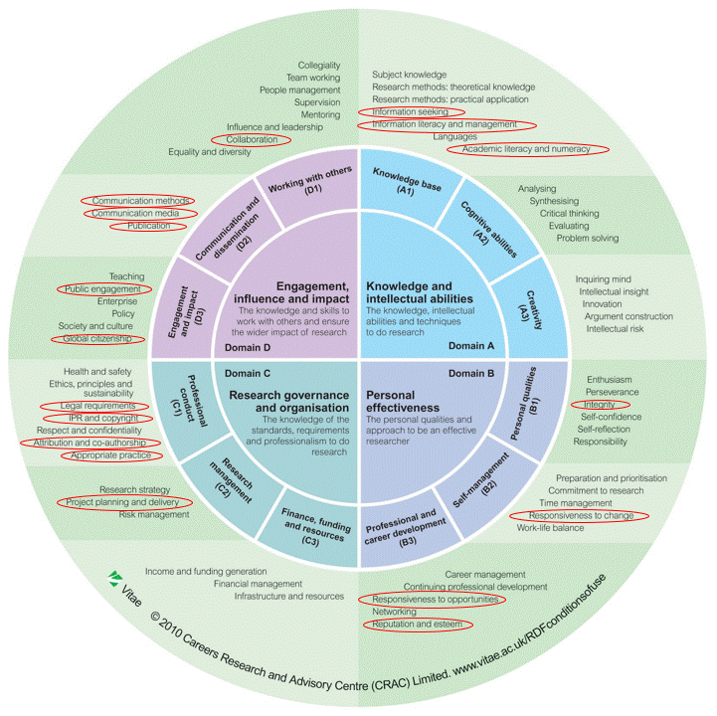
A need for new skills?
Vitae recognises the need for open research skills.
✓ Member poll identified gaps in researchers’ understanding, skills and confidence.
✓ Relevant skills mapped to the RDF.
✓ Working in an open research environment extends beyond academic jobs.
Notes:
The good news is that there is growing recognition that open research taps on several skills…

Slide 6
Open research
Accommodated with in the researcher professionalism model (Evans).
Behavioural
Attitudinal
Intellectual
Development related to open research is largely behavioural – but is this enough?
In fact, is this a case where the behavioural element hinders further development?

Slide 7
From box ticking to culture change.
Meet all open access and data requirements (HEFCE, funders, institutional).
Understand licensing and copyright.
Awareness of publishing models – and predatory publishers.
How, when, where to deposit on open access?
Research metrics.
Why do all this?
Have a stance on sharing research openly.
Attitude and culture change.
Notes:
Most Library websites and workshops tackle the above. But this is not about receiving training on how to use a platform, what to do for the REF, or understand copyright. This is about becoming an open researcher – and for this, developing rather than learning, is key.
Aim: to explore ways in which a researcher can engage with open research ; go beyond a skill set developed for this purpose.
To pilot a pedagogical method and discuss its potential value for researcher development more broadly – beyond this particular area.

Slide 8
New outlooks on the development of researchers in a changed landscape: pedagogy and theory.
Apply pedagogical methods that aim to:
Encourage independence in looking up and evaluating relevant information.
Develop attitudes and values.
Encourage having a critical stance.
Open research is a political issue, after all.
Notes:
Aim: to explore ways in which a researcher can engage with open research / visit the skills required and argue that these go beyond a skill set developed for this purpose.
To pilot a pedagogical method and discuss its potential value for researcher development more broadly – beyond this particular area.

Slide 9
…which brings us to the research idea.
Introduce and evaluate a workshop aimed at the attitudes related to open research.
Test the effects of a debate-based session on changing researchers’ perception of open research.
Look for evidence of deeper engagement, not just behavioural change.
Notes:
Which brings us to the pilot.

Slide 10
Brief review of the literature on debate-based learning.
Flipped classroom approach documented in:
Critz et al., 2013; Kong, 2014; McLaughlin et al., 2014.
Evidence supporting benefits of debate-based learning:
Candela et al., 2003; Smith Randolph, 2007; Lampkin et al., 2015.
Evidence for:
Increased knowledge of the subject;
Improved communication, critical thinking, team work and research methods skills (self-reported);
Greater engagement with the subject.
Notes:
Not many studies have addressed the impact of debate-based learning…

Slide 11
The pilot study: design and method.
✓ Participants (PGRs) asked to sign up for ‘Become an open researcher’ workshop.
Given basic information (definitions) of open research concepts.
✓ Working in pairs, debate the following:
Concerns and benefits of sharing a thesis online.
Concerns and benefits of sharing publications and data openly.
✓ Optional cue cards provided for ideas (semi-structured debate).
✓ Measures of attitudes towards open research practices taken before and after the discussions. 12 questions, 1 – 5 ratings.
General discussion: what will you do next?

Slide 12
Examples
✓ Questions
‘I would be reluctant to share my thesis online before it is published’
‘Knowledge is a public good; research should be freely available to everyone’.
✓ Debate cues:
Concern that having the thesis online will stop it from being published.
Counter-argument: evidence that most publishers do not consider an online thesis prior publication.

Slide 13
The pilot study: results.
✓ 5 participants.
✓ Average pre-session score: 3.94
Average post-session score: 4.63
New actions considered:
Consider preparing thesis for open access
Look into further information
Look up open access journals
Look up creative commons licences
Discuss open access with peers
Look into open practices outside traditional journal publishing.

Slide 14
The pilot study: shortcomings
Selection bias
Informant biases
Not enough knowledge to go into depth
Control group needed.
Discussion too structured?
Evaluation of an instructional method not simple…

Slide 15
The pilot study: discussion and suggestions.
How can we use this method to develop the open researcher?
(Last minute addendum: it doesn’t have to be a workshop!)
How can we demonstrate it worked?
(e.g. see Bromley, 2012, on impact levels)
Pedagogical implications: can we apply similar methods in other areas of researcher development?
How does this method fit (if at all) within current pedagogical theory on researcher development?

Slide 16
Thank you!
Contact us at
c.daoutis@surrey.ac.uk
christian.gilliam@surrey.ac.uk

