Slide 1
What do researchers want? Investigating PhD students’ perceptions of skills development
Dr Niall Oddy
Durham University
niall.oddy@durham.ac.uk

Slide 2
Opening lines
Central provision for researcher development
Generic versus disciplinary training
Thresholds in doctoral education? (Kiley, M., & Wisker, G. (2009). ‘Threshold concepts in research education and evidence of threshold crossing’)
How far do PGRs consider the difficulties they encounter to be inherent to the nature of the PhD?

Slide 3
Questions
What challenges have you encountered during your PhD?
Do you think these challenges are specific to your discipline?
How have you gone about addressing these challenges?
How could the University help you deal with these challenges?
How have you gone about learning and developing your skills in order to progress with the PhD and prepare for future employment?
How would you prefer to develop skills?

Slide 4
Generic challenges
Time management
Uncertainty
Wellbeing

Slide 5
Time management
difficult to adjust to the ‘PhD work pace and work life’
‘At the start of the third year I had no idea about how to plan my time leading up to the graduation’
‘I keep volunteering myself for things that I shouldn’t […] for things on my CV’

Slide 6
Uncertainty
‘This is such a long process’
‘I have no idea [how] to develop or progress with my PhD’
‘Sometimes I feel like I don’t know what I’m doing and I’ll get stuck in my research following a rabbit hole with no apparent end’
‘I often feel the work I produce is not good enough’

Slide 7
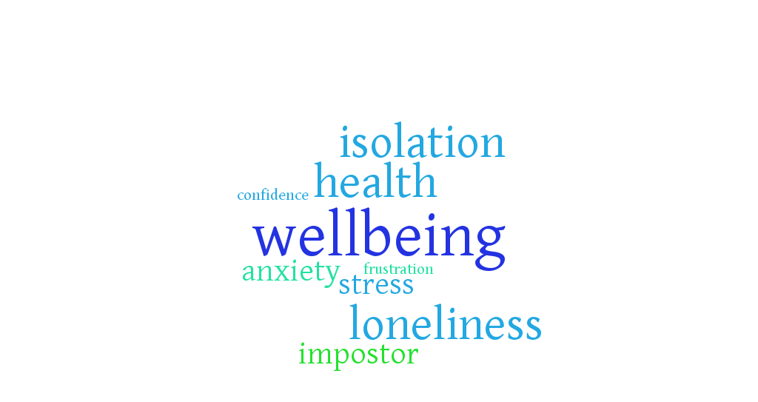
Wellbeing
‘disciplines do not discriminate when it comes to angst, writers block, de-motivation and a whole host of self-constructed human fallibilities which seek to hamper progress’ – (Mercer et al, 2011)

Slide 8
Disciplinary challenges
Ways of working
Thesis writing

Slide 9
Ways of working
‘I can’t imagine the same kind of [challenges arising] in Philosophy’ – a Physics researcher
‘In Geography [presentation style] is quite different [from the sciences]
‘I think that the situation for people who do science subjects is really different […] A science student who is living with me found the idea of unstructured time really baffling’ – a History researcher

Slide 10
Thesis writing
‘Physics has a very well specified kind of writing’
‘Different disciplines have implicit requirements about writing style’
‘Obviously there are difficulties with doing science PhDs but I think that it feels that you’ve got to figure it out a lot more by yourself [in History]. You’re not going to be given a methodology and you’re probably not going to be given an exact focus.’

Slide 11
Attitudes to training
‘I feel guilty for taking time out during the day’
‘taking time out of the actual stuff’
‘Sometimes I’ll be in the lab and the experiment’s working really well […] I can’t leave at that point’
A course might be ‘so broad-based it becomes irrelevant to the majority of people’
‘I can get by […] I’d rather do that than take a six-hour course on database management when half of it is not going to be relevant to what I’m doing’

Slide 12
Implications
Desire for additional support
Disciplinary / cross-disciplinary training?
‘Often I and other PhD students have very specific issues/skills/training that they need help with, and that isn’t necessarily available’
Wellbeing and resilience: ‘I like to attend sessions that are out of my department. The change of scenery helps me gain perspective’

Slide 13
Individualising development
Voice and empowerment for every student
Removing barriers to development
Encouraging researchers to take a holistic approach to development

Slide 14
Researcher
Supervisor
D
CENTRAL SERVICES

Slide 15
D
Researcher
Supervisor
Central services

Slide 16
Individualising development
Mentoring
Peer support / coaching
Space for more interaction with other researchers – workshops, writing/support groups
One-to-one follow-ups
Online interactive learning / resources
Signposting
Professional development grants
Changing attitudes

Slide 17
It’s been a long and winding journey, filled with uncertainty, but things are coming together in a way which is better than I could have asked for. In light of that, perhaps better awareness of the expected uncertainty, and support in the earlier stages (through peers?) could help to make it to the end of the research in one piece.

