Slide 1
++ teach early, teach often:
how early career researchers learn to supervise
Dr Kay Guccione | k.guccione@sheffield.ac.uk
Mentoring Consultant
@kayguccione #thesismentor

Slide 2
++ ECRs as supervisors
1. Supervision is described as the most important determinant of doctoral success and is therefore an important interpersonal, academic skill-set.
2. Early career researchers (ECRs; post-docs) play a key, if frequently unrecognised, role in the support and development of doctoral students.
3. Not always included formally in institutional L&T strategy, seen as educational assets, or understood to possess supervision skills/experience.
4. And so excluded from supervision until appointed as a supervisor…How then, do they learn how to supervise?

Slide 3
++ ECRs as supervisors
5. ECRs view experience of supervision and teaching as core to succeeding with an academic career.
(Akerlind, 2005).
6. Development of an academic sense of self requires the right formal institutional structures, responsibilities and resources (McAlpine et al., 2013)
7. Looking solely to new supervisors’ own prior experiences (Hammond et al., 2010) is unlikely to be sufficient in developing good supervision.
8. When should supervisor development start, and how can we encourage development that is reflective, self-aware, and relational?

Slide 4
400+ pairs
196 ECR mentors
++ Thesis Mentoring
‘stuck’ thesis writers
voluntary
confidential
16 weeks, 1:1
formal structures
complement supervisor open dialogue
reflection
affective & motivational solution focused
(O’Connell & Palmer, 2008)

Slide 5
++ pedagogical framing for TM
There is a growing literature on enabling doctoral writing, and separately on supervisor development, Guerin et al. (2017), call for “a strong framing of these two literatures together”.
“There is more to writing than cognition. The positive and negative attitudes and feelings of doctoral students towards writing matter in enabling them to succeed.”
(Wellington, 2010)

Slide 6
++ formal ECR L&T development
[
]
Supported to practice
(me)
(peers)
(feedback)
Training in mentoring
(Masters level short course)
(CPD series)
Momentum towards HEA accreditation
(mapped to UKPSF)

Slide 7
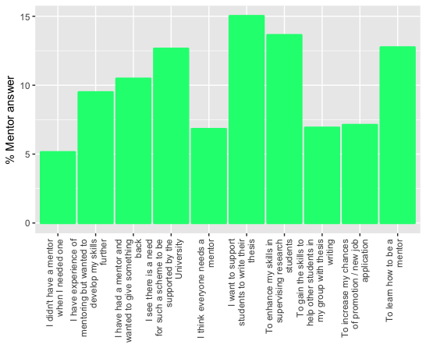
++ ECR motives for mentoring
To learn a skill (for now, for future) and apply it to an identified need to support PGRs – ‘gift economy’

Slide 8
++ research question
How are supervision practices developed through participation in a thesis mentoring programme?

Slide 9
++ methodology
INTERVIEWS
7 in depth semi structured conversations – positioned around PGR support needs.
Thematic interpretive analysis.
completion
literature
heavy on student demographics: M/F, FT/PT, nationality, discipline, age, work experience etc
external impact
factors
EXIT SURVEY
Individual mentor responses, first mentee
relationship.
196 ECR mentors
(54%M : 46%F)
MEAN: 5 y post-PhD
12% non-STEM
(Latona &
Browne, 2001)

Slide 10
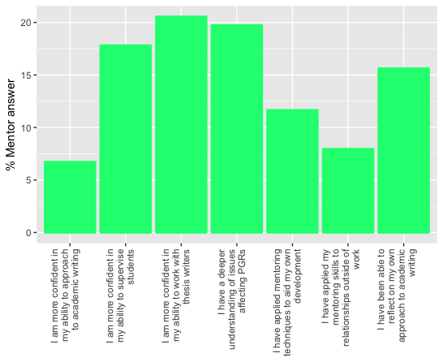
++ programme exit survey
Develop mentees
Develop other PGRS
Develop self (writing + Supervision)

Slide 11
++ headline findings
(1) Mentors develop supervisory awareness and skill sets that facilitate the building of trusting learning alliances.
(2) Mentors develop greater understanding of the enablers and disablers of doctoral writing.

Slide 12
++ 1. supervisory skill sets & learning alliances
Has being a
mentor influenced your approach to supervising PhD students?
82% YES
18% NOT APPLICABLE (0.01% NO)
ECRs described how they had learned to build trust and rapport with their doctoral mentees by:
Working with clear role descriptions, shared understanding, boundaries and limitations;
Open listening and empathy in paying attention to the mentee’s objectives and expectations;
Co-creating solutions to writing blocks.

Slide 13
++ 1. supervisory skill sets & learning alliances
“He was looking for a
proof reader. So I had to be very clear with him that that wasn’t what I was there for but we did investigate some ways in which he could [go and find] that. In terms of planning, I could have given him an answer, I was very conscious in myself to reign myself in a bit, like, I’m not going to tell you how to do this. I’m going to let you find it out. At the end of it he charged out of my office and went ‘right I’m
off to do this!’”
“…kind of anxiety procrastination… because, he does a lot of reading but then didn’t know how to take that forward. To actually putting kind of himself onto a computer and get writing. …But I think it just boiled down to a bit of a lack of confidence. He was anxious about how it would be received. Or wouldn’t be good enough. And I think he just worked himself up into a bit
of a state.”

Slide 14
++ 2. enablers and disablers of doctoral writing
Does the quality
of the student supervisor relationship impact on the ability of the student to produce the PhD thesis? 100% YES
ECRs described how they had developed a greater awareness of the role of the supervisor in:
encouraging early and frequent writing and embedding a sense of drafting and refinement as a continuous or cyclical doctoral process;
Giving feedback that builds confidence as well as competence in writing;
Building students’ self-awareness and problem-solving skills by taking time to engage in a critical reflective dialogue.

Slide 15
++ 2. enablers and disablers of doctoral writing
“I would make sure they are alright. Like in themselves as well as their work…once you feel relaxed with someone it makes talking about the work easier. Not necessarily that I think you need to be friends with people that you’re supervising but you, I think it’s just like people management skills. Isn’t it? That if you take an interest in a person, I think they are more willing to give you something back, to open up and talk about it.”
"They know they have to
write a thesis, they go ‘oh yes I’ve written a report before’…and it when it comes down to read this they realise oh, my, god that’s not going to be done in a day. Err its huge. I personally think a lot of the supervision leg work needs to be done when they are writing their upgrade. Cos that’s the right place, its early enough in the process to identify those who will have serious trouble writing…”

Slide 16
++ but how do ECRs develop supervisory skills?
Looking solely to new supervisors’ own prior experiences (Hammond et al., 2010) is unlikely to be sufficient in developing good supervision.
Indirect
via
mentee’s writing development & supervision
Direct experiences and observations of supervisor and PI
Direct interactions with mentee and feedback
Direct training in mentoring & coaching practices

Slide 17
++ but how do ECRs develop supervisory skills?
Development of an academic sense of self requires the right formal institutional structures, responsibilities and resources (McAlpine et al., 2013)
Thesis Mentoring Programme offers structures that support reflective supervisory development:
Opportunity to practice with real expectations and responsibility – supervisors’ ‘trial by fire’ (Amundsen & McAlpine, 2009)
Training in mentoring skills – self-monitoring against the training in practice
Feedback on practice from each mentee
Supervision (program manager) and peer supervision via CPD workshops
Reflective prompts (matching profiles, feedback forms, peer discussions)

Slide 18
++ conclusions
ECRs can develop as mentors, supervisors, and devise pedagogies for enabling doctoral writing.
ECRs combine cognitive (lists, planning) and emotional/motivational (listening, empathy) strategies to unstick thesis writers
ECRs develop an awareness of supervision as a ‘learned and developed practice’, not automatic
ECRs combine direct and indirect learning sources to develop their own supervisory identity.
ECRs make a contribution to writing development that supervisors cannot: neutral, near-peer, non-evaluative/judgmental
We need to position and develop ECRs as talented educational practitioners with a unique position and time to learn.

Slide 19
++ further work
Mentors who become supervisors – utility of the experience.
Mentors who take up other career paths – utility of the experience.

Slide 20
“My new role involves line management. I hadn’t formally done this before, and the experience I gained through mentoring contributed to my own belief I was ready. I was able to use specific examples from my mentoring experiences in my written application, and during the interview, to evidence why I was the right person to be responsible for the well being of a team and able to motivate
performance in
others.”
++ impact on career development across roles
“Mentoring helped me see the value of my experience beyond being an academic. Supporting PGRs to make the most of opportunities and face challenges, became part of my career goals. I now work in PGR development so my experience was very valuable in gaining my current position. I was able to demonstrate at interview my broad understanding of the challenges associated with writing up a PhD and articulate what can be done to support students.”
“Being a mentor has enabled me to evolve into a good team leader. I approach my team members and their progression as well as their day to day work with the mindset of a mentor; always aiming to help them make decisions for themselves. Being a mentor has helped me develop this mindset and put it into practice in my research team."
Senior University Teaching Technician (Engineering)
Lecturer (Science)
DTP Manager (Medical Science)

Slide 21
++ acknowledgements
ALL THE EXCELLENT POST-DOCS WHO MENTOR
YOU ARE AWESOME
AND YOU KNOW IT

Slide 22
++ references
Åkerlind, G. S. (2005). Postdoctoral researchers: Roles, functions and career prospects. Higher Education Research & Development.
Amundsen, C., and L. McAlpine. (2009). “‘Learning supervision: Trial by Fire.” Innovations in Education and Teaching International 46 (3): 331–342.
Guerin, C., Walker, R., Aitchison, C., Mattarozzi Laming, M., Chatterjee Padmanabhan, M., & James, B. (2017). Doctoral supervisor development in Australian universities: Preparing research supervisors to teach writing. Journal of Academic Language & Learning 11:1
Hammond, J., Ryland, K., Tennant, M., & Boud, D. (2010). Building research supervision and training across Australian universities. Sydney: Australian Learning and Teaching Council.
Palmer, S., and Whybrow, A. (2008) Handbook of coaching psychology. New York: Routledge
Wellington, J. (2010). More than a matter of cognition: an exploration of affective writing problems of post-graduate students and their possible solutions. Teaching in Higher Education, 15(2), 135–150

