Slide 1
REDS 2017
Rethinking skills: The Dynamic Development Model
From passive to active
Dr Tony Bromley
OD&PL

Slide 2
Issues - Personal and Professional Development now
A Passive Development Pedagogy?
What?
How?
Why?
Very long lists of required skills!
(e.g. RDF)
Daunting? Unrealistic?
Uninspiring?
Someone else's agenda
Knowledge economy
Employability
RCUK say you need it
Go to a workshop, ‘receive’ the skill

Slide 3
Issues - Personal and Professional Development now
A Passive Development Pedagogy?
How do we nurture or promote life long sustainable professional development?
How do we support people in making much more of the development opportunity open to them outside of scheduled activity?
How do we build on the dynamism that exists in an individual already?
How do we go deeper in respect of professional development with an individual (And with an increased volume of people)?

Slide 4
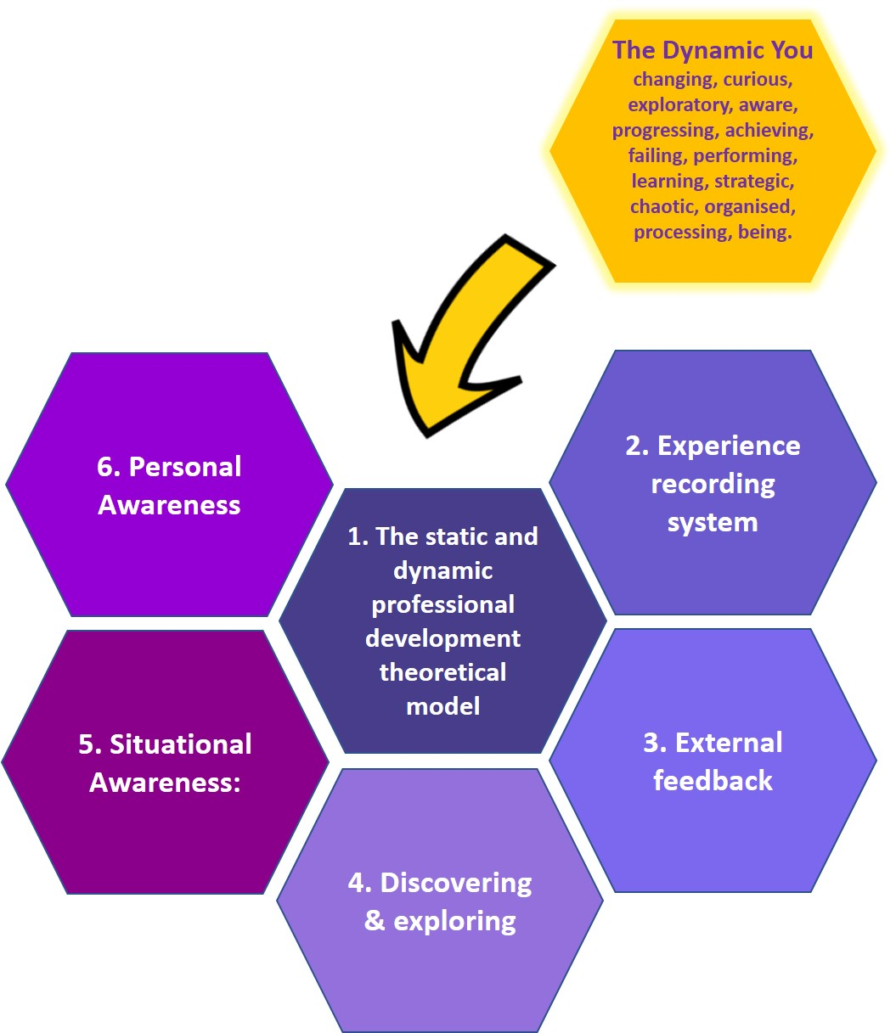
The Dynamic Development Model
An
Active Development Pedagogy

Slide 6
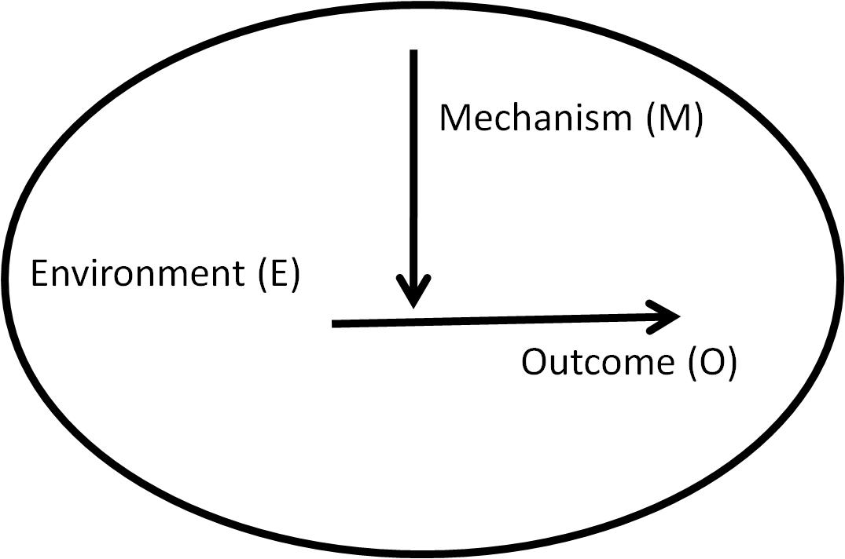
Realistic evaluation: Pawson & Tilley
Context (C)
Environment (E)
Mechanism (M)
Outcome (O)

Slide 7
Learning Logic Diagram: Kirkpatrick
Baseline
Reaction
Learning
Behavioural Change
Outcome
Level 0
Level 1
Level 2
Level 3
Level 4
Professional development is learning, that leads to behavioural change, that leads to a more successful outcome for the individual

Slide 8
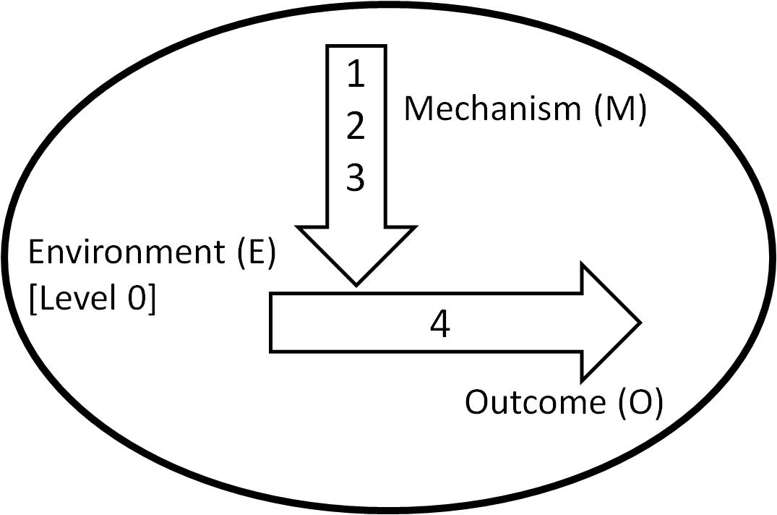
Combine realistic evaluation with the learning logic diagram

Slide 9
Combine realistic evaluation with the learning logic diagram
Learning is dynamic and has a self momentum
Context/Environment is more static in nature
What happens if we explore professional development in static and dynamic terms?

Slide 10
What happens if we explore professional development in static and dynamic terms?
Personal analysis
Situational analysis

Slide 11
Person profiling
Situational analysis
You (Static)
Situation (Static)
You (Dynamic)
Situation (Dynamic)

Slide 12
Person profiling
Situational analysis
You (Static)
Situation (Static)
Intuitive
Introvert
Feeling
Judging
Futuristic
Learner
Achiever
Strategic
Developer
You (Dynamic)
Situation (Dynamic)

Slide 13
Person profiling
Situational analysis
You (Static)
Conference presentation
Situation (Static)
Knowledge
Intuitive
Research idea
Introvert
Location
Feeling
Slides
Preparation
Judging
Futuristic
Q & A
Learner
Audience
Confidence
Achiever
Strategic
Schedule
Developer
Are there factors that dominate in the given situation?
You (Dynamic)
Situation (Dynamic)

Slide 14
The Dynamic Development Model

Slide 15
Acknowledgements:
Dynamic Development Steering Group:
Tony Bromley (Chair) University of Leeds
Jim Boran University of Manchester
Gail de-Blaquiere Newcastle University
Sarah Gray University of Leeds
Richard Hinchliffe Freelance Consultant
Mark Proctor University of Sunderland
Sandrine Soubes University of Sheffield
Project funding:
University of Leeds Student Education Fellowship (Development Award)

Slide 16
One conclusion
A skill is managing the dynamic and static components of a situation to a successful outcome
A dynamic component has a sense of self momentum in a situation and is not entirely under your control. E.g. When presenting, the audience response is dynamic
A static component has a sense of non-changing and controllability in a situation. E.g. When presenting, PowerPoint slides are static in that they can be pre-prepared and do not change during the presentation.

Slide 17
The following extract comes from a paper by McAlpine who studied early career researchers transitioning in their roles, ‘Becoming a PI: From doing to managing research’.
‘Thus, though getting the grant was a positive experience, individuals found themselves dealing with new challenges (not doing ‘what I thought I would be doing’ (Juliet)) which many characterized as a shift in perspective from ‘doing’ to ‘managing’ research – ‘become a manager’ (Sam).
All but Romeo and Will described a range of responsibilities they had to take on that they were not prepared for: managing the grant (Jerry), dealing with people (e.g. Frances, Fiona), managing the team (e.g. Pedro, Fabien, Jerry), line managing individuals (e.g. Laura, Cathy) as well as setting priorities amongst tasks (e.g. Mike), negotiating the ‘political’ environment (e.g. Fabien), developing a management style (e.g. Greg, Geoff, Victor), getting people to do things they don’t want to do (e.g. Dan).’
[Source: McAlpine 2016]
Lynn McAlpine (2016) Becoming a PI: From ‘doing’ to ‘managing’ research,
Teaching in Higher Education, 21:1, 49-63, DOI: 10.1080/13562517.2015.1110789
PI – The ‘Principal Investigator’ on a research project.

