Slide 1
Challenging values and attitudes that support Researcher Development?
Dr Lorna Warnock and Dr Amanda Barnes
Department of Biology
Notes:
We are based in the biology department at the University of York and provide employability support and training to UGs, PGs and staff
In biology there are around 140 PhD students in the department and 100 RA’s

Slide 2
Why do we need to challenge values and attitudes?
15 years since the Roberts Report
Authors are compiling a literature review assessing the impact of Researcher Development training
How can we record the impact of Researcher training?
Three themes have surfaced from our review which we set out to challenge in this session

Slide 3
Why do we need to challenge values and attitudes?
What are we training researchers for?
How do we develop and measure their personal effectiveness?
Why do we label a movement from academia as a transition?

Slide 4
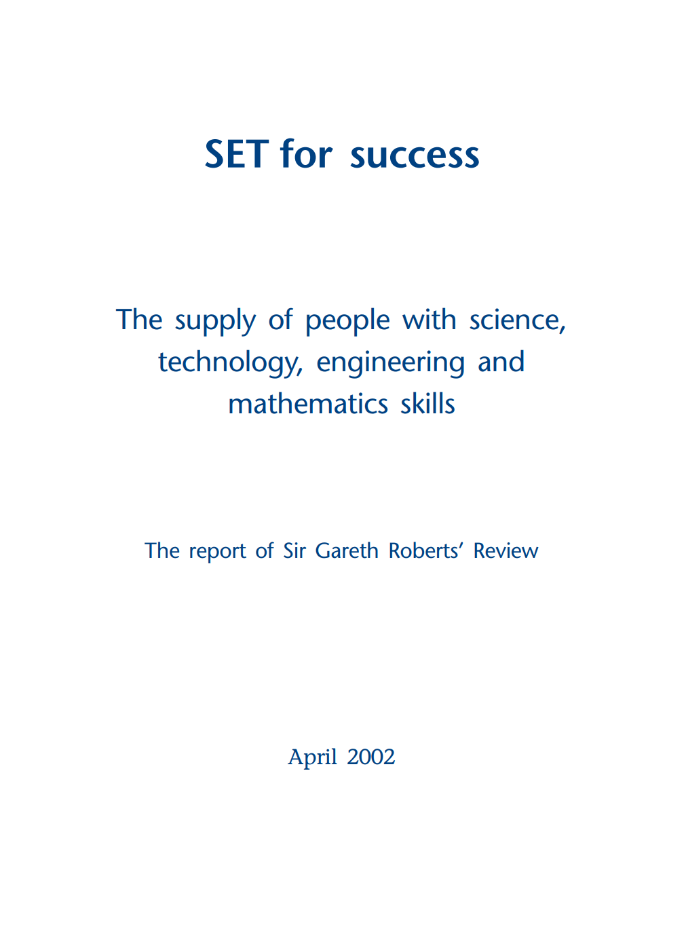
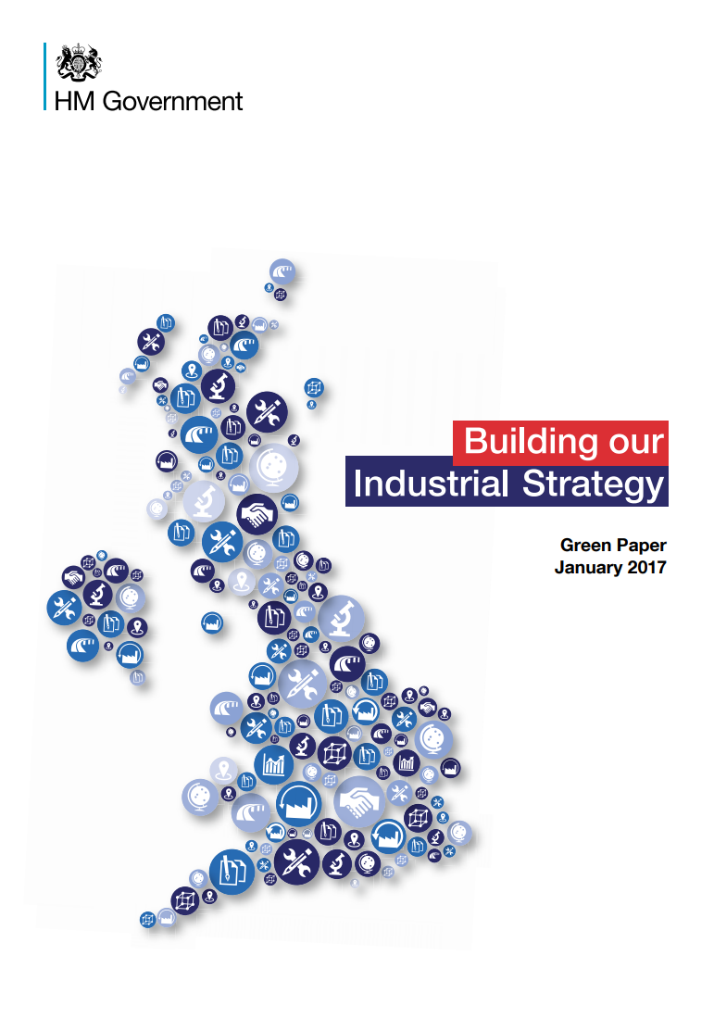
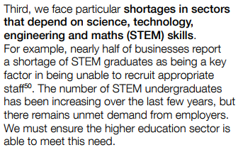
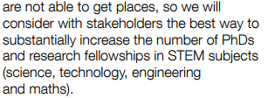
What are we training PhDs for?

Slide 5
What are we training PhDs for?
Less than ½ of PhD graduates stay in academia, this figure is lower in STEM
PhD landscape has dramatically changed
No longer viable to train PhD candidates just for academic careers
Shift seen in BBSRC funded PhDs – PIPS programmes
Notes:
There has been an increase in PhD numbers over recent years, which does not equate to an increase in lectureship roles
(also an increase in UG’s at York – therefore more students seeking work based learning opportunities, year in industry and PhD places)

Slide 6
Professional Internships for PhD Students
Many DTP/DTC programmes now include funding for students to perform a 3 month, paid internship during their PhD
Opportunity to gain work experience during your PhD in an area unrelated to your research
Can be unrelated to science
Experience of a potential career route after PhD

Slide 7
How should we be training PhDs?
More transparency and acceptance of career routes from supervisors as well as researcher developers
Change in the PhD model?
Competency frameworks developed through engagement with employers
Notes:
Still training PhDs to be academics and where that it isn’t their aspiration is it seen as an alternative career route

Slide 8
Personal Effectiveness
Enable PhD students to spend time tailoring their development to their strengths
Other essential skills desired by employers in addition to academic skills
Creativity and Innovation, Resilience, Digital skills, Commercial Awareness

Slide 9
Personal Effectiveness
Competency framework created
Skills and strengths that employers seek in an accessible format – York Strengths
Liaised with host organisations to gain feedback
All levels of students – UG, Masters, PhD
More accessible than the RDF
Notes:
Add images of CF

Slide 10
Competency Frameworks
Self Improvement and Resilience | A good self-awareness and competency in self-improvement means that you are continually looking for ways to learn and develop yourself. ……. during your research you may face setbacks which challenge you to develop strategies to develop resilience and perseverance………
Leadership and relationship building | Working closely with technical staff, visiting associates and overseeing student projects will help you to develop your own style of leadership. Opportunities may arise for you to be involved in networking and setting up collaborations outside of your research group. You take responsibility for your own research project management and will learn to make important decisions, motivating and persuading others.
Notes:
Add images of CF

Slide 11
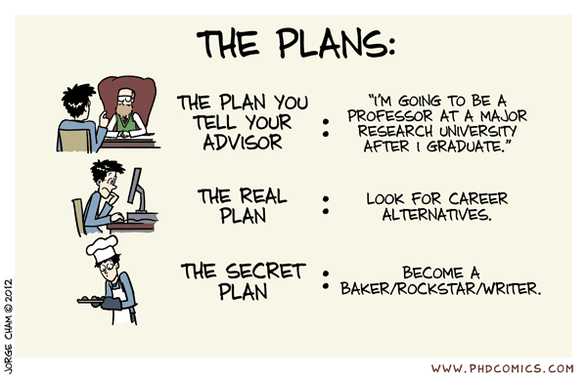
Notes:
Still training PhDs to be academics and students are still faced with attitudes that they should follow an academic route
It’s not alternative anymore!
At interview applicants are expected on many occasions to have aspirations to continue in research, whereas quite soon after they start we begin to encourage training in a range of areas to suit many careers
Should be more honesty in career options and recognition from academics that alternative careers aren’t alternative

Slide 12
Transitions? Alternative Careers?
Mindset that a move from academia is an ‘alternative career’
Stigma attached to leaving science
It is not a transition, it is a progression
UK Government is seeking these transitions
Notes:
Add images of CF

Slide 13
Thoughts from the audience…..
What should we be training PhD students for?
How to PhD students develop personal effectiveness?
How do we shift the alternative careers mindset?
Notes:
Add images of CF

Slide 14
Summary
Roberts and more recent publications are still highlighting the need for investment in PhD graduates
Progress has been made, but the focus is still centered on academic careers (STEM)
How do we influence stakeholders to challenge these values and attitudes?
Notes:
Add images of CF

Slide 15
Any questions? lorna.warnock@york.ac.uk amanda.barnes@york.ac.uk
Notes:
We are based in the biology department at the University of York and provide employability support and training to UGs, PGs and staff
In biology there are around 140 PhD students in the department and 100 RA’s

