Slide 1
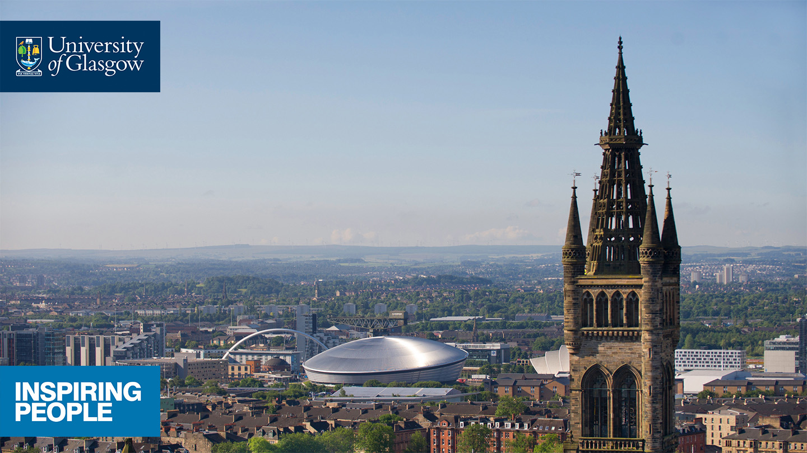
Supporting diverse PGR journeys through researcher communities
Mary Beth Kneafsey
Elizabeth Adams

Slide 2
Research Communities project and key themes
Reflecting on the project
Translating this to action

Slide 3
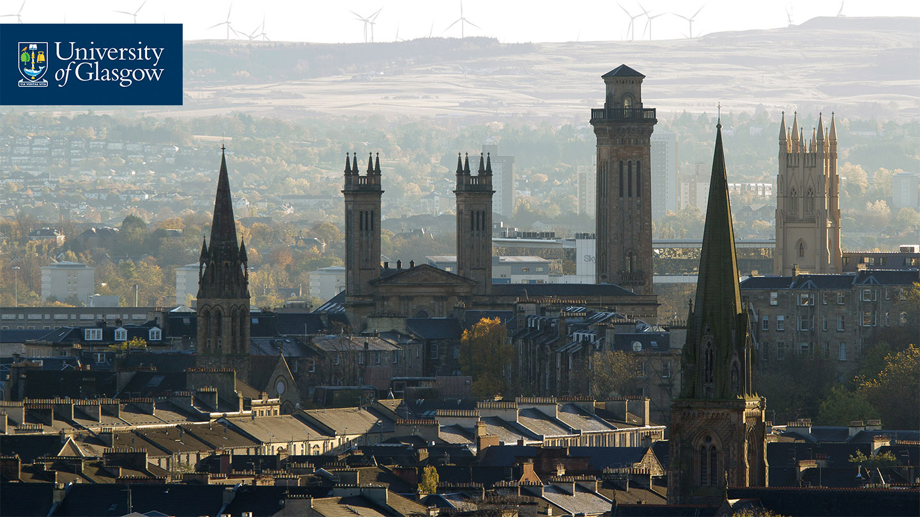
Initial Questions
Is there a consensus around what constitutes a ‘research community’?
What does a successful research community look like?
What is the purpose of a research community?
Where do/should the boundaries of the research community lie?
Notes:
Briefly discuss project and process
Research community – but we also conceived of this as a sense of belonging to a community as well as community more broadly insofar as was possible in our thinking on the project

Slide 4
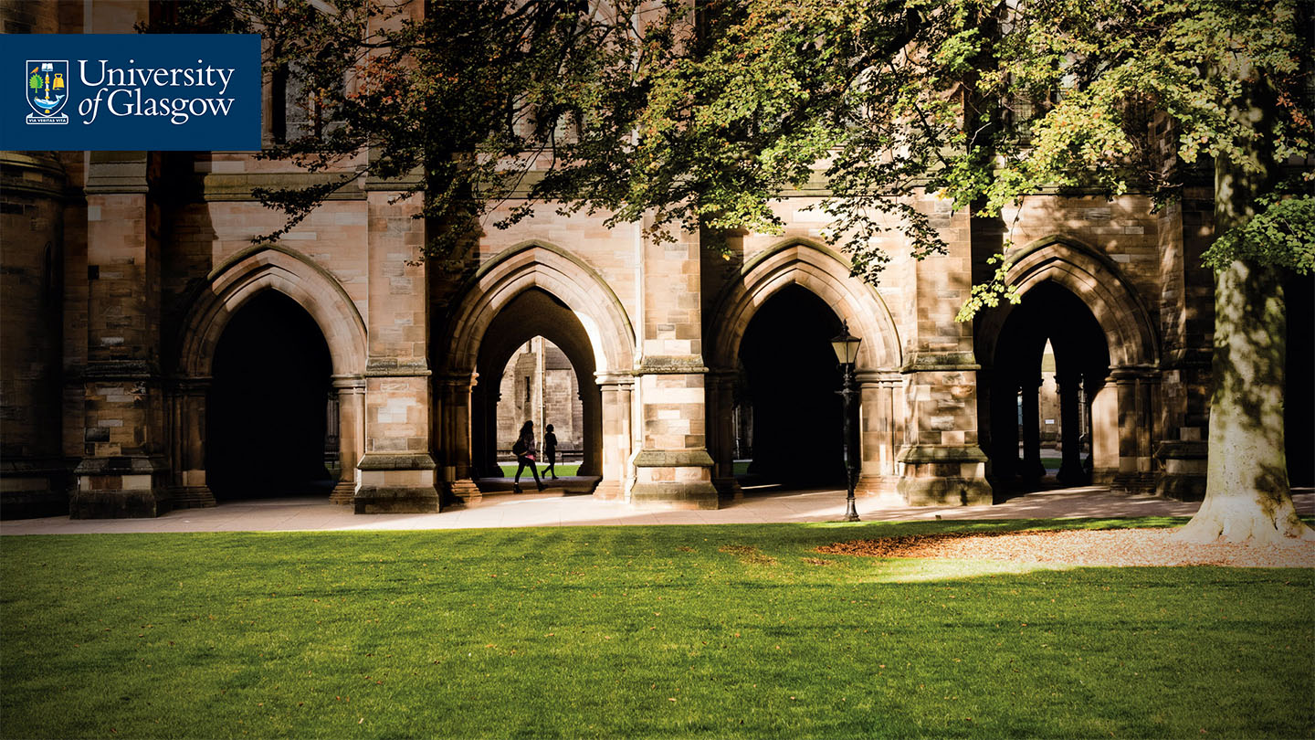
Key Elements of Research Community
Supervisors
Physical Space
Online Communities
Centralised Communities
PGR Training
PGR Representation
Building Academic Identity
Notes:
Having written the work up for QAA and presented and discussed this in different ways and at different events, something we were struck by was another thread…..that learning is taking place in all these spaces – whether directly about the discipline or the project or about broader elements of becoming a researcher or becoming embedded in the profession – and that we need to try a bit harder to hear all the voices in our community
Probably worth mentioning as well that we were focusing on academic life rathr than broader communities of support – arguable that communities that relate to personal life – friends, families, hobbies, etc are just as important although in an entirely different way

Slide 5
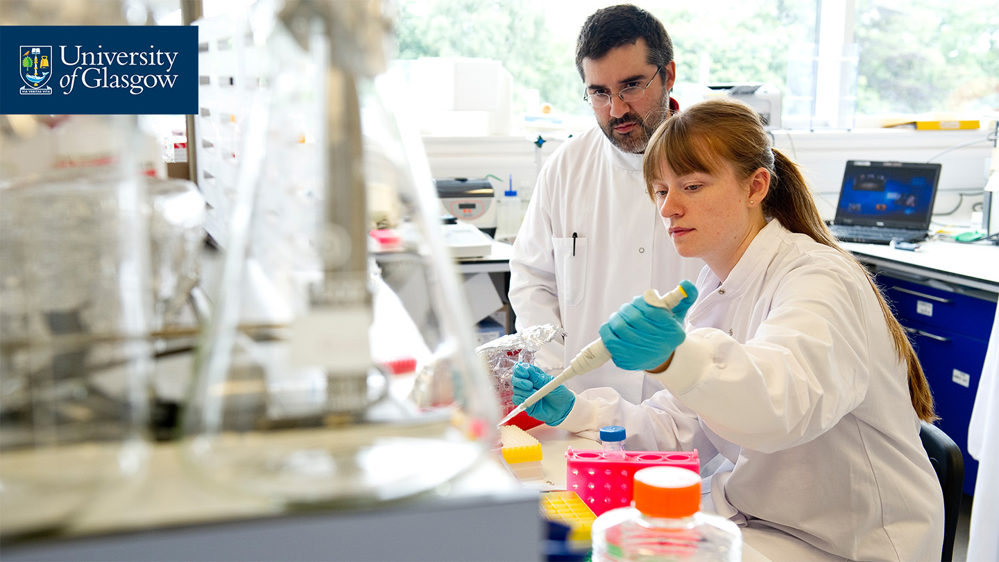
Supervisors
‘The first port of call’ – and provides access to professional networks and connections
Identified by both staff and PGRs as playing a crucial role.
Codes of practice can establish ethos and build a culture of involvement
Notes:
Clear that this relationship is KEY – although perhaps not in an of itself (necessary by not sufficient) the key to success

Slide 6
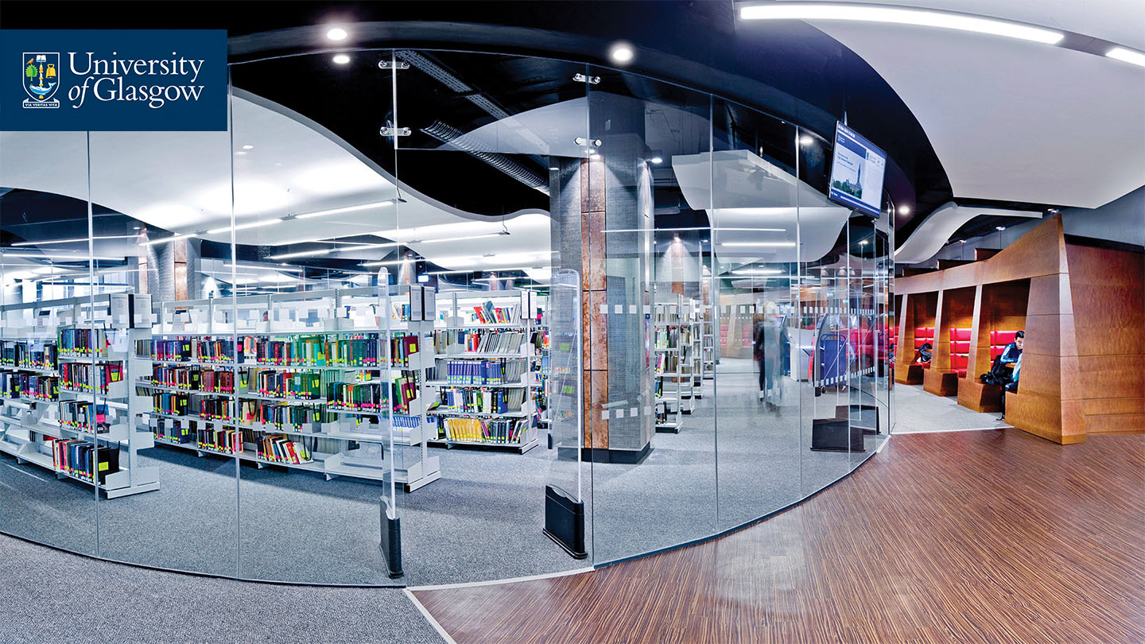
Physical Space
‘It’s not about creating the community – it’s about creating the space for communities’
Is there variation in terms of the type of space offered?
Multi-purpose spaces allow for a range of interactions: formal, informal, group working
Notes:
Comment about ‘space for communities’ is broader than physical space – many staff in HEIs pointed to the importance of physical space and was often a key to their strategy for their PGRs – many students noted the importance of spaces to meet, gather and work, e.g. find spaces to hold their own writing and reading groups

Slide 7
Online Communities
‘Joined Twitter for academic reasons and found a feeling of community’
Online communication can play a vital role in the research community
An active online presence, and offering online space, can enable distance and p/t researchers to maintain links with the community
Notes:
a counterpoint to physical space – students may seek out their own spaces to connect with a chosen community or engage with particular topics – formal and informal

Slide 8
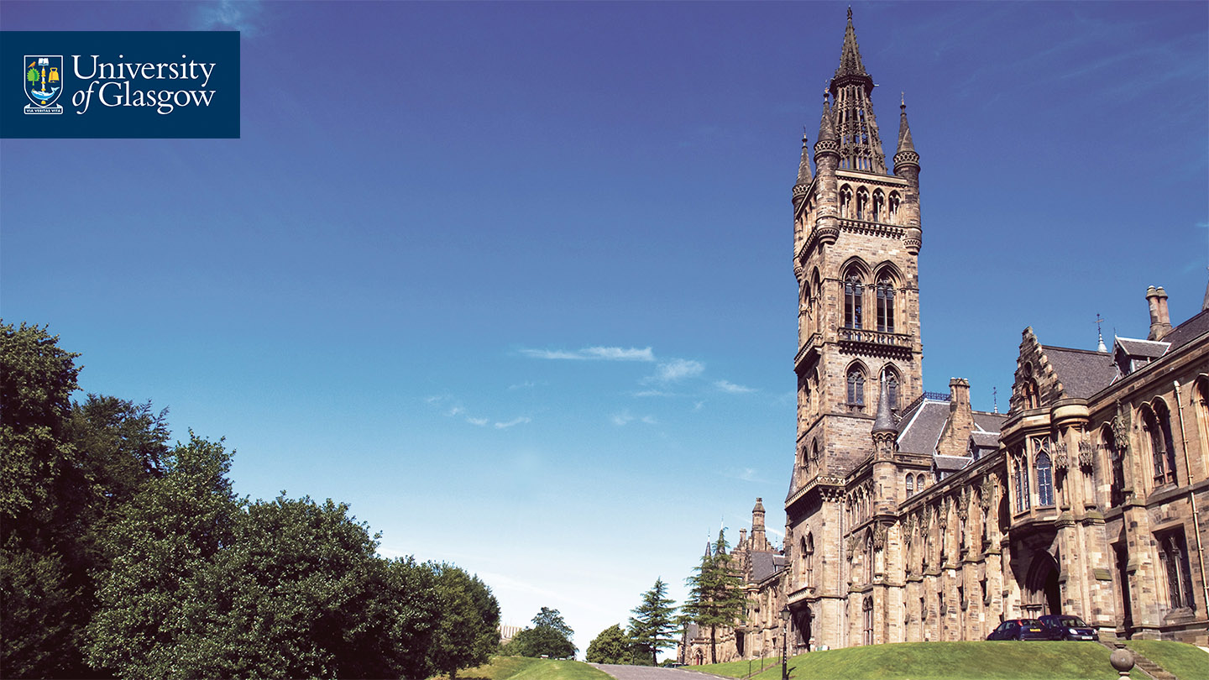
Centralised Communities
‘Outside the research group’
Cross institutional organisations, or temporary groups created by a focused activity
Is there scope for PGRs to create and lead their own centralised communities? Can lessons be learned from how centralised communities unite members?
Notes:
You might also call these created communities – might be broadly or narrowly disciplinary - are they about community per se or are the somewhat artificial group structures, e.g. targeted delivery. Arguable. Tend to think that most don’t focus on this overtly but bring students together in a variety of targeted ways around skills development or employability related activity

Slide 9
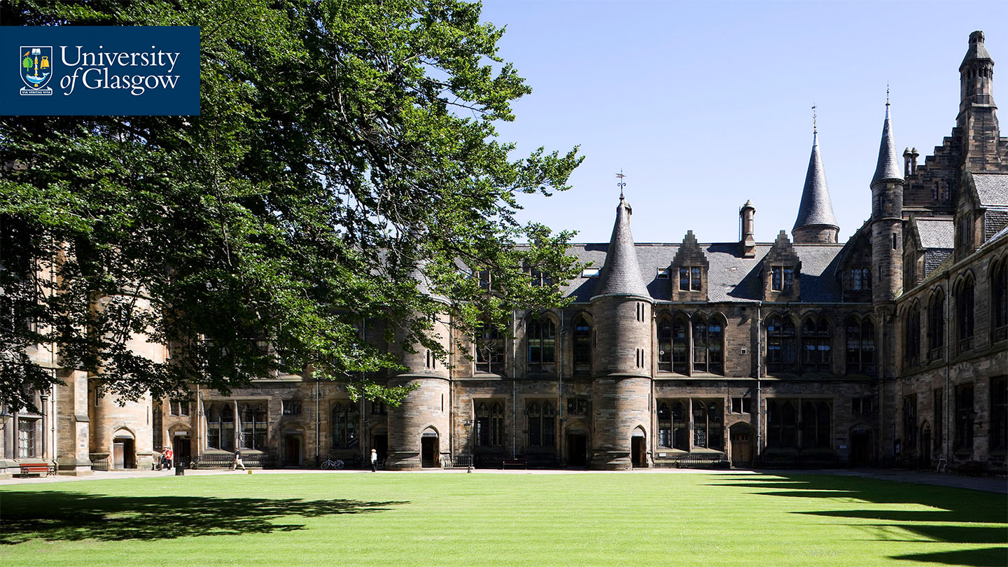
PGR Training
‘Get outside your own research bubble’
Opportunity to interact with other PGRs is as valuable as the content of the training itself
Training might cover the entirety of the PGR experience: issues such as managing mental health or work life balance as well as subject-specific and employability-related skills
Notes:
An obvious shared space where students move into and out of a variety of groups and work with a wide variety of students

Slide 10
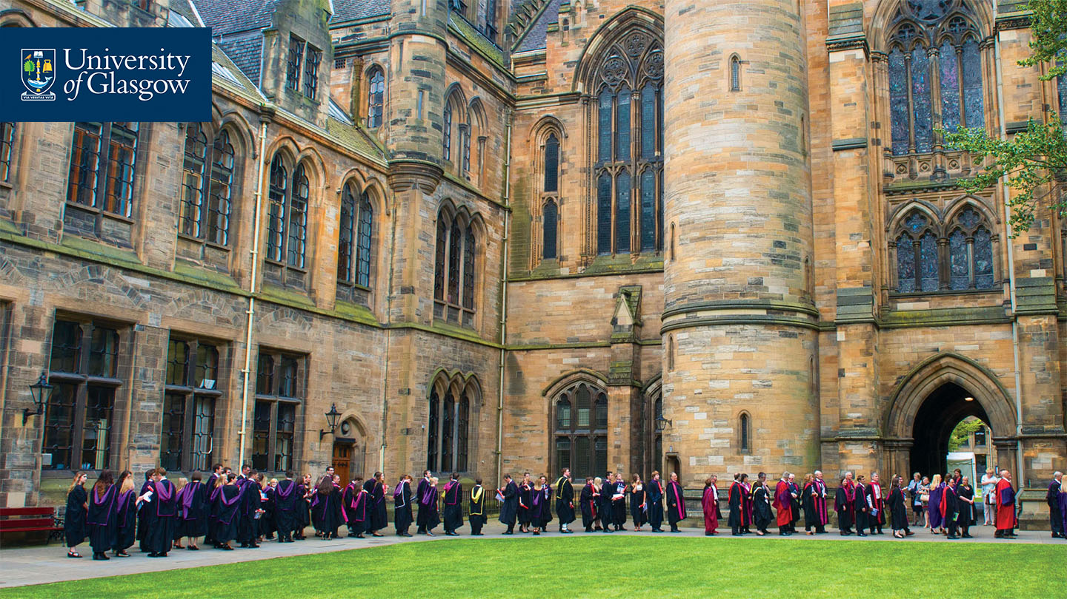
PGR Representation
Concern that not participating in as much as possible ‘might make me look invisible’
How can all PGRs make themselves seen and heard?
Sub-communities could be created for underrepresented groups.
Regular feedback could be sought from all PGRs.

Slide 11
Building Academic Identity
‘Working shoulder-to-shoulder’
Staff and PGR interaction is vital as are peer interactions
Policies and codes of practice as well as formal (e.g. GTA work) and informal interactions (e.g. work in progress workshops, reading groups)
Notes:
This was a key theme – students spoke about a sense of becoming, becoming a researcher or developing a scholarly or academic identity – a journey towards something – and this element of an identity under development is a key link to our thinking about how this related to doctoral earning

Slide 12
Drawing the themes together
‘It’s not about creating the community – it’s about creating the space for communities’ – this was a key observation by one our interviewees – students lead the way to what they need and when
‘The relationships and interactions that create the sociocultural context and developmental networks in which doctoral student learning is situated provide meaning, efficacy, and identity development. The interactions, and subsequent sense-making, that student engage in, help students determine if and how they can successfully make the transition through stage 2 and into their roles as independent scholars.’ Baker and Pifer (2011)
Notes:
Explain stage 2 – us context – stage 1 – taught elements and proposal development; stage 2 – dependence to independence as a researcher; stage 3 – final stages – dissertation, defence and next steps

Slide 13
Drawing the themes together
Can we think of communities themselves as opportunities for learning?
‘learning and identity development go hand in hand – it is through participation in the intellectual community in the field and the home institution that doctoral students build the knowledge and skills required of scholarship in their field of study’ Baker and Lattuca (2010)
Boud and Lee (2005) refer to ‘distributed learning’ in the sense of ‘networks of learning in which learners take up opportunities in a variety of ways without necessary involvement from teachers or supervisors’ and as a ‘horizontalisation’ of relationships where they gradually move into more peer-like relationships with supervisors and other researchers

Slide 14
Drawing the themes together
What can we do to encourage inclusivity and diversity in researcher communities, as well as promote a culture of support and academic kindness in our institutions?
Important to remember as well that students both negotiate and choose their communities – they may reject some and cultivate others
Are we collecting any data to monitor participation in informal training or enhancing or understanding in other ways? Are some groups disadvantaged by this? How can we do this better?

Slide 15
Some References
Baker, V. L. and Lattuca, L. R. (2010) ‘Developmental networks and learning: toward and interdisciplinary perspective on identity development during doctoral study’, Studies in Higher Education, 35(7), 807-827.
Baker, V. L. and Pifer, M. J. (2011) ‘The role of relationships in the transition from doctoral student to independent scholar’, Studies in Continuing Education, 33(1), 5-17.
Boud, D. and Lee, A. (2005) ‘’Peer learning as pedagogic discourse for research education’, Studies in Higher Education, 30(5), 501-516.
Hopwood, N. (2010a) ‘Doctoral experience and learning from a sociocultural perspective’, Studies in Higher Education, 35(7), 829-843.
Hopwood, N. (2010b) ‘A sociocultural view of doctoral students’ relationships and agency’, Studies in Continuing Education, 32(2), 103-117.
Pearson, M., Evans, T. and Macauley, P. (2016) ‘The diversity and complexity of settings and arrangements forming the ‘experienced environments’ for doctoral candidates: some implications for doctoral education’, Studies in Higher Education, 41(12), 2110–2124.
CONTACT US: MaryBeth.Kneafsey@Glasgow.ac.uk Elizabeth.Adams@Glasgow.ac.uk

Slide 16
