Slide 1
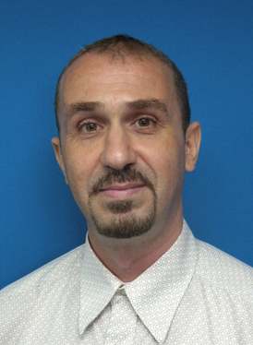
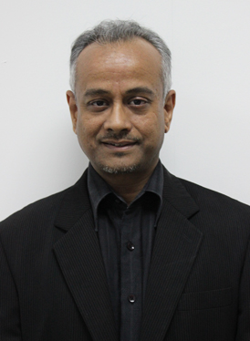
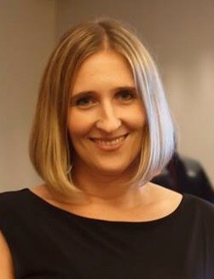
Refocusing Research Education in Malaysia
Dr. Ismail Ait Saadi, Prof. D.P. Dash & Dr. Heidi Collins
Swinburne University of Technology, Sarawak Campus

Slide 2
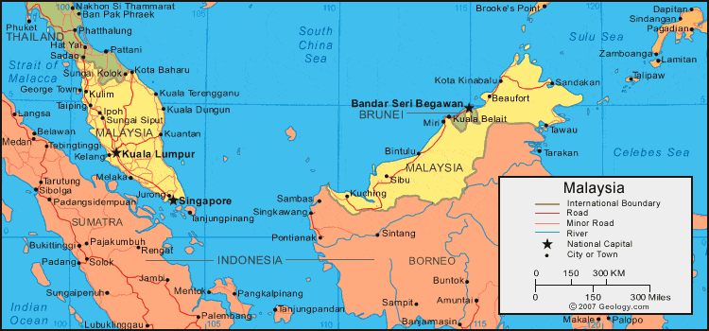
Background: Doctoral Education in Malaysia
Master by research and doctoral student numbers have multiplied over past 10 years
Masters tripled, PhDs multiplied five-fold:
PhDs awarded |  | Malaysian |  | International Students |  | Total
2006 |  | 427 |  | 234 |  | 661
2016 |  | 2163 |  | 2152 |  | 4315
Growth rate |  | 410% |  | 820% |  | 550%
To support its aim of becoming a high-income nation by 2023, the government has set a target: From 23,000 Malaysian PhD holders in 2014, to 60,000 by 2023
Looking to 20 public and 43 private Malaysian universities, and branch campuses of 9 foreign universities: Swinburne, Monash, Curtin, Nottingham, Heriot-Watt, Newcastle, Southampton, Reading & Xiamen

Slide 3
But how should this be achieved?
MyBrain15: Scholarships for Malaysians worth GPB 500 million are being awarded. But questions remain:
Why this number?
What skills and attributes are required?
Employability?
Supervisory capacity?
Quality?
Who should lead this endeavor?

Slide 4
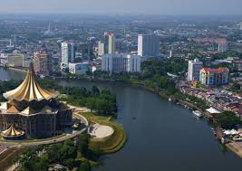
Borneo Research Education Conference (BREC) 2013-2017
From our observation that that Malaysian Government is largely focused on research outcomes, there was a need for universities to start talking about researcher development:
Personal & Professional Development, Process & Outcomes
Aim: To enhance research education in the region
Vision:
Doctoral education & beyond
Borneo & beyond
Conference & beyond
Business field & beyond

Slide 5
Principles of BREC
Collaborative
Five Borneo universities collaborated to establish BREC:
Swinburne, Unimas, UiTM, UMS & Curtin
Developmental
BREC 2013: Developing as a Researcher Through the Culture of Sharing
BREC 2014: Developing as a Researcher by Doing Meaningful Research
BREC 2015: Developing as a Researcher by Playing Scholarly Roles
BREC 2016: Developing as a Researcher by Building Research Skills
BREC 2017: Developing as a Researcher Through Perseverance

Slide 6
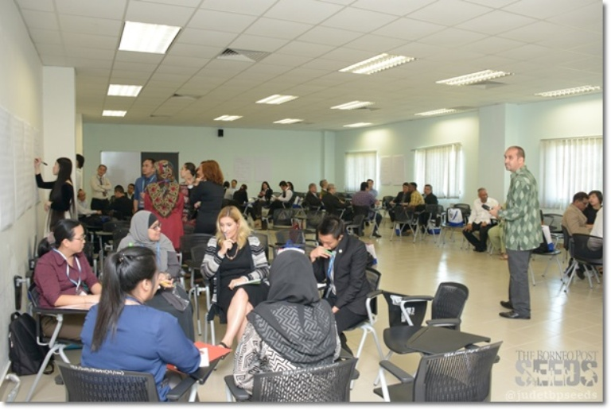
Conference Design
Warm-up workshop
Creating awareness and reducing barriers
Inclusiveness
Encouraging students at all stages of development
Students first
Increasing student empowerment
Authentic engagement
Exposing to various academic roles, high quality interactions
Safe environment
Overcoming inhibitions, learning to give & receive feedback
Constructive Feedback
Instilling academic rigour, with respect & dignity

Slide 7
Impact
Positive participant experiences
It was a very supportive (non-threatening) environment for a novice presenter.
It reduced the gap between research students and supervisors.
Great care taken in providing feedback.
It was possible to build closer relationships, which could develop as support systems.
I learnt by watching others talk about their research. Now I have a better idea about research proposals.
The conference has taken me to another level of my entire research.
But little ongoing dialogue between institutions…

Slide 8
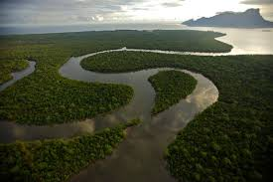
Challenges
Unfamiliarity with the the term and the field
What is research education?
KPI driven institutions, staff & students
Can I get a publication from this?
Hierarchical culture – national & institutional
I will have to talk to my boss
Leadership instability
That’s not my role now
Lack of role clarity
What does it mean to collaborate?

Slide 9
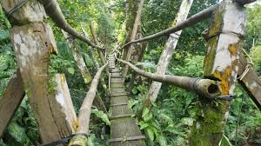
Conclusions – Our Way Forward
Create awareness of research education as an emerging field
Connect with local & international community
2. Reduce individual barriers
Encourage active participation & meeting KPIs
3. Neutralise the institutional barriers
Attach BREC to an external association
4. An Overhaul?
An event or a vision?
Coordination, cooperation, or collaboration?

Slide 10
References
Azman, N., Sirat, M., & Pang, V. (2016). Managing and mobilising talent in Malaysia: issues, challenges and policy implications for Malaysian universities. Journal of Higher Education Policy and Management, 38(3), 316–332. http://doi.org/10.1080/1360080X.2016.1174406
Cheong, K. C., Hill, C., Fernandez-Chung, R., & Leong, Y. C. (2016). Employing the “unemployable”: Employer perceptions of Malaysian graduates. Studies in Higher Education, 41(12), 2253–2270. DOI: 10.1080/03075079.2015.1034260
Evans, L. (2012). International Journal for Researcher Development The scholarship of researcher development: mapping the terrain and pushing back boundaries. International Journal for Researcher Development , 2(2), 75–98. http://doi.org//10.1108/17597511111212691
Fong, L. L., Sidhu, G. K., & Fook, C. Y. (2014). Exploring 21st Century Skills among Postgraduates in Malaysia. Procedia - Social and Behavioral Sciences. http://doi.org/10.1016/j.sbspro.2014.01.1406
Hill, C., Cheong, K-C., Leong, Y-C., & Fernandez-Chung, R. (2014). TNE – Trans-national education or tensions between national and external? A case study of Malaysia, Studies in Higher Education, 39:6, 952-966, DOI:10.1080/03075079.2012.754862
Ming, Y.C., Kai, W.H., Hoi, P.T., & Kuk, F.F. (2013). Patterns of co-authorship and research collaboration in Malaysia, Aslib Proceedings: New Information Perspectives, Vol. 65 Issue: 6, pp.659-674. DOI: 10.1108/AP-12-2012-0094
Ministry of Education, Malaysia (2017) Graduate Tracer Study, http://graduan.mohe.gov.my.
Poole, B. (2014). The rather elusive concept of “doctorateness”: a reaction to Wellington. Studies in Higher Education, 40(9), 1–16.DOI: 10.1080/03075079.2013.873026

