Slide 1
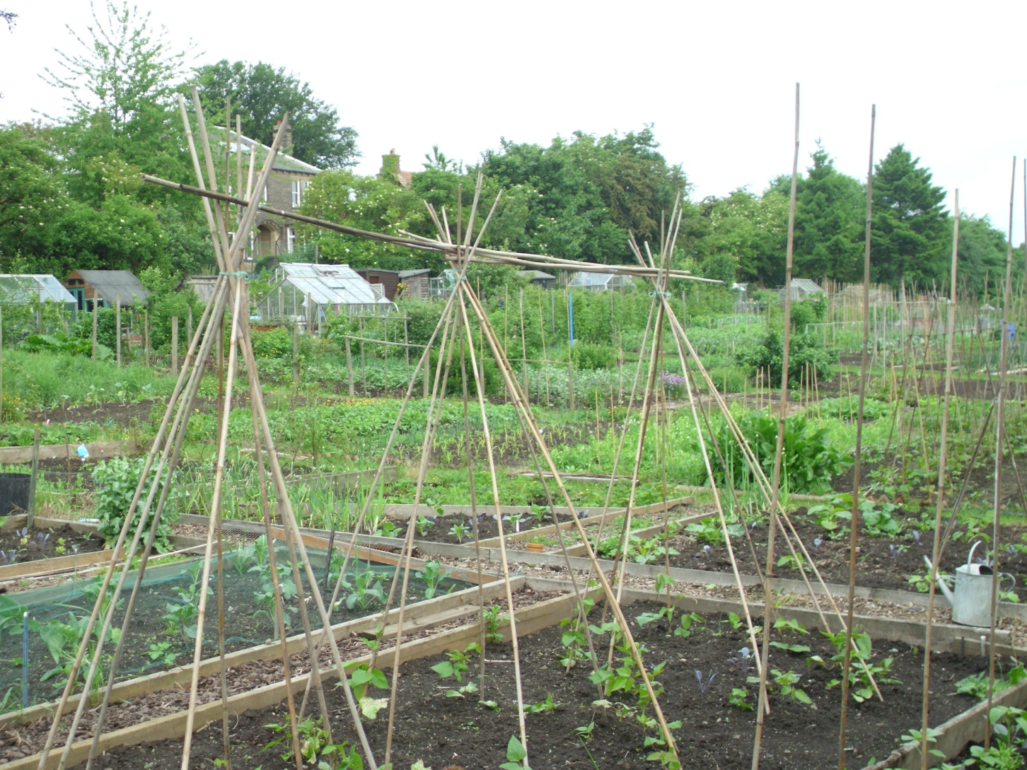
Time to Learn:
Lessons from Allotment Gardeners
Notes:
So very briefly, in terms of methodology, I interviewed and observed 16 gardeners over three years (during the growing season) and did lots of documentary/desk research and visited garden centres, other allotment sites and ended up with huge amounts of data – transcripts, photos…….
Interestingly, the long time I had for this study (part-time over 6 years) was also very important for my research because it gave me lots of time to generate data, and lots of time to analyse it in different ways and to get the best story out of it and to experiment with different ways of writing about it – and rewriting about it….: so time not just the subject of my research but very significant to the process of doing it.
As I said though I wasn’t looking for time – I’d originally explored the learning literature, particularly in relation to practice-based learning and work-based learning as this seemed the most relevant but then forced to go back and look at the time literature.

Slide 2
What time DOES
Nature’s diverse rhythms transcended by the uniformity of clock/industrial time
Cyclicity replaced by linearity
The intensification of time

Slide 3
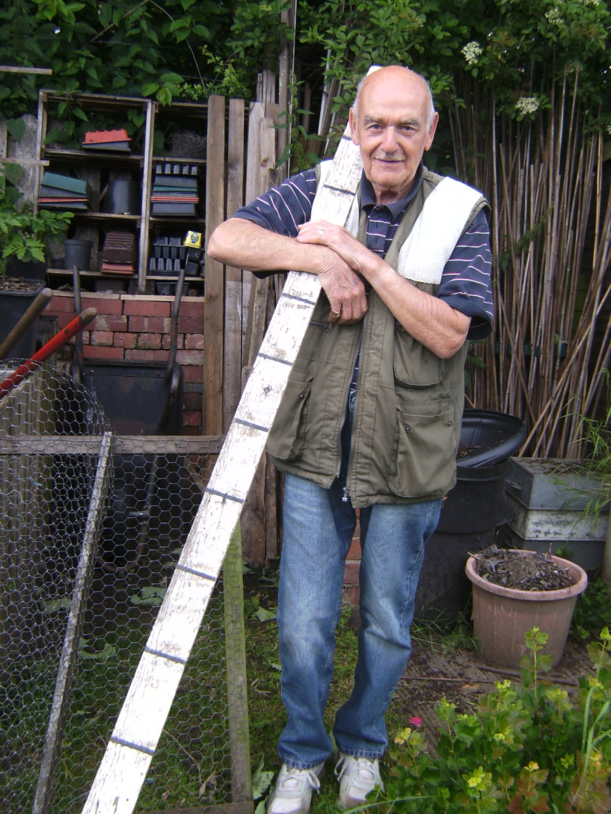
The Life of Bryan

Slide 4
The Regime of Instability
‘our meteorological lot is messy and erratic’
(Mabey, 2013)

Slide 5
The Regime of Continuity
‘[Allotment gardening is] one of those British horticultural eccentricities which are accepted and celebrated as part of the vibrant grassroots fabric of society’
(Mackay, 2011)
‘…when young lads go into a trade, they have six or seven years’ apprenticeship. I’ve done 33 years here now, so I’ve 4 apprenticeships in it. So you’ve got to have learned a bit of something in that time, haven’t you?’
(Bryan)

Slide 6
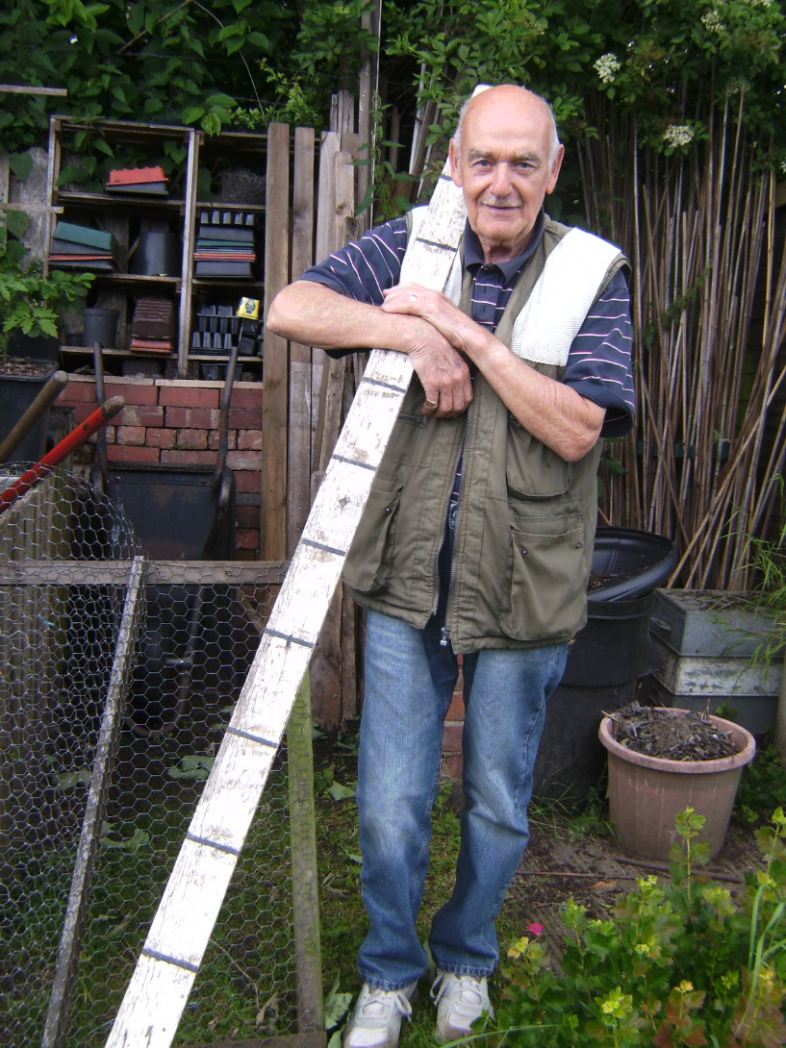
The Regime of Recurrence

Slide 7
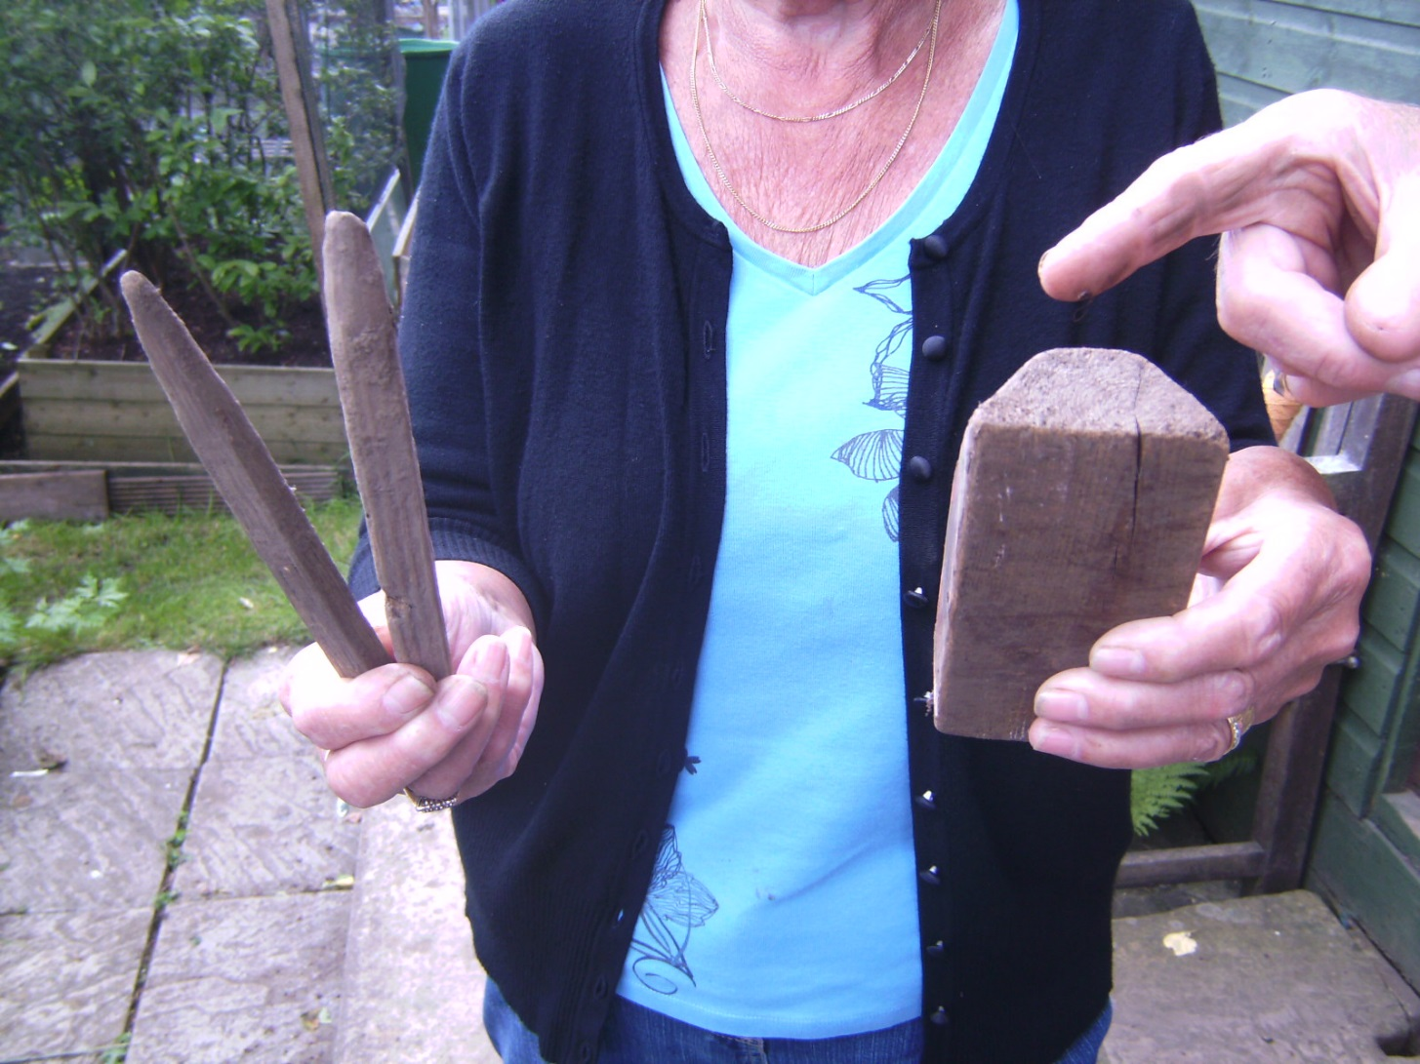

Slide 8
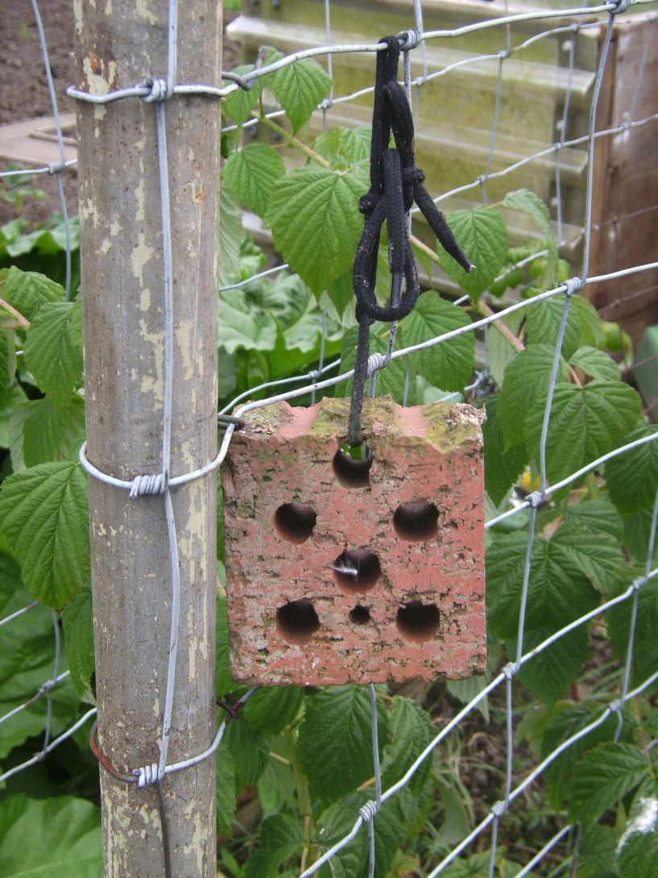

Slide 9
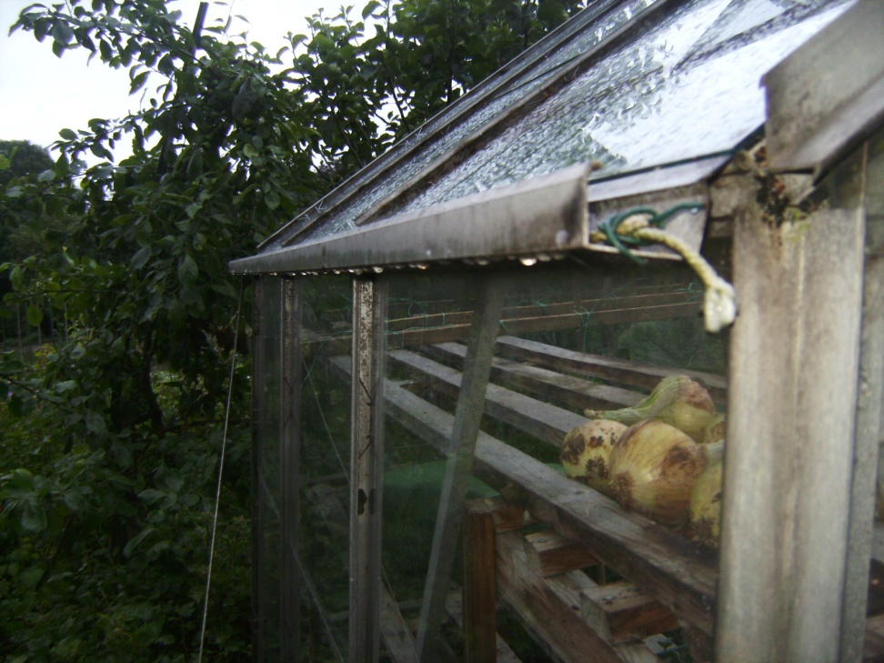
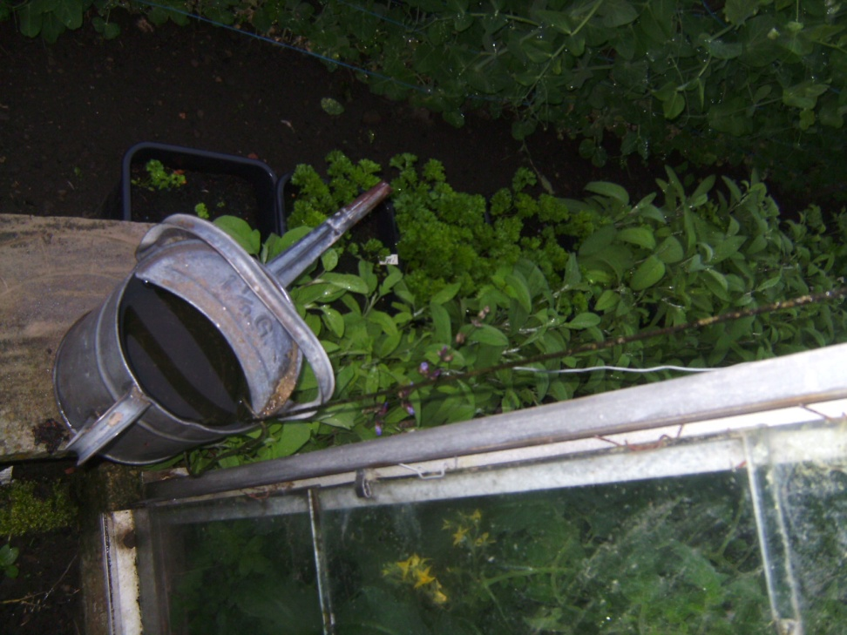

Slide 10
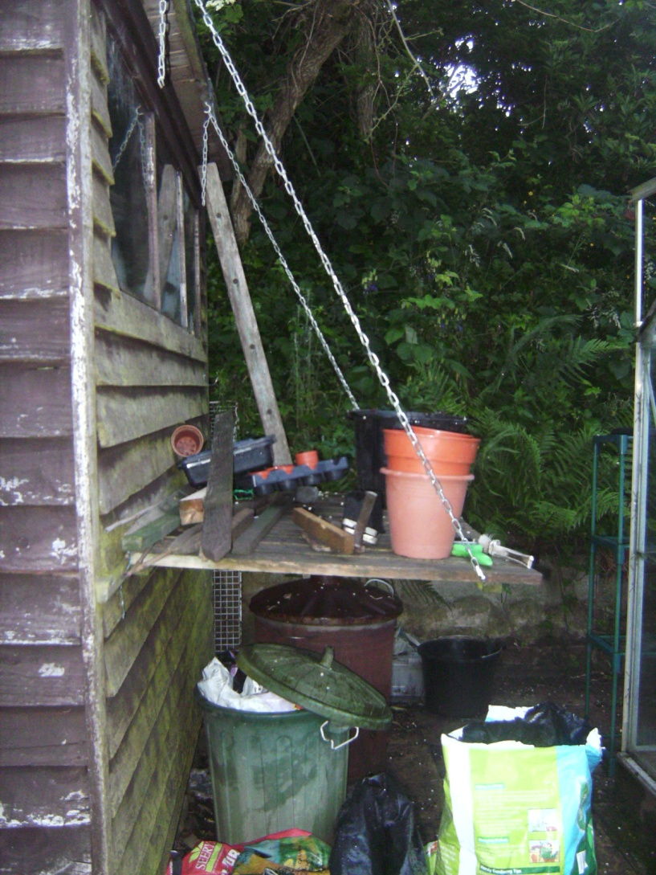

Slide 11
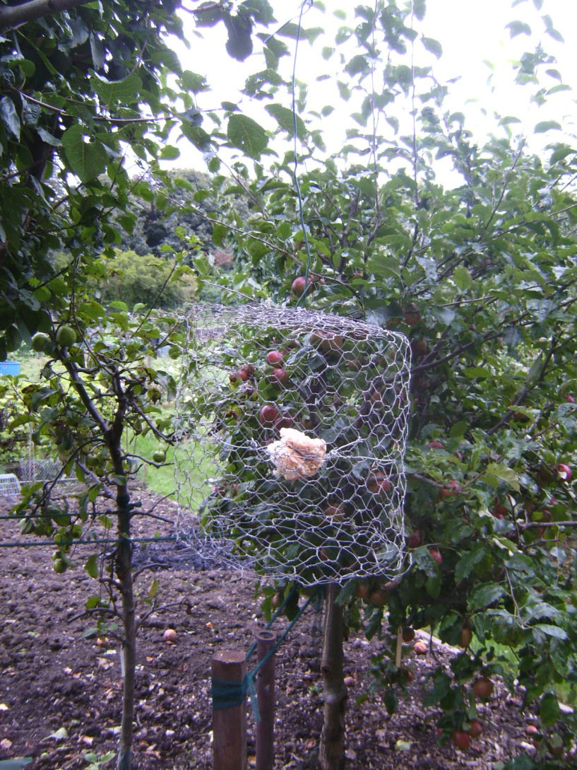

Slide 12
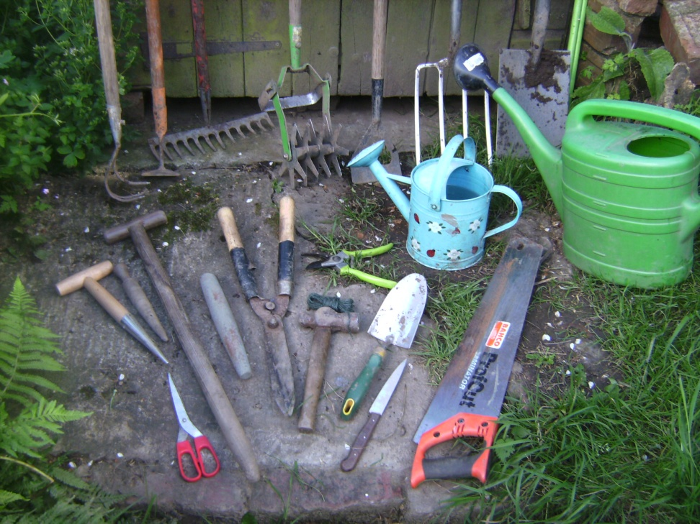
The Regime of Moderate Tempo
TO DO LIST
-sow swede
-plant out kohl rabi
-mow paths
-dig over old leek bed
-transplant raspberries
-stake tomatoes
-cut back comfrey
-paint bench
-weed cabbages

Slide 13
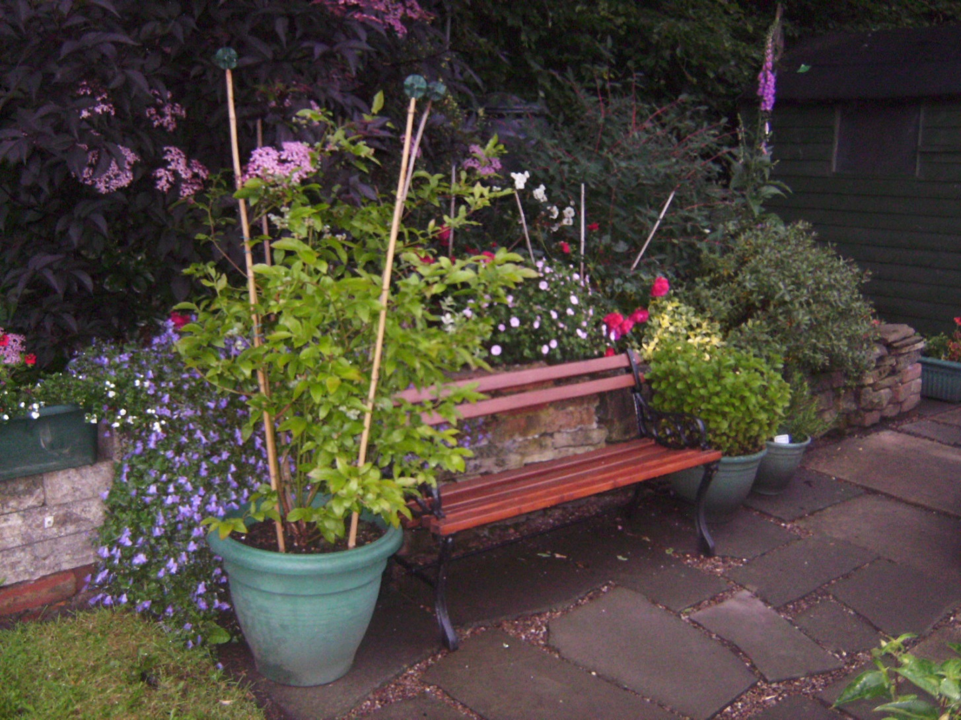
The Regime of Attendance

Slide 14
‘Learning = change over time’
Continuity and constancy vs. change
Learning as being vs. learning as becoming
Presence vs. absence
Notes:
As already noted, time is implicated e.g. as ‘duration’ in understandings of learning but even this is largely taken for granted and left unexplored.
The 5 regimes I have just presented indicate that time beyond simply duration is significant for learning; but when taken collectively, the regimes challenge not only the idea of ‘time in the ‘change over time’ definition of learning, but the change element too.
In allotment gardening, I have shown that change – the instability of weather, plays a significant role
Yet alongside this instability there is also the durability/stability of allotmenting and the long-term enrolment and persistence of plot holders;
Recurrence and repetition i.e. continuous discontinuity; and the stabilizing influence of slow tempo. Further, even the instability of the weather can be reframed to highlight the constant nature of its instability: its regular, to be expected performance of irregularity.
So in considering the 5 temporalites, on balance the defining characterisitic of allotment gardening is as much, if not more, continuity and constancy as change and that this continuity and constancy challenges change as a force for learning.
My study challenges too the dominant metaphor of learning as always becoming (Hodkinson, Biesta and James, 2008)
As Mason (2002) emphasises, learning is not necessarily prompted by a change in the learner’s environment, but by a change in the ability of the situated learner to notice, to perceive the familiar environment differently, to attend to what previously went unnoticed, developing understanding of the known rather than simply of the novel and unknown, as exemplified by the continuing tinkering of old hands, rooted in the now of their activity and the embodied intimacy they develop with their plots.
It is this learning as being, as much as becoming , which I suggest is of particular significance
The standard representation of learning as a process of change is predicated on a notion of absence, of lack and incompleteness and of continuing motion to reduce the extent of this absence
The additional or alternative representation of learning as effected by continuity/constancy I am suggesting appears, in contrast to be predicated not on movement, pursuit, travelling
But rather on remaining, or staying put:
Not on absence but on presence.
The significance of presence is not a new idea: its lack or loss is what is being critiqued in the growing educational literature on the intensification of time mentioned earlier – because of very special individual teachers…..
What is novel is the inevitability of presence mobilised in and through the everyday practice(s) of allotmenting and the explication of how different temporal regimes contribute to presence, to the enabling of rich learning.
Allotmenting may b e an exceptional or critical case – but attending to temporality, exploring ways in which different temporal orders individually and collectively enable such learning extends the parameters for understanding learning beyond the case of allotment gardeners, beyond the case of everyday learning - to learning per se.
It opens up for consideration what interventions might be possible/desirable to enact temporally enabling rather than disabling environments,
And inform enabling rather than disabling pedagogies – a timely debate as the concern over the acceleration and intensification of time in relation to learning gathers pace
So to join up the end of my study with the beginning:
My research is qualitative: an in-depth case study.
Not as in the case of objectivist (positivist)/hard science concerned with achieving representativeness through probability sampling in order to generalise statistically beyond my case to all cases/testing hypotheses ( and demonstrate validity and reliability)
But engaged in non-probability( convenience,purposive and theoretical) sampling to achieve ‘thick’ /rich description and understanding and build theory/gain new theoretical insights which MAY carry/travel beyond the specific case (= the beauty/contribution of small detailed case studies)
i.e. = ‘credibility’ and trustworthiness of research and = theoretically generalizable or ‘transferable’ to other (learning) situations – for researcher to persuade, but ultimately for the user of the research to decide.
So 1. You as leaners could be the end users of my research: how useful do you think it is to think about optimising your learning by
e.g. ensuring you make sufficient time (attendance) for learning – particularly because of the slower tempo it takes for real/deep learning
What opportunities can you create for recurrence – for repetition/practice – particularly in relation to improving writing skills – writing, getting feedback, using feedback for redrafts/trying things out/experimenting/trying out ( and maybe failing – but failing to succeed?
What about us as teachers – what can we individually do: to ensure a climate that ensures PRESENCE – tempo, opportunities for recurrence/practice; balance change/instability and continuity
What about universities as institutions: if we believe that the acceleration of life is beyond our control, are universities/facultieis/schools able to create locally an environment of presence
[ and not rely on Ss/staff going to mindfulness classes and stress management courses, denying responsibility for the stress-causing environment they are – at least co-producers of!

