Slide 1
How valuable is the doctoral degree in the UK modern knowledge economy?
Billy Bryan – PhD student in medical education
Dr Kay Guccione – Researcher mentoring and coaching
Questions/thoughts to #docvalue

Slide 2
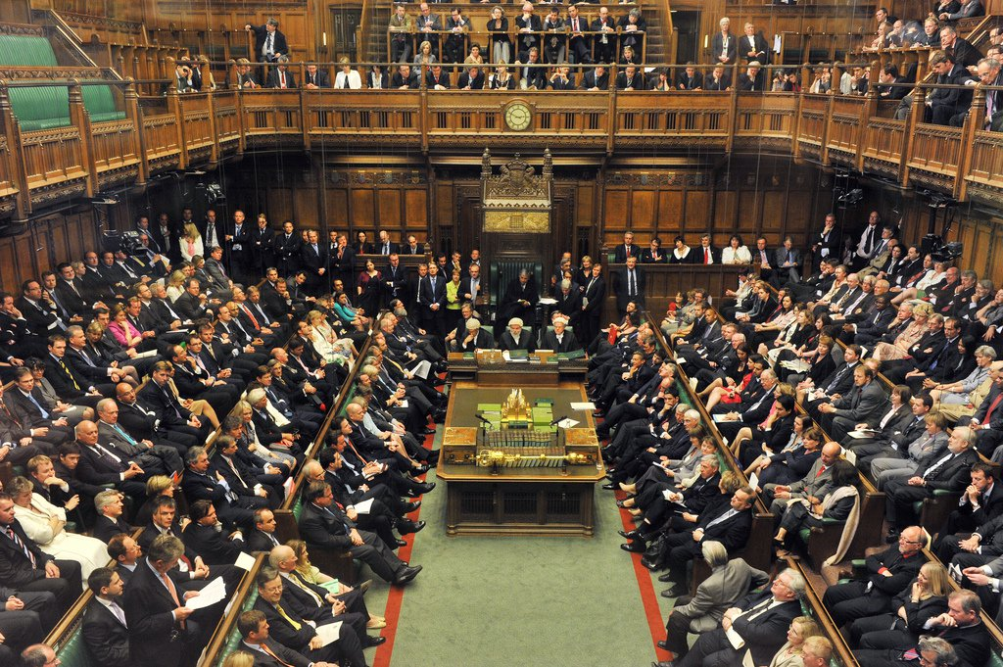
Why Doctoral Value?
Marketization in HE
‘fuelling the knowledge economy’
Development funding and support
Personal experiences

Slide 3
Educational value in HE - Economic
Benefit to Wider Society
Benefit to the Individual

Slide 4
Educational value in HE - Skills
Practical skills (hard)
Expert subject-skills
Disciplinary knowledge
Report writing
Personal attributes (soft)
Self-direction
Commercial awareness
Critical analysis

Slide 5
Educational value in HE - Employer
“The type of roles we have require intelligent people who have the ability to think, who can come up with novel solutions and cutting edge technology. [...] people with PhDs have proven that they can do this.”
Large Employer, Research and Development Employer
Diamond, A. Ball, C. Vorley, T. Hughes, T. Moreton, R,. Howe, P. Nathan, T. (2014). The impact of doctoral careers.

Slide 6
Gap in the literature: what about the other way around? Our question: How is doctoral value perceived by graduates in the context of the UK knowledge economy?

Slide 7
Methodology
The what: Explorative interview study
We don’t know the facts yet
Interviews – personal views, expertise, rich description
The how: Critical-interpretive lens
Who gets value and why? How does it work for each individual?

Slide 8
Sampling and Recruitment
The who – Doctoral Graduates
Graduation < 15 years ago
Any doctoral degree from anywhere in the UK
Various disciplines, job roles, and fields
Different genders and ethnic backgrounds

Slide 9
The Interview
Background info: demographic and career summary
Semi-structured – free flow with a quota
Topics:
Value – During the degree
Value – Since graduation
Skills and knowledge gained and used
Personal value

Slide 10
I.D:
HIGH
TIME
LOW
Year 1
Year 2
Year 3
Year 4
V.2

Slide 11
Results - Participants
22 interviews plus two pilot interviews – mostly PhDs
Gender | Ethnicity | Years since graduation | Topic area of PhD | Masters degree | Area of work
Female: 10 | White – British: 20 | Average: 5.2 Lowest: 1 Highest: 14 | STEM: 15 | Yes: 13 | Private: 6
Male: 12 | White – Other: 1 |  | A+H: 5 | No: 9 | Public: 7
 |  |  |  |  | Charity: 1
 | Asian – Indian: 1 |  | Social Sci: 2
 |  |  |  |  | Academia: 9

Slide 12
THE BIG THREE – so far…
Value
Skills
Social
Career ladder

Slide 13
Skills value
Hard – report writing, domain-specific practical skills
Soft – critical thinking, argument construction, problem solving, self-direction
Personal – Resilience, confidence, resourcefulness

Slide 14
Career Ladder
Higher up: more value
Skills: Managerial, abstract problem solving, strategic planning etc.
Time to reflect
Financial gain
Starting out: less value
CV enhancer
Less skills used
“Overqualified”
No time to reflect

Slide 15
Social value
Social and cultural awareness
Networks and connections for the future
Personal and professional identity
Social groups: similar ideologies

Slide 16
Added value came from…
Placements/conferences
Extra-curricular activities
Competitions
Public engagement
Value judgements affected by…
Supervision
Preparedness for work
Time since graduation
Money

Slide 17
Some notable quotes…
“It’s a part of who I am”
“It’s a badge of honour”
“you don’t need the PhD to do my job at the end of the day.”
“it’s given me currency and legitimacy in the environment in which I operate.”
“it’s not a golden ticket into academia”

Slide 18
I.D:
HIGH
Initial interest and enthusiasm
Realisation of the task
VIVA and
euphoria
TIME
Light at the end of the tunnel
Pressure to produce results.
Workload increased
Power through or seek help
Issues multiply and overwhelm
LOW
Year 1
Year 2
Year 3
Year 4
V.2

Slide 19
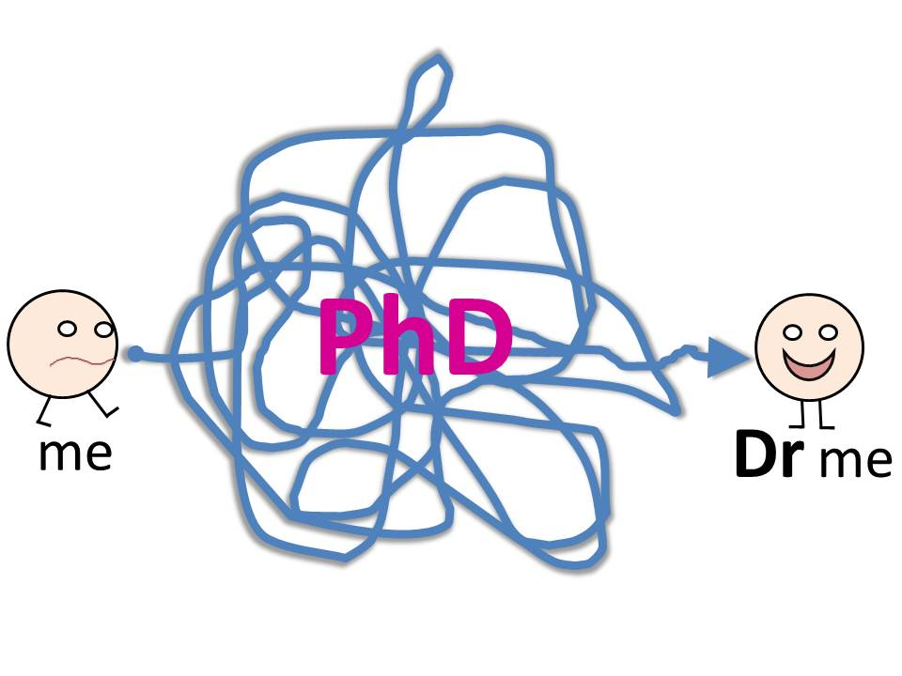

Slide 20
What’s the value?
Doctoral value perceptions are complex and change over time
Graduates benefit though skills, social capitol, and career progression
Resilience and self-determination flourish out of necessity
Implications:
How do we support PGRs at specific problematic stages?
How can we better ensure that value is added in our work with PGRs?

Slide 21
Next steps and further work
Fully analyse interview data
Integrate with student questionnaire data
200 responses – quantitative and qualitative data
Bigger scale – Re-interview? More diverse groups, more institutions (prof docs)
Explore demographic/cultural/contextual perspectives
Any more? Email: bjbryan1@shef.ac.uk or k.guccione@shef.ac.uk

Slide 23
Thank you for listening Questions? Contact: bjbryan1@shef.ac.uk and k.guccione@shef.ac.uk
How do you perceive educational value?
What value did you get from your PhD?
Let me know!
Questions/thoughts to #docvalue

