Slide 1

Practising Logics: A Qualitative Evaluation of an Early Career Interdisciplinary Training Programme
Robert Meckin & Sandrine Soubes (TUoS)
Susan Molyneux-Hodgson (University of Exeter)

Slide 2
Introduction
AIM: to think about what it means to practise interdisciplinary (ID) working?
Theory driven argument
Evaluation of programme (March-July) – in process of editing full report
1 RA and 2 PIs (Faculty and Sociology)

Slide 3
Background
Disciplines and interdisciplinary working
Changing relations between science and society
Societal Challenges; More funding
Collaboration as solution (e.g. translational research in biomedicine)
Indicates training and development in collaborative work
Contemporary discourse: accountability & innovation

Slide 4
Theory
Enacting (Mol 2002)
  Single in theory and multiple in practice
  Body multiple
Logics of Interdisciplinarity (Barry et al. 2008, 2013)
  Accountability – more, diverse stakeholders
  Innovation – new products/solutions to market
  Ontology – challenge concepts/world understandings, redefine problems
  Logics discernable yet entangled; multiple; not exhaustive

Slide 5
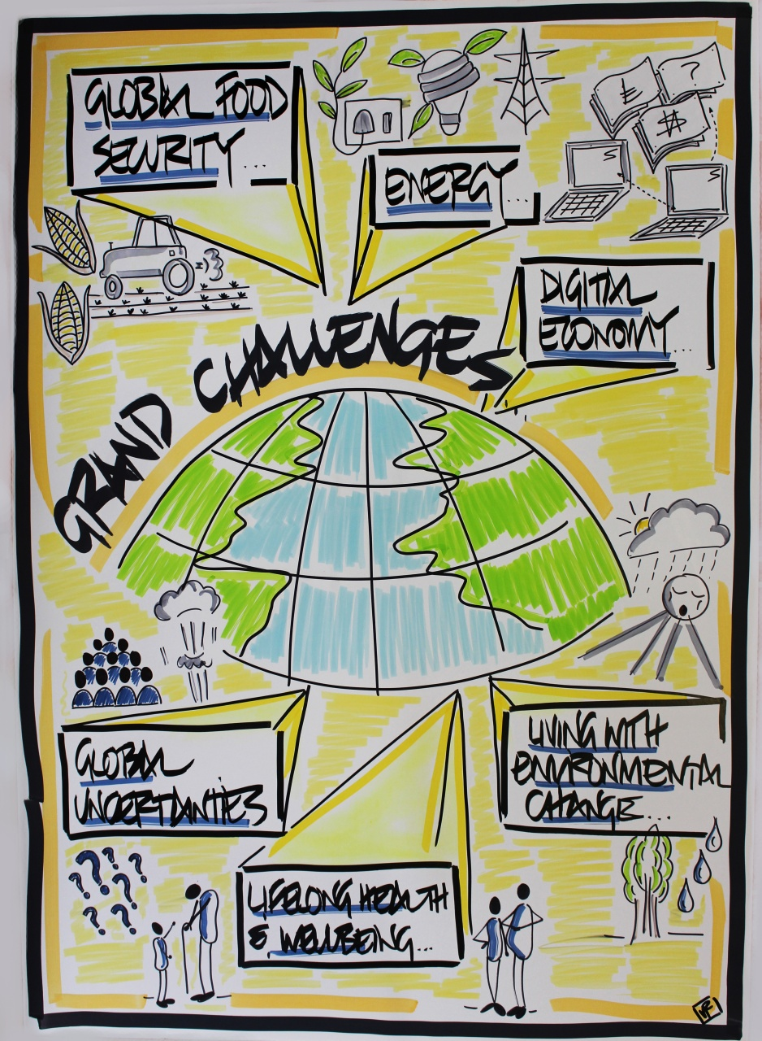
The Programme ambition
Professional development in interdisciplinary workings, innovation and unexpected collaboration
Developing a wider view of the world of research and the power research has to influence society
Increase their awareness of the skills and attitudes needed to become more innovative…
To promote … creating a network of peers within the research … providing the foundation of career-long networking skills and relationships
To develop an understanding of knowledge transfer activities and of the impact agenda.
To enhance grant-capture opportunities of young academics and researchers
Notes:
My motivation
How it fits in what we offer to researchers in Sheffield
Space to think, to play and time to think
Precious opportunity- rarely afforded
Researchers considering their transition to research independence
Getting researchers to think about where they might want to take their research in the future
Give opportunity to access funding in own name

Slide 6
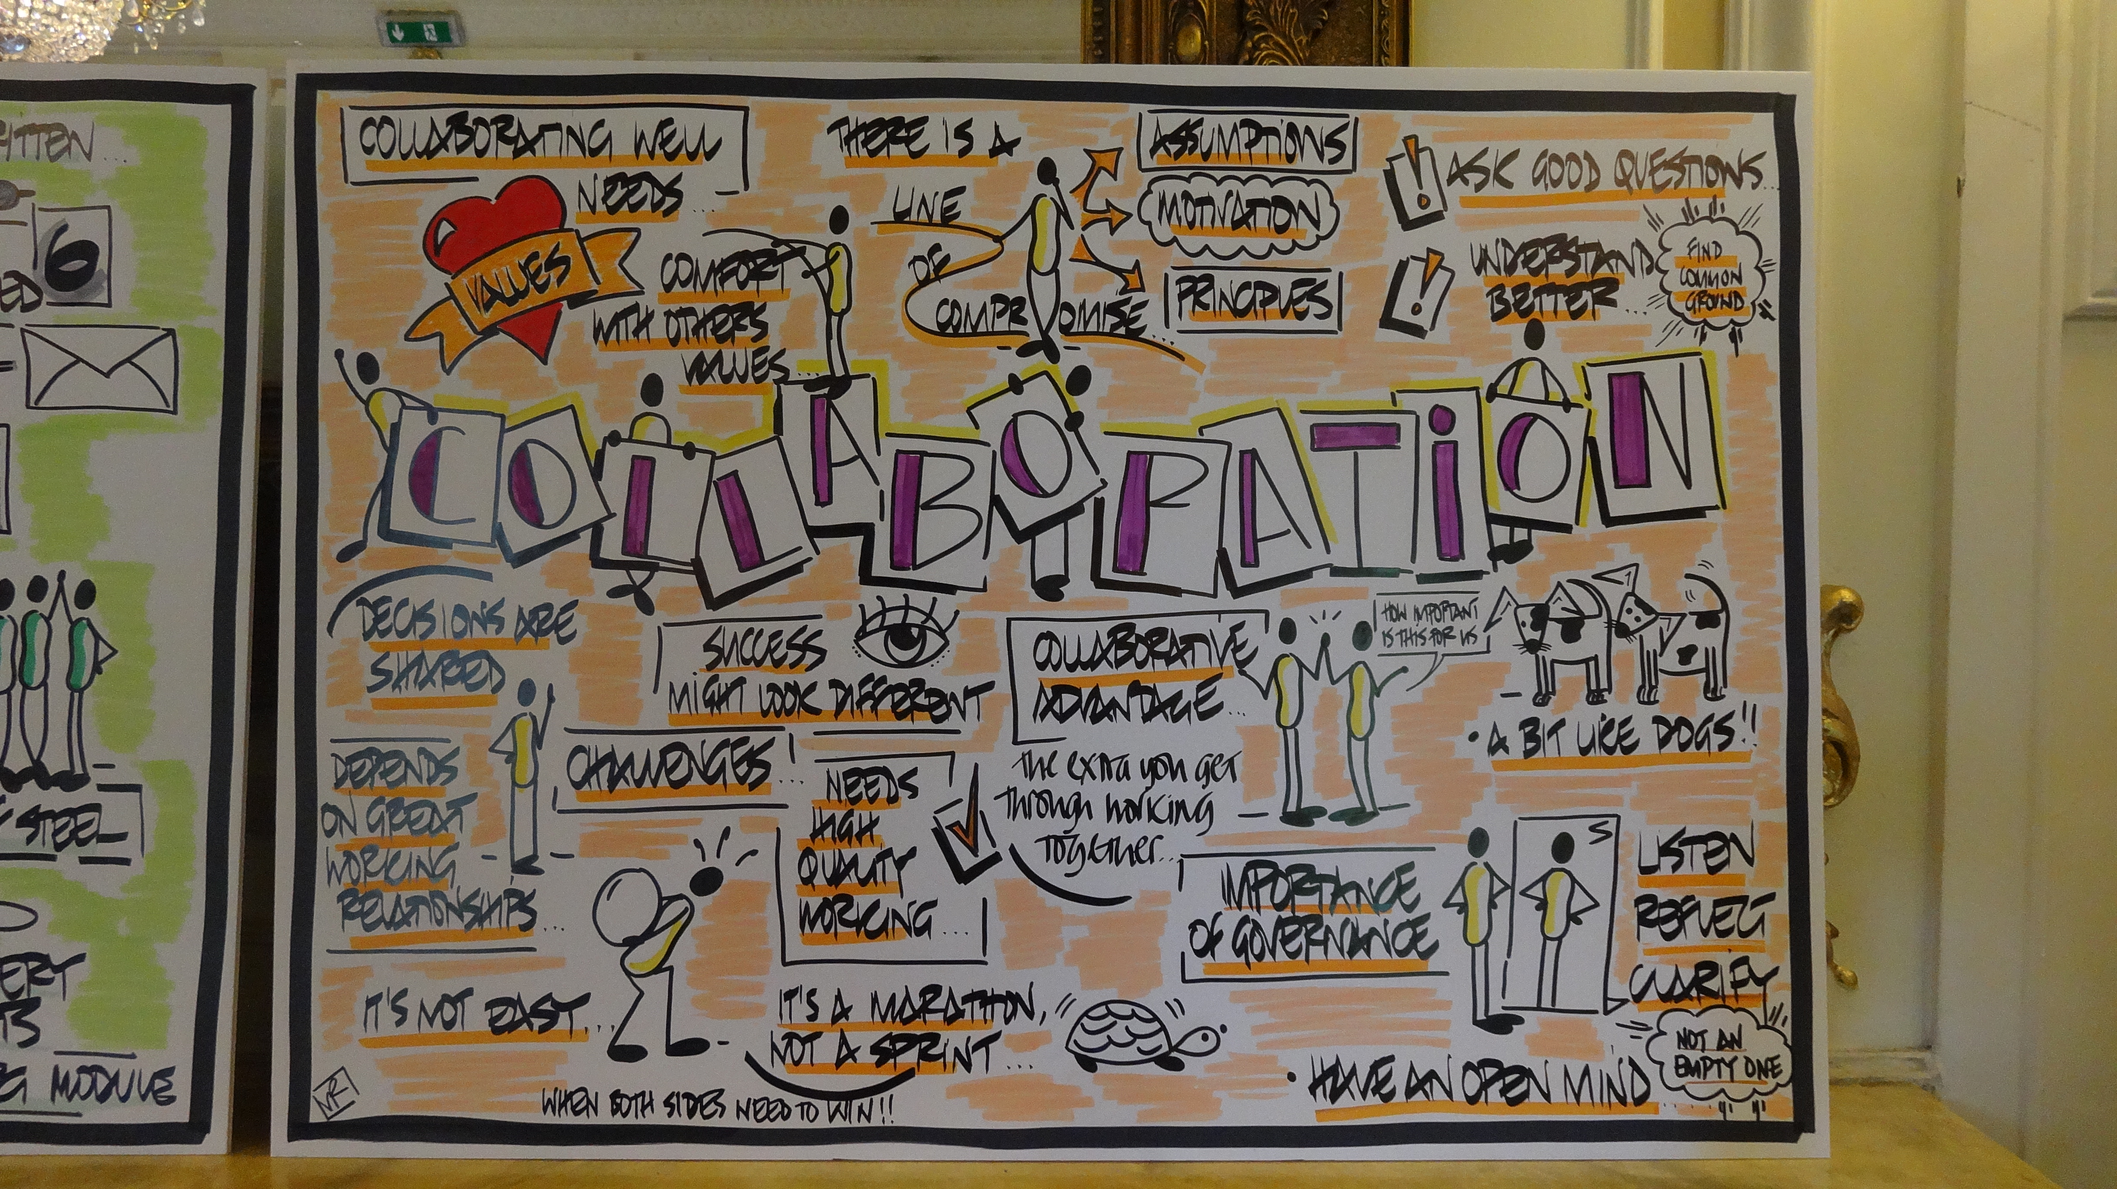
Programme Structure
Programme based on original NESTA Crucible
First time programme was run within a single institution
Ran twice in 2012 and 2014
University wide panel for selection of participants
Selection of 30 applicants per programme based on:
  Excellence in research
  Demonstration of an interest and/or experience in interdisciplinary research
  Interest in creative thinking and breadth of collaboration
  Commitment to the broader role of science in society
3 Labs (each are 2 day residentials) and collaborative proposal/projects
Notes:
Held information sessions with previous participants of the national NESTA Crucible for Crucible I recruitment and from Sheffield Crucible participants for Crucible II
Invited head of departments and academics to put forward ECRs and younger colleagues

Slide 7
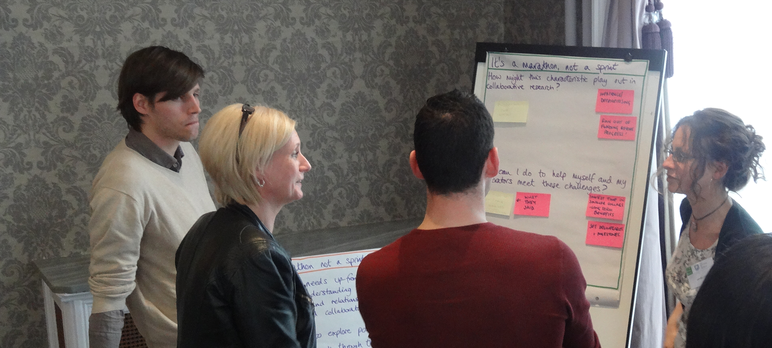
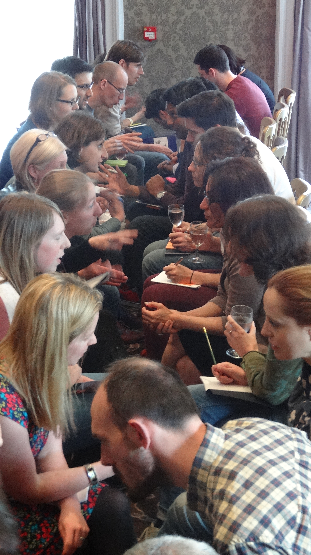
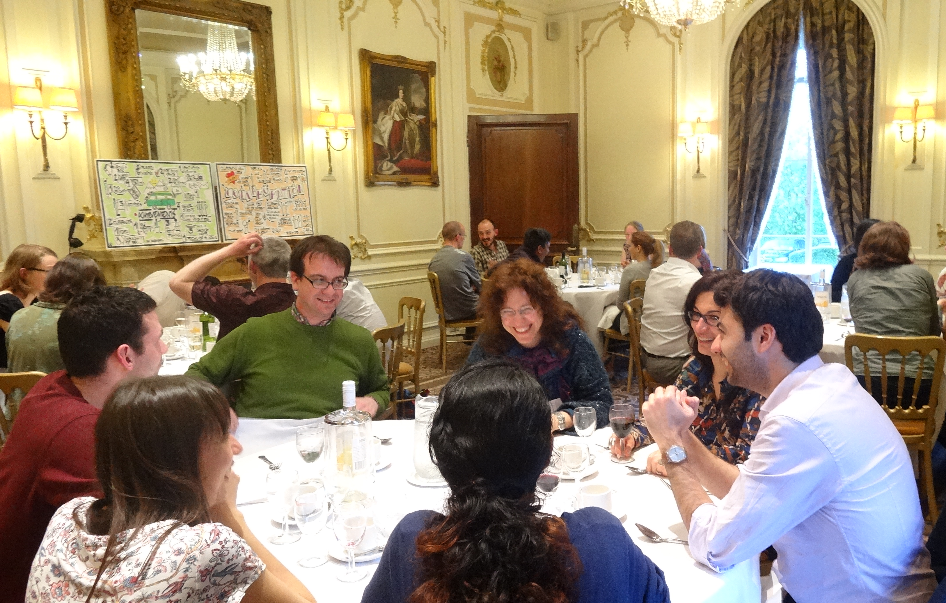
The Labs
The Labs
Notes:
Labs:
Weekend or no weekends.

Slide 8

Seed funding projects
A motivator for participation in programme and time investment
Leverage to negotiate participation with line managers
Putting into practice learning from the programme
Making these interactions “real”
First time experience of applying for funding for some researchers
Peer exchanges between participants on the process of applying for funding
18 of 40 proposals funded

Slide 9
Evaluation: Top Line
Documents, survey (38) and interviews (11)
Run again (89% respondents agreed)
Met aims
Raised question: what is practising ID?
“Doing interdisciplinary research is more instructive than listening about it” (C1 P10 survey response)

Slide 10
Applications to Programme
“…will give me further opportunities especially those associated with cross-faculties interdisciplinary collaboration to increase grant-capture opportunities and to establish dialogue with a range of stakeholders in particular expert patients and their carers.” (C2 P11)
“Industrial collaborations will play a strong role as I am keen to see the results of my research applied to solve everyday problems.” (C1 P6)
“… A dialogue between researchers of multiple disciplines will lead to original and creative ways of thinking outside ones’ box.” (C1 P17)

Slide 11
Giant’s Bone
2 x med scientists, 1 x Engineer, 1 x sociologist, 1 x comp sci + 2 external collaborators
“The aim of the project was to bring scientific knowledge to pre-school children and to explore how they learn about their own bodies. Together with local artists we built a giant interactive bone that formed part of [a] travelling exhibition”
Accountability – knowledge for the youngest in society

Slide 12
Condoms of Tomorrow
Collaboration: Materials physicist and a sociologist
“We intend to combine materials science & social science to explore how condoms & other female led approaches to the transmission of sexual diseases & contraception can be improved by focusing on the materials these products are made from.”
Logics of ontology and innovation.
Progress of this project was limited for a number of reasons, though the researchers are in touch and trying to complete. It was “much harder” than they anticipated.

Slide 13
Tract
Largest collaboration
Experimental – challenged what research might be, esp for ‘natural’ scientists
Publications & events
Personal and wider impact
Ontology – art-science

Slide 14
Engaging with ID Training
“networking at the [programme] was more important than the course” (C1 P22 survey response)
Applications and reports said things that did not fit into 3 ID logics
  Credibility (funding in applications, evidence in interviews)
  Networking/community

Slide 15
Theory Development
Logics of ID help understand what it means to practice interdisciplinarity – participants and programme enacted logics found elsewhere
Logics only covers project, rather than training/development
Seems that there are important skills/career/credibility drivers as well as:
  Accountability
  Innovation
  Ontology

Slide 16
Conclusion
Theory can help understand how researchers and facilitators develop ID experience
Enacting logics throughout design and practise
Logics of ID and logics of ID training may not be fully consonant
Space for creating theory explaining ID researcher development

