Slide 1
Horses for courses – are researchers just not that enterprising
Presented by
Eunice Lawton, Researcher Development Manager
Anita J Kenny, Quality and Operations Officer

Slide 2
Background
Low researchers engagement
Research ideas not been explored
Enterprise training is optional

Slide 3
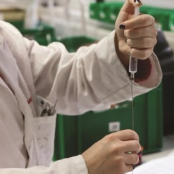
SOLUTION
Develop enterprise
skills while exploring a research idea
- Idea of a PhD student, Pratik Desai, during the poster display at conference he organised - USES

Slide 4
The Socially Enterprising Researcher
Can apply for £500 - £750 of funding:
include a researcher
be based on a research area.
include working with a community partner.
a project manager must be identified
one members of the project team to take part in a briefing/training
ideally completed in six months
risk assessment to be carried out
NOT for buying capital equipment

Slide 5
BENEFITS ATTRACTIVE TO RESEARCHERS
Involve a community partner so it includes public engagement
Need to bid for funding so develops application writing skills and builds a track record
Data collection can be used for further funding applications
Can build a useful network by involving other collaborators
Can be used as an example of project management – finance, communication etc

Slide 6
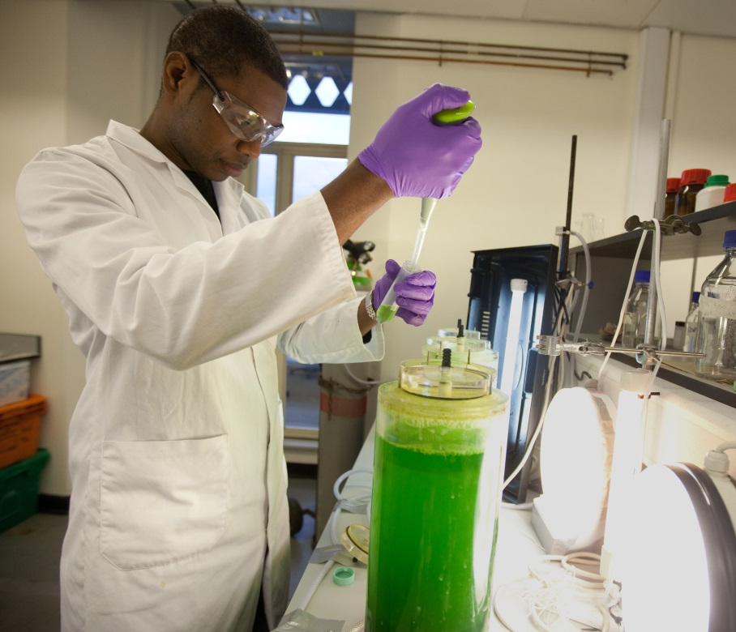
Research carried out
alongside the project:
perceptions and attitudes of researchers to
enterprise skills training
commercialisation of research

Slide 7
Theoretical Framework
Whilst holding a Critical Realist ontology we would seek to contribute to “the development of an approach to social theory that combines elements of realism and social constructionism” (Elder-Vass 2010 p145)
We would also concur with Deleuze and Guattari (2013) that knowledge is created in a rhizomatic nature that cuts across structures in trajectories of flight.
We suggest that the journey of the PhD student could also be related to Deleuze and Guattari’s concept of nomadic oppositional use of space. (2013 p474)

Slide 8
Methodology
We are carrying out a mixed methods study:
We used a questionnaire to confirm our research areas of interest.
We will be further exploring the results by a series of semi structured interviews
We will be conducting additional conversational interviews to explore participants views of research skills and whether participating in the projects has improved these skills
We believe that working with participants will help inform our development programme for the future.
Cohen et al (2007) list the strengths and weaknesses of the two types of interviews in Cohen, Manion and Morrison (2007 6th Edition) Research Methods in Education, London, Routledge Farmer

Slide 9
Research DATA collected covered:
What skills they would find valuable?
How they would like to learn?
How should we promote learning opportunities?
Did they think their research had commercial potential?
Would they be interested in £500 of funding to try out an idea?
How much encouragement is there to consider commercialisation?

Slide 10
Summary of ONLINE SURVEY
Introduction to survey:
Successful people usually possess what we call 'enterprise skills', however researchers often think this is about setting up a business, but in fact these are life skills that can help you in whatever career you decide to follow.
Was sent to all research staff and students - 134 responded
Which ‘enterprise skills’ do you think are important for research staff and students ( scored over 75%)
collaboration skills 84.3%
creative and innovative thinking 80.6%
networking skills 79.9%
problem solving 81.3%
project management skills 78.4%
time management 84.3%

Slide 11
Is it important for researchers to know how to commercialise their research?
Yes 65.7%
No 34.3%
Do you see a commercial application for your current research?
Yes 49.3%
No 50.7%
Does the University encourage the development of enterprise skills?
Yes 36.6%
No 5.2%
Not sure 58.2%
Does the university encourage the commercialisation of your research?
Yes 19 14.2%
No 37 27.6%
Not sure 78 58.2%

Slide 12
How would you prefer to learn ‘enterprise skills’
Competitions 17.9%
Guest speakers sharing their success stories 50.7%
Interactive workshops 73.1%
Online courses 44%
Taught sessions on individual skills 61.2%
Visiting newly formed business set up by young people 36.6%
What currently prevents you from taking part in Enterprise Skills sessions?
Lack of time
Do not think they are relevant
Don’t know about them
Lack of support from supervisor /peers
Would you be interested in a programme that provided up to £500 to develop your research idea by trying it out by either:
Developing a prototype 44.1%
Trying out an idea with a community group 68.6%

Slide 13
Is it important for researchers to know how to commercialise their research?
This increases the likelihood of translating research into a product or application which benefits people
impact on wider society doesn't necessarily mean commerce
May potentially bring more funding opportunities if research is successful
Is necessary to put in the real world and solve real problem
Research cannot be dependent on whether it can be 'sold' or not to the public; research is about furthering knowledge
I really don't think it's appropriate to commercialise all research.

Slide 14
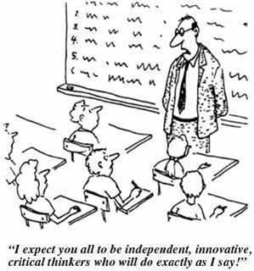
OUTCOMES
Projects are still ongoing
Data collection and evaluation
is still taking place
Data collected supports continuing the project next year
Initial findings suggest that an experiential learning process following the concept of andragogy as defined by Knowles (2015) is a useful model and that the projects have many inter-related benefits for participants.
Image sourced under a Creative Commons Attribution-Non-commercial-ShareAlike 3.0 license http://humbox.ac.uk/2480/
Notes:
Knowles, M., (2015 8th Edition) The Adult Learner: The definitive classic in adult education and human resource development

Slide 15
Ideas are the future
“The real source of wealth and capital in this new era is not material things it is:
-the human mind
-the human spirit
-the human imagination
and our faith in the future”
Steve Forbes (1999) The New Birth of Freedom: Vision for America
Notes:
Forbes (1999) The New Birth of Freedom: Vision for America

Slide 16
Researchers
Eunice Lawton
Pratik Desai
Anita Kenny
Thank you for listening, any questions?

