Slide 1




Slide 2


Slide 3
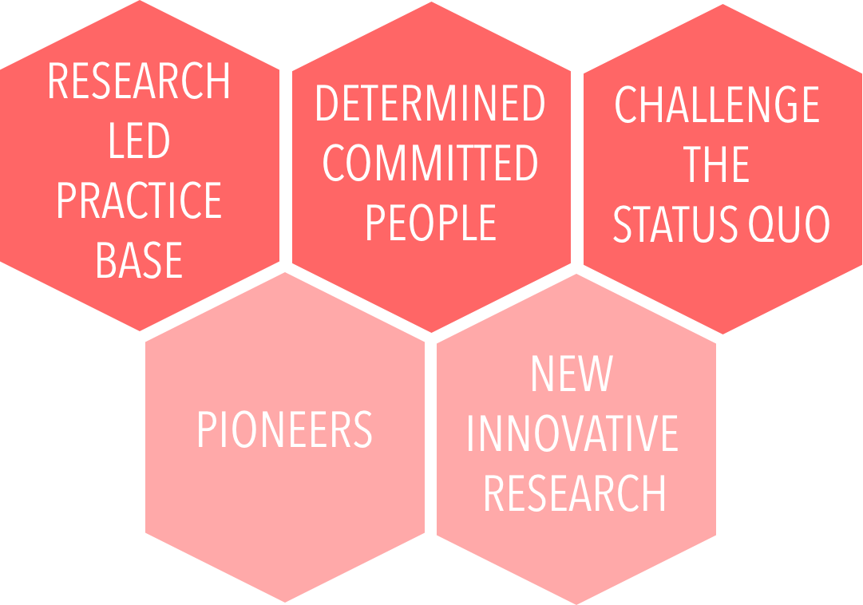

Slide 4
1.1 Researcher Developer: An Evolving Third Space Profession in Higher Education. Richard Freeman, UCL Institute of Education, Anna Price, Queen Mary University of London.
Third Space Professionals: looks at the roles in universities which fall between the traditional classifications of ‘academic’ and ‘professional services’ and which combine elements of both of these classifications, which is the case for the roles of many
researcher developers.

Slide 5
1.2 Finding our Feet: Establishing a Theoretical Base for Developing Research Capability. Kieran Fenby-Hulse, Heather Sears, Rebekah Smith McGloin, Coventry University.
Organization Theory: Critical and Philosophical Engagements: Peltonen analyses the history and evolution of organization theory schools and their meaning for the contemporary debates in organizational theorizing, as well as to taking a critical approach to the succession of paradigms.
The Problem of Agency: Reclaims the notion of common humanity. Archer argues that being human depends on an interaction with the real world in which practice takes primacy over language in the emergence of human self-consciousness, thought, emotionality and personal identity.
The Working As Learning Framework: positioned as a valuable, valid and reliable tool for researching policy and practice for improving learning at work.
Planning Theory Of Acting Together: Establishes a framework for understanding basic forms of sociality. Bratman proposes that a rich account of individual planning agency facilitates the step to the basic
forms of sociality.

Slide 6
1.3 Perceptions of Early Career Researcher roles in teaching Postgraduate Taught students. Peter Grabowski, University of Sheffield
The teaching-research nexus: The perceived benefits and problems of employing Graduate Teaching Assistants in Undergraduate teaching in exploring benefits and problems of employing early career researchers for teaching and for research skills training for Postgraduate taught students.

Slide 7
1.4 Interpreting Researcher Development across international locations: a tri-institutional perspective. Jane Wellens, University of Nottingham, Jennie Billot, Auckland University of Technology, Cecilia Stenstrom, University of New South Wales
The ‘componential model’ of
researcher development: Provides a conceptual and holistic framework for considering different dimensions of Researcher Development and categorises them into three key components: behavioural, attitudinal and intellectual. Evans later applies this model in the context of a qualitative study of research leadership in HE
Collective reflective practice: Explores and reviews the literature in relation to the collective (cf. individual) dimension of reflective practice and presents a conceptual model which identifies the importance of both inter- and intra-personal components.

Slide 8
2.1 Journeying into the Unknown: enabling the development of emerging researchers. Anne Boultwood, Birmingham City University
Experiential learning, employed recently, in a number of studies as an approach to doctoral education. This project builds on previous work in doctoral education, and applies some of the same principles, for example, the use of peer mentoring, and the adoption of a collaborative approach.

Slide 9
2.2 Horses for courses - are researchers just not that enterprising? Eunice Lawton, Anita Kenny, University of Sheffield
Knowledge construction: Whilst holding a Critical Realist ontology we seek to contribute to “the development of an approach to social theory that combines elements of realism and social constructionism” knowledge is created in a rhizomatic nature that cuts across structures.

Slide 10
2.3 Practising Logics: A Qualitative Evaluation of an Early Career Interdisciplinary Training Programme. Robert Meckin, Sandrine Soubes, Susan Molyneux-Hodgson, University of Sheffield
Logics of interdisciplinarity: three different rationalities for engaging in interdisciplinary collaboration. The logic of accountability is to increase the groups to whom the research is relevant, or who may evaluate it. The logic of innovation is to bring about novelty: e.g. products or methods, especially for the economy. The logic of ontology can challenge the way that people think about the world, and so the objects of the world are reconceptualised and research problems posed in different ways. The logics are not exclusive, and multiple ones can co-exist.

Slide 11
2.4 Trust me! Behaviours that build and break trust in doctoral supervision relationships. Kay Guccione, University of Sheffield
Trust and workplace supervision: Trust is a complex requirement of effective workplace learning and there is tension between ‘learning trust’ (revealing a learning need) and ‘workplace trust’ (being seen to be competent) that blurs role boundaries.
Professional Trust: Trust as an essential component of what it means to be a ‘professional’ – speaks to the ideas of expert/novice and guardianship of the academy.

Slide 12
3.1 What metrics for environments that nurture researcher development? Gavin Boyce, University of Sheffield
Sghrm, E.(2014), Using the Principles for Innovative Doctoral Training as a Tool for Guiding Reforms of Doctoral Education in Europe.
Kehm, B. (2007) Quo Vadis Doctoral Education? New European Approaches in the Context of Global Changes. European Journal of Education, 42 (3): 307-19
UUK (2014b), Joint declaration on Doctoral Training in Europe.
Wilsdon, J., et al. (2015). The Metric Tide: Report of the Independent Review of the Role of Metrics in Research Assessment and Management.

Slide 13
3.2 Presenting in a Personal Capacity; Reflections on Developing Research Independence as a Part-time PhD. Samuel Dent, Sheffield Hallam University
Reflective practices, and the PhD journey: Trace the personal autobiography of the research questions students pursue, as part of their engagement in reflexively. The complexity of this process if studying part-time, and the potential challenges of working both within and against systems, creates new identities

Slide 14
3.3 What is the value of a doctoral degree? Exploring perceptions of personal value gained from doctoral study in the context of the UK knowledge economy. Billy Bryan, University of Sheffield
Concepts of doctoral value through the lens of the individual's perspective. We draw upon work which has explored doctoral value from the economic, skills and employer perspectives. The best representation of the concept under study is individual's perceptions of educational value.

Slide 15
3.4 Doctoral internships - fun times but was it a good learning experience? Caroline Pope, University of Edinburgh
Impact framework: This makes a connection between activity and ‘behaviour, action or change’ which occur as a result of a training activity. It also distinguishes evaluation from impact.
Vitae Researcher Development Framework This was designed to help early career professionals plan and support their personal, professional and career development.

