Slide 1
The Development of Researchers:
A bright new future?
Dr Tony Bromley
University of Leeds

Slide 2
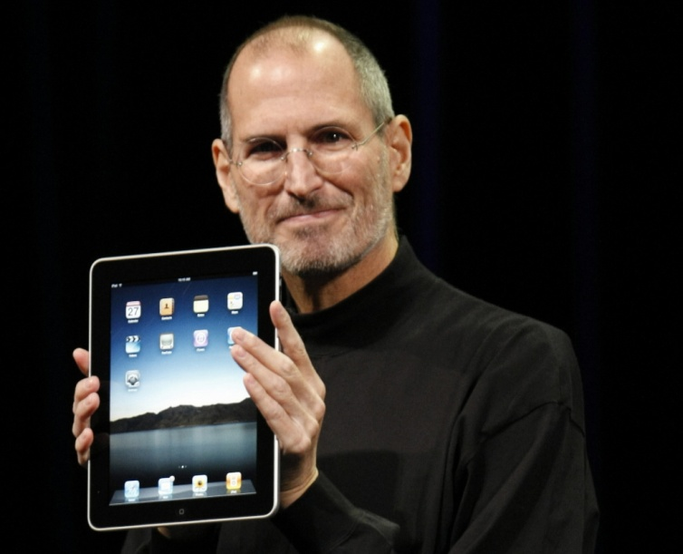
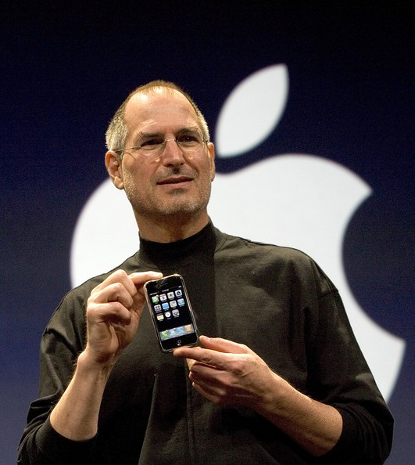
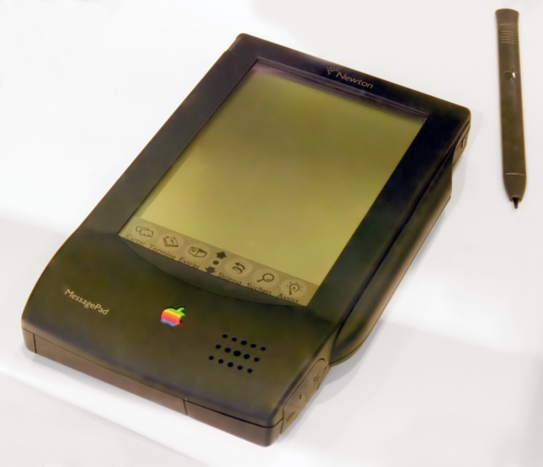
An ordinary day...?
2015
2010
2007
1993
Watch
iPad
iPhone
MessagePad

Slide 3
Where are we headed?
Researcher development in the UK
2011-
3rd era
2nd era
4th era?
c1975 - 2003
1st era
c1900-1975
2003-2011
The change in volume of activity with time?
The change in impact of activity with time?
The change in creation of knowledge and understanding of how to develop researchers with time?
Notes:
Japanese analogy: Business grew through exploitation of existing patents. Plateau reached when all existing patents had been exploited. To progress further they needed to invest in their own creation of ideas. Have we reached that plateau? We need to create more of our own ideas to progress. We have implemented: Belbin, MBTI, experiential learning, Blooms taxonomy, but how much have we created? We have laid foundations – RDF, IF, IJRD Mention Davina Whitnall at Manchester and her

Slide 4
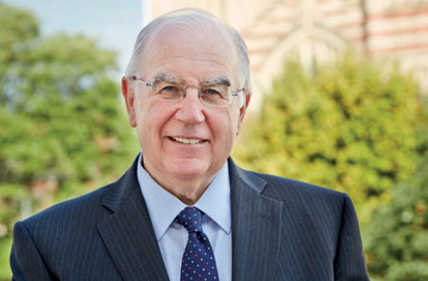
Researcher Education and Development Conference: A new beginning?
An opening line...
‘The creation, dissemination and application of knowledge remains at the heart of all that we do...’
Sir Alan Langlands VC University of Leeds
Strategic Plan 2014:2020
Notes:
This is what a University is for. I strongly believe in this and don’t see that the development of researchers is exempt from this

Slide 5
What do we do?
‘The creation, dissemination and application of knowledge...’
Notes:
Professor Paul Emery: Leeds academic elected Fellow of the Academy of Medical Sciences – 900 peer reviewed publications. What are we missing from knowledge by not having even one individual doing this. What would we know if there was a group of people doing the research and publishing even a fraction of that volume? What are our researchers missing out on terms of their development because we are not researching to any significant level of volume? What if everybody in this room over the period of our careers researched and published ten papers each? What would we collectively know?

Slide 6
What do we do?
‘The creation, dissemination and application of knowledge...’
Has the emphasis in our profession been here?
Are we creators of knowledge or appliers of knowledge?
What do we have to disseminate?
Notes:
Professor Paul Emery: Leeds academic elected Fellow of the Academy of Medical Sciences – 900 peer reviewed publications. What are we missing from knowledge by not having even one individual doing this. What would we know if there was a group of people doing the research and publishing even a fraction of that volume? What are our researchers missing out on terms of their development because we are not researching to any significant level of volume? What if everybody in this room over the period of our careers researched and published ten papers each? What would we collectively know?

Slide 7
How far can we go?
Without changing how we operate?
Without research?
And
Are we near or at a plateau of knowledge and understanding?
What is likely to be better:
A presentations workshop based on knowledge and experience of presenting
A presentations workshop based on knowledge, experience and a six year longitudinal study of the development of presentation skills in nearly 100 researchers?*
*IJRD paper Volume 6, 2015 University of South Australia

Slide 8
The future of researcher development
One that includes research…
We need people who believe in the capability of research to create knowledge and understanding
We need people with determination
We need people willing to challenge themselves and their development
We need pioneers
We need to create, disseminate and apply knowledge with demonstrable impact

Slide 9
The future of researcher development
Make this an extraordinary day
2011-
c1975 - 2003
c1900-1975
2003-2011

