Slide 1
Evaluating the impact of tailoring annual appraisal processes specifically for Early Career Research staff
Dr Lucy Lee
Researcher Development Manager
Faculty of Medicine, Dentistry and Health
University of Sheffield

Slide 2
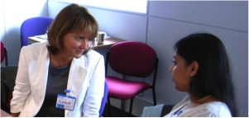
Background to TUoS Annual Appraisal
SRDS (Staff review and development scheme)
Drivers for change:
UoS staff survey
Subsequent RSA questionnaire
Departmental focus groups
Focus groups during Athena Swan applications
CROS 2013/2011
Key concerns:
Experience by ECRs not satisfactory and needed improvement
Focus often only on research project
Previous additional career development page often not seen as compulsory

Slide 3
1. Change to ECR SRDS forms
Aim:
formally acknowledge the range of contributions and achievements beyond research output
Improve structure of SRDS conversations to balance research focus with career development
Process:
2 years from development to gaining approval for change:
Faculties management
UoS HR
Joint unions committee
Work with each department to ensure documents were appropriately communicated
Workshop ‘Getting the most from your SRDS’

Slide 4
1. Change to ECR SRDS forms

Slide 5
1. Change to ECR SRDS forms

Slide 6
2. Additional support materials

Slide 7
3. Recommendations to change reviewer pairings
Normally reviewer is the line manager which is often the Principle Investigator
Focuses mainly on research project development
Conflict of interest
Recommendation to departments:
Ideally reviewer is not the PI
Include a second academic reviewer with career development agenda
Aim: Alleviate possible conflicts of interest between PI’s needs for research output and ECR’s needs for career development activities

Slide 8
Research Methodology
Mixed methods approach:
Part 1: Online survey (December 2014 -January 2015)
Qualitative and quantitative data
164 respondents (ECRs and reviewers of ECRs)
Survey respondents:
33.5% (n=55) academics (grade 8 upwards)
49.4% (n=81) Postdoctoral Research Associates/fellows (grade 7)
17% (n=28) of ‘other’ staff
From all departments with postdoctoral researchers.
Ethics approval was obtained from the University Ethics Committee.
Notes:
The ‘Other’ category including researchers who may or may not describe themselves as ECR and have other types of job titles (eg. Experimental scientists/Facility manager/ Theme manager-G8), but also Research Assistants-G6, Core facility technician
It is important to note that some individuals employed as PDRA/ fellows at grade 7 may not describe themselves as Early Career Researchers

Slide 9
Research Methodology
Mixed methods approach:
Part 2: Thematic focus groups
2 x academics focus groups (n=7)
2 x ECR focus groups (n=10)
participants from both faculties
Ethics approval was obtained from the University Ethics Committee.

Slide 10
Results from the survey: Use of new form
Percentage (%)
100% of postdoctoral respondents used the new SRDS form

Slide 11
How useful did the users find the new form?

Slide 12
Academic opinion on reviewing ECRs with the new form
“the categorisation of activities actually meant that the reviewees considered achievements over the previous year more broadly and that they highlighted these as a result.”
“the reviewees were better prepared for the meetings since they had been prompted to consider their wider contributions more”
“The integration of the questions into the main form on career pathway meant that this was considered by the reviewees beforehand as opposed to an afterthought and add-on as it had been in the past.”
“the new form was a helpful tool that allowed the SRDS process and the discussion during the meeting to be more meaningful for the reviewee”

Slide 13
ECR opinions of the new form
“more relevant sections for Postdocs and really help to facilitate the discussion with PI around my career development rather than simply on my project”.
“it focused the mind”
“more friendly and more supportive to the ECR”
“better tailored for the needs of researchers”
“ found the clearly defined headings really helpful to identify all the different aspects of my job and points to discuss”
“The big improvement with the new form was to make my role far more proactive in the SRDS and to approach it with a clear idea of my achievements thus far and objectives”

Slide 14
Results from the survey: Use of the supporting document
Percentage (%)
74.4% used the associated document
84% found it useful to review the previous year
81.6% found it useful to set objectives

Slide 15
Additional concerns raised:
Improved perception of documents after attending workshop
Negative feelings when reviewers had not read documents prior to meetings or do not provide written feedback
Mixed feelings from non PDRA staff who were asked to use the form in some departments
Extremely positive comments in departments where reviewer is not the PI/line manager, or having a 2nd reviewer in addition to PI/line manager
timings of SRDS reviews to align with contract start/end date instead of the generic summer deadlines
Large number of participants recommended changes in the scoring system

Slide 16
Future recommendations
131 respondents (80%) would like to continue using the tailored ECR- SRDS document
9 respondents said they would not like to use the form
Clearer guidelines about using the supporting documents
ensure ECR are clear that this is not a list of requirements

Slide 17
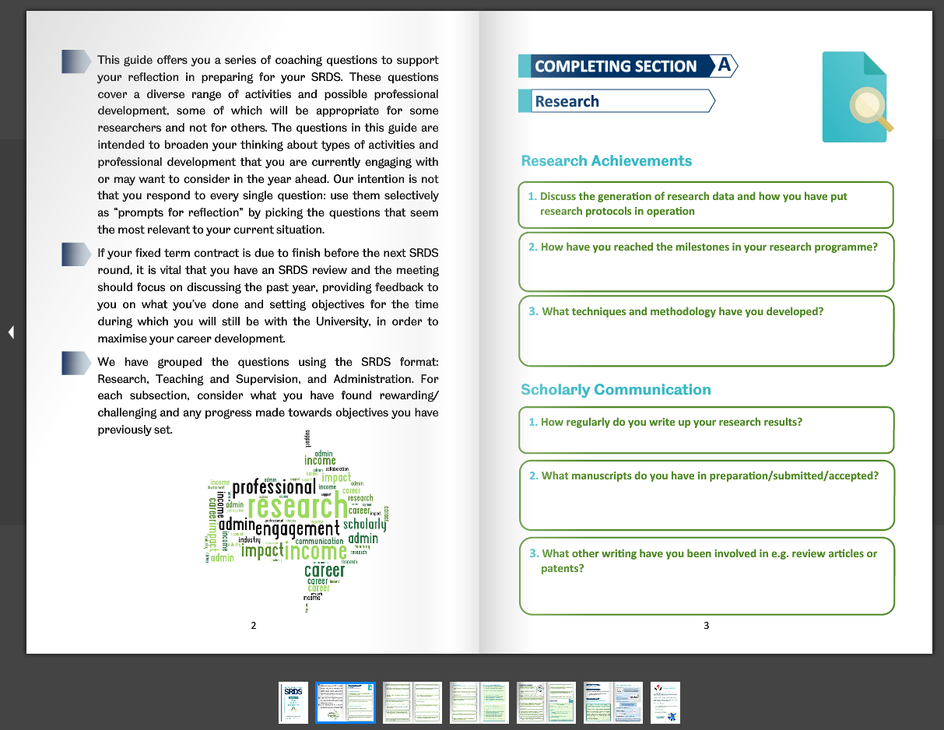
Further development to SRDS
Form name changed to ‘Researcher’ SRDS form
Change to reviewer pairing communication
Removal to the 1-3 scoring system

Slide 18
Summary of key findings
Evidence of widespread use of the new SRDS documents across the 2 faculties
Majority of users identified both document as useful
Majority of survey respondents and all focus groups participants recommend that the tailored ECR-SRDS documents continue to be used

