Slide 1
Developing career-related skills in completing and post doctoral researchers
Anne Boultwood Birmingham City University

Slide 2
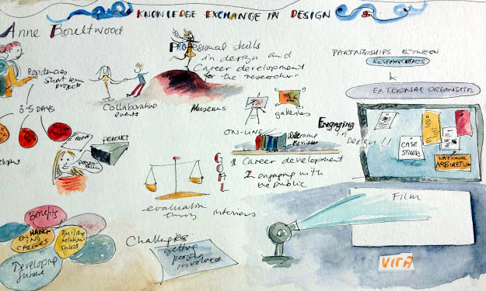
Knowledge Exchange in Design scheme

Slide 3
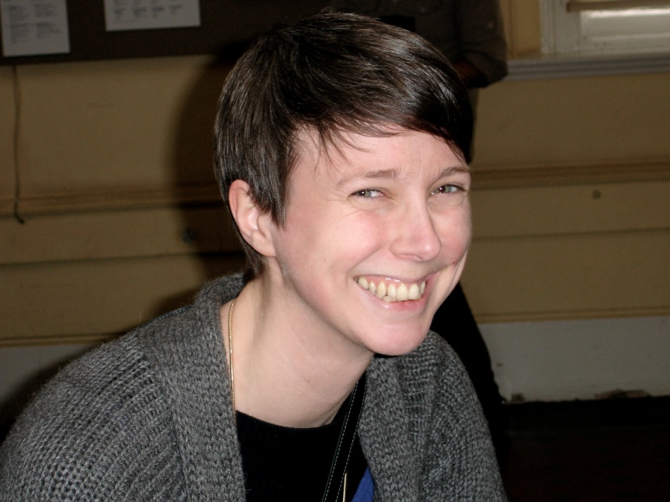
Birmingham Museum and Art Gallery
Amy Twigger Holroyd PhD researcher fashion sustainability
Sylvia Crawley
Martin Ellis Curators of applied art

Slide 4
The Curation Game

Slide 5
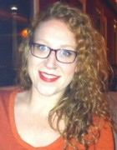
Bracket Creative
Frances Brown PhD researcher user-centred design
Alison Coward Founder of Bracket

Slide 6
Observation

Slide 7
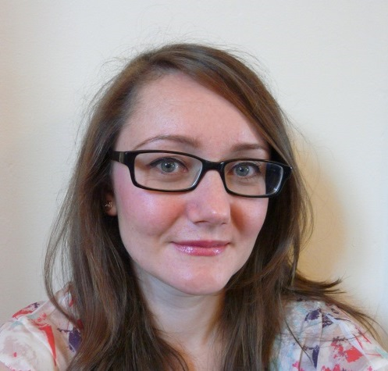
New Art Gallery Walsall
Jacqueline Taylor PhD researcher fine art
Jo Digger Head of collections

Slide 8
Portrait room

Slide 10
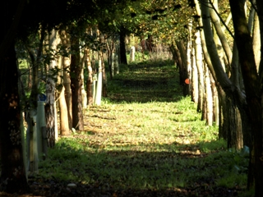
Fira landscape architects
Zoe Millman Early career researcher landscape narratives
Jane Findlay Director of fira
National Memorial Arboretum

Slide 14
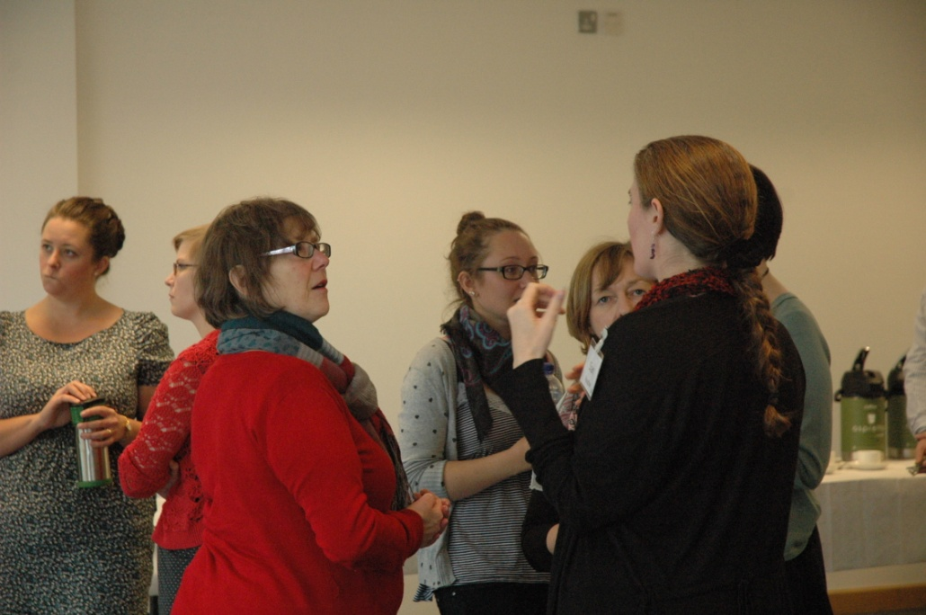
Benefits to organisations
Fresh perspective
Novel approach

Slide 15
Skills development
Collaborative working
Negotiation
Communication
Project management

Slide 16
Please visit
Our website
KED film
anne.boultwood@bcu.ac.uk

