Slide 1
In theory: A realist approach to the development of researchers
Dr Tony Bromley
University of Leeds
http://www.sddu.leeds.ac.uk/people/tony-bromley/
Notes:
What do we understand about the development of people? What knowledge do we have? What do we know? This comes from me applying a realist evaluation approach to the development of people and seeing where that takes us

Slide 2
Overview
Realist approach key ideas
Application to development programme
Application to the individual
A realist future

Slide 3
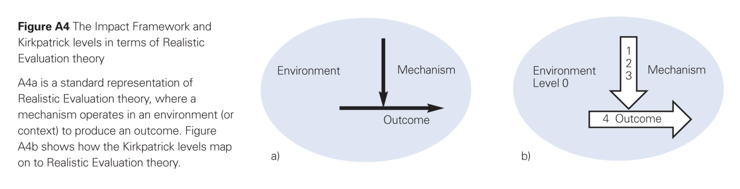
1. Realist approach key ideas
Mechanisms are: ‘frequently occurring and easily recognizable causal patterns that are triggered under generally unknown conditions or with indeterminate consequences’ Jon Elster

Slide 4
1. Realist approach key ideas
The current environment, with the current mechanism(s) acting in it leads to the current outcome(s)
The relationship between the environment and mechanism(s) and outcome(s) is fluid: change in one can cause change in another
We can influence the environment, to support the operation of a mechanism to support the achievement of an outcome
Whether we choose to attempt to influence or not there will always be an environment, a mechanism(s) acting and an outcome(s)
Notes:
There will also be environmental factors and mechanisms that dominate – e.g. related to culture – Dominant mechanism, Dominant Environment

Slide 5
2. Application to a development programme
A. Understand now:
What is the environment now?
What outcome(s) do we get?
What mechanism(s) is acting?
B. Where do we want to be?
What outcome(s) do we want? why?
How can we change the environment to…
Support the mechanism(s) we want?
Environment
Outcome
Understand A, Understand B, design a logical progression from A to B
(Continue to monitor and re-assess. Logic and reality differ)
Mechanism
Notes:
This is hypothesis creation and testing. The mechanism arrived at is a hypothesis. We don’t know that is the mechanism but it is our best logical suggestion based on our knowledge at the time.

Slide 6
Understand now: Environmental influences map – Factors that can impact on time to submission for a doctoral thesis
Transfer process
6 month assessment
Environment
Timely appropriate feedback
Prior knowledge of research area
10 meetings/year
Personal funding level
Initial project set up
Career Plan
Training: ERSS/
Internal Examiners
Progress monitoring of researcher
Personal Circumstances
Language skills
PDR System
Research method/
methodology
Motivation
PhD Researcher
Graduate School Systems
Supervision
Funding Level
Awareness of support
Relationship
‘At risk groups’
Funder requirements
PhD Process Workshops:
Starting Your Research
Prep for Transfer
Final Stages and Thesis Presentation
Final Year Planning
Preparing for Viva
Sub/Qual influences
Training and Development
Administration
Res Deg admin
Process/Systems
Examiners
Degree Type
Recruitment process & Criteria
University
Mode of Study
Advice:
Training needs analysis
Training plan
PhD, MD, DClin etc
Transfer Panel
PhD Viva
Advice given
Split site
Part time
SDDU; Faculties; ISS; Library; Careers
Full Time
Additional Support/Services:
International Office; Equality and diversity
Language Centre; Leeds University Union
Careers; Library; ISS
Etc.
Facilities:
Office space
Study space
Laboratory
Equipment

Slide 7
Mechanism
Environmental
Changes
New online system
Improved recording and monitoring of progress
Rationalisation, simplification, unification of process
Increased clarity of procedure
Increased PhD ‘Process’ training
Training Messages
To PGR and supervisors
‘Three year standard period of study’
Skills development
Increased PGR numbers through:
Time management
Project management
Final stages and thesis presentation
Outcome
Short term PRES
Long term tbc

Slide 8
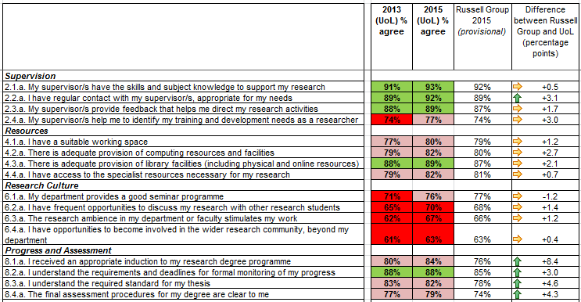
Postgraduate Research Experience Survey 2015 University of Leeds

Slide 9
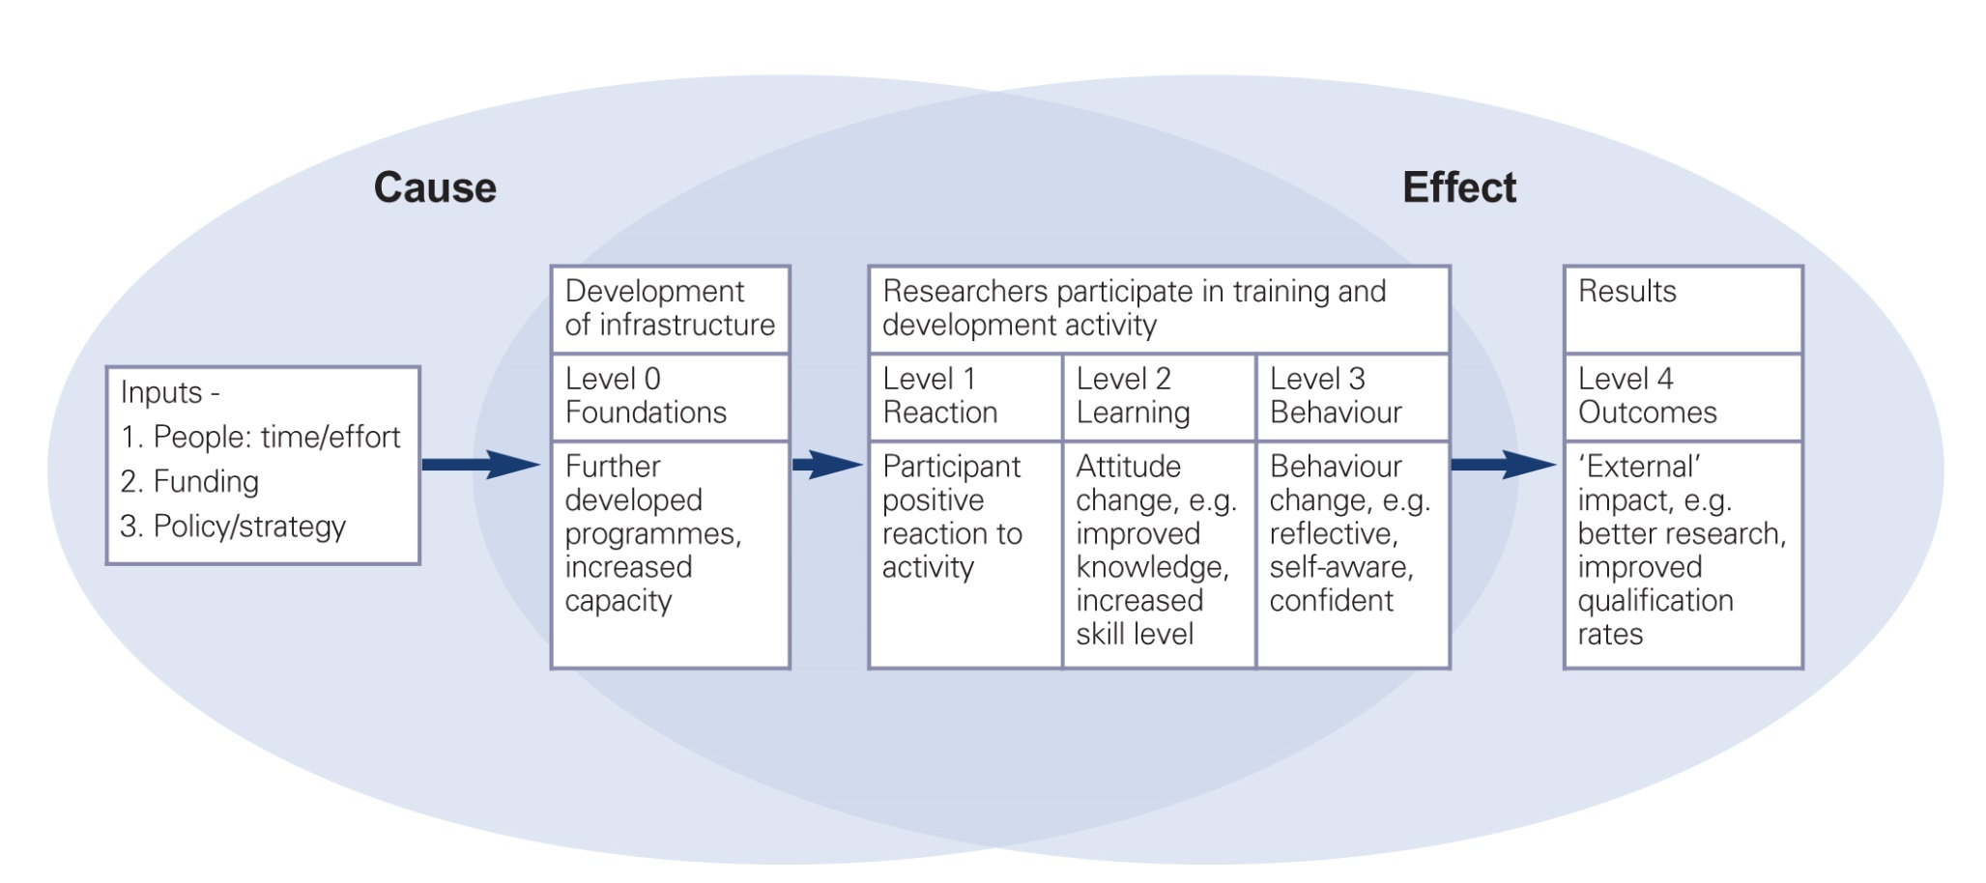
3. Application to the individual
Development or learning?
The development mechanism or development process?
Environment
Mechanism
Outcome
Environment
Fundamental
Mechanism
Level 3
Level 4
Outcome

Slide 10
3. Application to the individual
The development mechanism process comprises:
Reaction – ‘Fight or flight’ mechanism
Learning - mechanism
Behavioural change – an outcome
Outcome – ultimate achievement of objectives
Mechanism re an individual: an attribute fundamental to an individual that has magnitude and direction and independent momentum
Notes:
I’ve suggested two ‘Fundamental Mechanisms’. There will be others

Slide 11
3. Application to the individual
Understand the individual
Questions:
What is the unique environment of the individual now?
    Skills, attributes, strengths, weaknesses, personality traits, motivations, learning preferences, ambition, personal circumstances etc…
    Tools: Self reflection, MBTI, Training Needs Analysis, Belbin etc…
So what can we do to minimise the flight mechanism and maximise the learning mechanism?
Tailor the development activity

Slide 12
4. A realist future
A realist approach providers a reference framework for the development of people
A realist approach to design engenders the creation of understanding
Putting a realist approach into our ‘environment’ for creating development activity supports the development of our understanding and the creation of knowledge

Slide 13

We are all in this together…
http://www.sddu.leeds.ac.uk/people/tony-bromley/

Slide 14
A diagram to ‘finish you off’ Complexity of developing people
Workshop/activity
Programme
People

Slide 15
What other fundamental mechanisms are there?
What is your environment?
What are your fundamental mechanisms?

