Slide 1
Reconfiguring doctoral pedagogies as de-centred dialogic practice: developing repertoires of doctoral scholarship
Dr David Hyatt
School of Education
University of Sheffield
Researcher Education & Development Conference, 18th Sept 2015

Slide 2
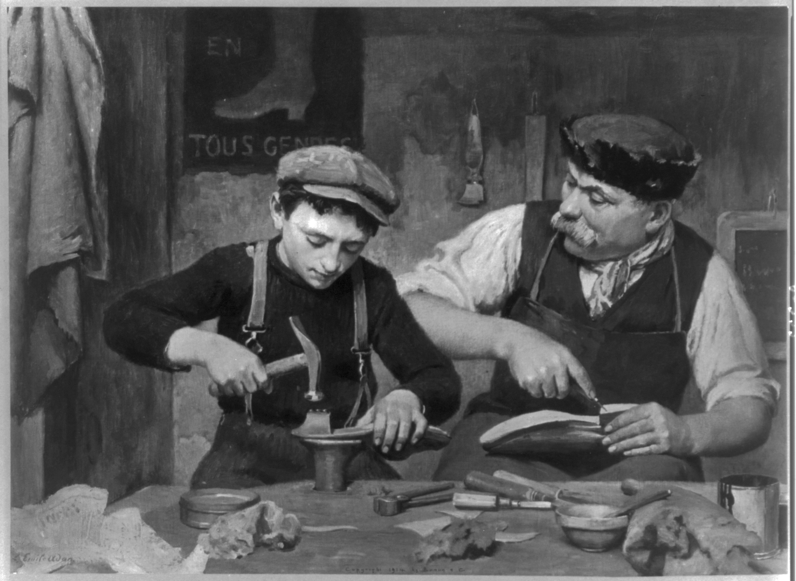
Traditional Modes of Supervision
A master/apprentice – expert/neophyte relationship
An authoritative figure dispensing factual information and advice
However, Kamler and Thompson (2008) have argued the ‘advice’ genre positions the doctoral researcher as a ‘diminished scholar’, potentially patronised or infantilised.
Janks and Ivanič (1992) many doctoral supervisory relationships are characterised by an asymmetry of power-relations between supervisor and student
Notes:
3 – ‘diminished’ - 10 Top Tips for PhD Students implies there 10 mistakes they are likely to commit without the wisdom of the supervisor.
- patronising e.g. telling a mid-career professional that time-management is important.
5. Janks and Ivanič (1992) note the problem inherent in many doctoral supervisory relationships which are characterised by an asymmetry of power-relations between supervisor and student, terms which themselves construct subject positions for both parties
2

Slide 3
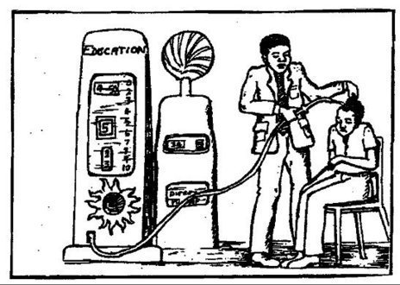
What’s doctoral pedagogy for?
Training???? Transmission of expertise???

Slide 4
What’s doctoral pedagogy for?
Creating spaces / opportunities to challenge assumptions and consider alternatives for transformation
Paré (2010:113) argues the role of doctoral pedagogy is in part an enculturation process
Induction into an academic discourse community
Notes:
2. Paré (2010:113) argues the role of doctoral pedagogy is in part an enculturation process, though which students ‘ learn more about the community they are joining, its past, its current debates, its cultural and discourse practices’.
4

Slide 5
Reconfiguring doctoral pedagogy
Construct more collaborative, egalitarian relationships ‘to enhance the value placed on individuals’ academic contributions and facilitate the process of induction into the academic discourse community, through a notion of critical inclusion’ (Hyatt 2005a: 339)
It advocates more collaborative supervisory relations (Lee & Kamler 2008, Kamler 2008), careful and reflexive supervision (Lee 2008), an expansion of student research literacies (Green & Lee, 2008)
Notes:
challenge such interpellations and to construct more collaborative, egalitarian relationships ‘to enhance the value placed on individuals’ academic contributions and facilitate the process of induction into the academic discourse community, through a notion of critical inclusion’ (Hyatt 2005a: 339).
The alternative is one which advocates more collaborate supervisory relations (Lee & Kamler 2008, Kamler 2008), careful and reflexive supervision (Lee 2008), an expansion of student research literacies (Green & Lee, 2008), advocates
5

Slide 6
One where students are invited into the discourse community (Swales 1990) through a critical inclusion to, as Golde and Walker (2006) put it, envisaging doctoral education as preparation of the future stewards of the discipline.
One where our job is not to ‘skill up’ learners but to help them to develop the repertoire of a successful member of the academic discourse community or one which mirrors established professional norms e.g. design, architecture, engineering
Notes:
moving beyond an approach characterised by tips and techniques to one where by students are critically invited into the discourse community (Swales 1990) through a critical inclusion to, as Golde and Walker (2006) put it, envisaging the future of doctoral education as preparation of the future stewards of the discipline.
2. Design & architecture have studio approach – problem-solving, working in term-based multidisciplinary environments – so this pedagogy also models professional practice
6

Slide 7
Doctoral Repertoires
What comprises the repertoire of a successful academic / researcher / research informed practitioner? (if capacity-building and individual development is the goal as opposed to summative assessment hoop-jumping)

Slide 8
Doctoral Repertoires
These will differ in different contexts/disciplines and in transdisciplinary contexts (e.g. co-production)
More than just a measurable list of competences
In a super-diversity context, learners engage with a broad variety of groups, networks and communities, and their resources are consequently learned through a wide variety of trajectories, tactics and technologies.
These different learning modes lead to very different degrees of knowledge whereby all of these resources in a repertoire are distributed in a patchwork of competencies, skills, dispositions, values, etc.
The origins of repertoires are biographical, and repertoires can in effect be seen as ‘indexical biographies’. (Blommaert & Backus 2011)
Notes:
5 - indexical biographies - who we are and where we come from and what we bring – repertoires reflect our individual subjectivities
8

Slide 9
What this view of doctoral pedagogy is not!
A denial of expertise/experience or knowledge
A denial of the psychological safety students desire in feeling their supervisor is ‘expert’
A ‘sink or swim’ abandonment of students but rather a structured programme of learning that works from the student’s current state of knowledge (constructivist?)
A disregard of the importance of scholarship – rigour, subject knowledge, originality, significance, credibility
Disregard or neglect of the demands of professional practice
A face-threat to the supervisor
Notes:
3 – this links with the notion of ‘indexical biographies – who we are and where we come from and what we bring
9

Slide 10
Reconfiguring doctoral pedagogy – an example
Students selected an article using a discursive analysis relevant to their own doctoral research, and to circulate this article to the group for pre-reading.
They selected a short piece of text that they would like to analyse discursively as part of their research and to circulate the text to the rest of the group so they had an opportunity to read/analyse the text.
They were requested to analyse their text in detail, using a previously discussed CDA framework – a draft article of mine
They were also briefed to prepare a 10 minute informal presentation of their analysis and to be prepared to offer their analysis/evaluation/interpretation of the text. In the workshop, each student critiqued the paper they had selected, describing to the group why the approach taken was relevant for them. They then presented an analysis of their text, after which the group offered their supplementary thoughts/analysis of the text.
The workshop concluded with a critique of the pre-circulated framework, with the each member of the group discussing its bearing on their own doctoral research, including ways in which it might be supplemented/enhanced.
This final element was a key aspect in the reconfiguration of relationships between tutor and student.
Notes:
Students selected an article using a discursive analysis of a policy text that they felt was relevant to their own doctoral research, and to circulate this article to the group for pre-reading.
They were also invited to select a short piece of text that they would like to analyse discursively as part of their research and to circulate the text to the rest of the group so they had an opportunity to read/analyse the text.
They were requested to analyse their text in detail, using the frame described which was circulated and had already been discussed in a previous teaching session on CDA.
They were also briefed to prepare a 10 minute informal presentation of their analysis and to be prepared to offer their analysis/evaluation/interpretation of the text. In the workshop, each student critiqued the paper they had selected, describing to the group why the approach taken was relevant for them. They then presented an analysis of their text, after which the group offered their supplementary thoughts/analysis of the text.
The workshop concluded with a critique of the pre-circulated framework, with the each member of the group discussing its bearing on their own doctoral research, including ways in which it might be supplemented/enhanced.
This final element was a key aspect in the reconfiguration of relationships between tutor and student.
10

Slide 11
Avenues to de-centred pedagogy and the development of repertoires
Creation of student-determined spaces for authentic dialogue
Diagnostic Assessment to complement Formative Assessment
Repeated presentation and defence of work
Supervisors sharing draft work with supervisees
Collaborative writing / Co-publication
Questioning the discourse – should we be supervisors or advisors (or mentors)? DTC’s or DDP’s? TNA’s or Doctoral Development Analyses?

Slide 12
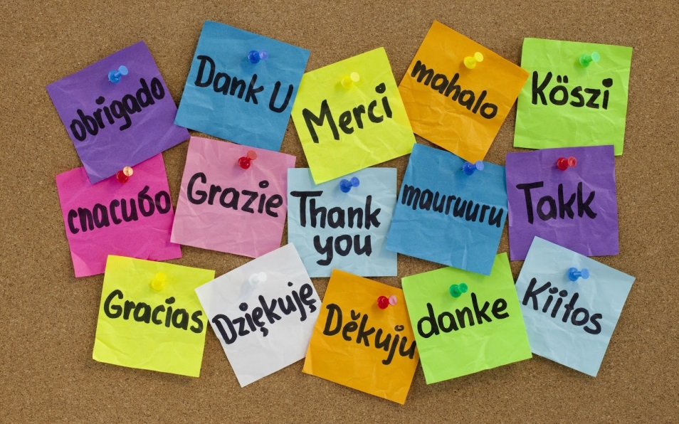
Concluding Thoughts
A decentred pedagogy is one in which learners are invited to appropriate and take ownership of their learning and to develop their academic repertoire
The doctoral process then becomes an invitation to critical inclusion in the academic discourse community
Notes:
12

