Slide 1
Doctoral Internships: Friend or Foe?
Ms Talia Garza Garza and Dr Hilary M Jones Postgraduate Internships Coordinator The University of Sheffield

Slide 2
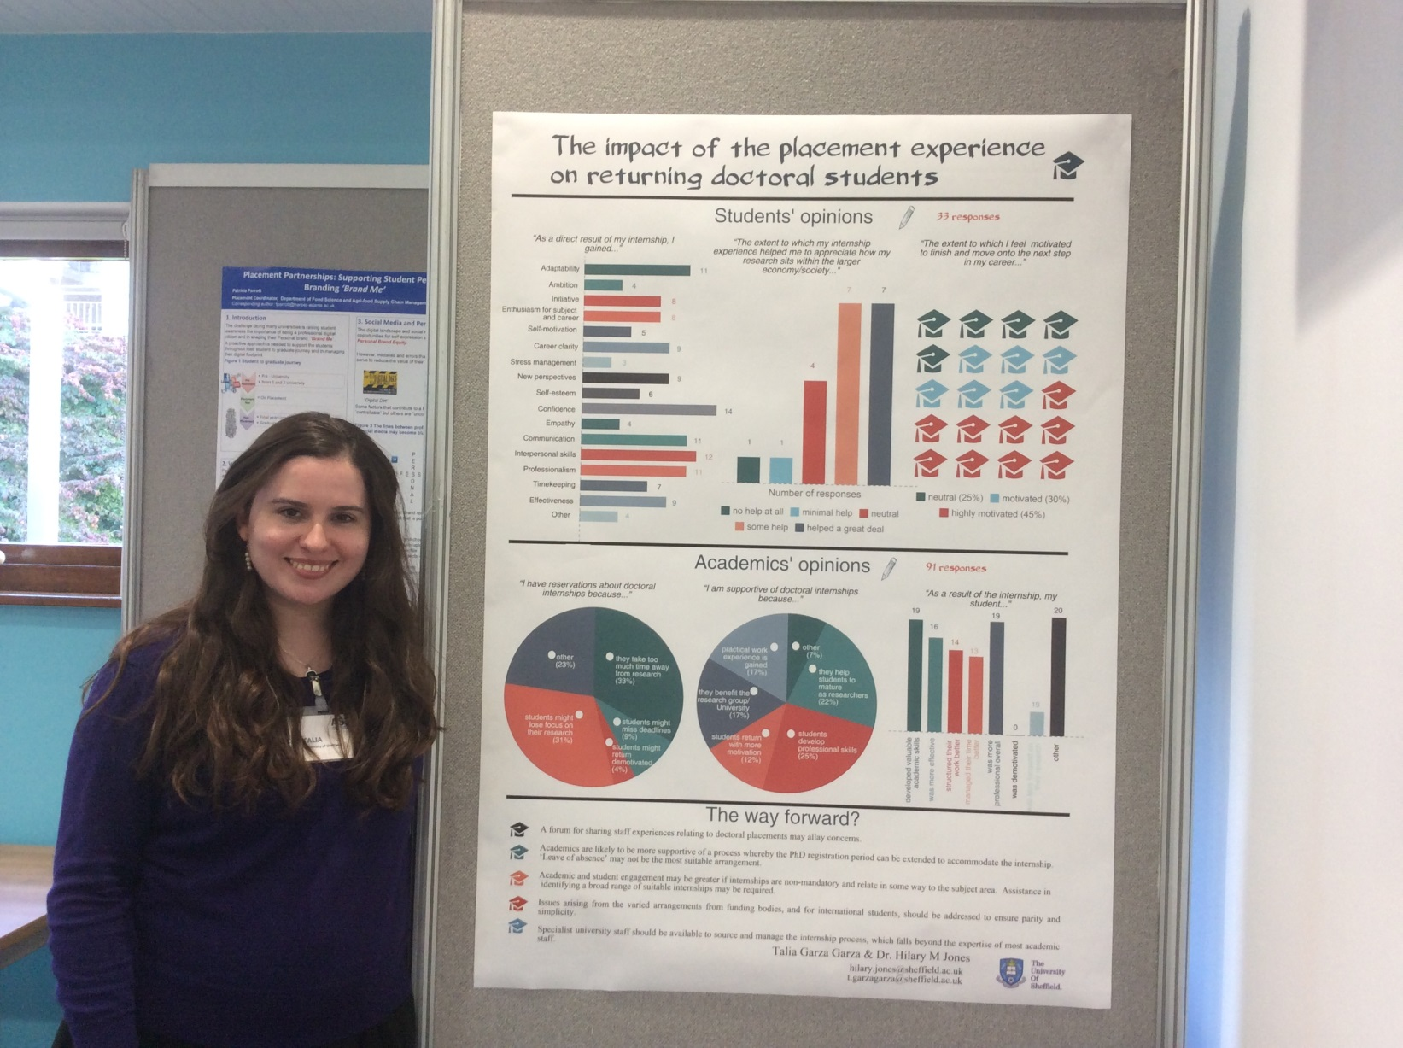

Slide 3
Rationale for research
Majority of doctoral students do not pursue an academic career
Proliferation of placement schemes at doctoral level
Anecdotal evidence about benefits and disadvantages of these schemes

Slide 4
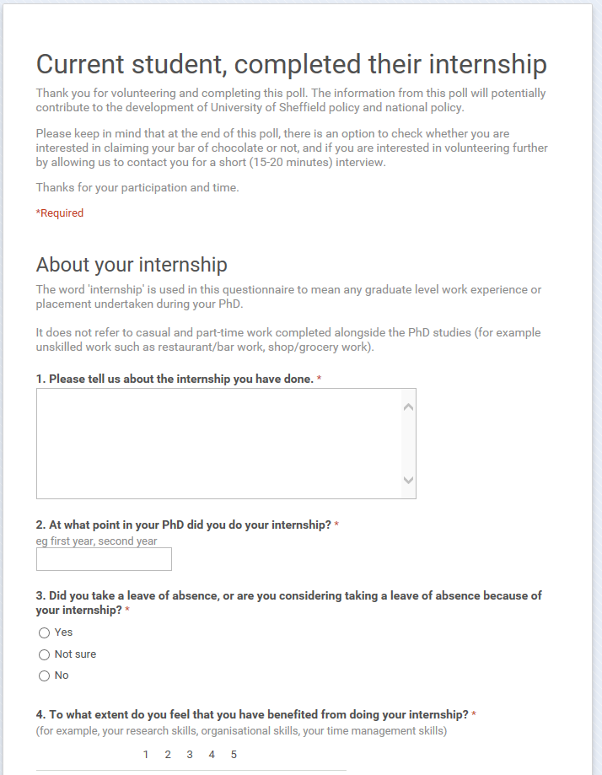
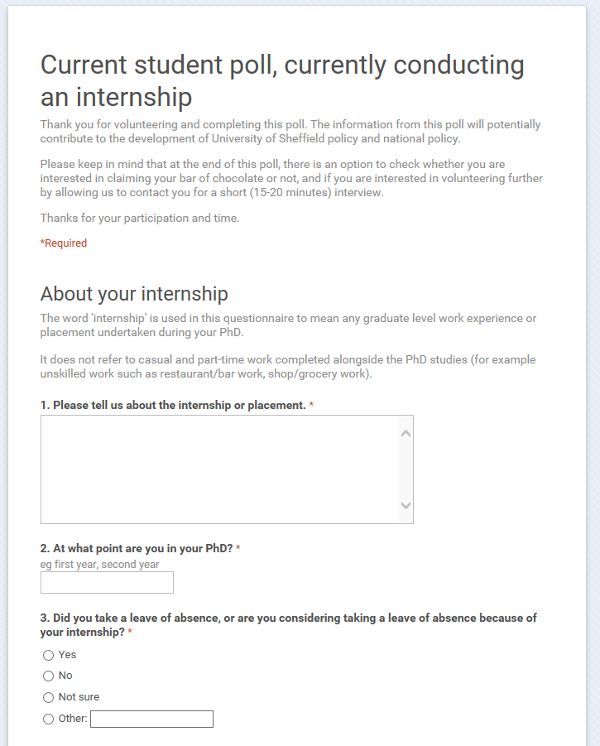
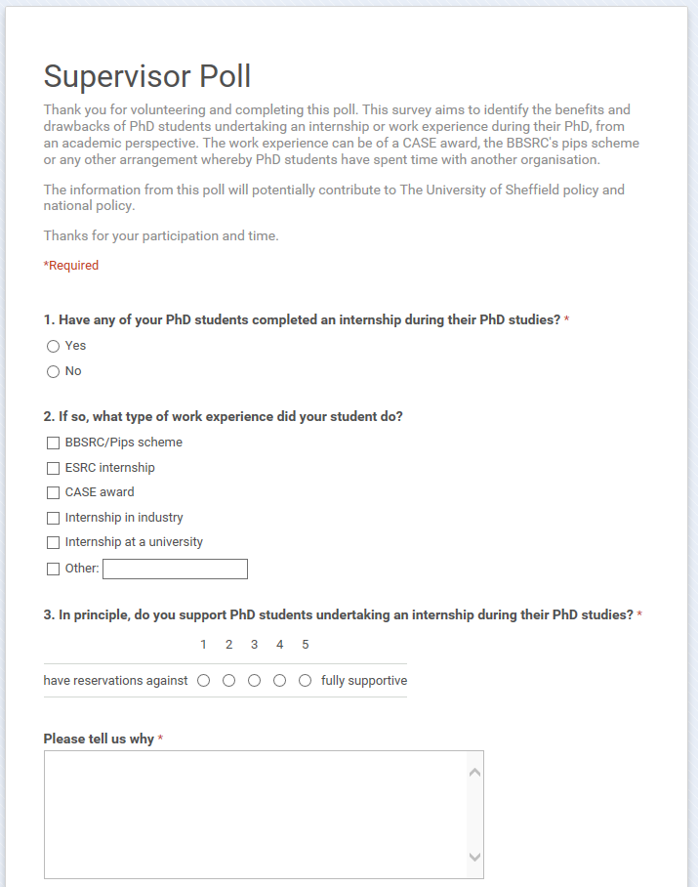
Research methods
Three separate surveys
Face-to-face interviews with students and staff

Slide 5
Academics were supportive of doctoral internships because:

Slide 6
Academics had reservations about doctoral internships because:

Slide 7
Are academics with experience of doctoral Internships more or less supportive?
Number of responses

Slide 8
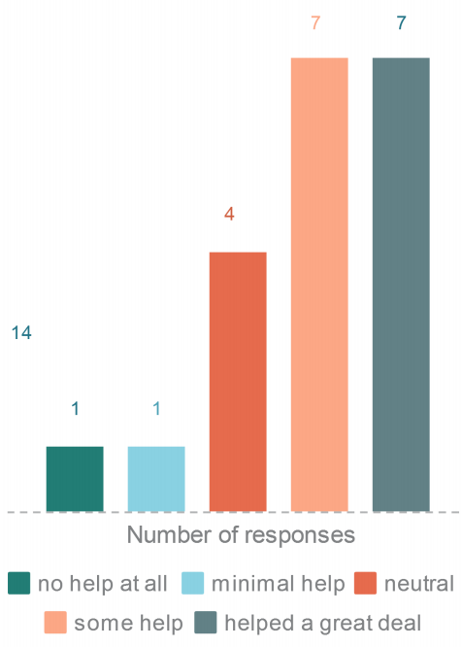
Extent to which students
felt motivated to move on to the
next step in their career:
Extent to which the internship experience helped students appreciate how their research sits within the larger economy/society:

Slide 9
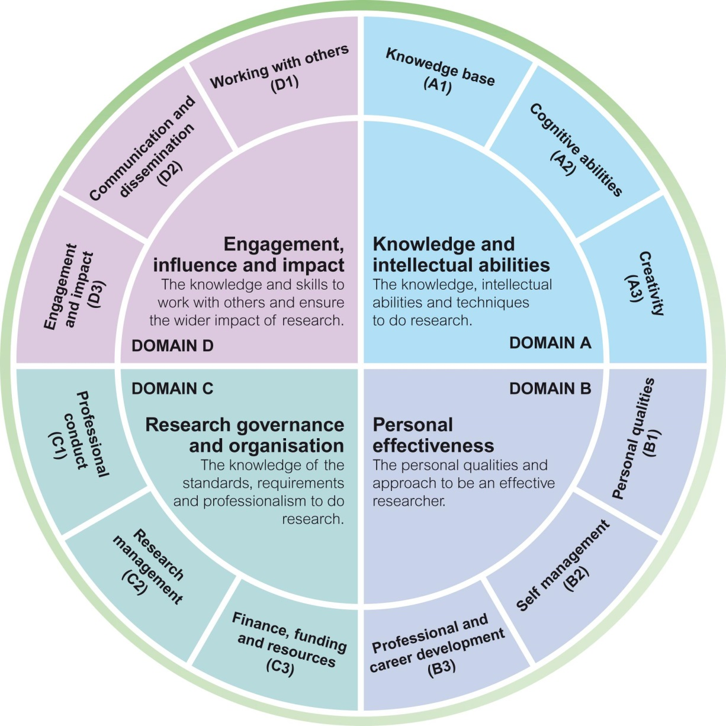

Slide 10
Reasons to be cheerful…
“Excellent experience for the student and expands the network and connections for the academic.”
“Good for student to gain wider experience. Good for supervisor and University in building links and reputation with external organisations. Raises possibility of future spin off work or impact of PhD output.”
“Many PhD students do not end up in academic careers. Often they are poorly informed about other options. Internships are a good way to get external experience and, if they do end up as academics, it is no bad thing to have seen something outside University life.”

Slide 11
…and reasons not to be
“I work in pure mathematics. I don’t see how an internship can be relevant?”
“Internships are training students for what they do if they fail as researchers. I would prefer schemes that optimize success rather than mitigate failure.”

Slide 12
Recommendations
Forum for sharing staff experience
Extension of registration period – not LOA
Non-mandatory, related to subject area
Simplify multitude of arrangements
Specialist staff to source, manage and ensure compliance

Slide 13
With thanks to
Talia Garza Garza ASET Research Bursary Scheme Lorna Warnock, The University of York

Slide 14
Dr Hilary M Jones Postgraduate Internships Coordinator The University of Sheffield Careers Service
hilary.jones@sheffield.ac.uk @DrhilarymJones uk.linkedin.com/in/hilarymjones

