Slide 1
Researcher development: between policies
and lived experiences
Attempting a sociological perspective
Dr Sandrine Soubes
Faculty of Science
The University of Sheffield
Researcher Education and Development Conference 2015

Slide 2
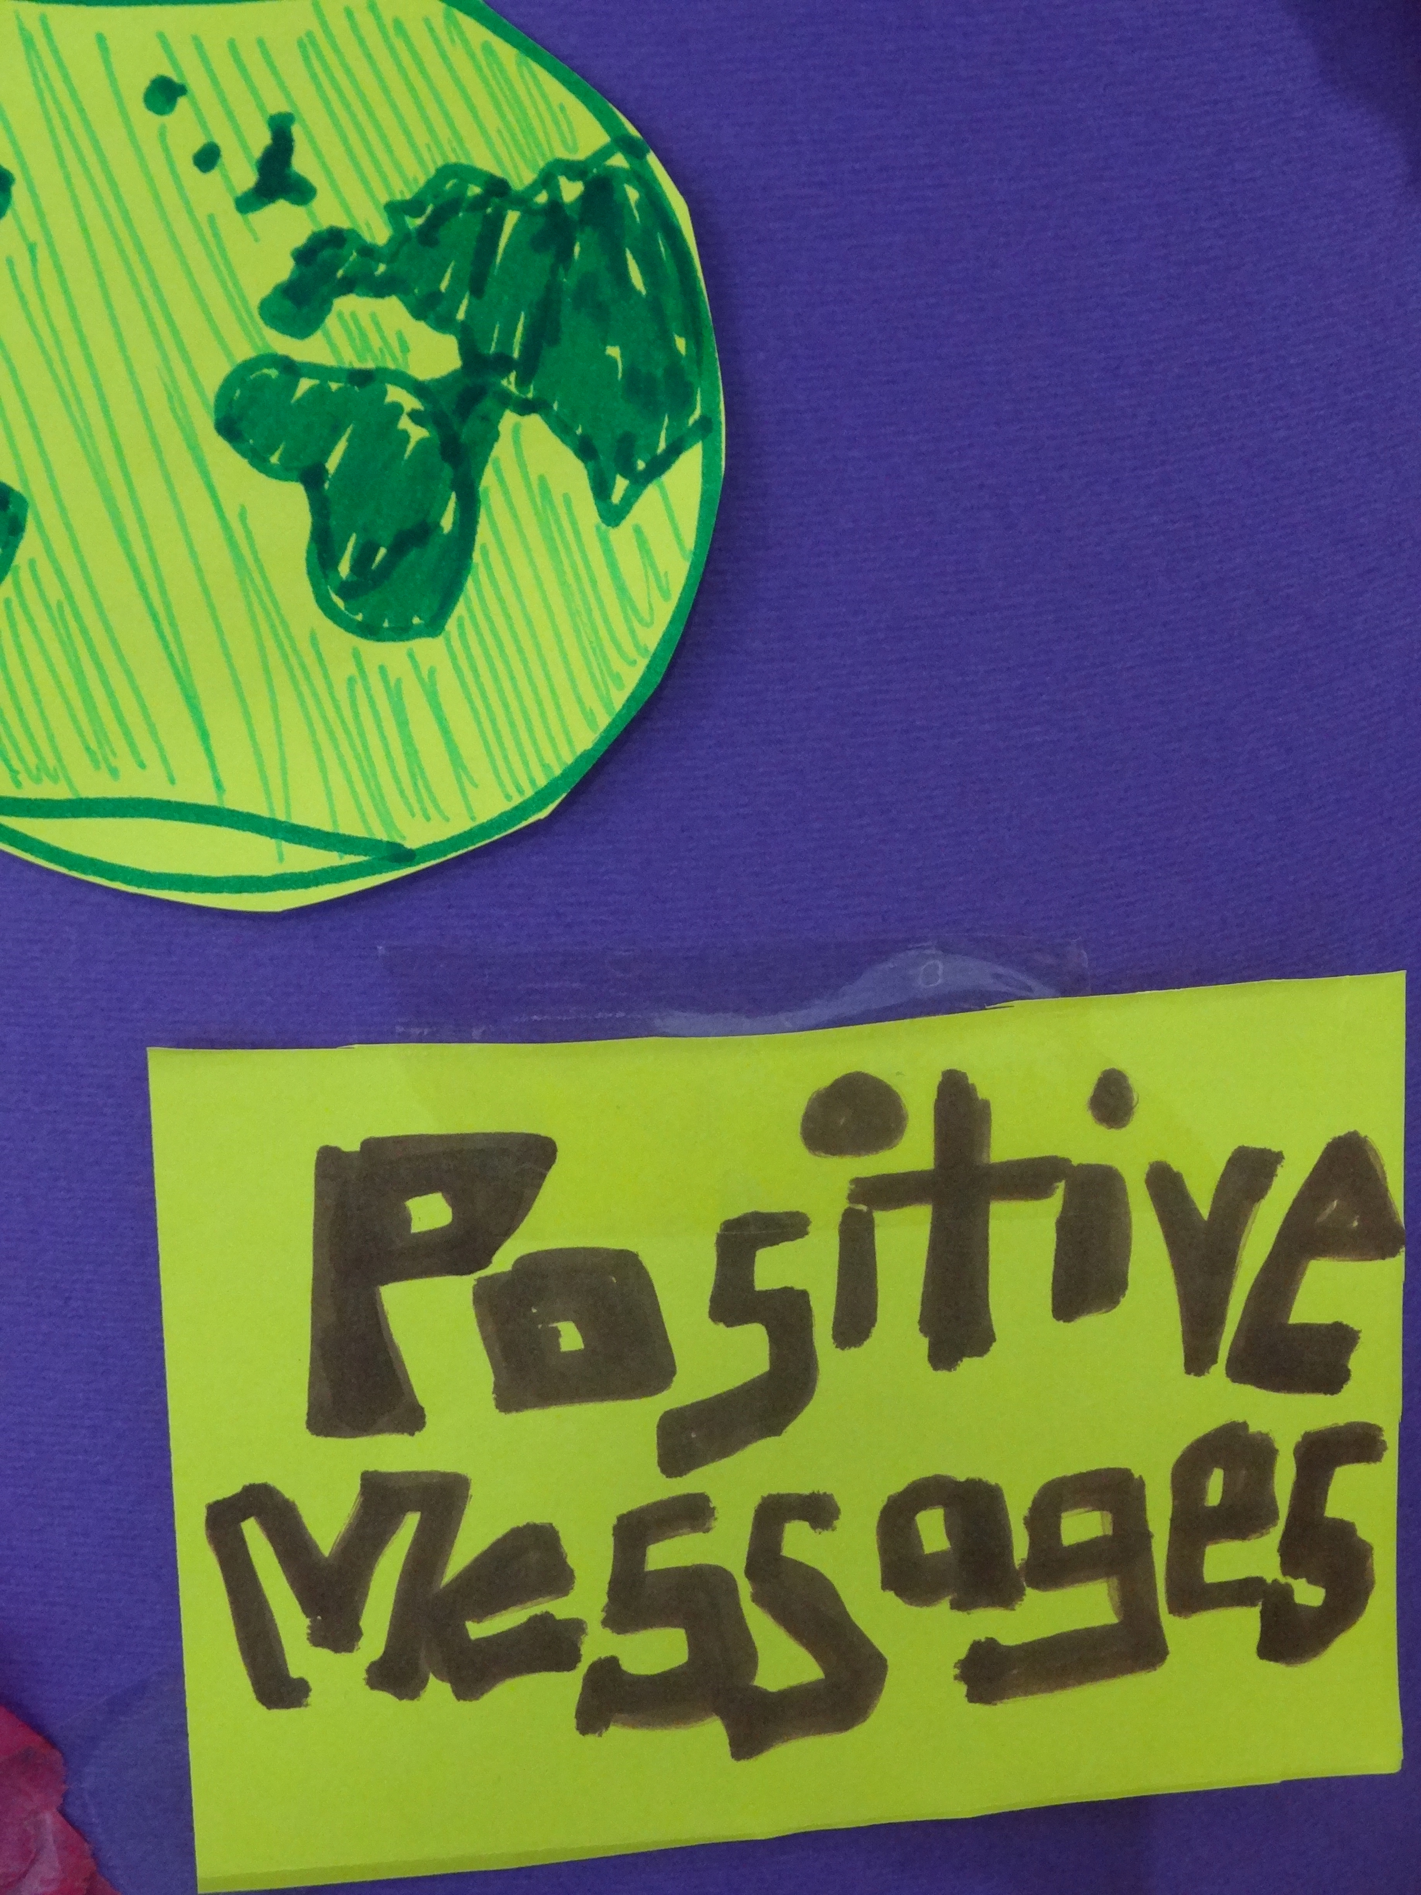
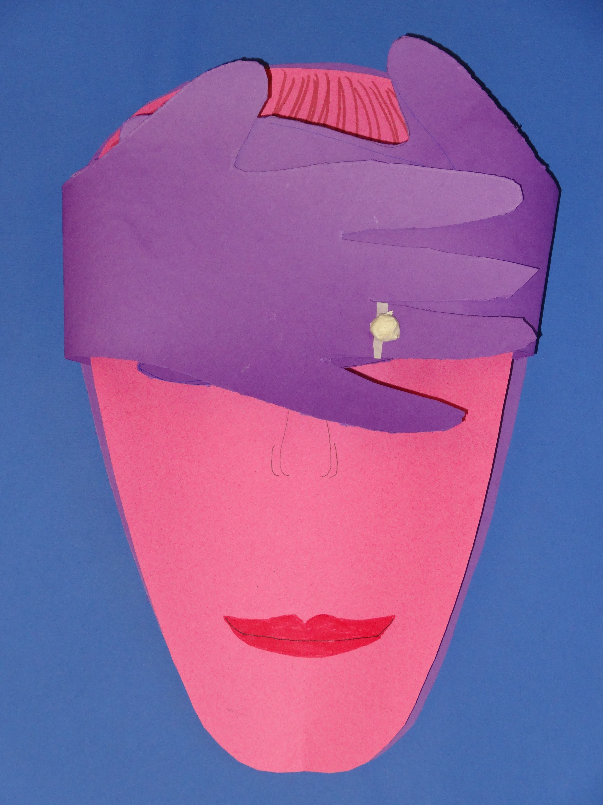
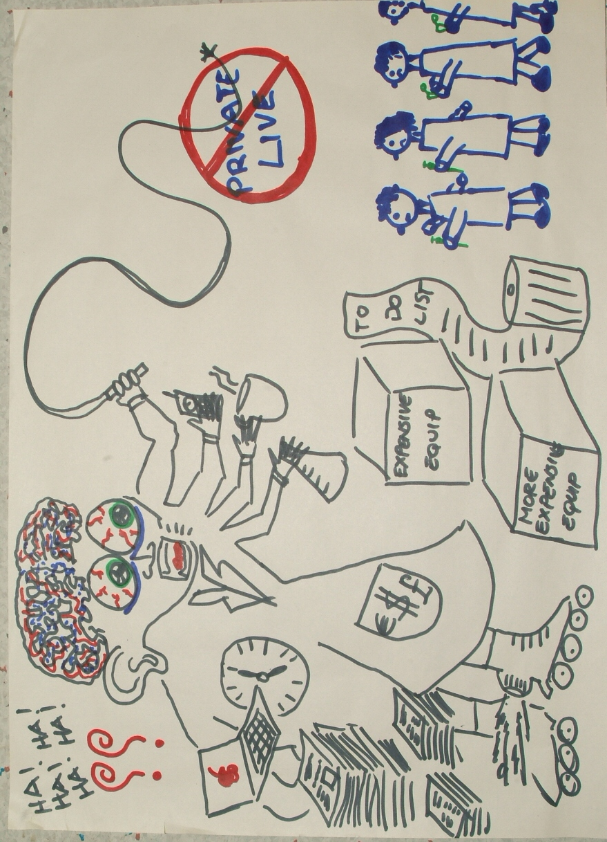
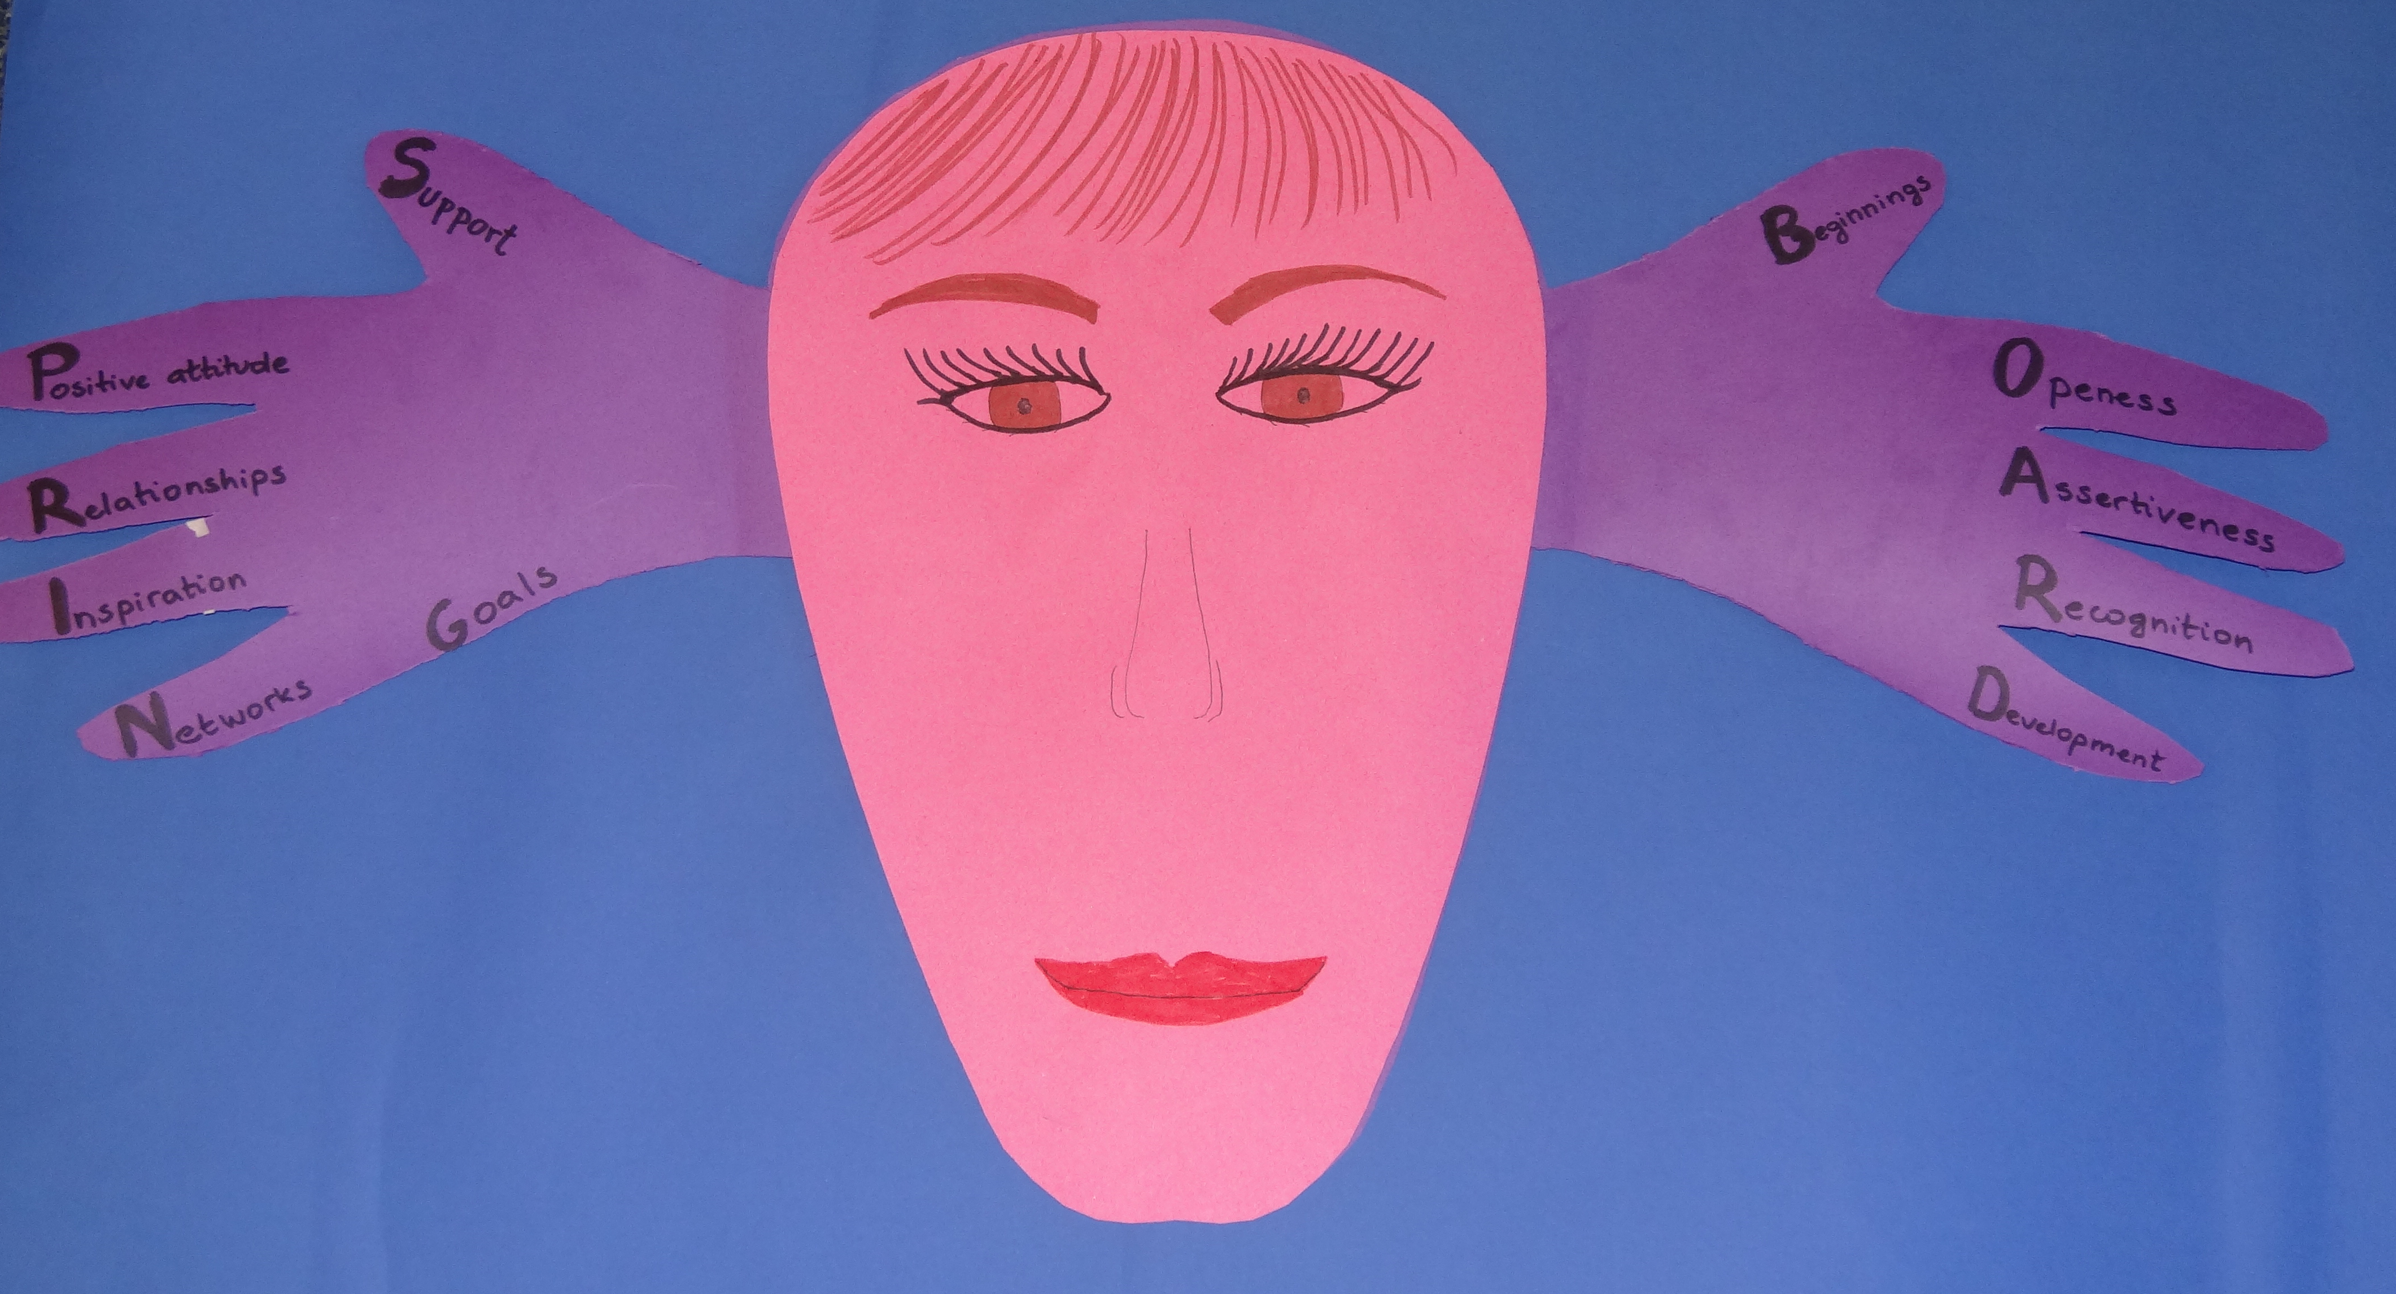
What does it mean to have a sociological perspective
on researcher development?

Slide 3
What does it mean to have a sociological perspective
on researcher development?
It is about:
Taking researcher development as an object of analysis
Conceptualising the meanings of researcher development
Understanding the discourse of researcher development in broader discourses, challenging its meanings and becoming an actor in shaping its direction
Reflecting and positioning our role as researcher developer
Pointing to the obvious and/or unproblematised practices

Slide 4
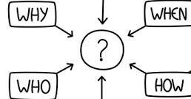
Research Methodology and Analysis
Researching Higher Education: messiness, wickedity and complexities
(Ashwin and Case, 2012)
Ethnographic approach in own institution:
“the researcher-author describes a cultural setting to which s/he has a natural access, is an active participant, more or less on equal terms with other participants…uses the experiences, knowledge and access to empirical material for research purpose” Alvesson (2003)
Enriched by semi- structured interviews of postdoctoral researchers, research fellows and academics (n=23)
Analysis using concepts from Bourdieu’s tool kit (eg. field, capital and habitus)
“offers a particular way of theorizing the rules, narratives and self-held truths of social phenomena and of educational policy as a specific object of analysis.” (Thompson 2005)

Slide 5
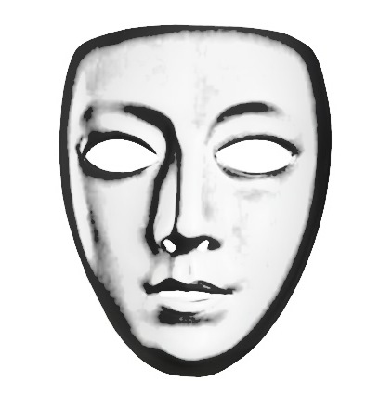
Researcher development: discourse by positioned agents
Vitae
Government
Department for business, innovation and skills
Research funders, Research charities
European Research Area
Industry
Research and Innovation Services
Researcher Developers
Postdoctoral societies and Research staff associations
Faculties, HoD
Researcher Development Group or ECG
Postdoctoral researchers
Research Staff, PhD students
Research support staff
Fellows, university teachers
PIs
Academics
Research groups
Departments
Committees
(eg. Athena Swan, E&D,
DRDC)

Slide 6
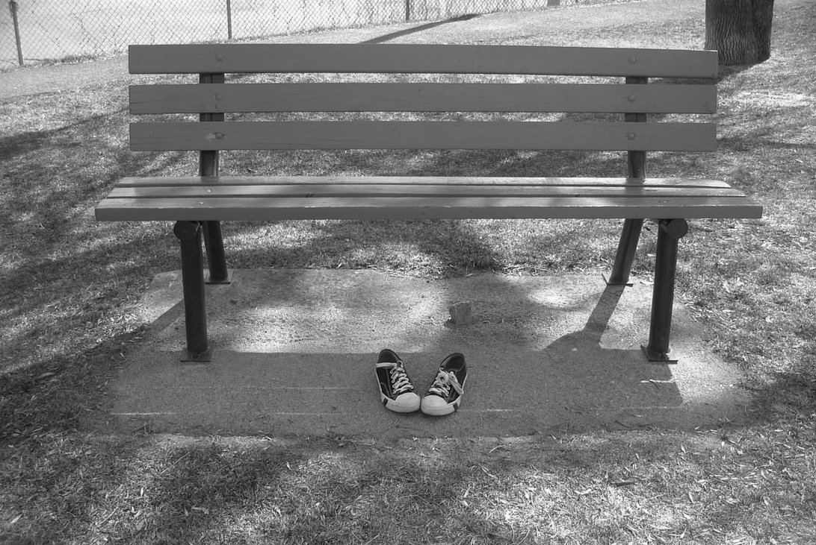
Symbolic violence
Invisibility of researchers as full members of the academic enterprise:
Not incorporated in the academic sections on university website
Either not visible on webpages or visible under their PIs
Experience, interest and expertise not displayed (or limited)
No names on the doors
Indifferentiation among researchers (who’s who?)- flat hierarchy or symbolic violence?
Limiting activities other than research activities
Fellowships as a symbol
of the unattainable

Slide 7
Articulating researcher development
Still perceived by academics as a separate box, another thing done by others
Considered as something to do when everything else is done
Still very little consideration of the job market outside of academia
Not considering it as an element of academic culture
Responding to policy drivers and demands from funders
Limited description* of the “knowledge worker”

Slide 8
Unbearable lightness of “research independence”
The notion of transition towards research independence is not formally stated
Principle 4 “The importance of researchers’ personal and career development, and lifelong learning, is clearly recognised and promoted at all stages of their career”
Principle 5.1 “Researchers are employed to advance knowledge and should exercise and develop increased capacity for independent, honest and critical thought throughout their careers. “
“they can enjoy the right to be recognised and listed and/or quoted, in the context of their actual contributions, as co-authors of papers, patents, etc, or to publish their own research results independently from their supervisor(s).” (p.22)
4 X

Slide 9
Tension between agency and structural expectations
“But yet you need to belong to a tree. So if you look at the very successful scientists – because that’s something, I say “what am I doing that is not correct”, so who are the successful youngy’s that are getting the positions then, you know, such and such. You can trace all of them to one tree, so it’s just branches out from a tree, and then you go back and there’s just the…whoever, you know, it’s like a family of….In a way now, I think it makes sense and it’s important that you trust people that you’ve trained and they are going to help you in research because times are hard. So I wish they would say that on the applications, and say you need to have pedigree, you need to come from a lab that will support you no matter what…”

Slide 10
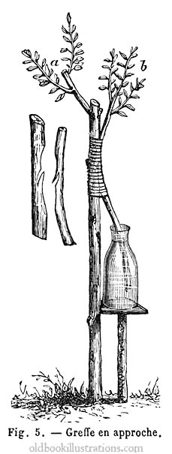
Metaphor describing agency
“ I think I’m not a branch but I am…what do you call it when you cut….so you have a tree and then the tree is doing such and such, and then you cut a branch from off the tree and you stick it and you make it grow…. a graft, a graft on a tree, because I think I can improve. I mean his work is amazing, it’s flawless and he’s one of the best chemists, one of the top chemists, but I can bring a different aspect to his work. So I feel I am a part of his team but I’m a completely new part of it, and he is a bit excited about it I think…”
Notes:
“So I thought it would be very interesting because it would be full interface and I could definitely prove my bestest, because if he was going to work biologically
it would be because of my help because he wouldn’t know any biology.”

Slide 11
Elements for transition towards researcher independence
Being left alone
Having a PI who was ‘hands off’
Trying things out without discussing them
Being given ‘permission’
Exploring putting ideas forward
Experiencing independence and building an identity as an independent researcher
Confusion between autonomy and independence
Assumptions about raw talent
Keeping results close

Slide 12
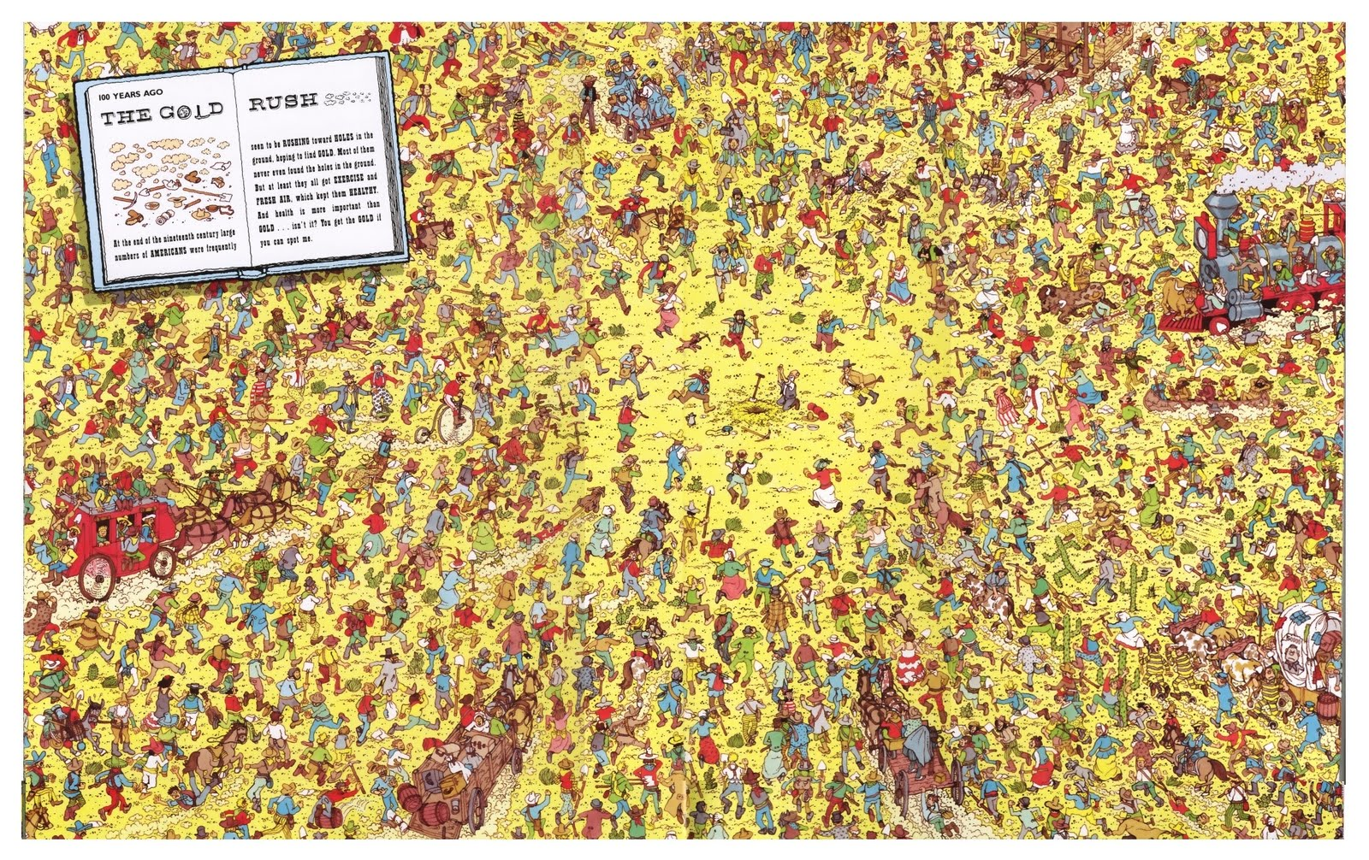
Paradox about research independence
“politics are politics and they are very convoluted. So there are layers on top of layers on top of layers, and I guess that’s what I’ve learnt, you know, things that look like they are like something, they are completely different to what you think they are. And people never tell the truth” “you have to read in between the lines…” | “I guess I’m in the wrong…not knowing what politics is about…a naïve way of thinking about development as a scientist. I develop much too far my knowledge and very little my political skills I guess…”
“So one of the things that I was told several times is that I needed to socialise much more with the people, you know, because it’s important. But I just barely had time to be honest with the careers that we have. “ | “So what I’ve learnt in my career is that you need an awful lot of politics for science, and that we didn’t know. You need to be…it’s not the best that wins, it’s…I don’t know how to say it, it’s someone that is often not the best person but that person seems to be OK with everyone “

Slide 13
Unchallenged practices
Having to let go of ‘your own’ research when transiting towards research independence
Supportive but up to a certain point
Being threatened if choosing to continue on same topic
“ So basically he said “either you come with me or you will never work on this field ever again, I’ll just make sure that…you’re done, you can’t work on this, this is mine”. And I remember some days he would be a bit upset and he would say it like that, and other days when he was a bit more relaxed he’d say “it’s not good for you neither to work on this field, you must…” and I was just like “what do you mean, this is what I’ve trained for”. So when I was writing….because I wanted….because he said “look, you are going to be left with nothing if I leave because I hold your contract, so if I leave I can actually take it and you would be left with nothing so you had better come with me”. So I said “well I’m going to apply for things on my own and try…you know, trying to make it real easy doing that year and a half”. And he was like “but what can you do, do you have to do something different”.

Slide 14
Structural enablers: being able to apply for funding
BBSRC ‘vision for postdoctoral researchers’:
“Postdoctoral researchers should be empowered through independence, and able to make well-informed decisions about their future career progression from an early stage”
(30th January 2015 )
Faculty of Engineering Faculty Executive board
“We wish all independent researchers and those working towards independence to be able to apply for research grants. Within the rules, we will do what we can to enable this….
If you are a researcher who is either funded externally (e.g. on a grant) or your post is below Grade 8, and you have made a substantial intellectual contribution to a grant application, you can be named as a Researcher Co-investigator.”
(21st January 2015 )

Slide 15
Structural impediments
At funders’ level
Complexities of eligibility criteria
At institutional level
“So the University of …forbid me to apply for money myself…they worked out that because
of the law, if I would have worked for them for more than 5 years, they would have to give me a permanent job so they forbid me to apply… When I say forbid me, they refused to give me support. In practice it is the same thing…They refused to sign up the papers when we applied for grants…so we had to write with my PI grants which I’d be named but I still had to apply for the job for which I wrote the grant for.”
“just being named as a Postdoc”
“HR even lied…. It was mostly down to a certain number of people that decided that how it should be and mistaken their wills with the Law “

Slide 16
Conclusion
Considering a sociological perspective on researcher development to understand the habitus of agents
Suggest a move beyond a normative view of evaluation (eg. What works?)
Being prepared to play a role in shaping the rules of the game
Can this help us consider the kind of researcher development to establish and the kind of researcher developer we want to be?

