Slide 1
Political Economy of Attention – Well/be-ing
Dr Peter Doran,
School of Law,
Queens University Belfast
Notes:
Objective:
To frame ‘wellbeing’ and the governmental drive to measure so called non-economic dimensions of life using ‘biopolitics’ and ‘cognitive capitalism’.
To consider the central role of ‘attention’ and critical understanding of biopolitical regimes as a key mediator of ‘wellbeing’ understood as an emergent field of struggle over autonomy, freedom, and sustainability. [This implies, among other things, overcoming the dichotomy between ‘care for the self’ and our understanding of power structures (notably capitalist or neoliberal ontology: Capital as Power).
An interesting feature of this thesis is the contribution of non-Western thinking about ‘askesis’ or ‘practices’ entailed in care for the self….as potential moments of radical resistance and insight into the contemporary operation of power – the colonisation of attention, understood as a ‘new enclosure’ of the subject/citizen within global circuits of production-consumption.

Slide 2
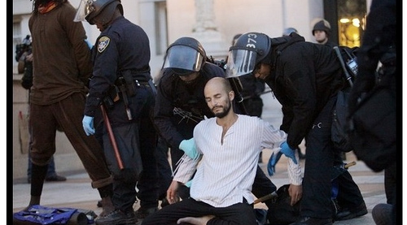

Slide 3

Summary: Everything Counts
The current policy debate on measuring wellbeing coincides with – and is not unrelated to - the neoliberal transformation of capitalism: ‘cognitive capitalism’
‘Cognitive Capitalism’ (Moulier Boutang, 2011) is best understood as a form of bio-power (Foucault, 2008): the absorption of life into the circuits and algorithms of consumption and production (capitalization)
Under Cognitive Capitalism everything – including ‘environmental services’, our health and attention – gets drawn into the calculation of productivity and valuation
Everything counts – Every-‘thing’ Must Be Counted
The axis of critique/opposition is increasingly where we place our attention & the quality of our attention (‘care of the self’)
Notes:
Foucault on ‘biopolitics’ (Course Summary):
Biopolitics (origins in the 18th c. – the rationalization of the problems posed to governmental practice by phenomena characteristic of a set of living beings forming a ‘population’: health, hygiene, birthrate, life expectancy, race…(Foucault, The Birth of Biopolitics, 2008, 317)
Franco “Bifo” Beradi, The Soul At Work (2009):
“With the word biopolitics, Foucault introduces the idea that the history of power is the story of the living body being modeled by deeply mutational institutions and practices, capable of introducing behaviorsand expectations and indeed permanent modifications in the living…(187)…(Neo)Liberalism is a political programme whose purpose implies the inoculation of the enterprise principle to every space of human relations:
Privatization and the fact that every fragment of the social sphere wa reduced to the entrepreneurial model freed economic dynamics from any tie, be they political, social, ethical, juridical, union or environmental.
“…the more liberal deregulation eliminates any legal ties within production and the juridical person is freed from regulations, the more living social time is caught in linguistic, technological and psychological chains. (Beradi, p.188)
For Foucault biopolitics is a process of internalization: economic chains are incorporated in the physical and linguistic sphere once society has been freed from any formal rule. The question of freedom becomes ‘biopolitical’.
[‘Unpublished Sixth Chapter of Vol.1 of Marx’s Capital, refers to ‘formal subsumption’ (juridical) and ‘real subsumption’, the latter meaning that workers’ lifetimes are captured by the capital flow, and souls are pervaded by techno-linguistic chains. (cited, Beradi, p.188)
“The introduction of pervasive technologies, the computerization of productive processes and of social communication enact a molecular domination upon the collective nervous network. This is the domain of the dead object, the commodity, which objectifies human activity reducing it to a cognitive automatism.” (p.188)
Main Point: The translation of the ‘subject’: “Neoliberal
Wellbeing articulated as biopolitics:
Shift the analytical interest form state/population policy/governance to economic or capitalist strategies that take as their object the preservation or enhancement of vitality and wellbeing (neoliberal capitalism and changing concepts of life).
Lemke (Lecture):
Biopolitics to Biocapital:
Biotech innovations and biomedicine provoked new expectations. This vision has been taken up in ambitious action plans by OECD and EU.
The economy will soon transform itself into a ‘bio-economy’ (OECD to 2030) (OECD)
EU Commission stressed that a knowledge based bio-economy to strengthen EU competitiveness, protect environment and support renewable materials.
Central to this is stimulation and creation of new markets.
Capitalism and the life sciences: biocapital (2006) Biopolitics and Marxist critique of political economy. The emergence of the biosceinces marked a new phase of capitalism. The constitution of biocapitalism can be met through two perspectives.

Slide 4
Cognitive Capitalism
Virtualization (immateriality)
Innovation: market and public administrative capture of social cooperation, learning and tacit knowledge
Reversal of ‘conception/production/marketing’ cycle
Irreducible plurality of inputs (productive resources)
Network society
End of the hegemony of industrial/manual labour
Living labour (not machinism) and consumption occupy central positions

Slide 5
Cognitive Capitalism
External effects – “externalities” – cease to be marginal.
What needs to be uncovered and addressed is work done outside working hours and implicit knowledge.
Inventive power (beyond labour power) is mobilized by cognitive capitalism. This creates knowledge and the living through the production of the population.
This production of life can be called ‘bio-production’ via ‘biopower’
Notes:
Defining Cognitive Capitalism:
A new system of accumulation:
Whereas industrial capitalism can be characterised by the fact that accumulation was based mainly on machiner and on the organisation of manual labour, cognitive capitalismis a different system of accumulatio, in which the accumulation is based on knowledge and creativity: immatrial investment. (p.56, 57, Moulier Boutang, paraphrased)
“This regime manifests itself empirically through the important place of research, of technological development, of education (the quality of the population), of information flow, of comunication systems, of innovation, of organisational learning and of management organisational strategies. On the demand side, consumption is […] oriented towards technology, and particularly technologies of the mind – in other words those that set mental faculties into operation through interaction with the new technical objects: audiovisual media, computers, the Internet, game consoles.” (p.57, Moulier Boutang)

Slide 6
Deregulation and Privatisation
“…the more liberal deregulation eliminates any legal ties within production and the juridical person is freed from regulations, the more living social time – beyond the State - is caught in linguistic, technological and psychological chains. (Beradi, p.188)
Biopolitical modes assume the power to directly measure, produce, control, and regulate life itself. (Wright, 2013, p. 26)
Freedom has become a question of the biopolitical
The market freed becomes the site of the exercise of contemporary freedom as well as being the supposed mechanism of distributive justice. (Wright, 2013, p.26)
“Neoliberalism could be said to translate Benthamite utilitarian welfarism out of the Keynesian welfare state of the mid-20th Century and into a competitive health and happiness market emerging in the 21st C.” (Wright, 2013, p.27)
Notes:
For Foucault biopolitics is a process of internalization: economic chains are incorporated in the physical and linguistic sphere once society has been freed from any formal rule. The question of freedom becomes ‘biopolitical’.
[‘Unpublished Sixth Chapter of Vol.1 of Marx’s Capital, refers to ‘formal subsumption’ (juridical) and ‘real subsumption’, the latter meaning that workers’ lifetimes are captured by the capital flow, and souls are pervaded by techno-linguistic chains. (cited, Beradi, p.188)
“The introduction of pervasive technologies, the computerization of productive processes and of social communication enact a molecular domination upon the collective nervous network. This is the domain of the dead object, the commodity, which objectifies human activity reducing it to a cognitive automatism.” (p.188)
The key point about the ‘biopolitical’ is the engagement by governments (in an essentially economic project) in forging citizens and communities for industrialization and intensifying European imperial competition and the perceived need to render populations disciplined for work, and economically productive.
“Thus, if classical liberalism aimed to limit the power of the state, neoliberalism has succeeded in figuring this limitation as one specifically vis-à-vis its capacity to intervene in the planning, regulation or steering of the market mechanism. When the state interferes, claim neoliberals, it disrupts the market’s delivery of human happiness and wellbeing .” (Wright, 2013, p.27)
In an interesting anticipation of the debates on the ‘enabling state’, Foucault has documented the retreat or eclipse of the state as understood in the old Weberian sense, that is the retreat of the state understood as the seat of power as such, but one component in a more complex and fluid dispositif of technologies of governmentality that would include private ‘providers’ .” (p.27)
For Wright it is obvious that we should view Happiness Studies as an outgrowth of this neoliberal tradition that takes wellbeing as its object, precisely as it wrests that object from the hands of the ‘nanny state’ in order to monetize it. (p.27)

Slide 7
Biopolitics and Wellbeing
Foucault was associated with the early critique of psychiatry and the use of ‘madness’ to discipline normality
“Now, in the 21st century, the elasticity of ‘health’ has enabled biopolitical forms of regulation to enter the very pores of contemporary selfhood, especially when discursively linked with happiness.” (Wright, 2013p.26)
Notes:
“It is this 360 degree extension of economic logic to traditionally non-economic dimensions of life, right up to the reinscription of both felt selfhood and the legitimate remit of the state, which helps us to understand Happiness Studies, the concept of flourishing, and the kind of subject they interpolate.
This focus on humans as input/output devices [wherein the circuits of production and consumption are perfected, completed, joined up], amenable to training and (self)improvement, clearly opens the way to an alliance between neoliberalism and behavioural psychology, of which managerialism might be seen as one particularly pervasive consequence (see Fitzsimons, 2011) (cited in Mills, 2013, p27)

Slide 8
Translations
A 2008 report funded by the UK Department for Business, Innovation and Skills – re-defines wellbeing as ‘mental capital’, with the author’s breezily asserting that “The idea of ‘capital’ naturally sparks associations with finance capital and it is both challenging and natural to think of the mind in this way.” (see www.bis.gov.uk: mental-capital wellbeing executive summary) (cited in mills p.28)

Slide 9
Biopower
With the word biopolitics, Foucault introduces the idea that the history of power is the story of the living body being modeled by institutions and practices, capable of introducing behaviors and expectations and indeed permanent modifications in the living…(Beradi, 2009, p187)
(Neo)Liberalism is a political programme whose purpose implies the inculcation of the enterprise principle to every space of human relations.
Notes:
Privatization and the fact that every fragment of the social sphere was reduced to the entrepreneurial model freed economic dynamics from any tie, be they political, social, ethical, juridical, union or environmental.
“…the more liberal deregulation eliminates any legal ties within production and the juridical person is freed from regulations, the more living social time is caught in linguistic, technological and psychological chains. (Beradi, p.188)

Slide 10
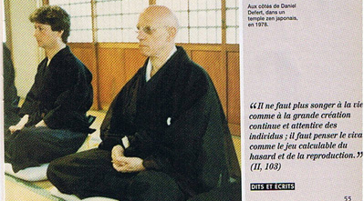
Foucault Encounters Zen
Notes:
It is no accident that Michel Foucault, one of the great philosophers of power during the 20th century, towards the end of his life – moved between the Western academy and a deep curiosity/appreciation of Zen Buddhism.
The figure of Foucault sits at the axis of an important source of understanding and critique when it comes to exploring the issue of ‘wellbeing’ within the contemporary experience of power (as governmentality): government at a distance, and entailing multiple actors (notably the global private complex of corporate actors)

Slide 11
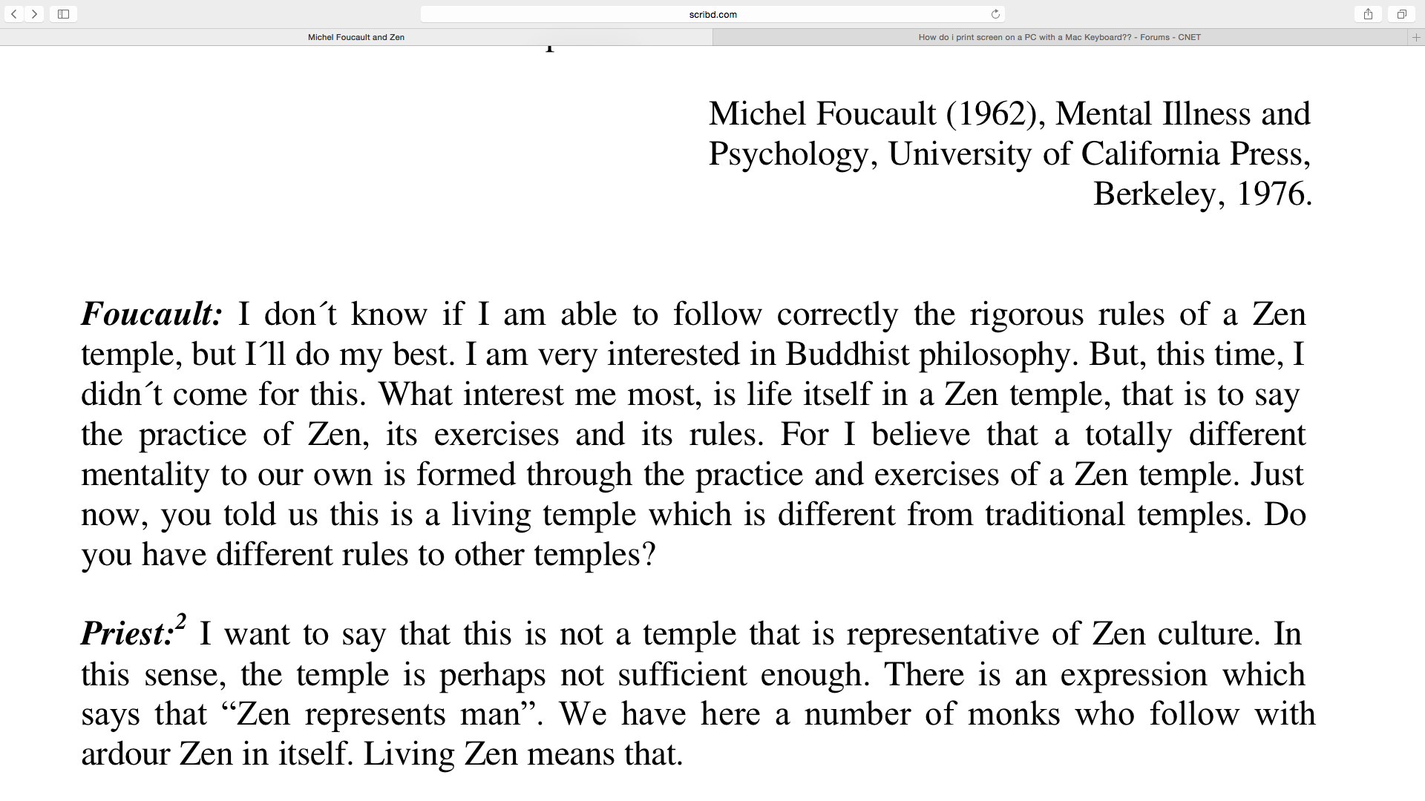
Foucault Encounters Zen

Slide 12
The Biopolitical
“Wellbeing facilitates a move within Happiness Studies toward bodies as sites of measurable productivity and populations as patterns of predictable mass behavior…”(Wright, 2013, p.
“It is [this] 360 degree extension of economic logic to traditionally non-economic dimensions of life, right up to the re-inscription of both felt selfhood and the legitimate remit of the state, which helps us to understand Happiness Studies, the concept of flourishing, and the kind of subject they interpolate.”(Wright 2013, p.27)
Notes:
Health, Culture and Society, Vol. 5, No.1. 2013. Page 23. Article by C.Wright ‘Against Flourishing’

Slide 13
Interpolations In
The Attention
(Cognitive) Economy
In his Liquid Life (2005) Zygmunt Bauman describes how our culture interpolates people primarily as consumers, a syndrome of cognitive and evaluating predispositions.
Tim Jackson associates these predispositions with a ‘social recession’, including rising rates of anxiety and clinical depression, addiction, and a decline in morale. (Jackson, 2009; Kasser, 2007)
Notes:
As advanced global capitalism targets, perhaps, above all else, the human capacity for attention there are far reaching implications for our wellbeing – psychologically, physically and spiritually, and ultimately for our global economy – because our innate capacity for mindulness and a quality of attention is the realm, the final commons, where the potential for human adaptation to ne ecological and social boundaries must be cultivated if we are to flourish as a species in the era of the anthropocene.
Instead, as Zizek has described, capitalism relies on a structural disavowal based on an overvaluing of individual belief – in the sense of inner subjective attitude – at the expense of the beliefs we exhibit and externalize in our behaviour. So long as we believe (in our hearts) that capitalism is ambivalent or plain bad for ourselves and our ecology, we are free to continue to participate in capitalist exchange – settling for an ironic distance. This corporate sponsored rupture between our routine attitudes and actual behaviour (disavowal) is neatly captured in Saul Alinksy’s observation that ‘most people are eagerly groping for some medium, some means by which they can bridge the gap between their morals and their practices.’
Capitalist actors, spanning the advertising industry, the mass media, the social media, video game manufacturers, celebrity culture, and more traditional actors engaged in the circuits of production and consumption, are deeply invested in practices of individualism and materialism facilitating a global competition for ‘mind share’ in the attention economy. Their wired technologies have come to mediate our popular self-understanding and how we relate to notions of self, other and the world in a profound way. But at what cost? There is an increasing recognition that ‘attention deficit’ is the price we now pay for our participation in a new ‘attention economy’ that treats atttention as a scarce commodity to be pursued and monetized at every opportunity. Materialism is systematically promoted via habit-forming cues (Laibson, 2001), reinforcing extrinsic values at the expense of intrinsic values (Kasser 2002). Even the economist Jeffrey Sachs has recently attached big business in America for both destroying democratic institutions and transforming citizens into ‘consumer addicts’.

Slide 14
Intimate Distance
A decisive shift in the public/private balance of control of global media and telecommunications has taken place since the 1980s.
Acceleration in the capitalization of ‘attention’ = capitalism’s psychic investment
Fastest growth during the 1990s was in culture industries: extending commodification into the realms of subjective life

Slide 15
Intimate Distance
Cognitive Capitalism’s forms of production perfect the use of individuals and their relationships in co-inventing cultural and symbolic meanings and ideas.
The market creates communities of interest and seeks out the intimacy of the consumer in order to embed commercial transactions in personal and daily life.
Promotional culture creates desiring consumers whose personal histories can be mined for their interests, desires and purchases.

Slide 16
The Price
Writing from a Chan/Zen Buddhist perspective, Peter Hershock observes:
…the single most important long-term cost of convenience [and our technological experience of control] – in the context of the availability of commodities – is an overall erosion of relational quality resulting in a mounting incapacity for appreciation and contribution.
Notes:
Noting considerable implications for the nature and dynamics of the public sphere, he describes the market valorization of convenience and coice as signalling both a general narrowing of our horizons of personal responsibility and, over time, a severe compromise of relational capability and attunement.

Slide 17
Conclusion
Just as early industrial capitalism enclosed the commons of labour and land, cognitive capitalism extends the process of commodification : enclosing cultural and intellectual commons. (Rutherford, 2008)
A key productive force of post-Fordist economic activity is the ‘life of the mind’ (Virno, 2004) or ‘the mindful commons’ (Doran, 2009)
This extends to the realms of the unconscious and the non-verbal.
Addressing an ancient breach in the human pursuit of ‘truth’ and ‘practice’, Foucault wrote that reflection on the notion of governmentality cannot avoid operating, theoretically and practically, with the notion of a subject who would be defined by the rapport of the self to the self. (McGushin 2008, 14)
Foucault’s exploration of ancient and contemporary technologies of the self (meditation) takes on a new urgency under conditions of cognitive capitalism – where the form of ‘attention’ we bring to the self – in the context of a multitude of practices and technologies of the self and of life – draws us to consideration of a practice of care as a practice of freedom.
Foucault anticipated and addressed the contemporary disavowal: for an action to be ‘moral’ it must not be reducible to an act or a series of acts conforming to a rule, a law, or a value. There is no moral conduct, for Foucault, that does not also call for the forming of (cultivation) oneself as an ethical subject; and no forming of the ethical subject without ‘modes of subjectification’ and an ‘ascetics’ or ‘practices of the self’ that support them.
Personal and political economies of attention are best understood – in relationship – around the emerging struggle for the final ‘commons’ (mindfulness and critical engagement with biopower). He discusses biopower as the normalizing power of disciplinary practices but holds open the prospect for self-formation, of reflective modification of the sensibility of the self by the self.
This is also an axis for consideration of wellbeing in its subjective and objective dimensions.

