Slide 1

The Performance (Management) of Wellbeing

Slide 2
What are the roles of wellbeing measures in the implementation of public policy:
commissioning & performance management

Slide 3
New Public Management:
Markets
Managers
Measurement
Fearlie et al (1996), New Public Management in Action. Oxford: Oxford University Press.

Slide 4
Wellbeing measures
+
New Public Management
=
Reduced actual wellbeing

Slide 5
Measurement Problem:
People measure what is measurable, not what reality is like

Slide 6
Body Mass Index (BMI)
“true measures of body fat are impractical or expensive to use”
“BMI is an attractive measure because it is an easy, cheap and non-invasive means of assessing excess body fat.”
National Obesity Observatory, 2009

Slide 8

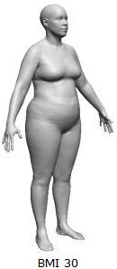
“A picture of obesity: NHS tells bodybuilder she must lose weight and exercise more…”
Metro, 26th March, 2014

Slide 9
The attribution problem:
Outcomes are beyond the control of organisations

Slide 10
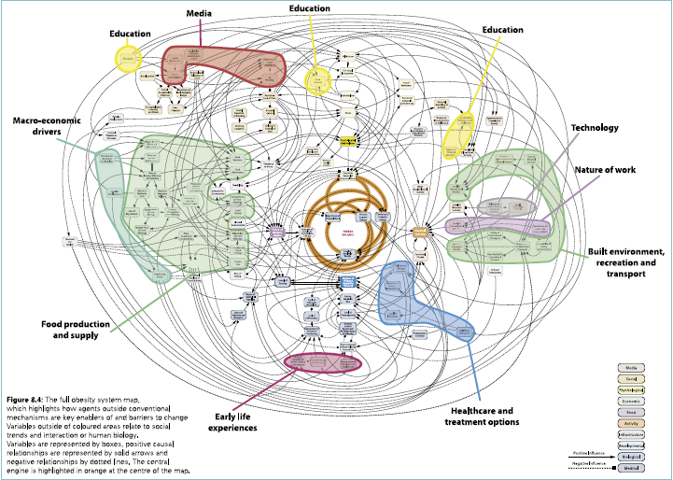

Slide 11
Programme Logic Model
Robert Schalock & Gordon Bonham “Measuring outcomes and managing for results”, Evaluation and Program Planning, 2003

Slide 12
“Results decision-making uses results…as the starting point for making decisions. It is a business-like process that starts with ends and works backwards to means.”
Mark Friedman, Results Based Accountability Implementation Guide

Slide 13
Theoretical problems:
Measurement problem: Outcomes don’t measure impact in people’s lives
Attribution problem: Outcomes are beyond the control of organisations
#LittleHeresies

Slide 14
What happens when people implement OBPM approaches?
The production of data:
Cherry picking/creaming and parking
Teaching to the test
Reclassifying what counts as success
Making up the figures

Slide 15
Targets for results “frequently distort the direction of programs, diverting attention away from, rather than towards, what the program should be doing.”
Burt Perrin, “Effective Use and Misuse of Performance Measurement”, American Journal of Evaluation, 1998

Slide 16
Campbell’s Law
“The more any quantitative social indicator is used for social decision-making, the more subject it will be to corruption pressures and the more apt it will be to distort and corrupt the social processes it is intended to monitor.”
Donald Campbell, Assessing the Impact of
Planned Social Change,1976

Slide 17
Gaming

Slide 18
“Regional Official A:
You don’t hire a ‘‘people person’’ anymore for a career manager [social worker] position. You hire a clerical computer person. You can teach them the social work stuff easily. The job’s all about time, accuracy, and files now. There’s a person [client] down there somewhere. But the technical stuff is what matters.
State Official:
What you’re telling me is the [information] systems are driving the [case management] process.
Several Regional Officials: Oh yes. Oh yes!”
Soss, J et al, (2011), The Organization of Discipline: From Performance Management to Perversity and Punishment, JPART, 21

Slide 19
Regional Official C:
“If you talk to any case manager here, they will tell you they’re not a case manager; they’re a technician. They spend about 10 percent of their time on their clients. Their
time is about being a technician, and that’s the way the program is written. They’re doing what they have to do under this system.”
Soss, J et al, (2011)

Slide 20
“The focusing effects of outcome benchmarks,the pressures of competition, the prospects of incurring rewards or penalties, the awareness that one is being closely monitored: these features of performance management do more than just make agents accountable; they reshape agency itself.”
Soss, J et al, (2011)

Slide 21
Implications for promoting wellbeing
Remember Campbell’s law!
If you the promotion of wellbeing is undertaken via OBPM frameworks, you won’t get wellbeing, you’ll get the performance of wellbeing
Good reasons to measure: to improve practice

Slide 22
Thanks for listening
Toby Lowe
E: toby.lowe@newcastle.ac.uk
Twitter: @tobyjlowe

