Slide 1
Subjective wellbeing: A force for radical change?
Politics of Wellbeing Final Conference
Sheffield University - 17th July 2015
Saamah Abdallah, New Economics Foundation

Slide 2
Outline
Motivations of those using subjective wellbeing
Three models for role of indicators in society
... applied to subjective wellbeing

Slide 3
What is subjective wellbeing?
Overall questions on experience of life in large representative surveys. ONS questions are:
Overall, how satisfied are you with your life nowadays?
Overall, how happy did you feel yesterday?
Overall, how anxious did you feel yesterday?
Overall, to what extent do you feel the things you do in your life are worthwhile?
Other surveys include more questions about flourishing or eudaimonia, e.g.:
Vitality: Please tell me how much of the time during the past week… you had a lot of energy
Autonomy: I feel I am free to decide how to life my life (agree-disagree)
Social acceptance: Please tell me to what extent… you feel that people treat you with respect?

Slide 4
EU funded project 2011-2014
Explored the barriers and opportunities to use of alternative indicators in general, including subjective wellbeing
Methodology included interviews, workshops and case studies
Funded by:

Slide 5
What do people expect from subjective wellbeing?
To create more evidence-based policy-making.
To raise profile of mental health issues
To help inform progress towards sustainable development
Sometimes big picture, e.g. help understand the point of economic growth, sometimes not: “it would be a stunning indictment of democracy” if wellbeing data radically changed policy.
Survey of indicator producers found that 5 respondents intended their work on subjective wellbeing to “contribute to a radical change in society”, and 7 did not.
NEF’s work on subjective wellbeing based on hope that it can contribute to a radically more sustainable and equitable economy

Slide 6
Models of indicator use
Rational-positivist
Note, can also be iterative
Strategic-political
To support a policy or political position
To manage image
Discursive-constructivist
Boulanger,P. M. (2007). Political uses of social indicators: overview and application to sustainable development indicators’ International Journal of Sustainable Development 10, pp.14–32.

Slide 7
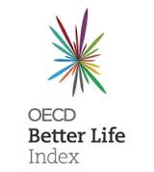
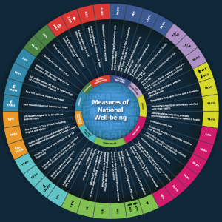
Rational positivist
A lot of the focus on subjective wellbeing is within this vein:
Office for National Statistics
OECD
Can it contribute? Probably yes:
Drinking regulations
Wellbeing evaluations (e.g. Big Lottery Fund, National Citizens Service)
What Works Centre for Wellbeing

Slide 8
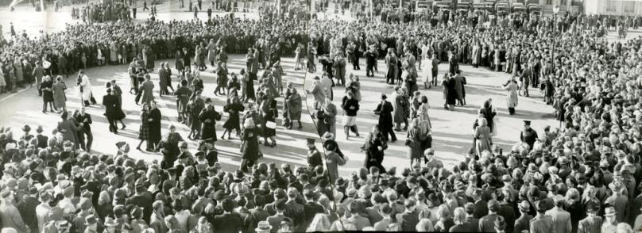
Rational positivist
How about radical changes? Evidence points to…
Greater focus on economic stability than growth (O’Donnell)
Reducing inequality, e.g. increasing minimum wage and introduce pay ratios (APPG Wellbeing Economics)
Tackling long working hours (NEF)
Increasing investment in mental health (Layard)
Greater focus on social (Bartolini)
Higher government spending (Radcliffe)
But where NGOs and academics have pointed to these, are they really examples of the rational positivist approach?

Slide 9
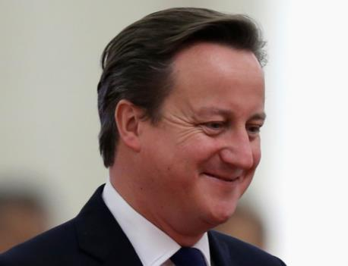
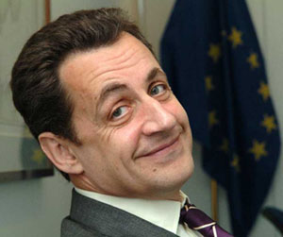
Strategic political
Leftist ideas have been argued for using wellbeing data, e.g. reducing inequality.
Also pro-environmental policies, e.g. reducing working hours, abandoning emphasis on growth.
But left wing politicians have not used subjective wellbeing in this way.
Instead…

Slide 10
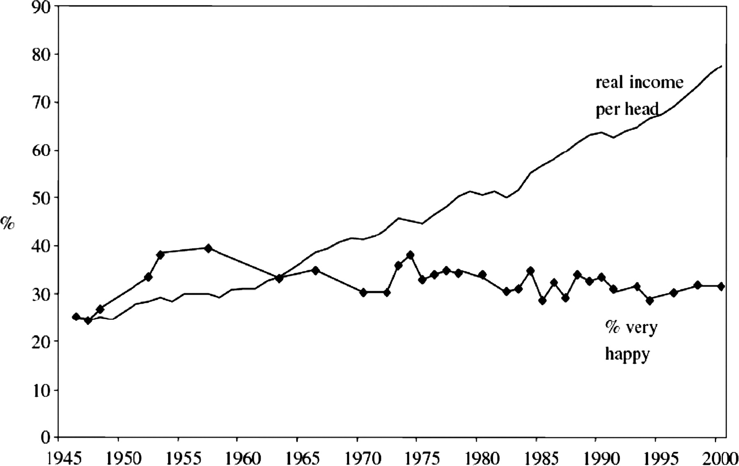
Discursive constructivist
Seen this graph before?

Slide 11
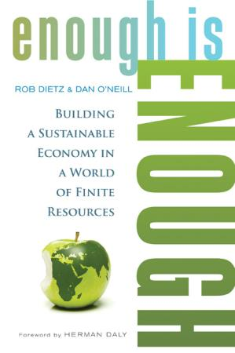
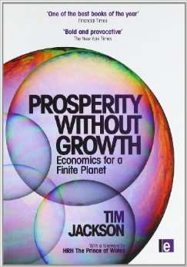
Discursive constructivist
Easterlin Paradox has been used by many who are concerned with growth for environmental reasons (e.g. Tim Jackson’s Prosperity without Growth, Steady State Economics, Degrowth)

Slide 12
Discursive constructivist
Findings about diminishing returns from income on wellbeing, and the importance of relative income (vs. absolute income) are cited widely

Slide 15
Discursive constructivist
RQ: Are these stylised findings influencing thinking?

Slide 16
The role of headline indicators
Beyond GDP movement advocates replacing GDP with alternative measures (including subjective wellbeing)
Belief is that this new measurement regime will shift political discourse not just cost-benefit analyses
Hinges on belief that what we measure, and measure regularly effects what we think and do.
Or at least that what is talked about in media frames people’s thinking (Lakoff) and shapes their values (Kasser)

Slide 17
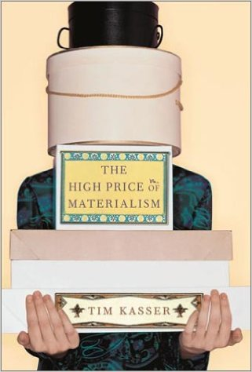
The role of headline indicators
Materialism associated with many bad outcomes (wellbeing, environment, pro-social behaviour)
RQ: Is there any evidence that GDP has influenced values and attitudes? (or were we always obsessed with economic growth?)

Slide 18
GDP as a discursive constructivist force
Berman & Hirschman (2014)
“The indirect influence of economics on policymaking is likely as important as the direct role of economists”
Focussing device: “GDP, persistently directs our attention to changes in the formal market economy; no equivalent device brings income inequality, for example, to the forefront of our minds each quarter”
Crystalising device: “The successful creation of the policy device of GDP helped raise the professional authority of economists ... policymakers became more concerned with economic growth — something they could not have ‘seen’ without GDP”

Slide 19
Wellbeing as a discursive constructivist force?
Could...
Promote a less materialistic value frame which would bring dividends for in terms of sustainable and pro-social behaviours
Allow growth to be questioned as an overarching goal which would make sustainable policy more feasible
Highlight the inefficiency of income inequality and shift attitudes against inequality
But...
Could it lead to more individualistic attitudes as wellbeing is perceived as individualistic? More so than a focus on GDP?
Could it actually lead to abandoning concern about income inequality because money is seen as unimportant?

Slide 20
Conclusions
It’s possible that a focus on wellbeing might lead to a discourse change that favours more sustainable, equitable behaviour and policy, but:
We need more evidence that this could happen
Evidence on impact of GDP on values and discourse would be valuable
We need evidence that thinking about wellbeing does not trigger more individualistic values
Wellbeing evidence itself, if followed in the rationalist model, would lead us to more sustainable equitable societies. This is perhaps not articulated enough. If it were, then more political use of wellbeing by the left could ensue.

Slide 21
Thank you
saamah.abdallah@neweconomics.org
www.neweconomics.org
@nefwellbeing
“I perceive that the great part of the miseries of mankind are brought upon them by false estimates they have made of the value of things.”
Benjamin Franklin (1706–1790)

