Slide 1
Dr. Dave O’Brien,
Goldsmiths
A hand grenade or off to hell in a hand cart?
Notes:
‘Public policy cannot be developed by intuition alone’ JRF

Slide 2
Introduction
Why Wellbeing for culture?
History of cultural policy making
Distributional issues in culture
The need for cultural theory

Slide 3
APPWG/NEF (2014)
‘DCMS, and the arts sector more generally, should use wellbeing analysis to help make the case for arts and cultural spending.’
‘Government should use wellbeing analysis to help set strategic priorities for spending on arts and culture. For example spending should give greater priorities to participatory arts’

Slide 4
‘So we need continually to demonstrate how it benefits us individually and collectively, and to translate that value into policies that increase participation; promote culture’s importance as a way of boosting public education, civil engagement and personal wellbeing; and lead, ultimately, to national growth and resilience.’ DCMS (2015)

Slide 5
WWCW Culture and Sport
What forms of cultural or sporting engagement or participation work, and how can the design of culture or sports interventions be enhanced to increase their impact on wellbeing?
What forms of cultural or sporting engagement or participation work, and how can the design of culture or sports interventions be enhanced to increase their impact on wellbeing?
What works when, where and for whom? What works best for different groups and in different contexts? How are the wellbeing benefits of different forms of culture or sport engagement distributed between different groups and user communities?
How does it work? How can we better understand and evidence the causal relationships between culture or sport and wellbeing?
What are the longer term impacts of culture and sport on wellbeing?
How can evidence be most effectively combined to meaningfully inform policy choices and cultural or sports practice?
Systematic review tradition

Slide 6
Culture is good for you!
Health impacts:
  Those engaging with the arts as an audience member were 5.4% more likely to report good health.
Education impacts:
  Participants in arts are 14.1% more likely to report an intention to go on to further education.
Economic productivity related impacts:
  Unemployed people who engage with the arts as an audience member were 12% more likely to have looked for a job in the last four weeks when compared with unemployed people who had not engaged with the arts.
Civic participation impacts:
  People who engage with the arts as an audience member are 6% more likely to have volunteered frequently (once a fortnight or more).
  Those who engage with the arts as an audience member are also gave £50 per person more in charitable donations over the last year.
(Fujiwara et al 2014)

Slide 7
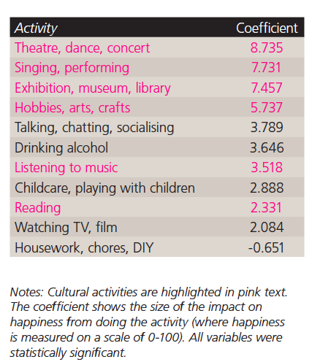
Fujiwara and MacKerron (2015)

Slide 8
Getting to grips with culture
Myerscough, J (1988) The Economic Importance of the Arts in Britain
  ‘In 2011 cultural businesses generated an aggregate turnover of £12.4Bn’ (ACE 2013)
Matarrasso, F (1997) Use or ornament? The social impact of participation in the arts
  ‘There is strong evidence that participation in the arts can contribute to community cohesion, reduce social exclusion and isolation, and/or make communities feel safer and stronger’ (ACE 2013)
McMaster Review (2008)
Measuring the Value of Culture (2010)
AHRC Cultural Value Project
Enriching Britain (Warwick Commission 2015)

Slide 9
McMaster (2008)
‘Funding bodies must move to a new assessment method based on self-assessment and peer review that focuses on objective judgements about excellence, innovation and risk-taking and is made up of people with the confidence and authority to take tough decisions. Funding bodies must also have, as the quid pro quo for removing ‘top-down’ targets, the ability to intervene strategically when an organisation is failing.’

Slide 10
Cultural Value debate in the UK
2003 Demos’ valuing culture
2004 Jowell’s Government and the Value of Culture
Holden & Hewison’s work & the ‘value triangle’
Intrinsic/instrumental debate
Measuring the value of culture 2010
Cultural Trends conference 2011
2014- On going AHRC project & Warwick Commission
Notes:
Note influence of public value theory
Attempting to reassert the ‘cultural’ aspects of cultural funding, whilst recognising the new reality facing cultural organisations

Slide 11
Why does cultural value matter (1)
‘The Cultural Value Project seeks to establish a framework that will advance the way in which we talk about the value of cultural engagement and the methods by which we evaluate that value. The first part of the framework will be an examination of the cultural experience itself and its impact on individuals and its benefit to society. The Project will take as its starting point the different forms of cultural experience, such as, for instance, the aesthetic and cognitive dimensions of our cultural encounters. This might be seen as analysing the phenomenology of cultural experiences in order to understand better the benefits uniquely associated with cultural activity. This significant approach will be conducted alongside exploration of the many other economic and social benefits conventionally associated with cultural activity. The ambition underpinning the second part of the framework is to articulate a set of evaluative approaches and methodologies suitable to assessing the different ways in which cultural value is manifested.’
http://www.ahrc.ac.uk/Funded-Research/Funded-themes-and-programmes/Cultural-Value-Project/Pages/default.aspx

Slide 12
Why does cultural value matter? (2)
Our starting point is the belief that a vital cultural ecosystem is central to the health, vibrancy and prosperity of society at large, and the acknowledgement that, in an age of austerity, the arts and culture face especially tough challenges. Cuts to public funding at all levels of government, and reduced private giving resulting from the economic downturn have highlighted points of pressure and disconnection within the cultural ecosystem and the infrastructure for its support, and between some sector of the arts and the general public. Our ambition is to build on the research conducted in several departments across Warwick to engage with research, evidence and cultural statistics available. We aim to contribute a fresh perspective on how, going beyond an exclusive focus on matters of arts funding, we can develop new policy thinking and practical recommendations that allow the country to ensure the flourishing and long-term sustainability of its cultural ecosystem in a competitive and challenging global landscape
http://www2.warwick.ac.uk/research/warwickcommission/futureculture/mission/mission/

Slide 13
Warwick Commission (2015)
‘The extraordinary cultural and creative talents we share contribute to the well-being of our society, our economic success, our national identity, and to the UK’s global influence. These are precious returns, a powerful cocktail of public good and commercial return. They need to be recognised more fully, invested in more intelligently, and made available to all.
Culture and creativity exist in a distinct ecosystem. They feed and depend on each other. The points of connection between the Cultural and Creative Industries are where the potential for greatest value creation resides – culturally, socially and economically.
Insufficient attention has been paid to the synergies between the interlocking sectors of the Cultural and Creative Industries Ecosystem. There is already a flow of talent, ideas, and public and private investment across and between the Cultural and Creative Industries. This flow needs to now be better identified and encouraged.’

Slide 14
O’Brien and Oakley (2015)
‘specific types of cultural consumption are intertwined with who is able to succeed in cultural production. This insight is at the core of many studies of social inequality (for example Rivera’s 2012 study of the role of shared cultures in hiring decisions or Boliver’s 2014 work on Oxford admissions or Zimdar’s et al 2009 on university admissions) and is best outlined in recent work by Skeggs (2011) on how persons are, or are not, designated as having value.’

Slide 15
Is there a distribution problem?
6,800 young people are estimated to have tried theatre for the first-time: 8.9% of young participants.
36.6% of A Night Less Ordinary survey respondents said they would probably or definitely not have gone to the theatre if it hadn’t been for the free theatre tickets.
First-time attenders were less certain that they would pay to re-attend, 36% said they definitely would, compared to 58% of repeat attenders. (Audiences UK 2012)

Slide 16
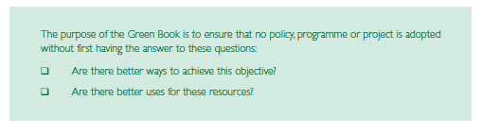
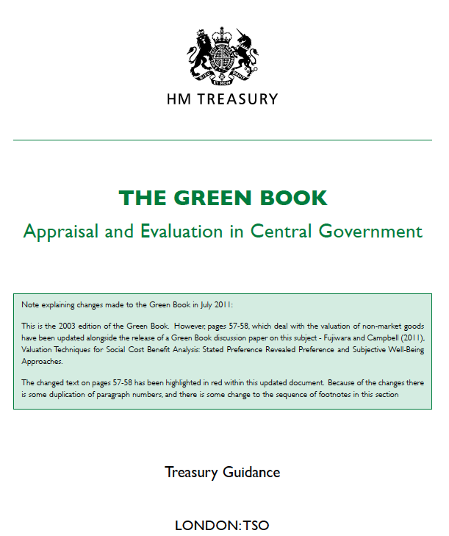
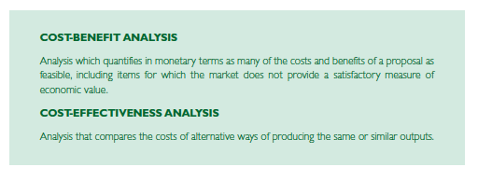
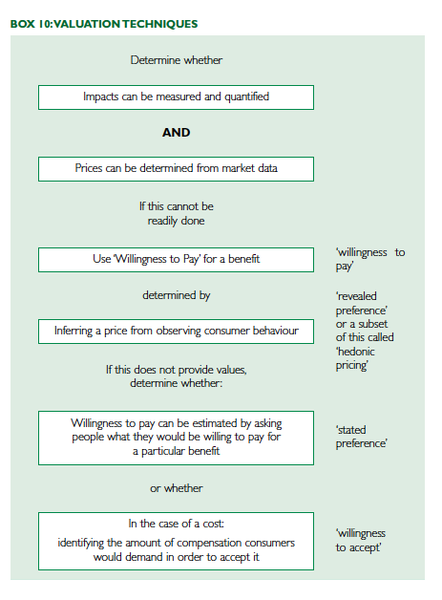
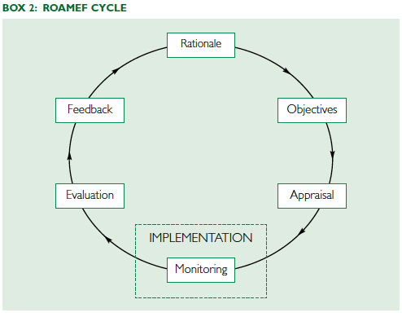
Notes:
Discount rates, NPVs, Social Cost Benefit Analysis

Slide 17
…..But what works for government?
The need for individual stories and case studies…..
….to provide contextual information….
….against the backdrop of the What Works agenda (http://whatworksscotland.ac.uk/)
Differences between the pace of policy and academic life
As well as the nature of academic language and ‘speaking human’

Slide 18
The limits of evidence based policy
‘The problem was not a lack of evidence, but the sheer quantity of data and opinions that was available. And most of it was unsuitable for answering policy questions. Policy-makers want to know what the costs and effects of a policy option will be, and on whom they will fall.
……Civil servants learn from their colleagues that certainty is more useful than accuracy, and action is better than contradiction. This means that – for the team I worked with at least – evidence was far more likely to be used if it fitted with the story that was already being told’
Stevens (2011) http://blogs.lse.ac.uk/impactofsocialsciences/2011/04/20/in-whitehall-academic-research-is-far-more-likely-to-be-used-if-it-fits-with-the-story-already-being-told/

Slide 19
Where next?
‘ministers should ring fence the arts budget. If it is right for overseas aid, it is surely right for the arts at home. This is not just being "nice" to the "luvvies". It would be to recognise and understand that the arts at their widest benefit people, places, ideas, curiosity and wellbeing. Nitpicking around the edges of a tiny budget is not an arts policy. It is bad politics too.’
http://www.theguardian.com/commentisfree/2014/jul/01/wise-arts-policy-arts-council-england-money-organisations

Slide 20
Fujiwara and MacKerron (2015)

Slide 21
Judging success, studying actual effects and helping resource allocation?
‘It is difficult to decide whether Shakespeare’s Hamlet is better than his King Lear and even harder to persuade others of our decision or define what such a ranking would mean. How many Gershwin songs sum up to a Shostakovich symphony? Is a Haydn string quartet better than a Hemmingway short story? How does a Blake poem compare to a modern ballet performance?’
Cowen (2006:6)
Notes:
Ex. here to prove a point. Cowan is discussing economics vs aesthetics
But not just political or aesthetic decisions......the Green Book!

Slide 22
Conclusion
What is wellbeing? Is it a measurement tool? Or is it the function of art?
The need for a theory of cultural policy
And to recognise the history of measurement and theories of policy
WWCW vs Culture?

Slide 23
D.obrien@gold.ac.uk
@drdaveobrien

