Slide 1
On well-being and public policy: Are we capable of questioning the hegemony of happiness?
Annie Austin
University of Manchester
Political Studies Association 2015
31 March 2015

Slide 2
‘Beyond GDP’
(and ‘GDP fetishism’)
Notes:
The political project of incorporating the well-being of citizens into metrics of national well-being and progress is now well established, and has moved up the political agendas of nations across the world, including many of the advanced industrial democracies- the UK Measuring National Wellbeing programme was launched by David Cameron in 2010 - and also in some developing countries – Bhutan’s Gross National Happiness Commission was a forerunner, also multinational initiatives
Acceptance that GDP is not adequate, recognition of social and environmental externalities of GDP…People-centred rather than economic-growth centered. Good thing.

Slide 3
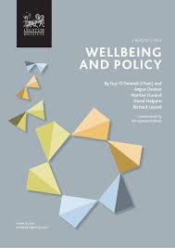
Subjective well-being (SWB)
SWB:
The ‘Strong Position’
Overall, how satisfied are you with your life nowadays?
Overall, how happy did you feel yesterday?
Overall, how anxious did you feel yesterday?
Overall, to what extent do you feel the things you do in your life are worthwhile?
Measures of ‘Personal well-being (SWB)’
UK Measuring National Well-being programme (ONS 2011)
“In a decade’s time we’re going to be using happiness as the sole basis for judging the impact of public policy.”
(Paul Dolan, ITV 23/10/14)
Notes:
Measures of SWB have come to the fore. Asking people about their own lives, instead of using income as a proxy. Must be a good thing. Radical, democratic, non-paternalistic.
However, a more extreme version has emerged – the ‘strong position’
SWB on its own can guide policy – a ‘policy yardstick’. – summarises objective well-being
The aim of the paper is to examine how the idea of well-being is being used in relation to public policy, and particularly to develop a critique what I’m calling ‘the hegemony of happiness’, through a discussion of the fundamental assumptions behind different accounts of well-being, and implications for policy
Note use of term ‘wellbeing’ as shorthand for SWB.
But wb can be defined in different ways, with different implications for policy.

Slide 4
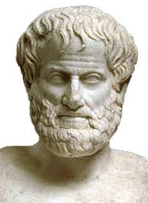
Well-being: What constitutes the good life?
Epicurus: Hedonic - Pleasure and an absence of pain (…Bentham)
Aristotle: Eudaimonic - Social and political activity; ‘flourishing’
Subjective-Instrumental-Monist
Or
Objective-Constitutive-Pluralist
Notes:
The meaning of well-being and how to achieve it has been debated at least since the times of the ancient Greeks; the enquiry into what constitutes a good, flourishing, worthwhile human life was at the heart of the ancient Greek ethical philosophy, and the answers they gave can be roughly grouped into two categories. On one hand, the Epicurean hedonistic philosophy was that a life well-lived is a life characterised by pleasure and an absence of pain: being in a state of subjective pleasure is of ultimate intrinsic value; it is the ultimate goal, the benchmark for evaluation of a life, and all other goods, activities and states of existence are valued in terms of their contribution to subjective pleasure. To achieve well-being, Epicurus advised withdrawal from political and civic life (Rowe 1991; Bergsma 2008).
On the other hand, in contrast to the Epicurean hedonistic account, Aristotelian well-being consists in a life of activity that enables a person to flourish in the concrete spheres of human life, in accordance with the essential nature of humans as social and political animals. According to this view, a worthwhile life is one characterised by striving towards the goal of actualizing one’s innate potential as a human being embedded in a social and political world (Aristotle, Nichomachean Ethics). While Epicurus’ account of well-being was grounded in individuals’ subjective experience of their lives, the Aristotelian account defined well-being as constituted by activity in the concrete domains of life: Aristotle defined well-being not as a mental state, but as a process or activity, and he set up objective standards for the evaluation of well-being, grounded in the universality of the human experience and the essence of what it is to be human.
Another way to think about this is the relationship between the concrete domains of human life and well-being: on the Benthamite view, things like material security, social relationships and good health are instrumentally related to well-being, they lead to it. On the Aristotelian view, they are constitutive of well-being: these things in themselves ARE well-being. So on one hand, good social connections are valued instrumentally, while on the other they are valued intrinsically.
In the rest of the presentation I will go into more depth about how these categories apply to the contemporary debate, and offer a critique of the current hedonic tendencies, and defend an alternative Aristotelian approach.

Slide 5
Subjective-Instrumental-Monist
Classical Utilitarianism
(Bentham 1789)
Utility:
“…that property in any object, whereby it tends to produce benefit, advantage, pleasure, good, or happiness (all this in the present case comes to the same thing).”
(Bentham 1789)
The greatest happiness of the greatest number.
‘GDP Fetishism’ (Stiglitz 2009)
The ‘New Science of Happiness’
(Layard 2005)
‘Back to Bentham?’ (Kahneman et al. 1997)
SWB: “Overall, how satisfied are you with your life nowadays?” (ONS 2011)
“A modern felicific calculus”
A Hegemony of Happiness
Notes:
I’ll begin with the Subj-Instr-Mon category, which has its roots in Epicurean hedonism, whereby the ultimate value is pleasure – a subjective mental state. At the core of classical economics was the concept of utility, defined by Bentham as “that property in any object, whereby it tends to produce benefit, advantage, pleasure, good, or happiness (all this in the present case comes to the same thing)” (Bentham 1982/1789:1).
The prominence of GDP as the measure of well-being favoured among institutions of national and global governance in the 20th and 21st centuries reflects the dominance of the neo-classical paradigm, according to which utility is the guiding value, and is equated with preference satisfaction, achieved through the consumption of goods and services. On this model, an increase in income therefore enables increased consumption, and so increased utility. Applying this principle at the macro-level implies that the aim of national public policy should be the maximisation of economic growth, as measured by GDP, as a means to maximise national utility – the greatest happiness of the greatest number, defined in Bentham’s Epicurean terms as the pleasurable subjective experience of preference satisfaction.
Despite the recognition of the shortcomings of economic measures of well-being, economic growth has been the priority of modern governments. It has been argued that ‘GDP fetishism’ (Stiglitz 2009) is symbolic of the neoliberal agenda that has characterised the political economies of many advanced democracies in recent decades, the core tenet of which is a liberal-individualist approach to economic governance, centered on the shrinking of the welfare state in favour of market-based approaches to public policy. Neoliberalism is presented as a ‘universal science of human behaviour’ (Wade 2005) based on a ‘revolutionary account of the self, knowledge, information, markets, and government’ (Mirowski 2013); neoliberalism, whose roots may be traced directly back to classical utilitarianism, has become a ‘Theory of Everything’ that imbues the thinking of modern policy-makers (Hay 2001; Mirowski 2013). It is this paradigm that has provided the foundation of the idea that society and individuals can consume their way to happiness.
The new science of happiness: shares many of the precepts of classical utilitarianism, including that an individual’s subjective experience of life is a valuable object of study, and that measures can be developed of this. Example of measures – respondents answer on 7 point Likert scale.
Direct lineage from classical utilitarianism

Slide 6
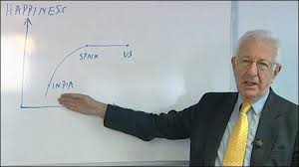
SWB: The strong position and public policy
“Expected gains in SWB could be computed for different policy areas and this information could be used to decide which forms of spending will lead to the largest increases in SWB.”
(ONS 2011)
Notes:
Those are some of the theoretical considerations around subjective well-being; now turning to the modern British context: The new science of happiness has enjoyed significant influence within the British government (Scott 2012, Tomlinson and Kelly 2013). The use of SWB (life satisfaction) as a “yardstick” for planning and evaluating policy has been advocated or implicitly assumed in different reports from a variety of governmental departments and bodies since the early 2000’s. In 2002, a ‘life satisfaction’ seminar was given by Richard Layard at HM Treasury (Scott 2012), and around the same time, a report from the Prime Minister’s Strategy Unit emphasised the usefulness of SWB in terms of its simplicity and comprehensibility for ranking policy options (Donovan and Halpern 2002).
This theme is echoed in a 2011 report from the Office for National Statistics (ONS) (Dolan et al. 2011), which sets out a classic utilitarian strategy:
The strategy advocated here is the valuation of policy areas by their contribution to average SWB: the recommended aim is the greatest happiness of the greatest number, with public funds to be allocated on this basis.

Slide 7
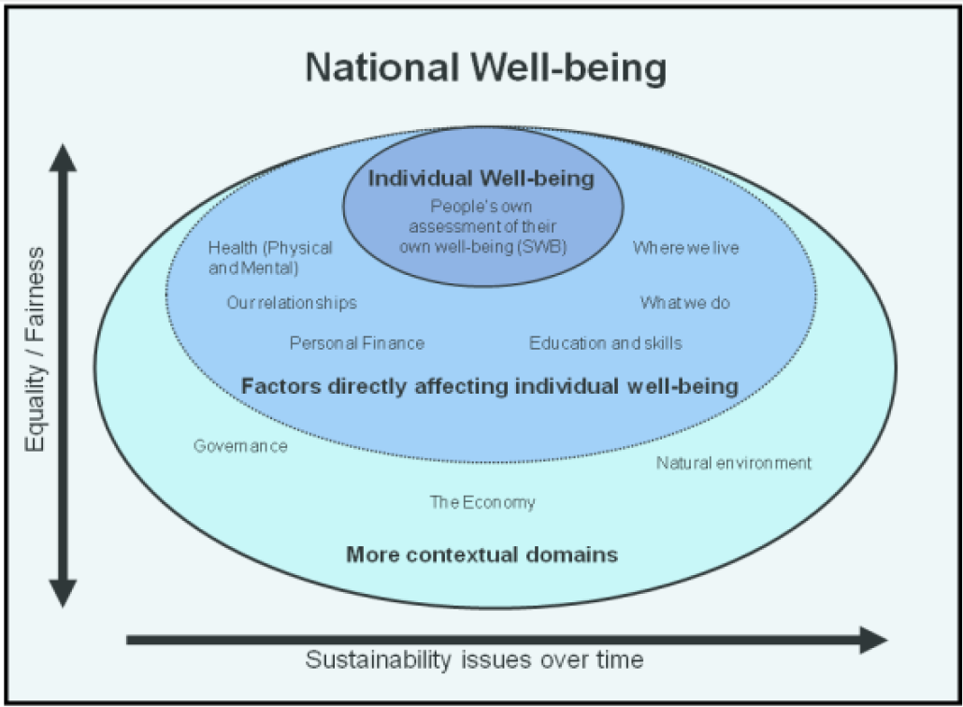
Measuring National Well-being in the UK
Notes:
Evidence here of the instrumental valuation of the things that came out in the consultation as really mattering to people: these simply lead to individual well-being – the psychological state of satisfaction. National well-being as the aggregate (average) of individual psychological states.
Individualistic.

Slide 8
Subjective-Instrumental-Monist: Advantages
Democratic/Anti-paternalistic
“…it grants respect to what people think and feel about their lives. People are not content to have experts evaluate their lives; they believe that their opinions matter.”
(Diener et al. 2009)
Notes:
Subjective well-being - advantages
Democratic/non-paternalistic
As such, it is argued that SWB represents an important advance in the validity of well-being measurement: while income and GDP provide only proxy indicators of individual and national utility, SWB is a direct report.

Slide 9
Subjective-Instrumental-Monist: Objections
Problem of adaptive preferences
“A person who is ill-fed, undernourished, unsheltered, and ill can still be high up in the scale of happiness or desire fulfilment if he or she has learned to have ‘realistic’ desires and to take pleasures in small mercies.” (Sen 1985)
The “Paradox of Happiness in Hardship”
(Veenhoven 2005)
Notes:
Despite these arguments in favour of a hedonic approach to well-being, there are many objections.
Most important one is the problem of adaptive preferences: this is the idea that a person could be deprived, disadvantaged or oppressed, but remain cheerful in the face of their adversity (and mark themselves high up on the SWB scale – Calcutta slum dwellers). Sen quote. Veenhoven – oecd countries, various kinds of crises.
→ focus on individual psychological states risks paying insufficient attention to the structural causes of deprivation and disadvantage; distorted view of social reality, and consequently distorted policy prescriptions.

Slide 10
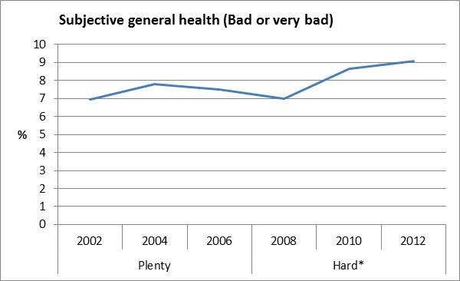
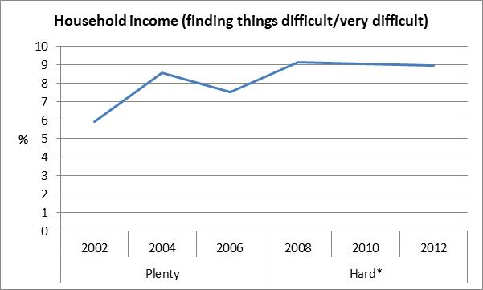
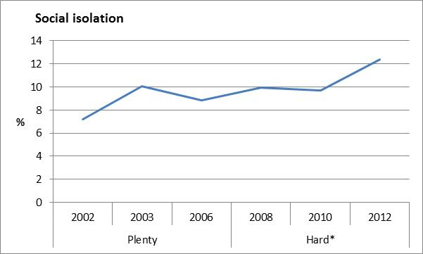
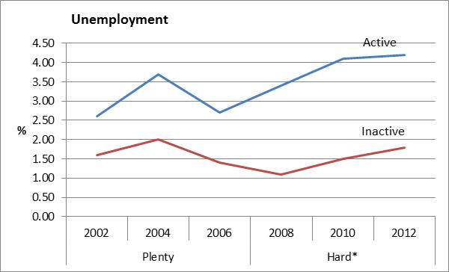
Multi-dimensional well-being during Hard Times
Notes:
European Social Survey, all changes statistically significant across the two time periods

Slide 11
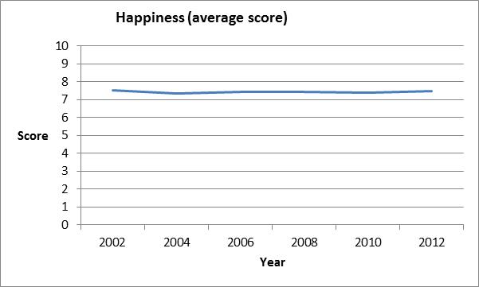
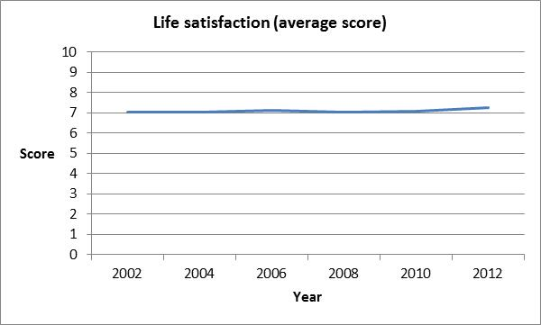
Subjective well-being during Hard Times

Slide 12
Explaining the popularity of SWB
‘Yardstick’ metric
Simple
Intuitive
Quantitative
Classical liberal roots
Neoliberal assumptions
and individualist norms part of
the DNA of modern policy actors
(Hay 2001, Mirowski 2013)
Notes:
The popularity of SWB among policy actors may be explained by the simple, intuitive nature of the metric: average national SWB, like its GDP predecessor, is a quantitative, headline indicator, and both have been interpreted, by some, as a summary measure of overall well-being (i.e. a subjective evaluation of objective well-being), and a “yardstick” for ranking policy options and evaluating policy programmes. The connection between GDP and SWB is not simply that both are quantifiable measures of well-being; in fact, as set out in Section 1, GDP and SWB share common roots in the utilitarian tradition, and both fit neatly with the modern neo-classical paradigm. It is possible that the roots of the SWB approach in the classical liberal paradigm can help to explain the appeal of the SWB-as-yardstick approach: the subjective account of well-being may be seen simply as a continuation of the neo-liberal assumptions that are argued to be part of the DNA of modern policy actors (Hay 2001; Mirowski 2013), and as an expression of entrenched individualist norms. In sum, the common ancestry and mutual compatibility of GDP and SWB may help to explain the popularity of the new science of happiness within the British government.
Where does this leave us?

Slide 13
The alternative account
Aristotelian-objective pluralist account of well-being
E.g. the Capabilities Approach
Well-being as freedom and capability to lead a flourishing life
“…the complex inter-relationship between human striving and its social and material context.”
(Nussbaum 2000)
Notes:
Objective – although many objective definitions on this account do include subjective experience, but just not as a summary of all the rest.

Slide 14
Conclusions
SWB is not a reliable indicator for public policy
SWB does not imply a radical new social model
Continuation of neoliberal assumptions
SWB does not get us very far ‘Beyond GDP’
Dominance of subjective approach risks crowding out alternative accounts
The Capabilities Approach
- a workable alternative (OECD, EHRC)
Notes:
I have argued that a subjective account of wellbeing on its own provides an inadequate basis for policy. It is not a reliable indicator: it is assumed to be a subjective evaluation of objective welfare, and has come to be used as a yardstick summary of all the other domains of well-being. However, the scope fallacy in life satisfaction survey items calls this assumption into question. On top of this, the problem of adaptive preferences means that reliance on SWB as a summary indicator risks creating an inaccurate view of social reality and distorted policy prescriptions. A focus on individual psychological states risks paying insufficient attention to the structural causes of deprivation and disadvantage. Finally, the unquestioned status of SWB within the British government has crowded out alternative approaches which would provide a sounder basis for public policy: the CA represents an alternative, and has been shown to be workable by the EHRC.
National

Slide 15
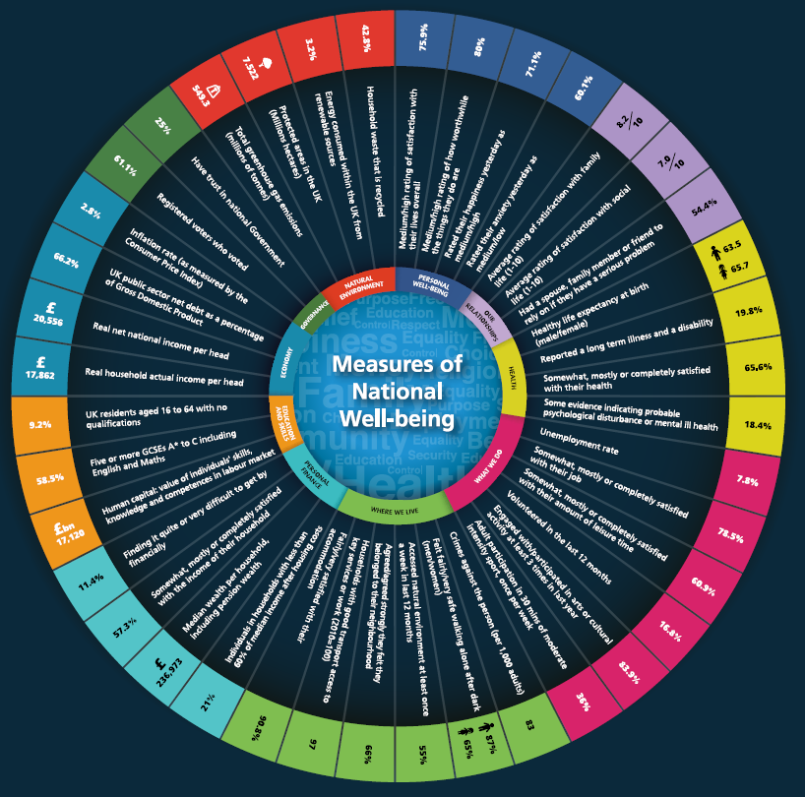
UK Measuring National Well-being
Notes:
National well-being framework is a multidimensional framework based on extensive consultation exercise that includes both individual and contextual factors – provides good basis for a capabilities approach – just add freedom and agency, and resist temptation to use SWB as summary of it all.

Slide 16
Thank you On well-being and public policy: are we capable of questioning the hegemony of happiness?
annie.austin@postgrad.manchester.ac.uk
Notes:
A nice summary of why a pleasurable mental state is not the best yardstick for well-being, and certainly not an appropriate goal for the political process…

Slide 17
Defining and measuring national well-being
 |  | Definition
 |  | Subjective | Objective
Measurement | Subjective | Extreme Epicurean | Strong Position (SWB as yardstick)
 | Objective | Observation, peer reports, bio-metrics | Resource-based (e.g. Rawls)
Objective
Stiglitz Commission
Capabilities Approach

