Slide 1
Well-being and Social Justice: Equality of What?
Annie Austin
University of Manchester
ESRC Seminar: The Politics of Well-being
Seminar 5
Newcastle, 17 April 2015
Notes:
Aim of presentation: to (1) argue that w-b is the right currency of social justice, and capability is the right metric of well-being and (2) to illustrate argument with some research findings about the effects of economic crisis on well-being in the UK

Slide 2
Equality of What?
What should egalitarians focus on?
Social Justice: What should be measured?
Resources (income/primary goods)? (e.g. Rawls 1972)
Differential needs?
Inequalities of power?
Opportunity? (e.g. Roemer 1998)
Background injustices?
→ Well-being (e.g. Arneson 1989)
Capability ✓(Sen 1999, Nussbaum 2000)
Contextual (structural/institutional/objective/external)
Individual/hh (+agentic/subjective/internal)
Notes:
Many people are egalitarians, and believe that a good society does not have high levels of unfair inequality. The question ‘Equality of what?’ has been fiercely debated in political philosophy, as well as in real world politics. What should egalitarians focus on, and what should be measured in order to evaluate social justice?
Several possible answers.
The right answer is well-being. But how to define it?

Slide 3
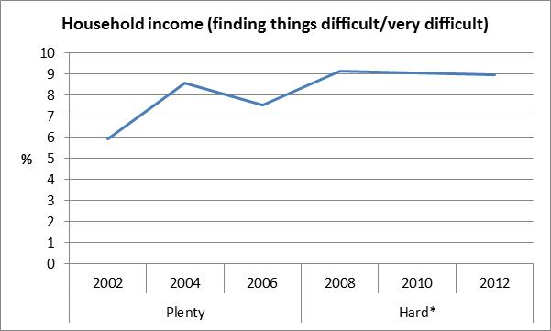
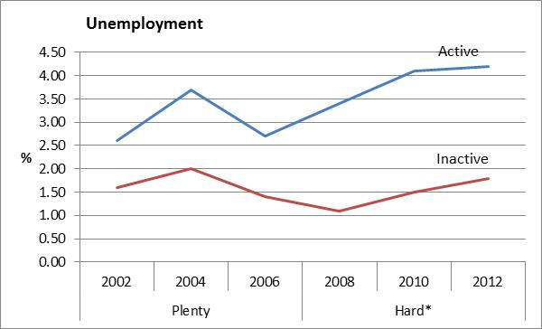
Economic crisis and well-being in the UK
External/contextual constraint on freedom to flourish
Constraint on resources and opportunities
Source: European Social Survey, Rounds 1-6

Slide 4
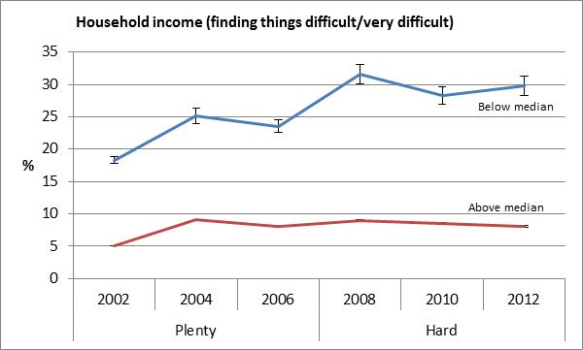
Economic crisis and well-being in the UK
External/contextual constraint on freedom to flourish
Constraint on resources and opportunities
Vertical inequality in effects
Source: European Social Survey, Rounds 1-6

Slide 5
Economic crisis and well-being in the UK
Internal/agentic constraint on freedom to flourish
Constraint on autonomy of agency
Personal value priorities: What people consider most important in life (Allport 1960)
Personal value orientations: conceptions of the good life → aspirations, goals, plans
Value-orientations and flourishing:
‘Higher’ and ‘lower’ needs/goals
(Sen 1985, Maslow 1955, Inglehart 1977, Doyal and Gough 1991)
Basic material security → freedom to pursue higher goals
Focus on lower ‘Security’ needs crowds out higher goals
≠ flourishing
= constrained autonomy of agency

Slide 6
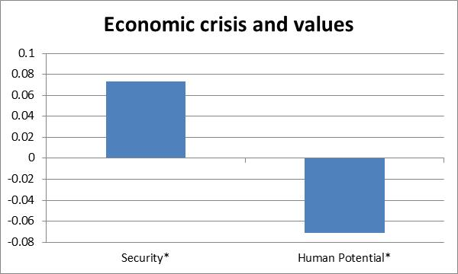
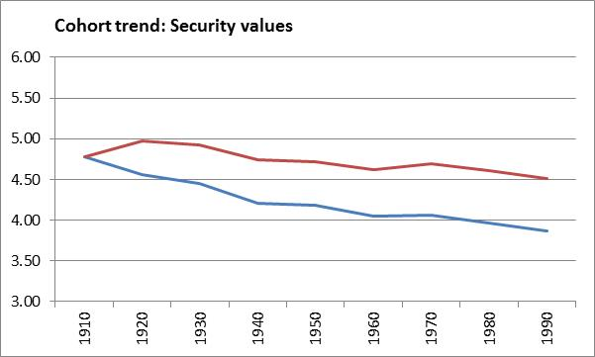
Economic crisis and well-being in the UK
Internal/agentic constraint on flourishing
Constraint on autonomy of agency
Social justice?
Below median income
Young people
Notes:
Adaptation: downgrading of goals and aspirations, effects concentrated among these groups.

Slide 7
Conclusions (1)
Economic crisis had a dual effect on well-being
Constraint on:
(1) external opportunities and
(2) internal horizons of aspiration
Vertical and horizontal inequalities
Compounded existing inequalities
Important effects on formative generation
…implications for wider social change

Slide 8
Conclusions (2)
Well-being is the right metric of social justice
Capability is the right metric of well-being
To evaluate social (in)justice (vertical and horizontal), a multi-dimensonal account of well-being, that recognises both contextual and individual constraints on flourishing, is required.

Slide 9
Thank you
Austin (2014) Practical Reason in Hard Times: The Effects of Economic Crisis on the Kinds of Lives People in the UK have Reason to Value (CMIST Working Paper)
annie.austin@postgrad.manchester.ac.uk

