Slide 1
Politics and the Inevitability of Well-Being
Alasdair Cochrane, University of Sheffield

Slide 2
Aims:
To offer a brief overview of well-being in political theory:
  its meaning
  contemporary competing understandings of the term
  its place in the history of political thought
To make a modest argument:
  well-being is not a new political agenda, but is an ineradicable feature of politics itself

Slide 3
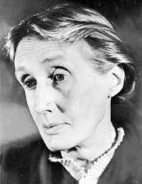
Definitions
Well-being is the notion of how well someone’s life is going for an individual
Is a ‘prudential’ value (rather than an aesthetic, perfectionist or ethical value)
Prudential not same as subjectivist

Slide 4

Taxonomy 1: Hedonism
Classic ‘mental state theory’ - understands well-being to be pleasure over pain
Intuitively plausible
‘Experience machine’ objection
Autonomy and authenticity seem crucial

Slide 5
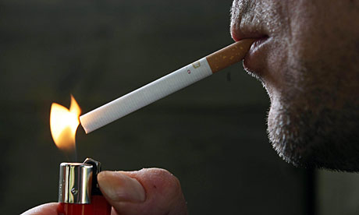
Taxonomy 2: Desire Based Theories
Retain focus on subjective assessment, but shifts from feelings to desires
Because of ‘bad desires’ – a shift to ‘informed desire’ accounts
But if only ‘good’ desires relevant, isn’t it the assessment of what’s ‘good’ doing the work?

Slide 6
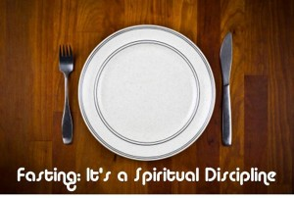
Taxonomy 3: Objective List Theories
There are some goods which make life go well, irrespective of individual feelings and desires
Needs, functionings or capabilities
But who says what’s on list?
And too removed from subjective assessment?

Slide 7
Well-Being & History of Political Thought 1
Bentham: “Nature has placed mankind under the governance of two sovereign masters, pain, and pleasure. It is for them alone to point out what we ought to do, as well as to determine what we shall do.” (An Introduction to the Principles of Morals and Legislation)
Aristotle: To determine eudaimon, need to determine ergon of human species. Humans are uniquely rational beings capable of virtue. Eudaimonia is the cultivation of the virtuous life – of human’s higher moral and rational capacities. That can only be achieved within the polis.

Slide 8
Well-Being & History of Political Thought 2
Hobbes: “I obtained two absolutely certain postulates of human nature, one, the postulate of human greed by which each man insists upon his own private use of common property; the other, the postulate of natural reason, by which each man strives to avoid violent death." (De Cive)
Marx: “For labour, life activity, productive life itself, appears to man in the first place merely as a means of satisfying a need – the need to maintain physical existence. Yet the productive life is the life of the species. It is life-engendering life. The whole character of a species, its species-character, is contained in the character of its life activity; and free, conscious activity is man’s species-character.” (Economic and Philosophical Manuscripts)

Slide 9
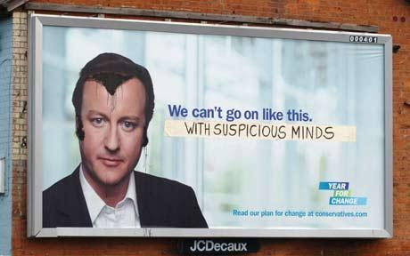
Well-Being in Politics 1: Two Waves
Two Waves (Bache and Reardon, 2013)
  The first emerged in context of post-war prosperity and rise of postmaterialist values in USA and Europe.
  The second (which has had more resonance in UK politics) in 2000s was inspired by environmentalist (and other) critiques of GDP and improved science in measuring well-being.

Slide 10
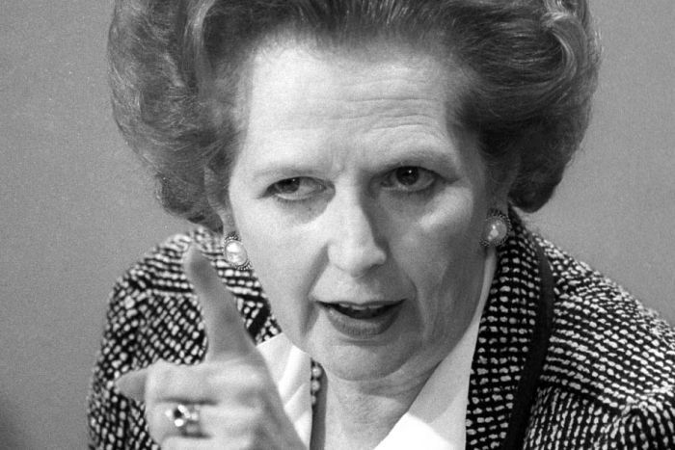
Well-Being in Politics 2: Neoliberalism
BUT even politics focused squarely on market performance and economic growth is underpinned by an account of well-being.
Adam Smith: "It is not from the benevolence of the butcher, the brewer, or the baker that we expect our dinner, but from their regard to their own interest." (The Wealth of Nations)

Slide 11
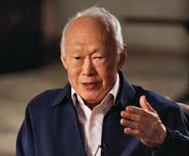
Well-Being in Politics 3: Authoritarianism
AND even political systems that are premised on the maintenance of order at the expense of individual freedom are concerned with well-being.
Lee Kuan Yew: “The task of the leaders must be to provide or create for them a strong framework within which they can learn, work hard, be productive and be rewarded accordingly. And this is not easy to achieve.” (The Singapore Story: Memoirs of Lee Kuan Yew)

Slide 12
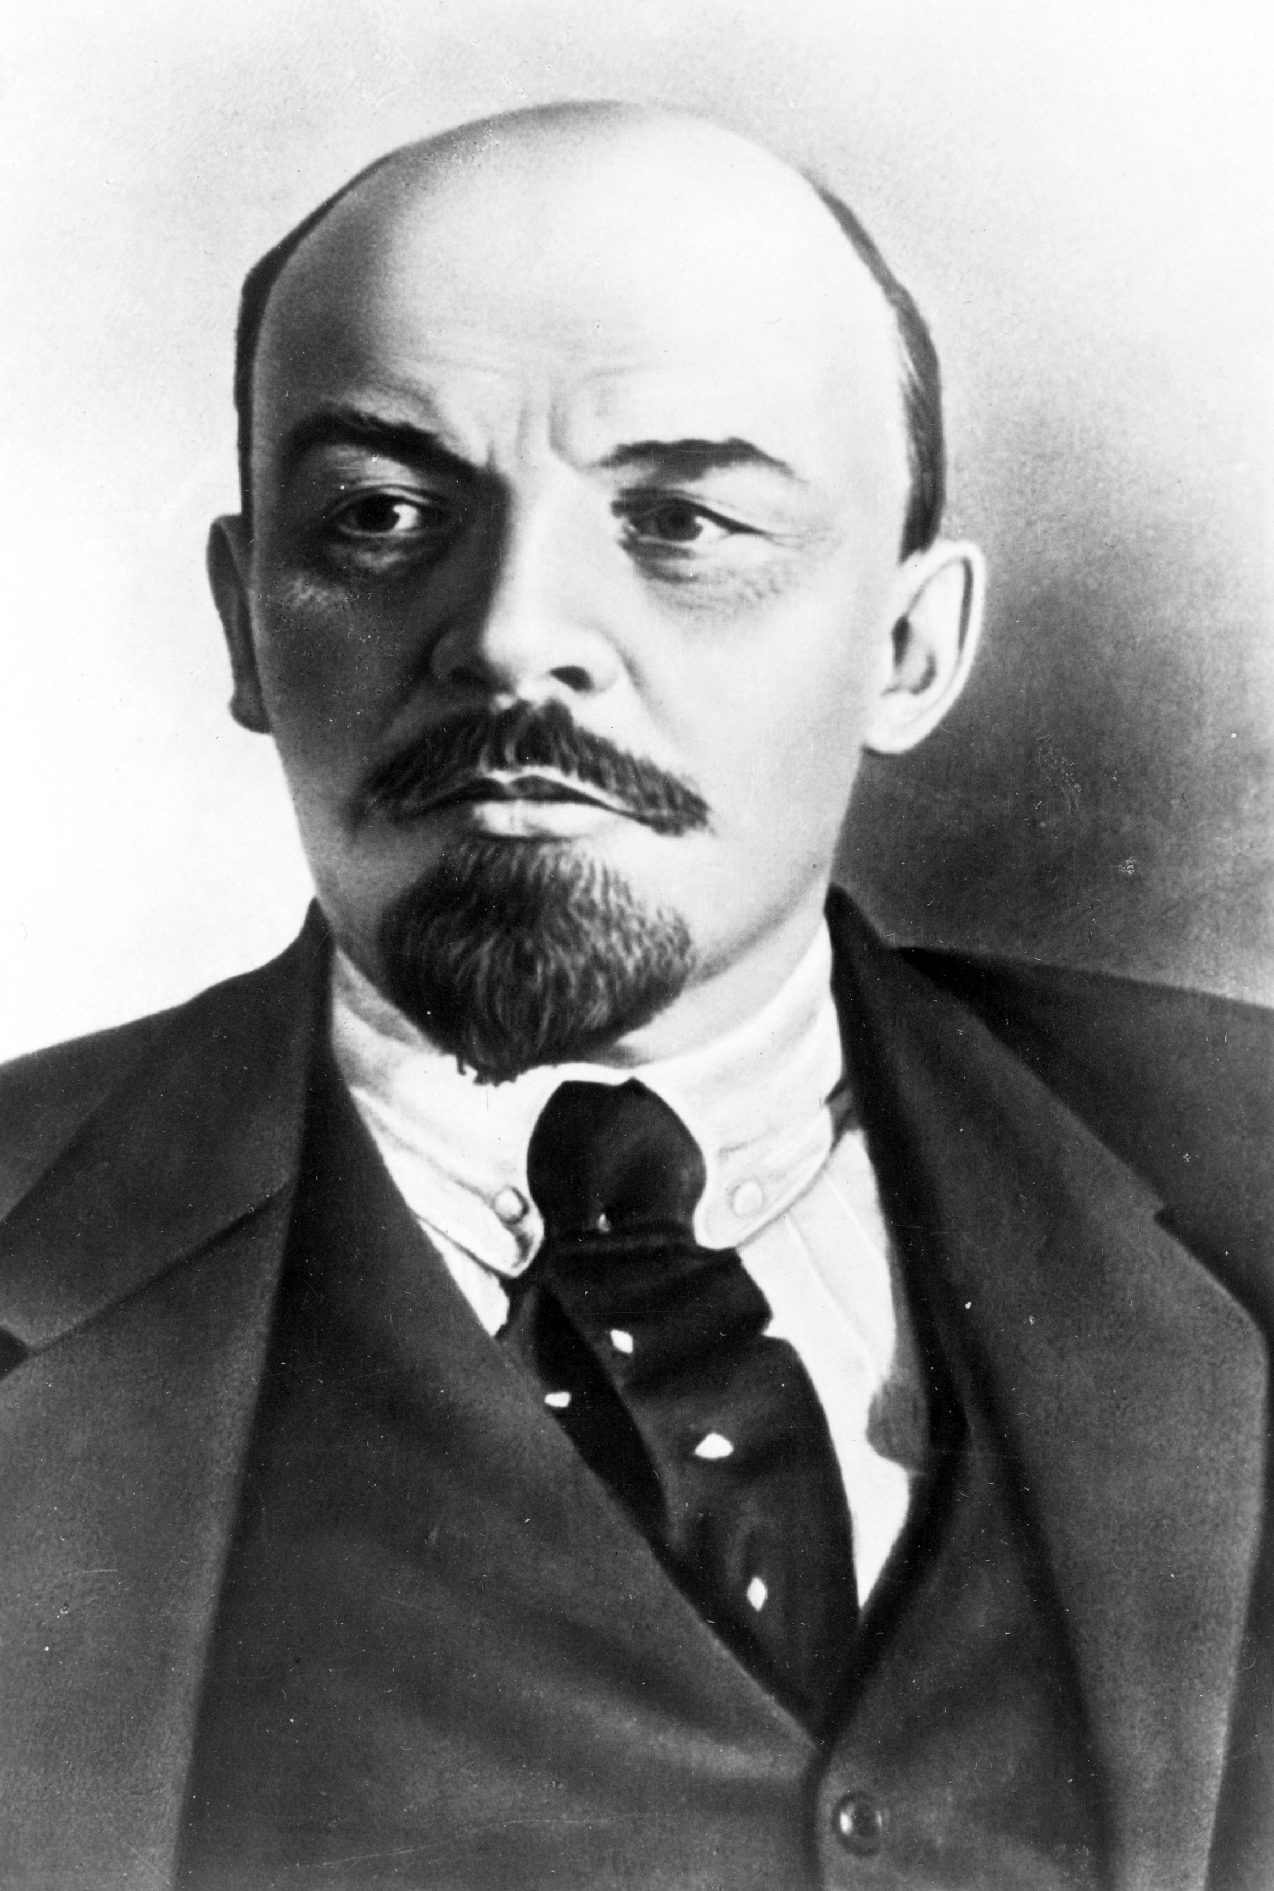
Well-Being and Politics 4: Communist
AND even political systems and ideologies that want to see an ‘end’ to politics do so ultimately because of a concern about human well-being.
Lenin: “So long as the state exists there is no freedom. When there is freedom, there will be no state.” (The State and Revolution)

