Slide 1
Sustainable development: degrowth, austerity and well-being
John O’Neill
ESRC Series on The Politics of Wellbeing
University of Sheffield
Friday January 30th, 2015.

Slide 2
Structure
Two inconvenient truths: physical and political feasibility in conflict
The conditions for degrowth – the maintenance and improvement in well-being
Another inconvenient truth
The conditions for degrowth – economic conditions

Slide 3
Anderson and Bows inconvenient truth
Unless economic growth can be reconciled with unprecedented rates of decarbonization (in excess of 6% per year), it is difficult to envisage anything other than a planned economic recession being compatible with stabilization at or below 650 ppmv CO2e. [required to make it likely to stay under 4 degree centigrade warming]
Phil. Trans. R. Soc. A 2008 366, 3863-3882

Slide 4
Physical feasibility
Acknowledging the immediacy and rate of emission reductions necessary to meet international commitments on 2 °C illustrates the scale of the discontinuity between the science (physical and social) underpinning climate change and the economic hegemony. Put bluntly, climate change commitments are incompatible with short- to medium-term economic growth (in other words, for 10 to 20 years). Moreover, work on adapting to climate change suggests that economic growth cannot be reconciled with the breadth and rate of impacts as the temperature rises towards 4 °C and beyond... Away from the microphone and despite claims of 'green growth', few if any scientists working on climate change would disagree with the broad thrust of this candid conclusion….
Anderson and Bows www.nature.com/natureclimatechange 2012

Slide 5
Better Growth, Better Climate
http://newclimateeconomy.report/
http://newclimateeconomy.net/content/press-release-economic-growth-and-action-climate-change-can-now-be-achieved-together-finds

Slide 6
Political feasibility
Austerity and the problems of degrowth
Syriza a plans for a new coal lignite plant
‘Konstantatos said that ‘degrowth’ ideas would be viewed as “absurd” in the austerity-wracked Greece of today. Leading party thinkers see the ‘keep fossil fuels in the ground’ idea as equally inappropriate... “If we face fiscal difficulties from abroad in the medium term, then to burn more lignite instead of importing energy will seem a wise thing to do,” a Syriza source said. “If we don’t have money to import petrol then we will burn lignite which is free – not of a carbon footprint – but relatively cheaper. One way or another Greek lignite will be exploited.”’
Athens.http://www.theguardian.com/environment/2015/jan/26/greece-syriza-juggles-coal-pipelines-and-climate-ambitions

Slide 7
Conditions for reasonable degrowth
Consent: difference voluntary and involuntary austerity
Well-being: degrowth and maintenance or improvement of well-being
Economic and political conditions

Slide 8
I. Well-being and limits
Classical question: Are there bounds to the goods required for a happy or flourishing life?
The classical answer in Aristotelian and Epicurean traditions: bounds do exist to the goods required for a happy life.
That answer survives into some central texts of modern economics.
Ramsey’s influential paper on saving assumes that there is a ‘maximum obtainable rate of enjoyment or utility’ which he terms ‘Bliss ’ (Ramsey, 1928, p.545).
The point of saving is for a community to have that level of goods at which they reach or approximate to Bliss.

Slide 9
Economic textbook answer
The standard economic textbook denies that there are bounds to the goods required for well-being understood as preference satisfcation: ‘more is better’.
‘Appropriation has no natural upper bound. Economic man seeks more.’ (Gauthier 1986, p. 318).

Slide 10
II. Epicurus
‘Natural wealth is both limited and easy to acquire. But wealth [as defined by] groundless opinions extends without limits’
(Epicurus Principal Doctrines 15, Inwood and Gerson 1988)
Hedonic account of well-being: well-being consists in pleasure and absence of pain.
Subjective well-being: being in the right mental state – feeling good, feeling happy.

Slide 11
Back to Epicurus
Findings in hedonic research on subjective well-being to suggest that a de-coupling of consumption and the improvement of well-being is possible. (Kahneman, Frey, Layard)

Slide 12
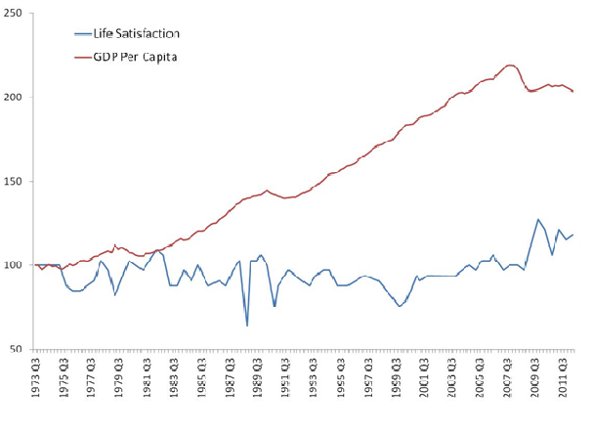
Life satisfaction and GDP in the UK
Notes:
ww.behaviouralinsights.co.uk/blogpost/measuring-national-wellbeing

Slide 13
Hedonic research and return to Epicurus
Income and happiness
  Relative income
  Absolute growth in income
Hedonic treadmill
  Hedonic adaptation
  Positional goods (Hirsch Social Limits to Growth)
Determinants of happiness:
  familial and personal relationships; secure and intrinsically worthwhile work; health; personal and political freedoms; the quality of wider social relationships.

Slide 14
Subjective welfare – back to Epicurus?
Return to an Epicurean theme about the limits of the goods needed for happiness once the determinants of well-being are properly understood:
‘The stomach is not insatiable as the many say, but rather the opinion that the stomach requires an unlimited amount of filling is false’ (Epicurus Vatican Sayings)

Slide 15
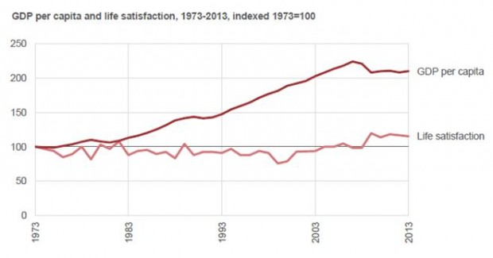
GDP and life satisfaction
Notes:
https://coanalysis.blog.gov.uk/2014/08/06/wellbeing-measuring-what-matters/

Slide 16
Austerity and life satisfaction
The recession has led to a higher proportion who are unemployed, with a particular impact on the young, and in 2009/10 more than 1 in 8 (12.3%) of us were finding it quite or very difficult to manage financially. Life satisfaction presents a more resilient picture, having remained broadly stable throughout the last decade. (ONS, 2012)

Slide 17
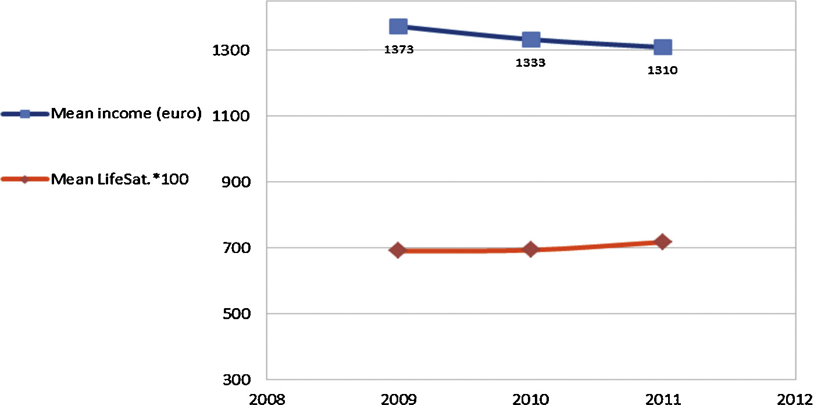
Relation of income and reported life satisfaction, Barcelona, 2009-2011
Notes:
Filka Sekulova, F., van den, J.C.J.M., Climate change, income and happiness: An empirical study for Barcelona. Global Environ. Change (2013), http://dx.doi.org/10.1016/j.gloenvcha.2013.07.025

Slide 18
III. Against subjective well-being
Is life-satisfaction is the best measure of well-being (justice)?
Adaptive preferences: One response to deprivation is cut one’s aspirations : ‘A thoroughly deprived person, leading a very reduced life, might not appear to badly off in terms of the mental metric of desire and its fulfilment, if the hardship is accepted with non-grumbling resignation’. (A. Sen Inequality Reexamined p.55).
Dissatisfaction may not indicate a life going badly. May indicate that what is wrong in life is better understood.

Slide 19
Subjective well-being and austerity.
Evidence that the lack of relationship between reported life satisfaction and austerity is a matter of adaptive preferences: shift in values and aspirations.
‘Economic times … enter into people’s practical reasoning about what constitutes a good life: during hard times there was widespread re-specification of ends in accordance with deficiency goals such as security, stability and certainty, with effects concentrated among those living in low-income households, and the formative generation. This adaptation represents a move away from self-actualization goals, and a diminishment of internal capability... ‘
A. Austin ‘Practical reason in hard times: the effects of economic crisis on the kinds of lives people in the UK have reason to value’

Slide 20
IV. Limits and well-being - back to Aristotle?
‘[T]he amount of household property which suffices for a good life is not unlimited, nor of the nature described by Solon in the verse “There is no bound to wealth stand fixed for men”. There is a bound fixed…’ (Aristotle, 1948, book 1, ch.8)
Eudaimonia – living a good life constituted by certain objective states

Slide 21
Objective state accounts of well-being
Objective state account: To live well is to have or realise particular objective states – particular forms of social relations, physical health, autonomy, knowledge of the world, aesthetic experience, accomplishment and achievement, pleasures, a well-constituted relation with the non-human world etc.
Needs based theories
Capabilities and functionings (Nussbaum and Sen)

Slide 22
Convergence of modern Epicureans and Aristotelians
GDP is not necessarily correlated in improvements in capacities to function
List of goods central to well-being: the quality of familial relationships; the quality of wider social relationships in a community; the security and intrinsic worth of work; health; personal and political freedoms; political participation.
Determinants or constituents?

Slide 23
Degrowth, austerity and climate change
Traditional measures of well-being and equality matter: health, life expectancy, housing + social relationships, good work etc.
Achievement and maintenance of social minima: needs or minimum combinations of functionings.
Social maxima – why we can’t afford the rich (Sayer).
Subsistence vs luxury emissions (Shue)

Slide 24
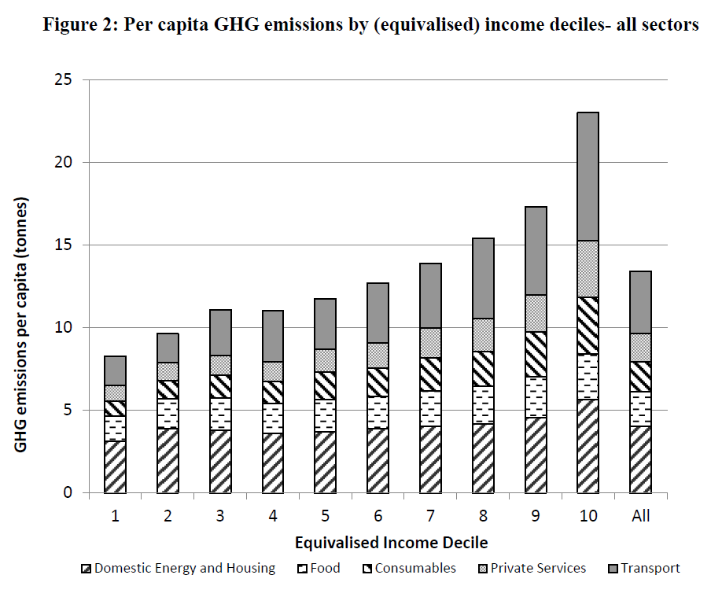
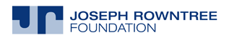


I. Differential Responsibilities by income
From I. Gough et al. 2011 The distribution of total greenhouse gas emissions by households in the UK, and some implications for social policy

Slide 25
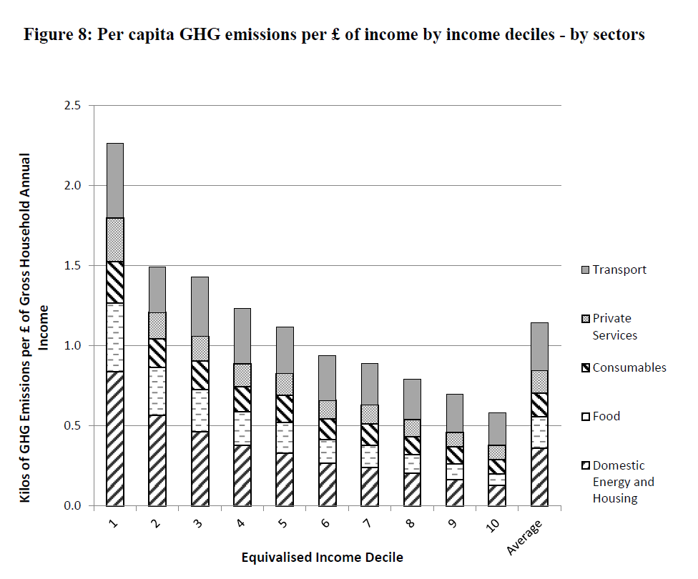
GHG per pound
From I. Gough et al. 2011 The distribution of total greenhouse gas emissions by households in the UK, and some implications for social policy CASE LSE

Slide 26
Policy implications
Emissions in private transport, in particular air, and personal services (hotels, meals out etc) are significantly correlated with income.
Emissions per pound are higher in lower incomes.
Mitigation policies that simply raise the costs of emissions will fall disproportionately on those with lower incomes despite the fact that they are least responsible for emissions.

Slide 27
Naomi Klein’s inconvenient truth
James Delingpole has pointed out, “Modern environmentalism successfully advances many of the causes dear to the left: redistribution of wealth, higher taxes, greater government intervention, regulation.” Heartland’s Bast puts it even more bluntly: For the left, “Climate change is the perfect thing…. It’s the reason why we should do everything [the left] wanted to do anyway.” Here’s my inconvenient truth: they aren’t wrong. Before I go any further, let me be absolutely clear: as 97 percent of the world’s climate scientists attest, the Heartlanders are completely wrong about the science…But when it comes to the real-world consequences of those scientific findings, specifically the kind of deep changes required not just to our energy consumption but to the underlying logic of our economic system, they may be in considerably less denial than a lot of professional environmentalists, the ones who paint a picture of global warming Armageddon, then assure us that we can avert catastrophe by buying “green” products and creating clever markets in pollution.

Slide 28
V. The sources of consumption without limits: Epicurus or Aristotle?
Epicurus: the source is cognitive
Aristotle: the source is institutional
Classical household vs. market
Economic vs. chrematistic acquisition
'There is no limit to the end it seeks; and the end it seeks is wealth of the sort we have mentioned [i.e., wealth in the form of currency] and the mere acquisition of money'. ( Aristotle Politics, book 1, ch.8)

Slide 29
From Aristotle to Marx
Marx is an Aristotelian. Aristotle’s analysis reappears in the distinction between the circuits
C-C
C-M-C
M-C-ΔM
Marx reiterates Aristotle:
The simple circulation of commodities - selling in order to buy - is a means of carrying out a purpose unconnected with circulation, namely, the appropriation of use-values, the satisfaction of wants. The circulation of money as capital is, on the contrary, an end in itself, for the expansion of value takes place only within this constantly renewed movement. The circulation of capital has therefore no limits. (Marx Capital I, ch.4)
Long footnote on Politics.

Slide 30
Well-being, consumption and economy
Limits of shifts in values – ethicist fallacy and the confusion of appraisal and explanation
Limits of moral and political declarations
Economic and institutional determinants of action
The structural determinants of consumption: increasing consumption is a condition for the stability and reproduction of the economic system itself – falls in ‘consumer confidence’ are indications of an economy in crisis.
Ambiguity in the concept of consumption (Williams):
  the process of using up material and energy in human life processes
  Market model - the activities that a person engages in as a ‘consumer’ understood as a purchaser of goods and services in a market

Slide 31
Marx in praise of capitalism
Grundrisse – capitalism has also developed human capacities and needs.
Central to that development of individualism
Social individuality
How should degrowth talk to a post-capitalist society in which life is better within limits?

