Slide 1


Slide 2


Slide 3


Slide 4
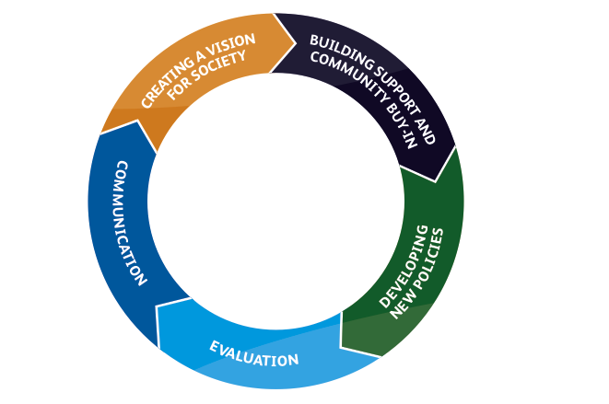
Shifting the dial: wellbeing in policy

Slide 5
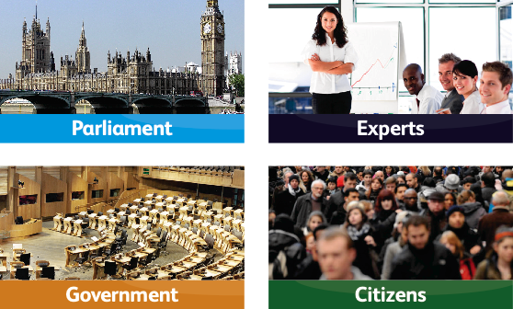
Challenge 1: Who ‘owns’ wellbeing

Slide 6
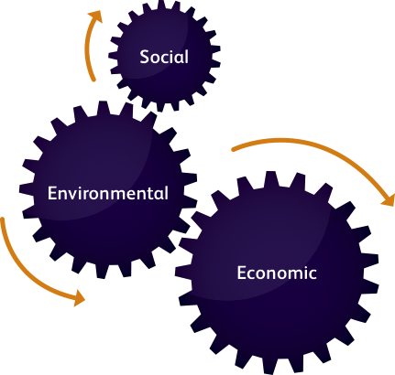
Challenge 2:
All domains of wellbeing are equal... but some are more equal than others

Slide 7

Challenge 3: Hitting the target but missing the point?
– Problems with proxies
– Anguish with attribution
– Stymied by silos

Slide 8
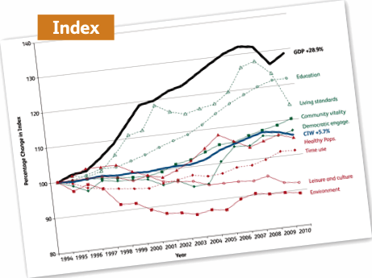

Challenge 5: How do you raise awareness about social progress?

Slide 9
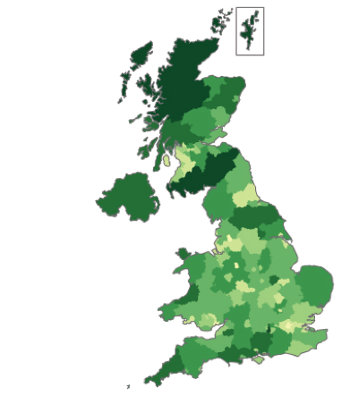
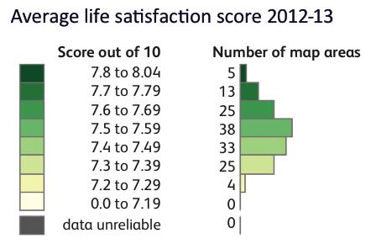
UK well-being estimates
Life satisfaction – average scores

Slide 10

Challenge 6: Finding an anchor
Government Ministers
Cross-party Groups
(not just the usual) stakeholders
Legislation!!!

Slide 11


