Slide 1
The Political Uses of Expert Knowledge:
Research and Policy on Well-Being
ESRC Seminar Series 'The Politics of Well-being'
Newcastle, 23 June 2014
Christina Boswell
University of Edinburgh

Slide 2
How and why research on well-being is taken up in policy-making
Streams approach (Bache and Reardon 2013)
Policies and politics not matched to problems
Take-up of ideas remains abstract/symbolic
Supplement through theory of political action: what motivates governments to take up new ideas?

Slide 3
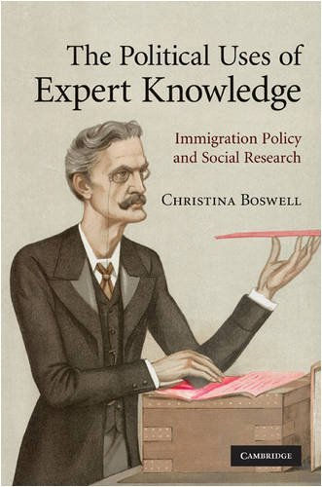
Political Functions of Research
Puzzle:
Huge interest in research, but
limited take-up in policymaking
Answer:
Not just problem-solving, but
also:
substantiating function
legitimizing function

Slide 4
Substantiating Function
Use of knowledge to support preferences/claims
When?
Contested issues
Technocratic mode of settlement
Areas of risk and complex steering

Slide 5
Legitimising Function
Signal competence of organisation to take sound decisions
When?
Inter-organisational rivalry
Legitimacy through formal structures/rhetoric, not output (Scott and Meyer 1991; Brunsson 2001)

Slide 6
Instrumental Function
Research to adjust output
When?
Organisation legitimised through outputs
Recognised knowledge gaps
Research is most appropriate knowledge source

Slide 7
Indicators
Instrumental Knowledge | Legitimising Knowledge | Substantiating Knowledge
1. Intensive exchange between senior decision-makers and research unit | 1. Looser ties between decision-makers and research unit | 1. Some exchange between decision-makers and research unit
2. Substance of research reflects performance targets | 2. Looser fit between substance of research and performance targets | 2. Substance of research reflects lines of contention
3. No obvious interest in publicising knowledge utilization | 3. Clear interest in publicizing knowledge utilization | 3. Selected interest in publicizing utilization

Slide 8
The well-being debate (1)
When are well-being ideas likely to be used to adjust policy? (Instrumental use)
Department/ministry relies on output legitimacy
Perceived need to adjust output
WB seen as relevant in informing adjustments
But: how to measure output? Essentially contested criteria
Indicators need to become more widely accepted first --> 'enlightenment' function? (Weiss)

Slide 9
The well-being debate (2)
When are ideas likely to be used symbolically?
Substantiating use?
Contested issues
Ideas/research on WB is authoritative in adjudicating between rival claims
Not there yet…
Legitimising use?
Organisations staking claim to competence
Govts bolstering credibility by adopting modish ideas
Very much in evidence…

Slide 10
The legitimising function of knowledge: international level
IOs strongly tend towards symbolic knowledge use
- Struggle for legitimacy
- Reliance on talk rather than action
- Technocratic style of justification (Commission, OECD, WB)
Institutional isomorphism as mechanism for diffusion of ideas
Certain ideas become fad
Bestow legitimacy on organizations/politicians
National level politicians adopt at little cost

