Slide 1
Dr Layla Skinns
Reader, School of Law, University of Sheffield
and
Charlie Barnes
Creative Director, Dead Earnest theatre

Slide 2
I am human

Slide 3
Art and science are two different streams which rise from the same creative source and flow into the same ocean of the common culture, but the currents of these two streams flow in different beds. Science teaches, art asserts; science persuades, art acts; science explores apprehends, informs and proves (Gabo, 1957: 164)

Slide 4
Art and criminal justice
Art used to effect change in prisoners, ex-offenders and those at risk of involvement in crime.
Include visual, design, performing, media, musical and literary arts;
Desistance is largely indirect or “secondary” (Cheliotis and Jordanoska, 2018).
Prison art also noted for its potential “political viability” to challenge the “carceral obsession” (Chamberlen, 2021).
But reasons for caution.

Slide 5
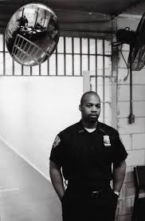
Little known about art and CJ practitioners, except:
Edmund Clark’s In Place of Hate
Safegrounds’ Officers’ Mess
Sharon Daniel’s Inside the Distance
Fergus McNeill’s Distant Voices
Artists as practitioners and practitioners as artists (e.g. Jamel Shabazz)
But none that relate to police stakeholders

Slide 6
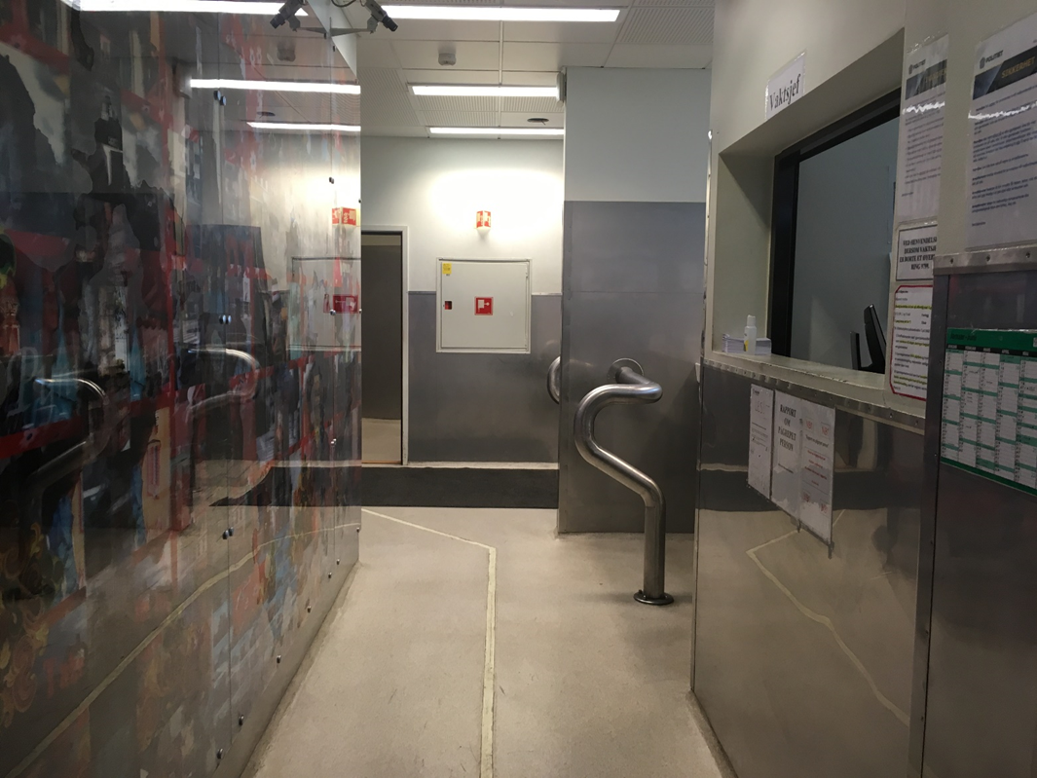
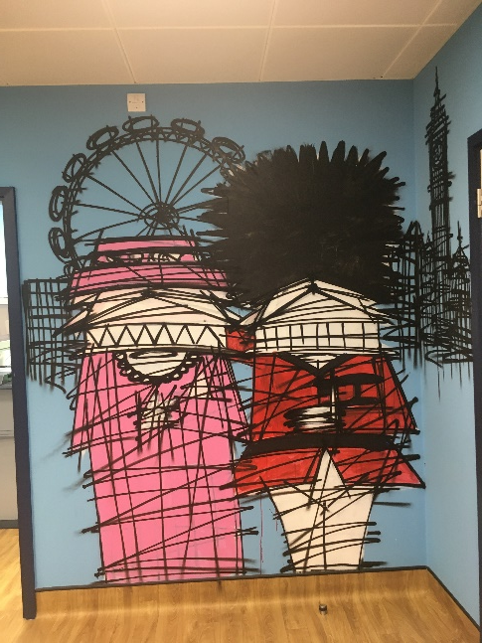
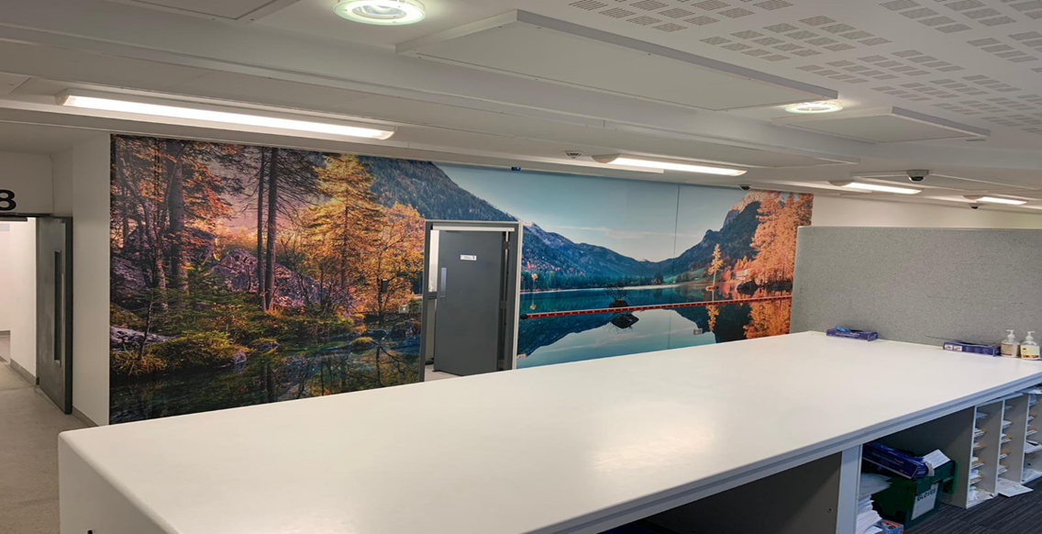
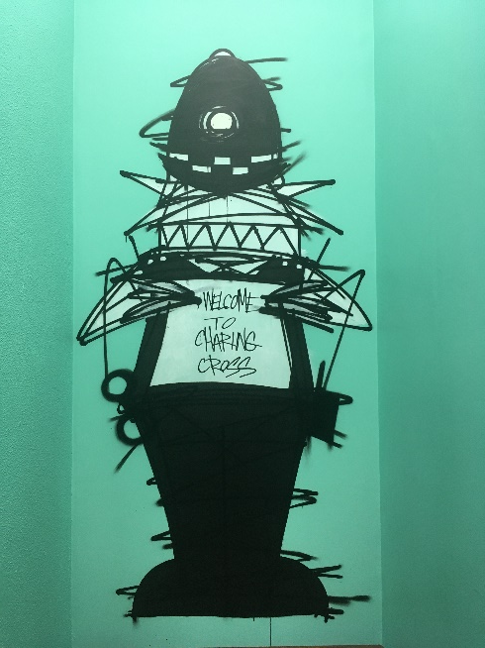
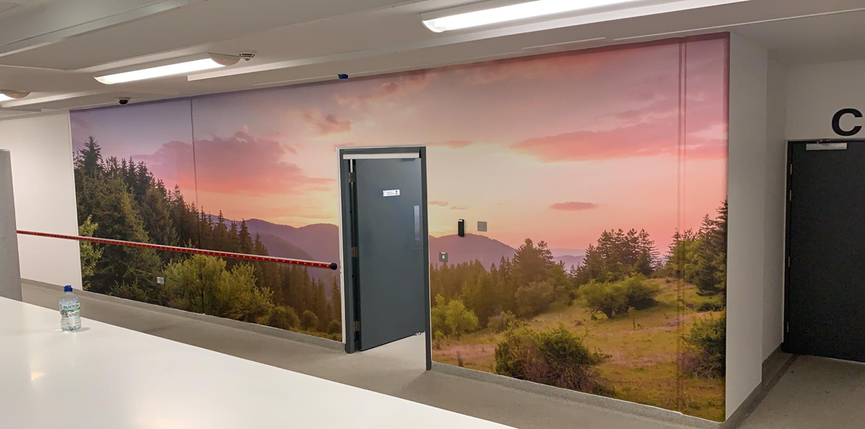
Overview
The process by which research findings from the GPCS were translated into ‘I am Human’
Effecting change through ‘I am Human’ on:
Independent Custody Visitor (ICV) scheme coordinators;
Custody staff.
Implications for the art of criminal justice
NB. I will not consider the impact of art in police custody settings on staff and detainee experiences e.g. of dignity

Slide 7
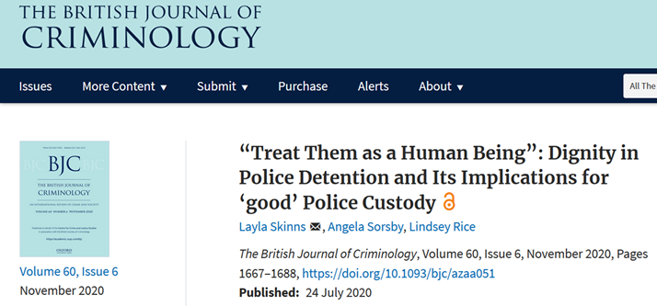
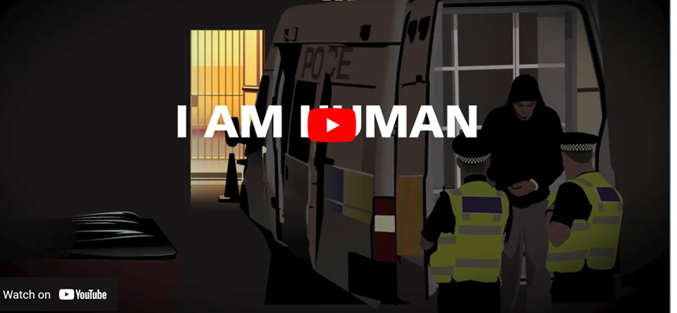
Aims, methods and phases of the GPCS
Overall aim – conceptualise ‘good’ police custody
Data collection phases of the GPCS (2013-18):
Survey of custody managers in 40 of 43 police forces in E+W
In-depth interviews and observation in 4 suites in 4 police forces
Survey of nearly 800 detainees in 27 custody suites in 13 forces
Data analysis, writing, KE and impact phases of the GPCS (2017-present):
Analysis, academic pubs., public engagement and launched recs.
Theatre production and animation, implementation of recs. in 3 police forces.

Slide 8
Creating ‘I am Human’
Research and collaboration with Dr Layla Skinns
Independent research – visit to custody suite.
- Interviews with custody Sergeant and custody officer
- Tour of custody suite: collection of props- mattresses, wands, blankets etc for authenticity
Development of plot and characters in collaboration with Layla
Devised rehearsals with strong cast of actors – intense 4 day rehearsal period to create 40 min piece
Delivery of two live shows – one for ICVA and one public audience at Sheffield theatres
- Used TV screens showing actual photos of custody suites which rolled throughout performance
- Finished show with facts based on Layla’s research
- Post show Q and A
Pandemic – cancelled live theatre show for ICVA. Adapted I am Human as radio play + animation
Original cast recorded audio in recording studio
Animators then created final piece

Slide 9
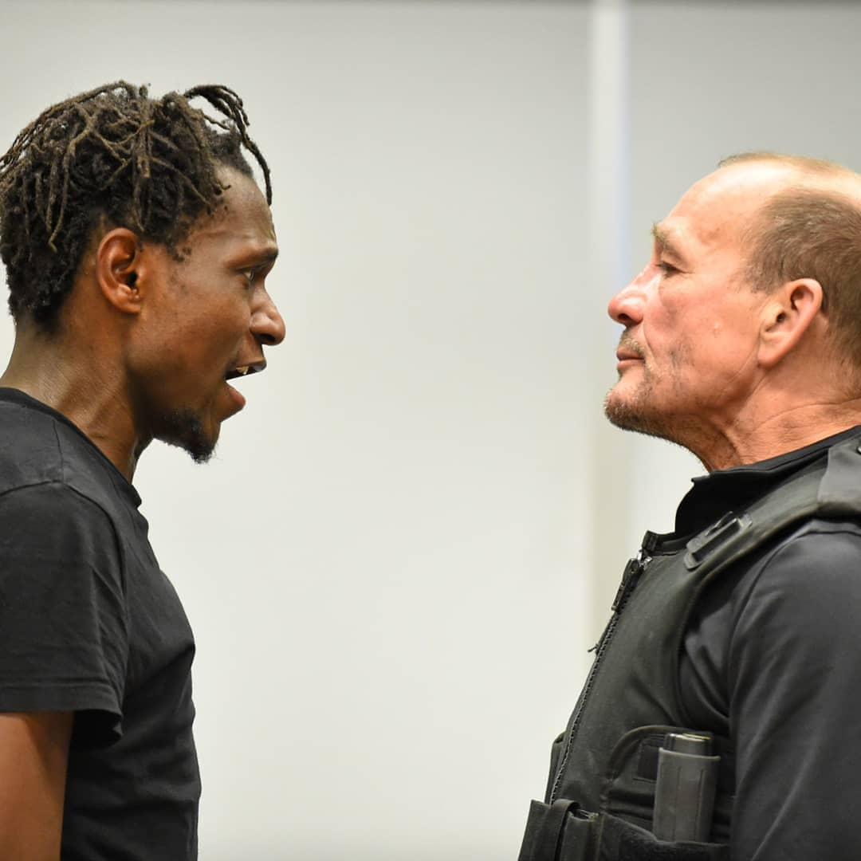
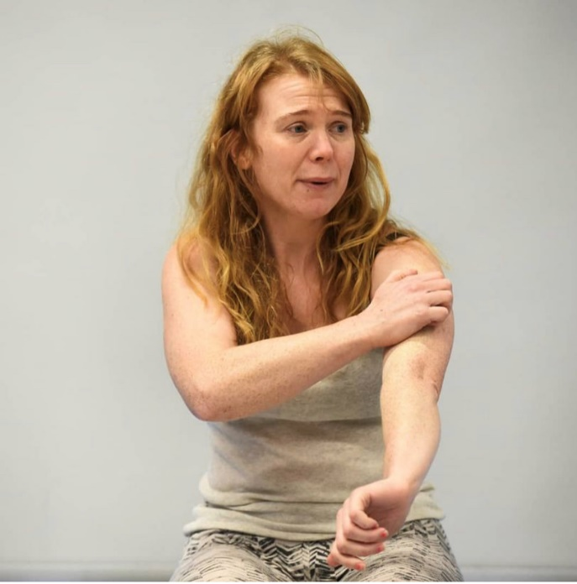
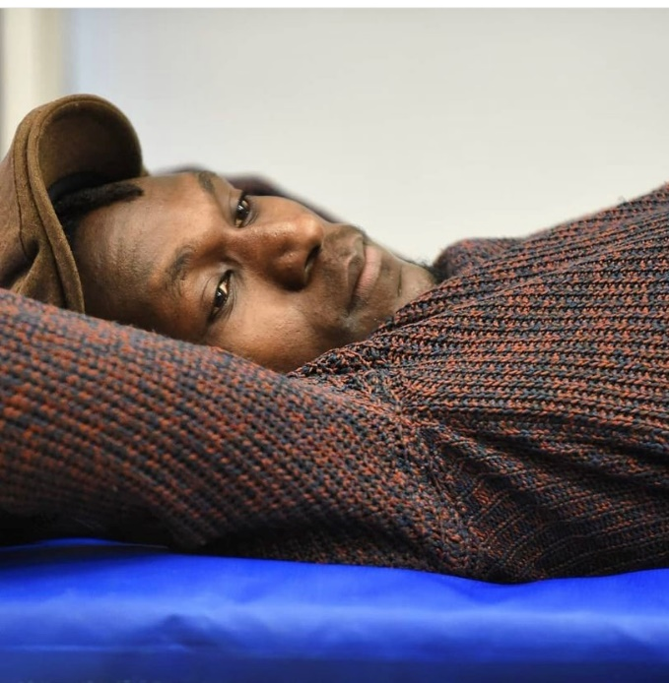
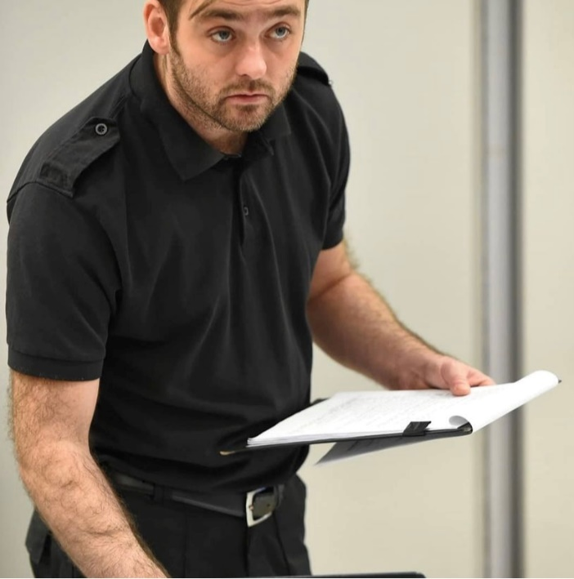
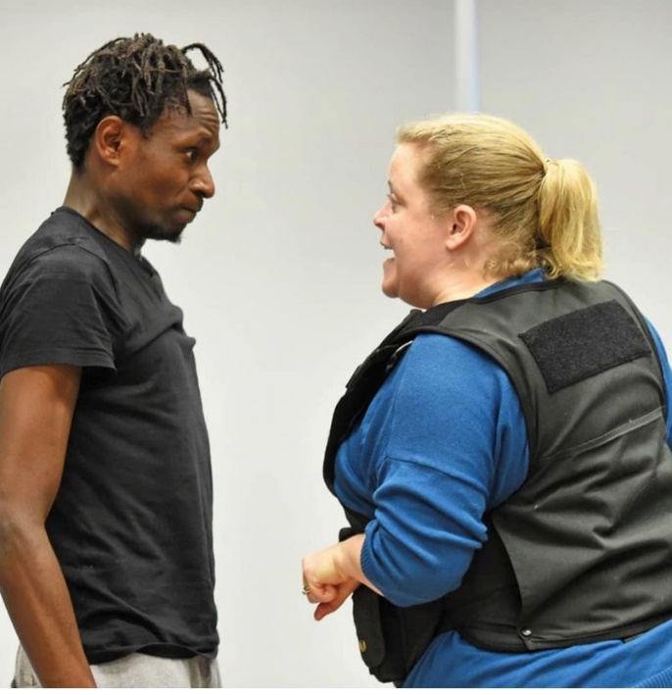
Charlie Barnes
Creative Director
info@deadearnest.co.uk
www.deadearnest.co.uk

Slide 10
Effecting change in ICV scheme coordinators
Performed for ICV coordinators in Nov. 2019 at their National Conference
Post-performance survey (n=30), showed likely to use information gleaned:
“To inform the decisions you make about your work” – 83% strongly agreed/agreed
“To make changes to practices at work.” - 90% strongly agreed/agreed

Slide 11
Effecting change in ICV scheme coordinators
Brought concepts to life:
Excellent idea to see the issues played out and to hear the detainees back story which adds another dimension - see them as a human, not just a number. V. emotional - especially when taking Jamal's necklace off. Great acting!” R2
Emotional response:
Absolutely brilliant idea. It was emotive and informative and really shows how the attitude of DDOs can have an immense impact on the detainees. The actors were brilliant and made me feel I was really in custody. I think this should be shown to all custody staff. R1
[W]e left the theatre … blown away, knowing that the performance we’d seen had conveyed some powerful messages … The play illustrated three elements of dignity – rooted in equal worth … autonomy … decency – which were both somehow obvious and revolutionary – as many of the best ideas are. Katie Kempen, former CEO of ICVA
Enduring effect:
Very original, engaging. Will help me to remember the main points better than powerpoints or written lectures. R3

Slide 12
Effecting change in custody staff
Animation used as an elicitation tool
Used to gather their responses and identify good practice examples
An arts-based research tool AND implementation tool used to encourage change, a sense of ownership and a willingness to contribute to the implementation process
Response rates – Force A (n=5), Force B (n=4) and Force C (n=3).
A small and self-selecting group but gave me hope for the implementation work to come.

Slide 13
Effecting change in custody staff
Most agreed that the animation accurately depicted where they worked (7/12)
Nearly all agreed that the character, DO Andy, offered the clearest embodiment of affording detainees dignity (11/12)
Nearly all agreed that detainees deserve the same level of dignity and respect as everyone else (11/12)
Most thought it important to treat detainees in the same way as if it were a friend or family member who had been arrested (8/12)
Most agreed that a cup of tea went a long way towards recognising a detainee as a human being (8/12)
All agreed about the importance of explaining what is happening to detainees and why (12/12)
All agreed that various material items (e.g. food, drink, reading and writing materials, blankets and distraction packs) should be routinely provided (12/12),
You do not know what their lives are like, you don’t know what they have been through and I would hope that custody staff show compassion in dealing with detainees

Slide 14
Key points
Explored the process by which research from the GPCS was transformed into theatre/animation
Examined how theatre and animation were used for disseminating knowledge, collecting data and encouraging the implementation of dignity-related changes to police custody practices.
The theatre production/animation succeeded, as intended, as a catalyst for change and innovation amongst police custody stakeholders.

Slide 15
Concluding remarks
The arts are an imaginative and powerful way of communicating research findings to police custody practitioners
They create conditions favourable to effecting changes to police custody policies and practices, tho there are risks too.
The art of criminal justice is perhaps also the art of innovation?
Likely given the lengthy history of combining art and science for the purposes of innovation.
Therefore, the arts should be further harnessed by criminologists in their work with CJ practitioners (not just with prisoners/probationers).

