Slide 1
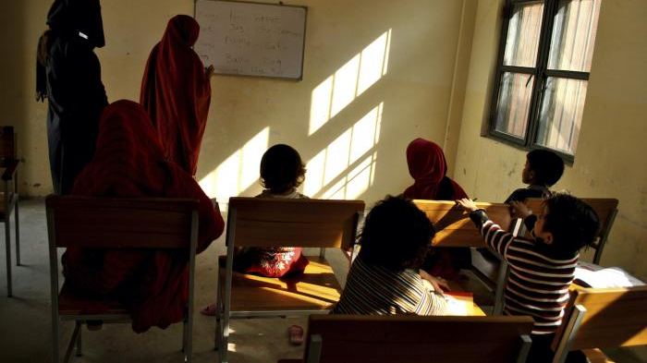
Sensory deprivation: Is Sound Enough?
A Reflection on the Potential and Limitations of Remote Research/ Researching from a Distance
Mark Brown
Photo: Education class for women in Mardan Central Jail, Pakistan. © HRW

Slide 2
A cross-national, multi-site, remote-research project undertaken during the time of Covid
Summary of the project
Covid-proofing: Use of remote data collection tools
Tactics and virtues of remote voice/video methods
Practical difficulties of voice/video methods
Methodological challenges and questions
Conclusion: Is it worthy of retention?

Slide 3
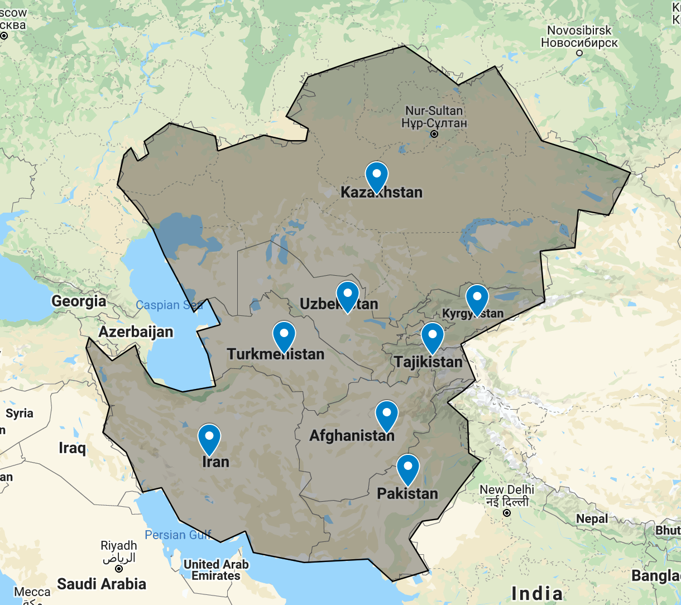
The project: A strategic cluster evaluation of UNODC programming in West and Central Asia 2015-20
Dispersed funds: USD 270M
Next programme cycle: 2022-26

Slide 4
Programme structure & evaluation methods
Within each programme, three primary deliver channels:
Sub-Prog 1: Borders, trafficking, law enforcement, countering TOC and preventing terrorism
Sub-Prog 2: Crime, criminal justice, law reform, legal matters
Sub-Prog 3: Drug use prevention, dependence, rehabilitation, reintegration, HIV and alternative livelihoods
OECD-DAC+ evaluation criteria
Relevance
Coherence
Effectiveness
Efficiency
Impact
Sustainability
HRGD-LNOB-FBF

Slide 5
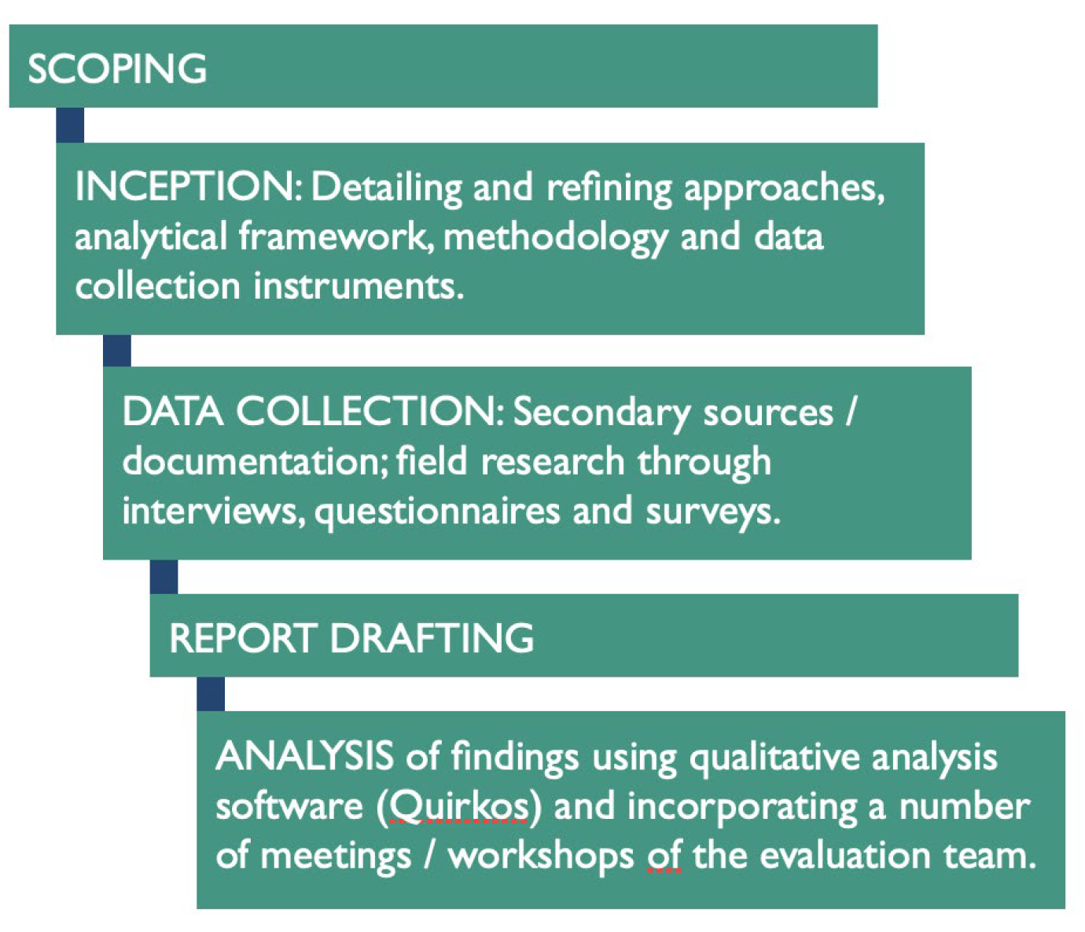
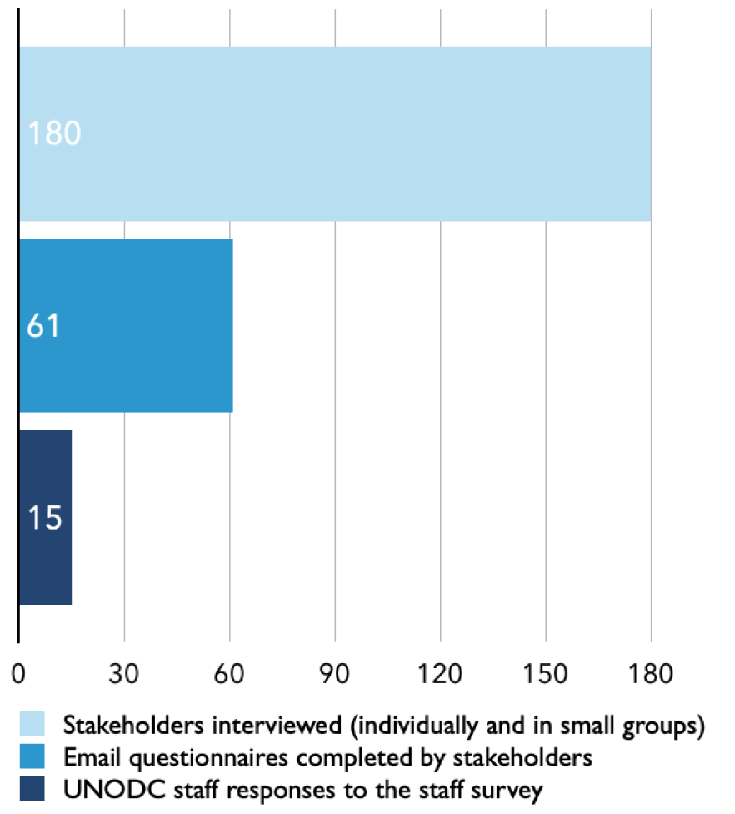
Covid-proofing: Reliance on voice/video
Method mix and triangulation
Stakeholder engagement methods

Slide 6
Tactics and virtues of remote voice/video methods
Tactics
Elementary
Audio or video KII & FGD
Translator-assisted KII & FGD
More innovative
Ethnographic listening exercises
National evaluator verbal reports
Field mission debriefs
Virtues
Audio technologies benefits
Geographical breadth
Geographical depth
Conflict sensitivity
Personal security
HRGD-LNOB-FBF
Covid-proofing & similar benefits
Withstood closure of countries & offices
Allowed access during hostilities

Slide 7
Practical difficulties of voice/video methods
These are fairly obvious
Burnout & researcher wear and tear
Difficulty of rapport on phone calls
Time involved in setting up KII & arranging FGD, esp across multiple time zones
Time wasted in tech malfunction
Lack of access among high priority groups
Residual conflict and participant risks

Slide 8
Methodological challenges and questions
Challenges: sensory deprivation
As a researcher, this deprivation becomes increasingly acute
How can we research something we cannot see, observe in action, interrogate (eg, VEP assessment tools, prog manuals)
How do we ‘ground-truth’ claims and (re)presentations
Questions: Case study: validity
Audio channel renders (largely) perceptual data
Meaningful triangulation is difficult in LDC & LMIC contexts that are data poor
Solutions may be expensive (eg, satellite imagery crop substitutes)
Content validity an Achilles Heel for non-perceptual measurement

Slide 9
Conclusion: Is it worthy of retention?
Short timeframes and high-priority research >> a ‘design of necessity’
Was effectively Covid-proof
Certain strengths, esp re geographical, conflict & hard to reach communities make it a useful tool
More suited to higher-level research objectives, as here
More suited to studies where perceptual data are adequate
May undercut validity without adequate real work on triangulation
In the form used here, was a crisis response, but subsequent work reveals other, supporting, remote methods (eg, Par-Evo)

