Slide 1
Listening to power in prison:
Flashbacks
Kate Herrity
@KateHerrity
kzh20@cam.ac.uk

Slide 2
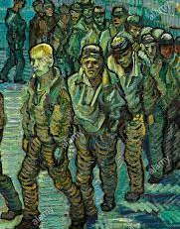
The project
An Aural ethnography
Over 7 months at HMP Midtown
Familiarising with soundscape (“sensemaking” and “attunement”)
Ethnographically-informed interview
The unusual nature of HMP Midtown
Van Gogh, 1890

Slide 3
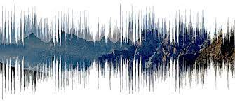
Sound?
Soundscape: aural components of a physical landscape
Sound is made by vibrations. Can be ‘felt’ as well as ‘heard’. *For powerful and important contributions to this area please see Laura Kelly (2017) https://www.crimeandjustice.org.uk/publications/psj/prison-service-journal-234
Interpretations are coloured by expectation, experience, emotion (British Standards Institute 2014: BS ISO 12913-1:2014 )
The “auditory imagination” Ihde 2007, Elliot 1939)
*The prison soundscape

Slide 4
Sound #2
Extends beyond the peripheries of vision (Herrity 2020)
In space: “I was like: the block’s getting smashed up … I was only leaning on the wall … but I knew from the vibrations, cos there’s different vibrations from music to damage” (Stretch in Herrity 2021)
In time: “…dreaming of keys, I thought I was back in here! But what was worse, was when I was back in I dreamed of the sounds of home, hearing my brothers and sisters running about, kitchen sounds, breakfast being made… but when I woke I was banged up” (prisoner, conversation in HMPYOI Aylesbury)

Slide 5
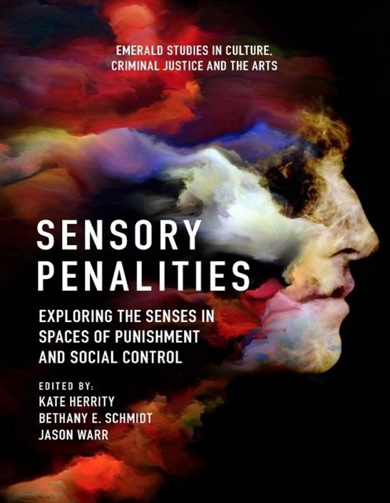
Methodology
Walking and standing still
The sensory lens
- Proximity
- Power
“Cognitive interviewing” – the sensory as a means of eliciting accurate information and foregrounding wellbeing (E,g, Shepherd et al. 1995)
- Control
- Circumventing emotions

Slide 6
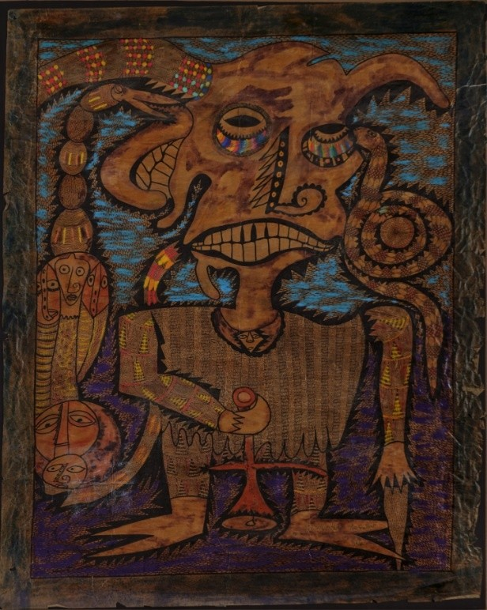
Hauntology
Smell, taste, cold, sound traverse time, space, memory, being.
The ASSAP tell us that: “Many hauntings involve witnesses smelling unlikely or unusual smells with no obvious source”
Toop (2010), sound “the temporal sense” (the sensory allows us to traverse time, space and ideas – e.g. between phenomenology and constructivism
What does this mean in prison, where people are haunted by past, present and future
What do we exclude from our ways of thinking when we impose the peripheries of vision?
“The smelling ghost” Twins Seven-Seven 1966. Yoruban god

Slide 7
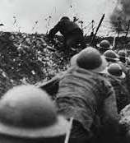
Flashbacks (foregrounding the sensory) Reliving rich and vivid sensory experience, or intrusive sensory recollections
A “hall mark” of PTSD, traumatic experience (Bourne et al. 2013)
The noise…. So much noise… No noise like it I’ve ever heard!! Chaotic, screaming, the noise… so much noise!! I know, I know… I’m used to battle noise, well I’ve experienced it… Never get used to it, but this… It’s different. Cries of pain, Co dees shouting to each other, but standing face to face… Why are you shouting? A young lad in the stairs, talking gobbledeegoop, he’s gone over, BANGTHUDTHUMPCRASH down the stairs… Blood everywhere all out on the floor, the screws shout to get inside our cells. Spice apparently? I don’t know what that is!! The noise doesn’t bang with munitions in the air… This noise has a deadly, yet silent violence to it… An unknown enemy!!
(Inside Out (PRT18/6, 2018, p.2) – March, 2021)

Slide 8
Violence – symbolic and literal
Bordieu (1991) “Symbolic power”
Elicit/impose effects upon the body
Draw upon wider cultural potency of the prison
A violence
Power is more than relational
Authority cannot be sufficient explanation for compliance

Slide 9
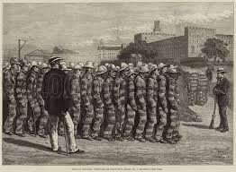
Order
Attending to Rhythms and routines expose different textures of prison life:
Collaboration
Means of survival
Power fluid and contested
Weakens legitimacy thesis

Slide 10
Sound (and sensory) matters
Foregrounding sound/sensory aspects of experience tell us different things about penal spaces
In turn this informs theorising anew about prison and the basis for social order therein
I invite you to consider what this does for how we engage with our social world, and how we think we know
“The answers we get, depend on the questions we ask” (Thomas Kuhn)

Slide 11
References
P. Bourdieu, P. (1991) Edited and introduced by John. B Thompson, Translated by Gino Raymond and Mathew Adamson. Language and symbolic power. Cambridge: Polity Press
Bourne C, Mackay CE, Holmes EA. The neural basis of flashback formation: the impact of viewing trauma. Psychol Med. 2013 Jul;43(7):1521-32
Eliot, T.S., (1933) The use of poetry and the use of criticism. London: Faber and Faber
Herrity, K. (2020) “Hearing behind the door: The cell as a portal to prison life” in Turner, J., Knight, V. (eds) The Prison cell: Embodied and everyday spaces of incarceration. London: Palgrave
Herrity, K, Schmidt, B., Warr, J. (2021) (eds) Sensory Penalities: Exploring the Senses in Spaces of Punishment and Social Control. Bingley: Emerald publishing (https://books.emeraldinsight.com/page/detail/Sensory-Penalities/?k=9781839097270)
Ihde, D. (2007) Listening and voice: phenomenologies of sound (second edition). Albany: State university of New York
March, E. (2021) “Orality and aurality in prisoner writing”[online] https://sensorycriminology.com/2021/01/18/proximity-and-distance-orality-and-aurality-in-prisoner-writing/
Shepherd, E., Mortimer, A., Turner, V., Watson, J. (1999) Spaced cognitive interviewing: facilitating therapeutic and forensic narration of traumatic memories Psychology, Crime and Law, Vol.5, No.1-2, Pp 117-143
Toop, D. (2010) Sinister resonance: the mediumship of the listener. London: Continuum

