Slide 1


01
4. Mapping Politics
(Spatial Data Analysis)
In this chapter, we are going to explore spatial data (Maps!) by using a variety of political topics to demonstrate the huge variety in which maps can be used to show data. There will be questions about what you see throughout the chapter in order to help you develop your understanding.
Maps are a really useful and interesting way of presenting information as they represent the real world on a much smaller scale. Maps can show how a value varies across geographic space - and the relationship between these spaces. They show us where specific things happen, and how densely.

Slide 2
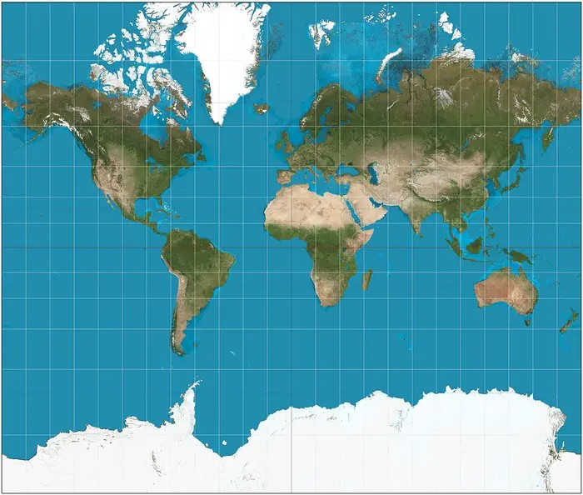
How we see the World
02
We do need to be careful with spatial data, because maps are manipulated to reflect a specific view of the world, and we should always scrutinize the story that the mapmaker is trying to tell us.
Maps are not as straightforward as they seem...
This is the map we are normally presented within understanding our world:

Slide 3
03
This map is actually quite distorted because the Earth is spherical, and any attempt to flatten this view ends up distorting the data. Look at Greenland and Africa for example, they look like they are close to the same size, but Africa is actually 14 times bigger.
Created in 1569 by a Flemish cartographer, Gerardus Mercator, this map is known as the Mercator Map Projection. We have been using this map widely since the 16th century - I’m sure you have seen it in google maps for example.
The map was initially created to preserve directional bearing, making it useful for navigation.

Slide 4
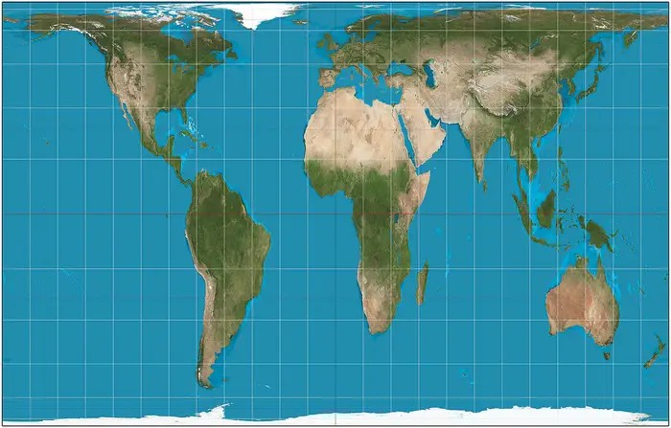
So are there any alternatives?
04
This map is known as the Gall-Peters Projection. In 1974 Arno Peters published this projection, and it was also drawn previously by a nineteenth- century Scottish mapmaker, James Gall. The projection is described as an “equal-area” map because it accurately scales surface areas.
The Gall-Peters projection. Wikimedia Commons

Slide 5
05
The Gall-Peters projection. Wikimedia Commons
However, it is important to note that the map is still nonetheless distorted as it is a two-dimensional visualization of a three-dimensional earth. These different perspectives are important, as they highlight how we conceive what the world looks like.
When we use spatial data (also known as geospatial data) we are presenting information and how it relates to a specific location on earth’s surface.

Slide 6
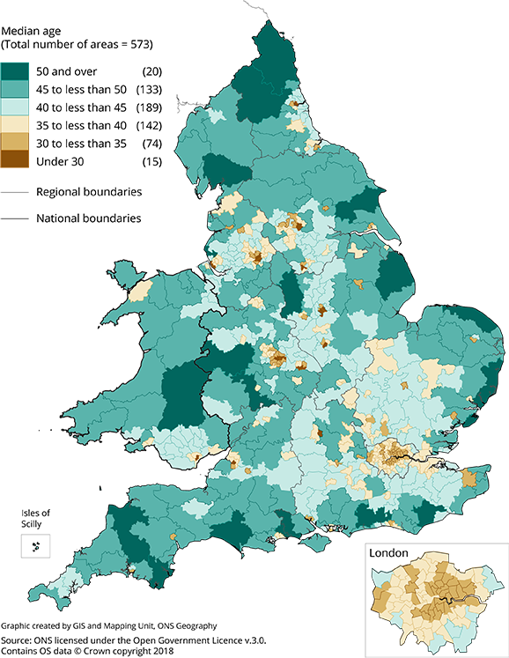
Activity 1: The Choropleth Map
06
There are many different ways of presenting spatial data.
First, we are going to start with Choropleth map, a type of spatial data you have probably seen before and is used very commonly in the media and research.
The Choropleth map will distinguish predefined areas by using different types of shading, colouring or symbols that represent the average values of a particular quantity in those areas. You have probably often seen this type of map to show characteristics of a population:

Slide 7
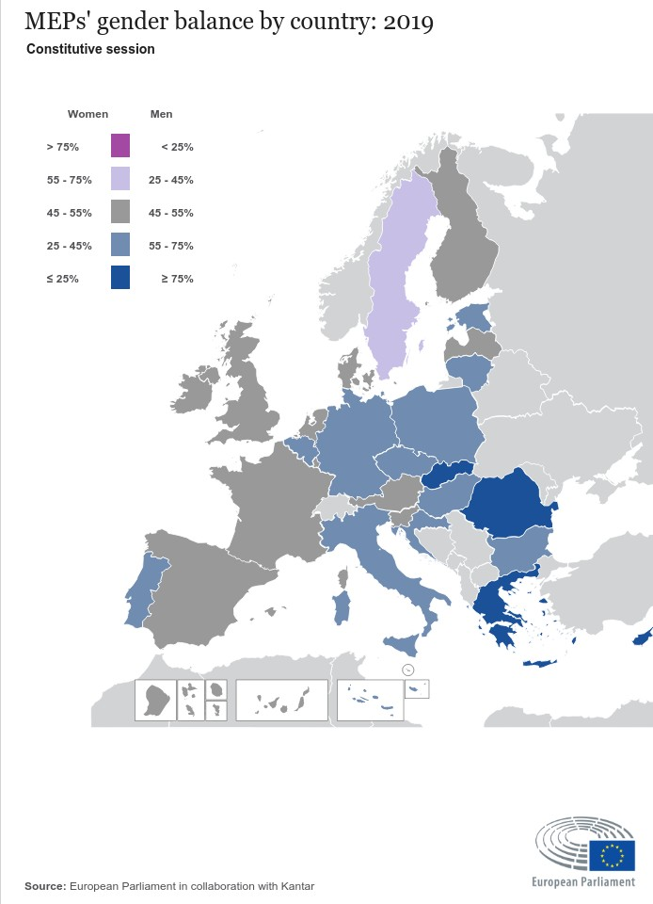
07
Let’s start with a simple example. This map relates to our last activity, and shows how many female MPs individual MPs were voting into the EU Parliament by country.

Slide 8
08
Why do you think this visual is useful?
What are the colours telling us?
What information is missing from this map that you think would be helpful in understanding the number of female MPs elected in the EU?

Slide 9
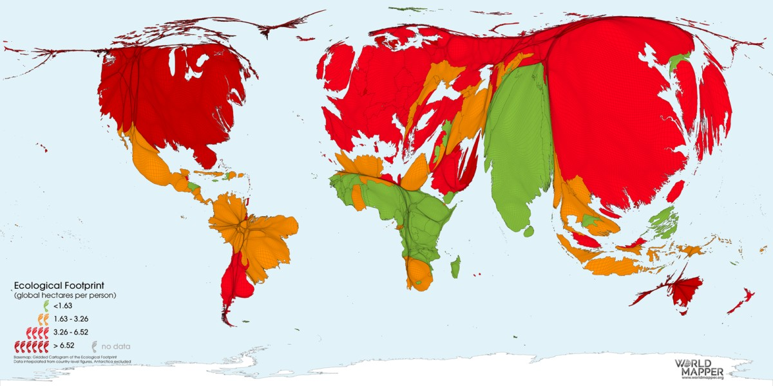
Activity 2: Cartograms
09
Cartograms are a type of map which distorts the area (typically shown in a Mercator or Gall Peter’s projection) in order to demonstrate how the data is equally represented.
Ecological Footprint of Consumption 2019

Slide 10
10
Ecological Footprint of Consumption 2019
In this map, the areas are altered to demonstrate the total ecological footprint of individuals in each country, in order to quantify humanity’s impact on the natural environment. An ecological footprint describes the impact of an individual person or community on the environment, expressed as the amount of land required to sustain their use of natural resources.

Slide 11
11
Using this map as a guide, answer the following questions: Which areas of the world have the best ecological footprint? Which have the worst?
How does the UK compare to the rest of the world? And what about the EU?
Why do you think it is useful to see this type of data in this way? Do you find this type of map distortion helpful?
Ecological Footprint of Consumption 2019

Slide 12
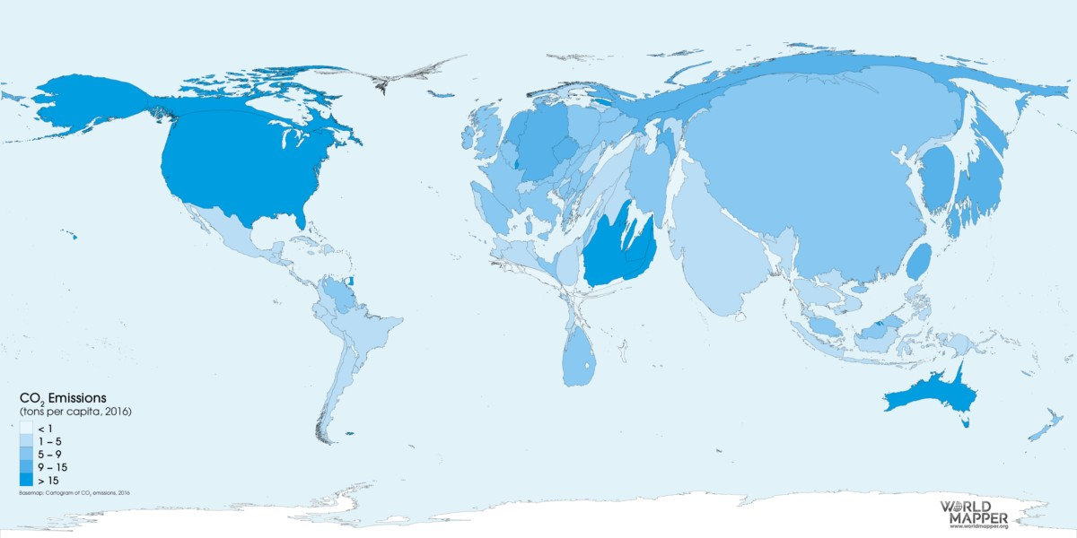
12
Here is another cartograph that demonstrates the CO2 emissions for each country in 2016.
CO₂ Emissions per capita 2016

Slide 13
13
CO₂ Emissions per capita 2016
This map distorts the areas to show which countries have highest and lowest carbon emissions. How does it correspond with the findings of the first cartograph map above?
How does it differ?
Why do you think that is?

Slide 14
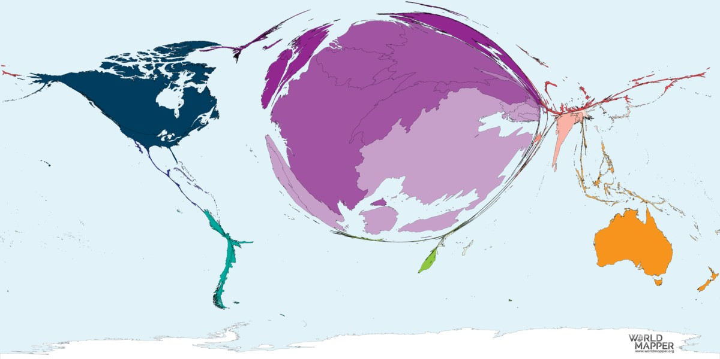
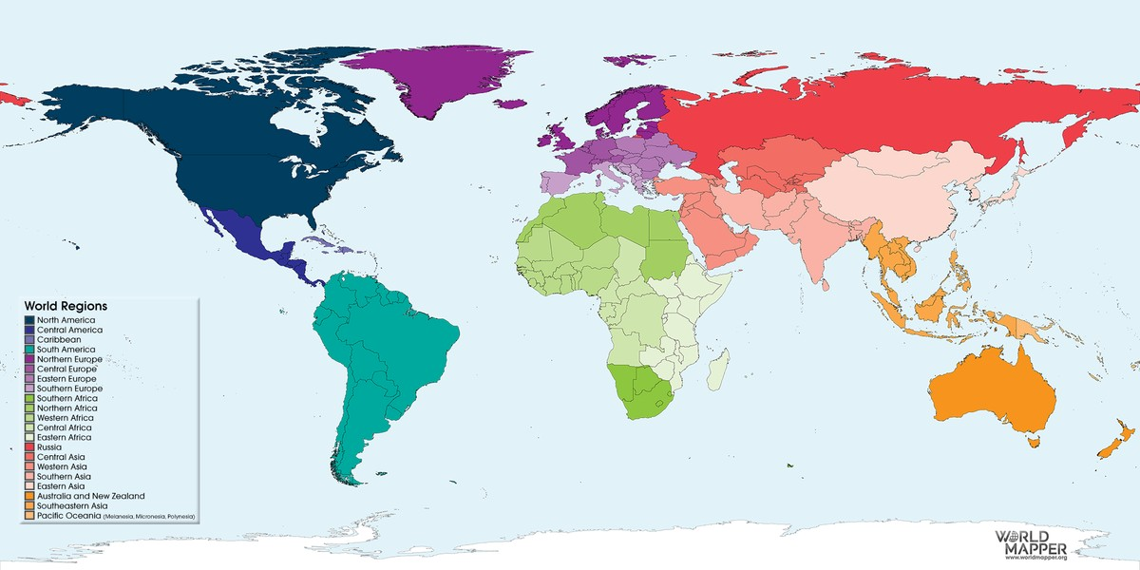
14
Lastly, let's look at this graph that looks an important day for Climate Crisis Protests. on Friday 15th March 2019, the largest School Strike for the Climate took place, where An estimated 1.4 million young people in 123 countries skipped school in order to demand action from political leaders to take action to prevent climate change.
#FridaysForFuture Climate Demonstrations (March 15th 2019)

Slide 15
15
#FridaysForFuture Climate Demonstrations (March 15th 2019)
How is the reference map helpful compared to a legend in the corner (that we saw in the two previous maps)?
Are you surprised about the areas that had the most turnout for the climate demonstrations?
If you compare to the two graphs above, why do you think the northern hemisphere appears to have held more demonstrations?

Slide 16
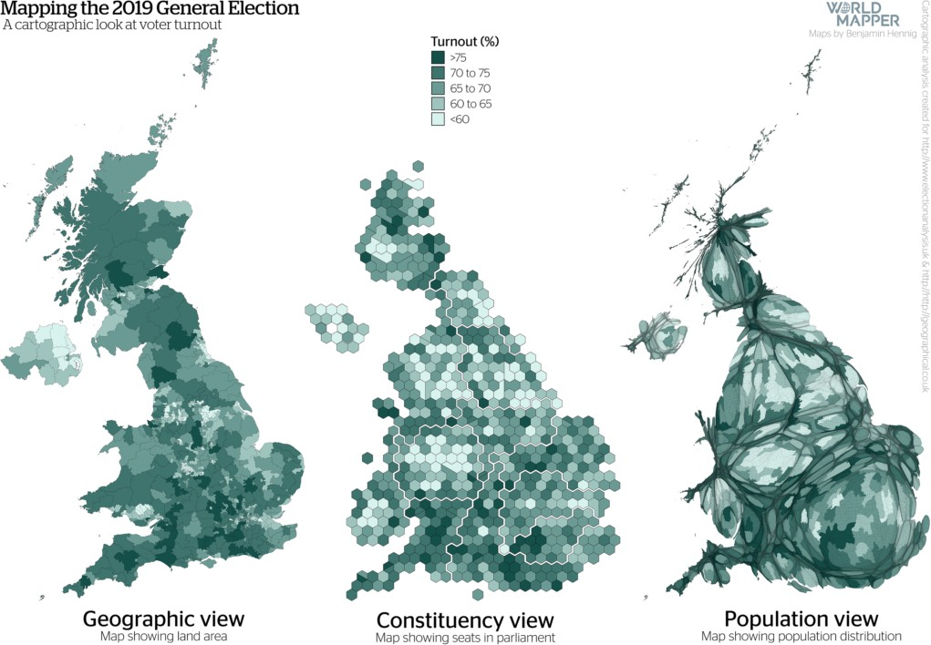
Activity 3: Comparative Maps
16
In this section will be comparing maps. Here is an example of three different ways of mapping the voter turnout at the recent 2019 UK General Election:

Slide 17
17
As you can see, there is a geographic (choropleth) view, a constituency (hexagon) view, and a population (cartograph) view.
The geographic views show voter turnout in a conventional choropleth map, in the form of the map of the UK that we are used to seeing.
The population view shows the map altered by how each area is resized according to the number of people living in that area (cartograph). In all three of these maps, the different shades of green represent levels of voter turnout.

Slide 18
18
The constituency view instead uses its hexagons to present individual constituencies. Hexogan maps can offer clarity in the way they standardize geographic spaces, due to the ability for the hexagon to tessellate well. They are still able to produce recognizable geographic representations, as you can see in the map above showing seats in the UK parliament.

Slide 19
19
From these maps, which area do you think has the best voter turnout? Which had the least?
How do the nations of Scotland, Wales, Northern Ireland and England compare?
What do you think is the advantage of each map?
Do you find one easier to understand than another?

