Slide 1


01
3. The UK’s Main Political Parties (Scatterplots and line graphs)
In this chapter we are going to look at a couple more types of data visualisations: scatter plots and line graphs.
We are going to look at the UK's main political parties to understand relationships between variables.

Slide 2

Our Political Parties
02
The UK political system consists of multiple parties. Since the 1920s there have been essentially two main political parties in the UK who take up a number of seats in the House of Commons: the Conservative Party and the Labour Party.
The first-past-the-post electoral system used for general elections tends to maintain the dominance of these two parties. The first-past-the- post system is the way in which we elect MPs.

Slide 3

03
How the first-past-the-post system works is that voters in a constituency mark their choice with an X - and the candidate with the largest number of votes wins.
In the 2019 elections, the Scottish National Party, the Liberal Democrats, the Democratic Unionist Party, Sinn Fein, Plaid Cymru, Social Democratic and Labour Party, the Alliance Party of Northern Ireland and the Green Party were also elected.

Slide 4
The Conservative and Labour Parties
04
First organized in the 1830s, the modern-day Conservative Party was actually an outgrowth of the Tory movement or party, which has been traced back to the end of the 17th Century. Members and supporters are often referred to as Tories and the party itself is also colloquially known as the Tory Party. The Conservative Party has been the governing party in the UK since 2010.
The Labour Party emerged at the turn of the 19th Century, emerging from the socialists and trade union movements of the period. It supplanted the Liberal Party which has previously been one of the two dominant parties (that included the Conservatives) in the UK. Currently, the Labour Party forms the Official Opposition to the Conservative government, as it won the second- largest number of seats in the 2019 general election.

Slide 5
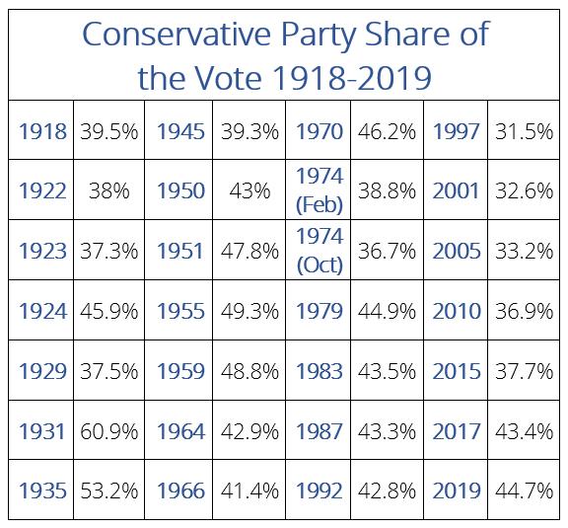
Activity 1: Scatter Plot and Line Charts
05
How has the UK supported these two parties since 1918? First, we are going to use scatterplots to examine voter support for the Conservative Party over the past hundred years.
A scatterplot displays points in order to present the relationship between two sets of data. The position of each dot on the horizontal (X) and vertical (Y) is a useful way of presenting data because the dots show the value of individual points, in addition to patterns in the data as a whole. In this example, the ‘whole’ is a century in time - the past 100 years.
Here is the Data:

Slide 6
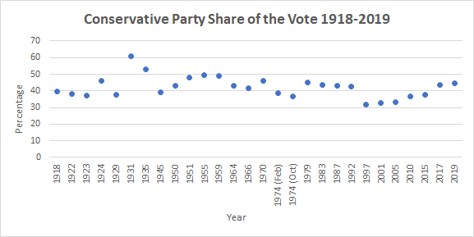
06
And then here is the scatter plot created from that data:

Slide 7
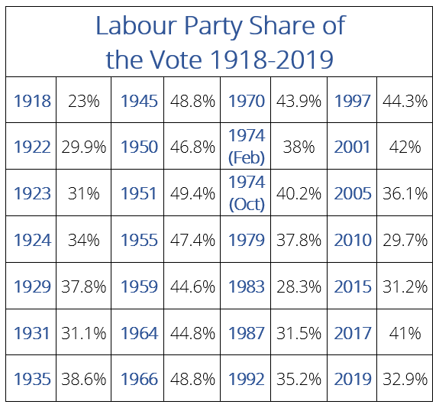
07
Let’s now draw a scatter plot of the voter support for Labour over the past 100 years. Use the table of data below and look at the previous scatterplot for inspiration and guidance.

Slide 8
08
What are the similar and different patterns between the two scatterplots?
Now, using a pen, marker or pencil, connect the dots and create a line of data for both graphs above. This is how you make a line graph!
A line graph (or chart) is a type of graph that displays data as a series of data points called 'markers' which are connected by straight line segments. The line shows how something changes in value (often this change is time).

Slide 9
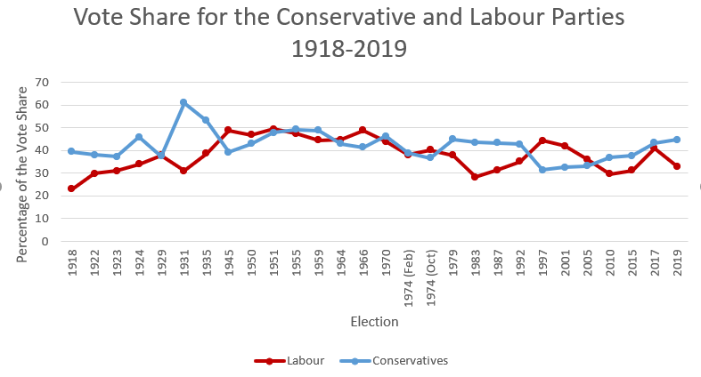
09
Here is how they would look together on one graph, with the blue colour (representing the Conservative share of the vote, and the red colour representing the share for Labour. Drawing the line helps us understand the past relationships between the data.

Slide 10
10
Why do you think having both sets of data on the same graph useful?
So why not present the data in a bar graph? In a bar graph, you use rectangular blocks to represent many different types of graphs. A line in a line graph will show one type of data, and is particularly useful for showing trends over a period of time.

Slide 11





11
Activity 2: What Can we do with these Points of Data?
In order to identify the relationship between the points of data, instead of connecting the dots, drawing a ‘line of best fit’ would be helpful.
The line of best fit is a line drawn through the dots in a scatterplot that best expresses the relationship between the points.

Slide 12
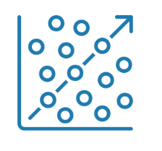
12
Social scientists will often use linear regression analysis to create a straight line that results from the relationship between the two variables. Was does this look like?

Slide 13
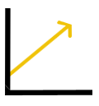
13
A positive relationship between X and Y is when the data shows an uphill pattern from left to right. As the X-value increases, so does the Y value. The data is moving right and up.

Slide 14
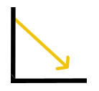
14
A negative relationship will show a downhill pattern from left to right, where Y value decreases and moves down as the x value increases.

Slide 15

15
If there doesn’t appear to be any pattern, and no clear line moving up or down, then that means no relationship exists between X and Y.

Slide 16
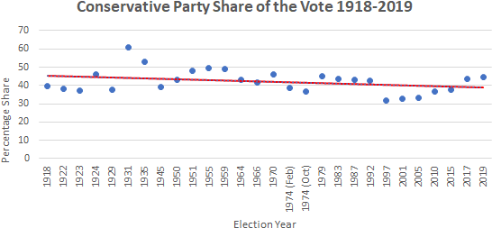
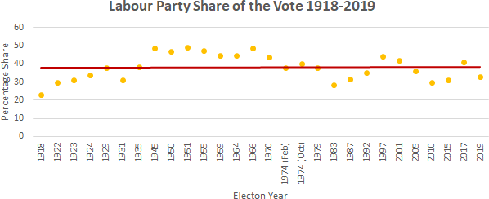
16
Here is the linear regression for the vote share for the Conservative Party from 1918 to 2019:
And here it is for the labour party:

Slide 17
17
For each graph, would you say that the 'line of best' fit' is positive, negative or that there is no relationship between the variables?

Slide 18
18
Activity 3: Correlation Does Not Equal Causation
It is important to note that the scatterplot and line graphs in these activities only suggest a linear relationship between the two sets of values. They do not suggest that the passage of time is responsible for the support for Labour and Conservative to increase or decrease. Instead, we need to think about what the passage of time infers.
You may have heard of the expression "correlation does not imply causation". This reminds us to be careful when reading graphs, as we cannot always conclude that there exists a cause- and-effect relationship between two variables because we think we see an association (or correlation) between them.
Essentially, just because two things appear to be related does not mean that one causes the other.

Slide 19
19
Let’s be a bit more specific in order to make things clearer:
Correlation informs us how strongly a pair of variables are linearly related and change together. It only tells us that a relationship exists, but does not tell us the how or why.
Causation, on the other hand, is what we know as a ‘cause and effect’ relationship between two variables. It is the change of one variable that we can define as changing another variable.

Slide 20

20
An example that is often used to demonstrate that correlation does not equal causation is the statistics that show that when sales of ice-cream increase, so do the sale of sunglasses. Rather than concluding that ice cream affects people’s ability to handle sunlight or desire to wear sunglasses, we have to look beyond these two variables and think of a missing causal link: sunshine. When it is sunny outside, and it is often hot, and people are more likely to want to buy ice cream or sunglasses in this kind of weather.

Slide 21
21
So, for example, in the two graphs about the history of the vote share for the Labour and Conservative Parties, the two variables in the graph are time and percentage of the vote share. Would you argue that it is the passage of time that affects the vote share for each party? Or could there be other types of data that could be affecting their vote share?
What are some possible unmeasured variables that could explain the correlation? List three and explain why you think they would be helpful.

