Slide 1



01
2: Women MPs in the UK Parliament (Graphs and Charts)
In this chapter we are going to start our exploration of Data Visualisation by exploring who we vote for in the UK, both currently and in the past.
Data Visualisation is how we represent information (data) in a visual context. This can include bar charts, histograms or pie charts and today we will explore all three. By using data visualisations, we make it easier to detect trends, patterns, and outliers, making it easier for our brains to process both big and small data.

Slide 2
02
Graphs are used to present data, or information, as clearly and understandably as possible. Some types of graphs are more useful for some types of data - and today we are going to understand why.
This chapter consists of 3 activities where we will explore and create different types of graphs and charts, using data about female representation in UK and EU elections.

Slide 3

03
Since 1918 who have we been voting for at General Elections?
From 1918, if you were at least 21 years old, both men and women could be elected to Parliament.
The first female to sit in the House of Commons was Nancy Astor in the 1919 by-election. Before Astor, Constance Markievicz was the first female MP elected, but along with other Sinn Fein MPs, did not take her seat.
Women never held more than 10% of seats until 1997. What does female representation look like now? We will explore all of this further in the following pages.
To see how the number of female MPs has increased over time, we are going to use some data visuals.

Slide 4
Activity 1: The Bar Chart
04
First, let’s start with a bar chart. A bar chart uses rectangle bars with different heights, or lengths, to represent and display categories of data.
A bar chart has a vertical axis (also known as the Y axis, and is the line going top to bottom) with numbers on it, and a horizontal axis (also known as the X axis, and is the line going side to side) that show the categorical data with rectangular bars where the heights are proportional to the values that they represent.
40
30
20
10
0
Item 1
Item 2
Item 3
Item 4

Slide 5
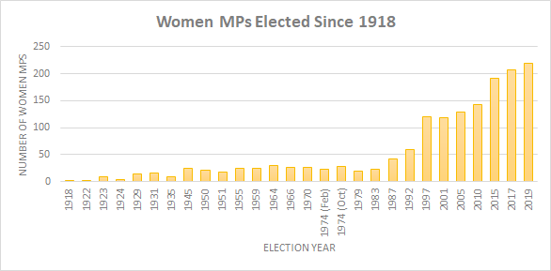
05
In the example below, the categorical data is the election year, and the vertical axis represents the amount of women MPs elected:
Looking at this graph - what information is missing that you think would be useful?

Slide 6
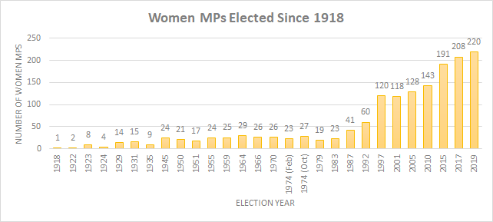
06
For example, what if we added the exact data for each bar?
Also - how would knowing the total amount of MPs for each year affect how you view the graph? Perhaps it would be better to have a percentage?

Slide 7
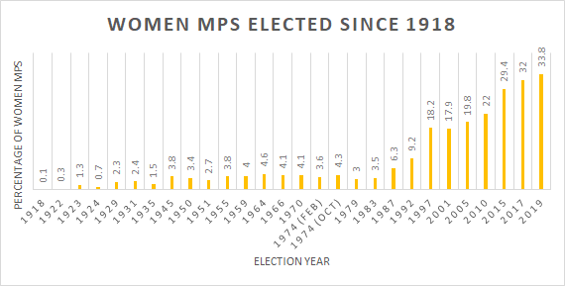
07
For example, even though the 2001 General Elections saw the election of 118 female MPs, it is hard to tell what this means if we do not know what this number is out of the total. Here is how a graph showing the percentage of female MPs, out of total MPs, would be displayed to display this type of data:

Slide 8
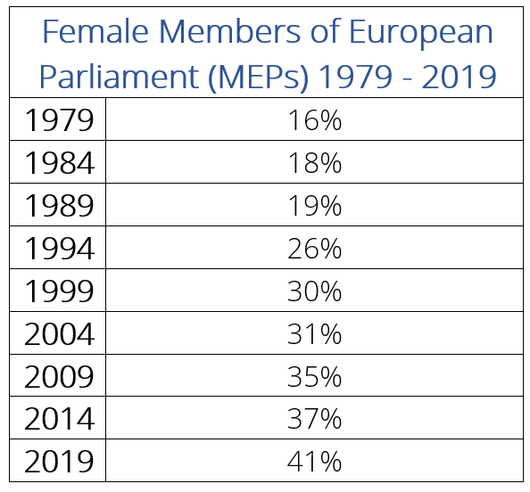
08
Here is the data for Members of European Parliament (MEPs) gender balance since 1979:
Create a bar chart to demonstrate the data (feel free to draw this by hand).

Slide 9
09
Have a look at the bar chart you have drawn.
1. Compare your bar chart to the previous charts. How does the UK compare to the EU Parliament for its gender diversity?
2. What is missing from the data in the graph that would be helpful for your comparison?

Slide 10
10
Activity 2: The Histogram
In this activity, we are going to look at the histogram. A histogram is similar to a bar chart, but instead of showing categorical data, its columns represent a continuous quantitative variable (e.g. age).
A histogram uses vertical columns to show frequencies (how many times each score occurs) and it will not have spaces between the columns because the data is continuous.
Let’s use the same data as the activity above to create a histogram: we are going to look at the frequency in which multiples of female MPs were elected.
This will be a useful way for you see how data can be presented in multiple ways.

Slide 11
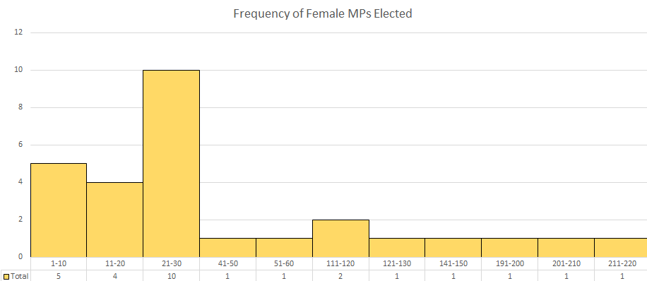
11
In this histogram, the frequency of women MPs elected is measured in groups that tell us how many times 1-10 Women MPs were elected, how many times 11-20 women MPs were elected, how many times 21-20 women MPs were elected, and the graph measures up to how many times 211-220 women MPs were elected. From this histogram, we can extrapolate that often, over the past 100 years, low numbers of female MPs were elected.
How is this histogram a useful alternative to the previous bar charts?
Notice there is a jump in the graph from 51-60 and 110-120 - why do think that is? Are there any other jumps in numbers?

Slide 12
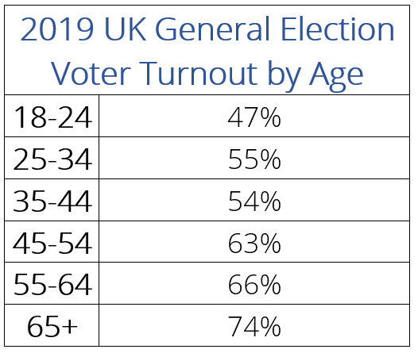
12
Let’s look at another example of a histogram, demonstrating the turnout for the 2019 General Elections by age group. The turnout is the frequency being examined, and the age groups are the categorical data. Here is the data we will use:

Slide 13
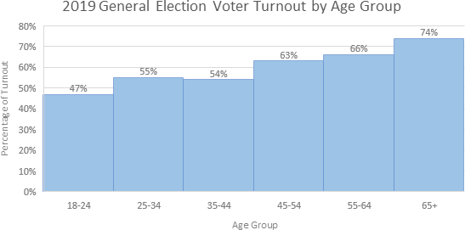
13
And here is the histogram representing that data:

Slide 14
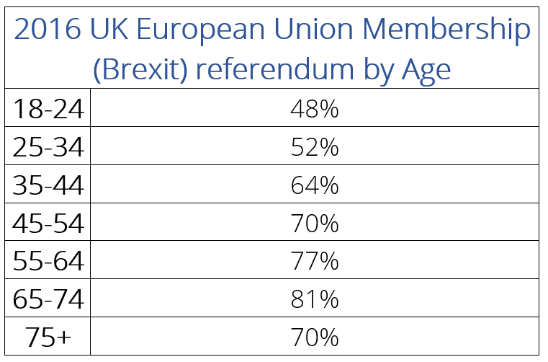
14
Now it is your turn to draw a histogram. Here is the data for the election turnout for the 2016 UK European Union membership (Brexit) referendum:
Now create the histogram, using the previous examples for inspiration and guidance (feel to draw the histogram by hand).

Slide 15
15
Here are some questions to help you reflect on and understand the histogram:
How does the turnout between the two events compare? How does it affect our ability to understand voter turnout for each event?
Why do you think the extra age bracket (age 65-74) was included in the EU Referendum data?
Why do you think there are larger percentage differences in some age groups and not others?
Why do you think some age groups appear to be more likely to vote than others?
Why do you think knowing the voter turnout for separate age groups is useful? For both the General Election and Brexit Referendum?

Slide 16
16
Activity 3: The Pie Chart
Now let’s look at pie charts.
By using pie slices in a circle we can demonstrate the relative sizes of data and how they add up to the whole. Often, this data takes the form of a percentage.
Pie charts are a useful way of showing how a total amount is divided up.
Pie charts are used to compare parts of a whole, not the difference between groups.

Slide 17
17
In the 2019 General Election, 220 female MPs were elected. This consisted of 34% of all MPs and was more than any previous election. What does this look like?
Women MPs 34%
Male MPs 66%
How does this compare to the General Elections in 1979, when only 11 Women MPs were elected, which was only 3% of the total MPs?

Slide 18
18
But how does the UK also compare to the current gender composition of the EU Parliament, where in 1979 Women MEPs consist of 16% of the total MEPs? And currently, where Women MEPs consist of 41% of the total MEPs?
Draw the two pie charts to help you compare.

