Slide 1
News, Crime and Culture 1991-2021: ‘news is our guidance, our conscience and our redemption; sometimes familiarity should breed contempt or at least criticism’
(Wykes 2001:205)
Paper for CCR e-conference ‘The Sights of Criminal Justice’
September 8th 2021
Author:
Dr Maggie Wykes
Honorary Senior Lecturer
School of Law
University of Sheffield
South Yorkshire UK

Slide 2
Abstract
This paper considers the analytical journey from writing about news coverage of race in the inner cities of the 1980s to researching news about sexual violence 40 years later. The turbulence of the 1980s happened well before the ‘internet existed as a consumer experience’ (Andrew Marr Observer (2.8.1998). MOSAIC opened up browsing from 1993 but even in 1998, Marr commented, if you could access the internet ‘you found a nerd-scape, baffling and dull’ (ibid). In 2021 my journey ends in a veritable explosion of electronic information sources that enable new offences like revenge porn and trolling, blur fact and fiction and reduce news to ‘tweets’. In 2001 I argued that:
  Culture is changing as rapidly as electronic communication is binding nations, institutions and individuals into a single (however unstable, exclusive and fragmented) cyber-communications system......the systematic analysis of news in relation to identifiable power, norms and values, is rapidly becoming more urgent and less possible for anyone concerned about the role of the media
  (Wykes 2001:7)
‘Less possible’ but nonetheless I tried and this paper explores that analytical journey and asks why it seems not to have taken us very far.

Slide 3
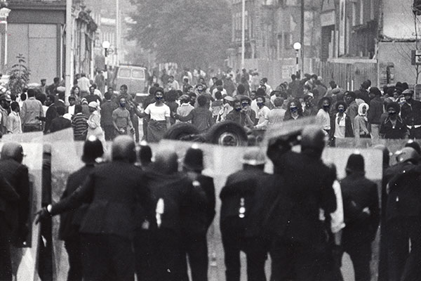

Slide 4
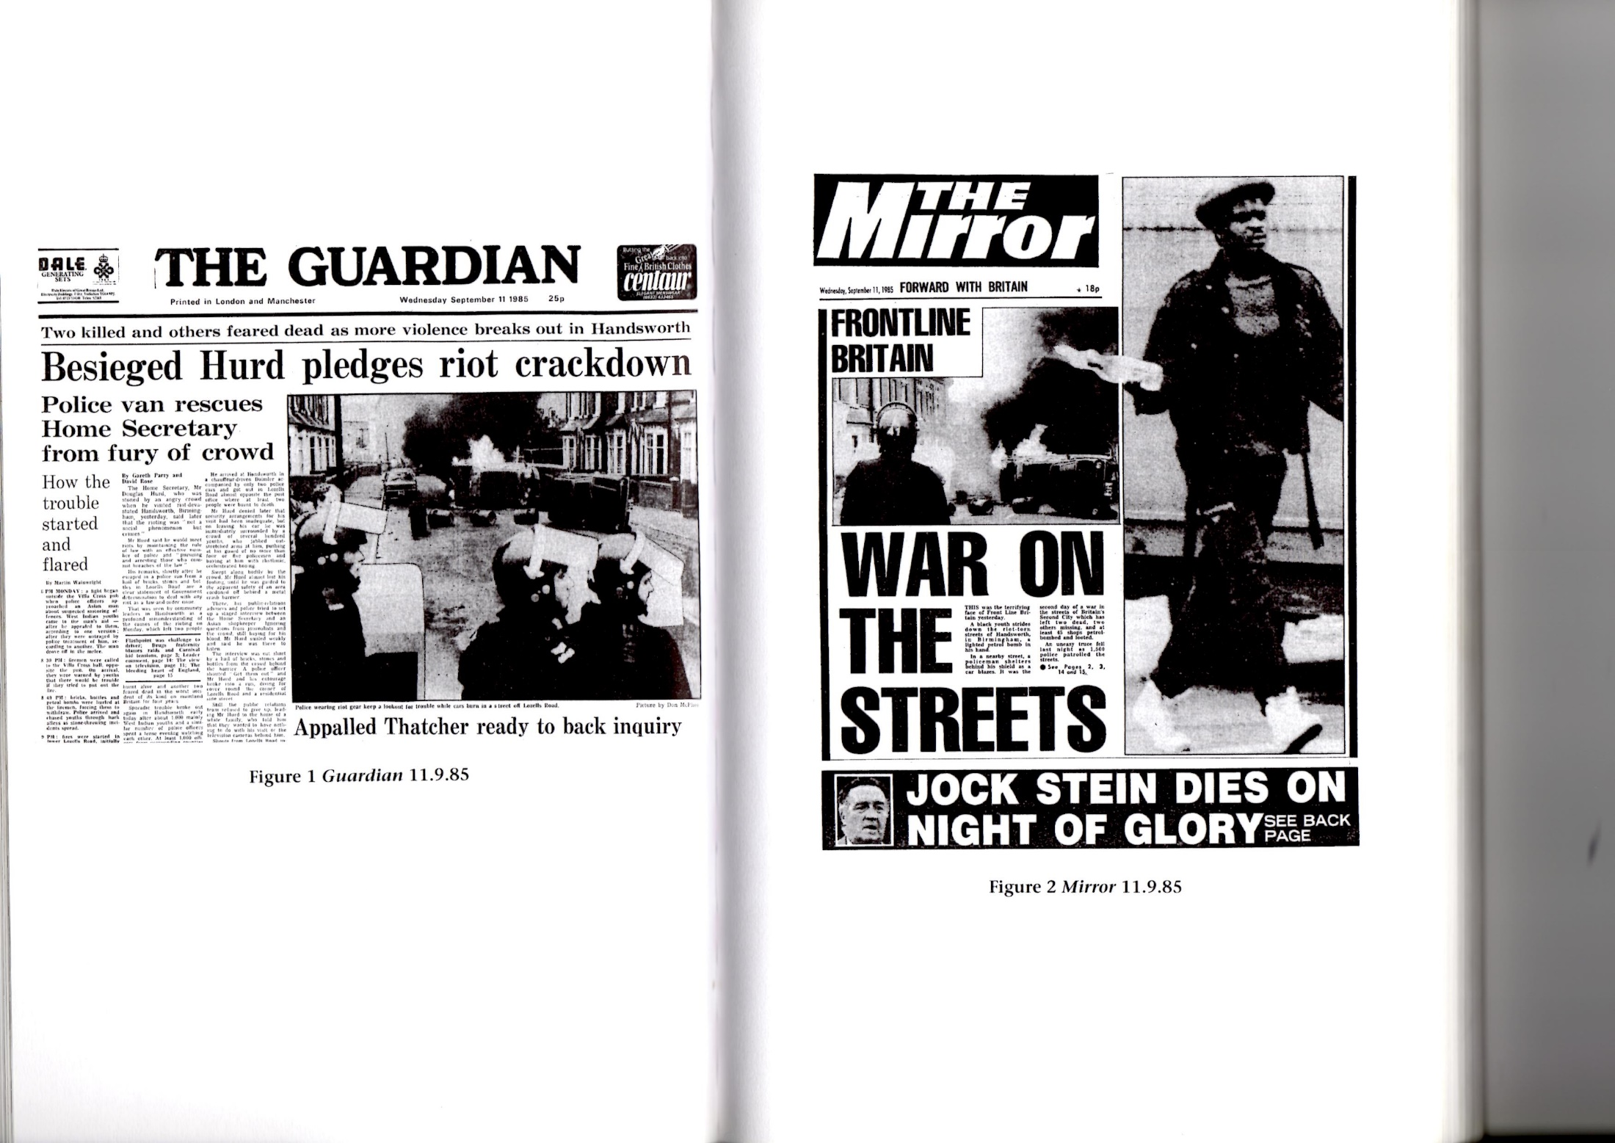

Slide 5
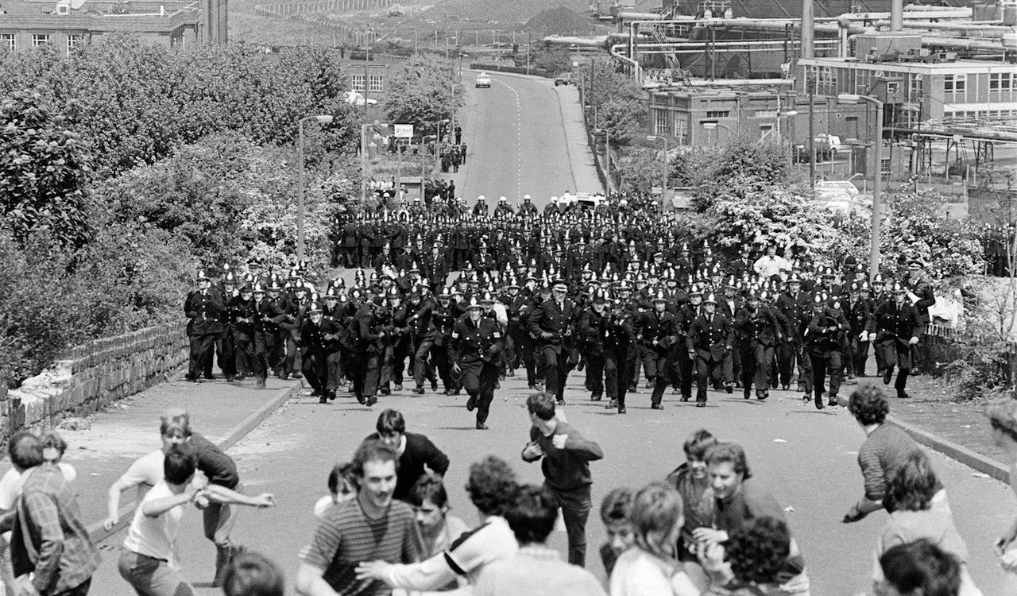
Orgreave June 1984

Slide 6
Power of/and meaning
Consistent association of a word shape/sound to an item, act or experience welds arbitrarily assigned forms to meanings, apparently immutably. Hall likens this confusion of form and meaning as the 'same', to our ready acceptance of the photograph as a 'meta-message....this event really happened and this photograph is proof of it' (1982a: 241). The photograph belies the selecting, transforming and reproducing and offers only the apparent evidence of an event. The apparent reality of the news photo is the visual equivalent of the apparent meaning of language. (Wykes 2001: 47-48)

Slide 7
Revelations
Berger (1972) ‘Women are depicted in quite a different way from men – not because the feminine is different from the masculine – but because the ideal spectator is assumed to be male and the image of the woman is designed to flatter him’ (p.64).

Slide 8
Revelations
The deviant, the criminal or the actor is always male; it is always his rationality, his motivation, his alienation or his victim…….selection of the male pronoun may be said to be inclusive of the female but in reality it is not; it merely excludes women and makes them invisible
(Smart 1976: 177).
Her point was that women were symbolically annihilated (Tuchman 1978) by such pronouns and however different the crime configuration was for women it deserved an account (Wykes and Welsh 2009).

Slide 9
Missing
Most crimes remain unimaginable without the presence of men (Jefferson, T.1992).
The claim that men commit most acts of physical violence is possibly the nearest that criminology has come to producing an indisputable fact (Hall, S. 2002: 36).

Slide 10
Violence
Fowler identified three political factors as having 'important and analysable implications for a reader's experience of newspaper language' (1991:6) during the 1980s. First was the adoption of a conflict paradigm 'to segregate and marginalise threatening and undesirable elements' (ibid.

Slide 11
Sex and violence
In the 1980 and early 90s, popular films were often pre-occupied with extreme interpersonal violence. Frequently, such violence was depicted as female, heterosexual and commonly directed against male suitors, lovers or spouses as in the films 'Fatal Attraction', 'Body of Evidence', 'Dirty Weekend' and 'Black Widow'. In reality, women were (and are) most often at risk, at home, from men they know. And in 'real' life, women are rarely violent.

Slide 12
Cultural and subjective constructionism
They matter because:
‘How social groups are treated in cultural representation is part and parcel of how they are treated in life,….poverty, harassment, self-hate and discrimination… are shored up and instituted by representation.
How we are seen determines in part how we are treated; how we treat others is based on how we see them; such seeing comes from representation.’
(Dyer, R. (1993) The Matter of Images London Routledge)

Slide 13
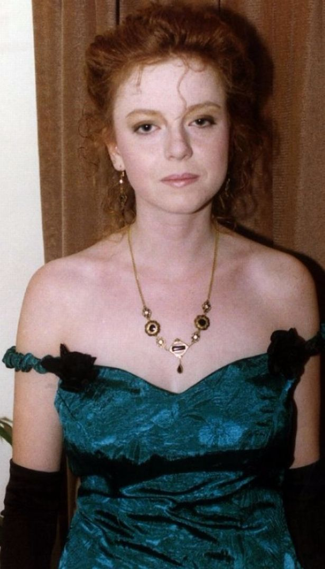

Rachel Mclean John Tanner
April 1991

Slide 14
Content analysis
‘Overall 37% of labels for women in press accounts of intimate killing attracted negative labels in the gendered discourses of sexuality, social life and psychology; similar negative male labels accounted for 15.7% percent of all gendered labels. 44.3% of the lexes in the place of causal agents in news about intimate killing were male labels; 55.7% were female labels. This suggests that blame was directed toward women more often than men, even though these cases included three women victims and two battered women.’
(Wykes 2001:159)

Slide 15
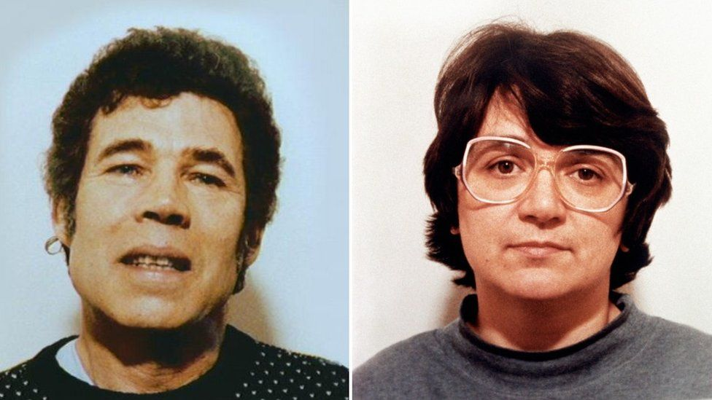
The West Case: 1994

Slide 16
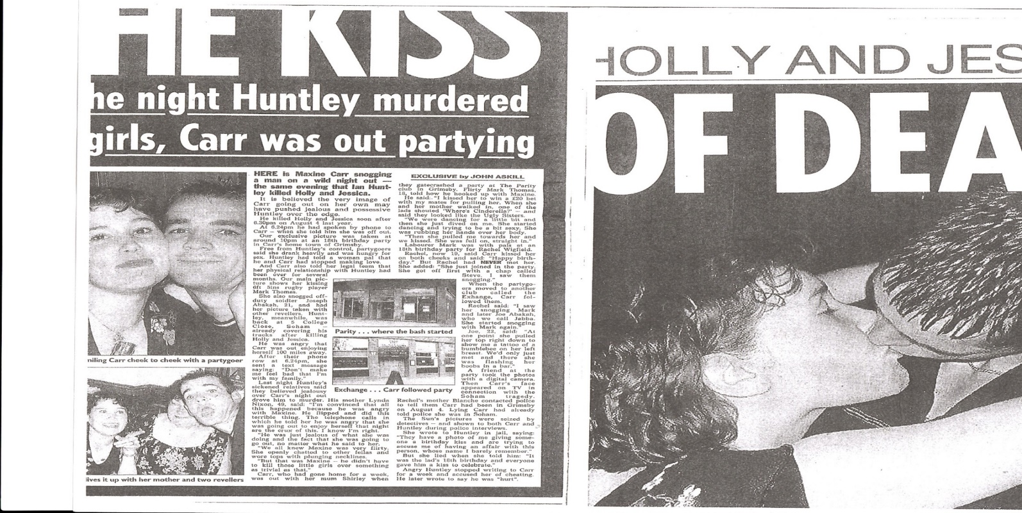
THE KISS OF DEATH On the night Huntley murdered two girls, Carr was out partying. Here is Maxine Carr snogging a man on a wild night out – the same evening that Ian Huntley killed Holly and Jessica. It is believed the very image of Carr going out on her own may have pushed Huntley over the edge.
(The Sun 18/12/2007: 8)

Slide 17
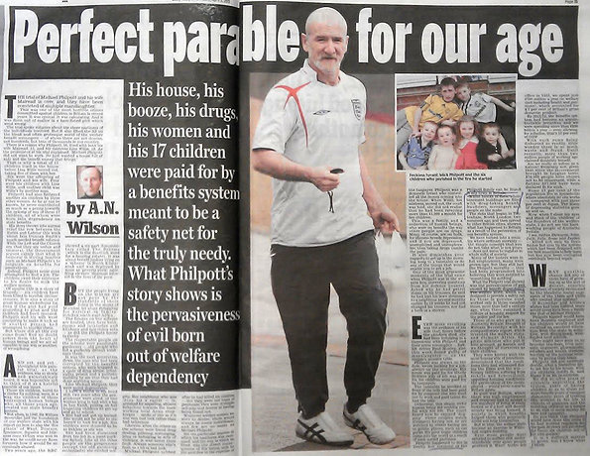
Daily Mail April 3rd 2013

Slide 18
Comment is free: Daily Mail public response to news of Mairead’s appeal
Who cares if she is scared and vulnerable? She will never ever know the fear her babies had. Mrs B , Down South, 19/5/2013 23:14
She needs to be kept inside, if only to stop her breeding half a dozen more children for the rest of us taxpayers to support for her. Kally , Derby UK, United Kingdom, 19/5/2013 23:13
Sterilise this monster BigBeaverlover , London, United Kingdom, 19/5/2013 23:11
NO, NO, NO - This sad excuse for a human being and an even sadder excuse for a mother must never be allowed to leave prison - let alone be given a shorter sentence - the people of Britain and the world say NO!! popl , Whakatane, New Zealand, 19/5/2013 23:07

Slide 19
Harassment, misogyny and social media
Now perpetrators are hidden, literally, by new media but also by myths about tech-determinism, panics about effects, and stereotypical ideas about female sexuality, making prosecuting and punishing, let alone preventing, sexual violations of women and girls doomed to failure (Wykes 2017).
In spring 2015 in Florida, two college students were arrested after ‘police . . . found video of an unconscious girl being gang raped on a Florida beach in broad daylight during Spring Break. Hundreds of people are seen watching without attempting to intervene during the alleged attack on Panama City Beach, authorities claim’ (Daily Mail 2015). The girl claimed she must have been drugged during a beach party and remembered nothing. Film was uploaded onto Metacafe.com and seen by 13,971 viewers before being withdrawn (Wykes 2017).

Slide 20
Change (or not)
Every year, approximately 3,500 deaths related to intimate partner violence occur in the 27 member states (excluding Croatia) of the European Union alone, according to a study from the DAPHNE EU programme. Further, research findings reveal that domestic and intimate partner violence cause more deaths and entail much higher economic costs than homicides or civil wars. Nine out of ten victims of intimate partner violence in the EU are women. Global incidences WHO
Research indicates that the cost of violence against women could amount to around 2 per cent of the global gross domestic product (GDP). This is equivalent to 1.5 trillion. Further, research findings reveal that domestic and intimate partner violence cause more deaths and entail much higher economic costs than homicides or civil wars (2016). UN Women

Slide 21
UK
While there were 52,210 rapes recorded by police in England and Wales in 2020, only 843 resulted in a charge or a summons – a rate of 1.6% There were 1,917 fewer rapists convicted in the year to December 2020 than in 2016-17, a decline of 64%
The Guardian May 2021
The police recorded 758,941 domestic abuse-related crimes in England and Wales (excluding Greater Manchester Police)¹ in the year ending March 2020, an increase of 9% compared with the previous year. Referrals of suspects of domestic abuse-flagged cases from the police to the Crown Prosecution Service (CPS) for a charging decision fell 19%, from 98,479 in the year ending March 2019 to 79,965 in the year ending March 2020, in England and Wales. ONS November 2020

Slide 22
Criminology
Discipline
Amid ‘the noise of criminology – the ceaseless chatter advocating the extension of criminal justice practices and “solutions” - there stands a series of telling, sustained silences’ ( Hillyard (2004) in Silvestri 2006:223) including the ‘absence about questions of power’ (Silvestri ibid).
Feminism
Mainstream criminology seems to have ignored masculinity as a problem whilst feminist criminology has preferred, and rightly so, women's place in crime.
Women, even feminist women, are entangled in what Cain (1990) called a hegemonic web of taken for granted ideologies of family life and commensurate gendered subjectivity, making it hard enough to deconstruct their own experience let alone address men’s.

Slide 23
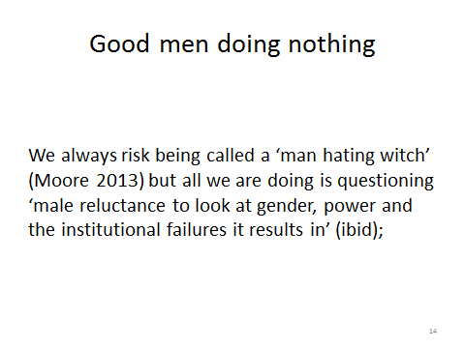
European Parliament: Michael Kimmel speech
Today, the movement for women's equality remains stymied, stalled. Women continue to experience discrimination in the public sphere. They bump their heads on glass ceilings in the workplace, experience harassment and less-than fully welcoming environments in every institution the public sphere, still must fight to control their own bodies, and to end their victimization through rape, domestic violence, and trafficking in women.
I believe that changes among men represent the next phase of the movement for women's equality - that changes among men are vital if women are to achieve full equality. Men must come to see that gender equality is in their interests - as men.
(International Women’s day 2001)

Slide 24
Conclusion
The cost of gendered violence is not just in harms and economic loss, private and public, but in identity, knowledge, justice and human rights.
Violence is not just a legal issue but deeply symbolic - it violates discursively through textual annihilation and abuse just as it does in reality, but merely analysing representation leaves reality as it is
Academia has devolved down to biographies, focus groups and celebrations of differences recognised, parodies played out and decoupage re-presented.
Criminology and allied disciplines focus on the crime problem rather than the gendered roles and relations and norms that underwrite and maintain it
Post-modernism has become ironically an effective tool of hegemonic power by disabling criticism and knowledge to just different points of view
It is not so much men who use violence but power, the seeking of it and the retaining of it, and power remains largely patriarchal

